Slide 1
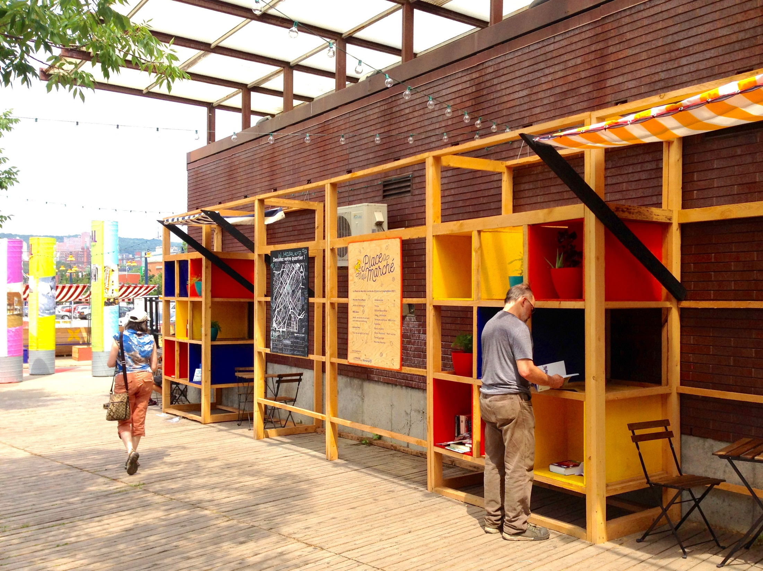
Arts & Culture in the Inner Core Inner Core Committee Meeting Thursday, March 21, 2018
Notes:
Reintroduce the Arts and Culture Division’s primary goal and practice areas
Provide an overview of one practice area: cultural planning through a dive into the Arlington Arts & Culture Action Plan

Slide 2
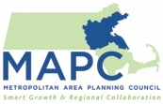
Agenda
9:00 – 9:25 am: Arts + Cultural Planning in the Inner Core
Julie Burros, Chief of Arts + Culture, Boston
Ali Carter, Economic Development Coordinator, Arlington
9:25 – 9:50 am: Cultural Vitality in Metro Boston: Two Initiatives
Jim Grace, Executive Director, Arts + Business Council of Greater Boston
Cara Berg Powers, Executive Director, Transformative Culture Project
9:50 – 10:30 am: Discuss: Opportunities for Regional Collaboration
Greg Liakos, Communications Director, Massachusetts Cultural Council
Speakers, ICC members
Notes:
Community Identity, Character, and Sense of Place:
APA has a series of briefing papers on arts and culture’s relevance to planning on their website
One of the papers examines how arts and culture can celebrate community character and reinforce a sense of place.
Intertwined: heritage, history, community character, culture, vitality

Slide 3
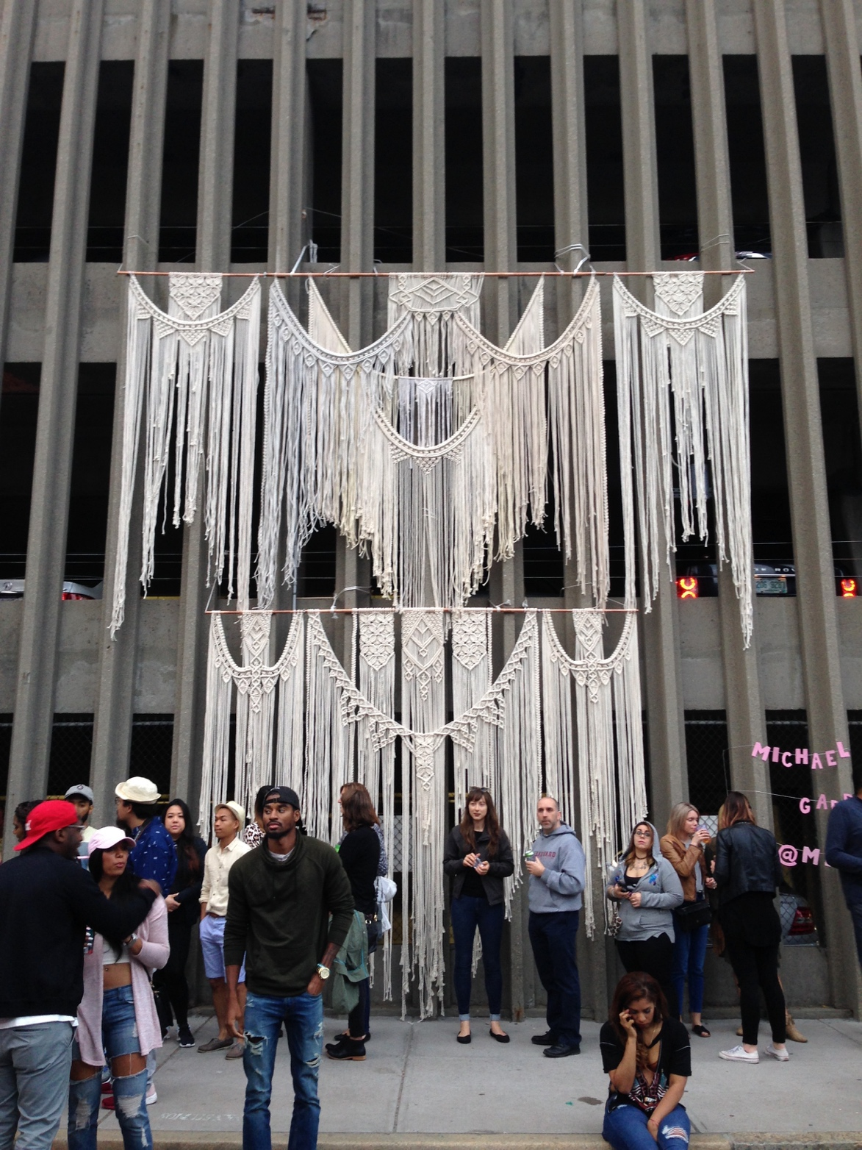
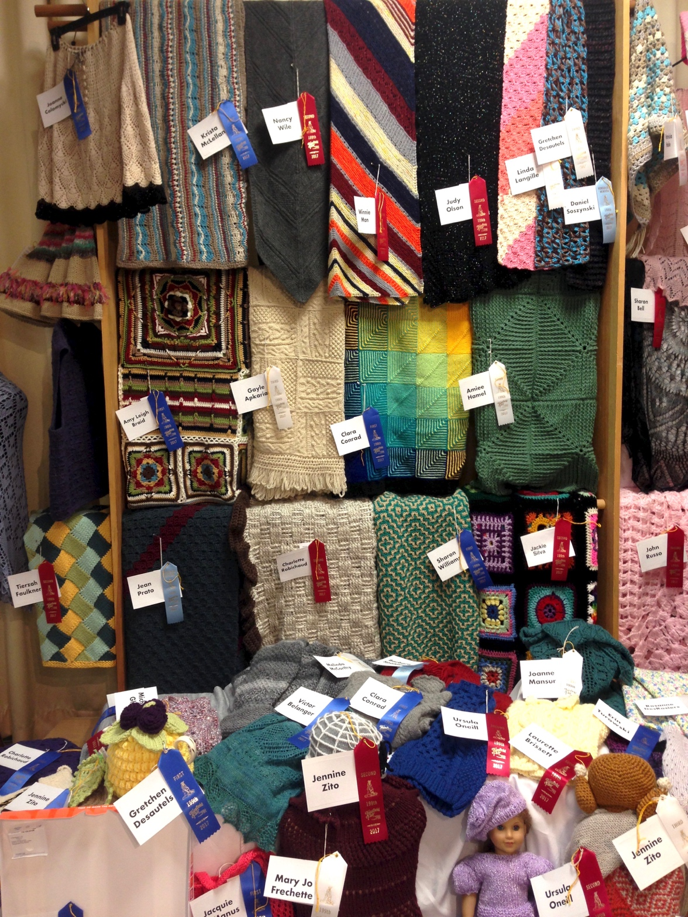
Arts and culture is a dynamic manifestation of human diversity, activity, and expression. It also strengthens and amplifies the human and physical assets of place.
Notes:
Art is the expression or application of human creative skill and imagination, which may come in various ephemeral and permanent forms and as a tangible product and/or process
Culture is inclusive of the customs, arts, social institutions, and other manifestations of human intellectual achievements. It is a manifestation of attitudes, behaviors, and norms characteristic of a place as influenced by the people who, live, work, play, and pass through a place.
Arts and culture reveals itself and is expressed in many ways in civic life. It is a core element of what makes our communities healthy, dynamic, livable, vibrant.
Why Arts and Culture:
How do we build understanding, ownership, and engagement of the places we move through, occupy, inhabit, and visit?
Arts and culture inherently creates awareness of the dynamism of human diversity, activity, and expression.
It also allows us to build up the community development side of our planning practice – creating new opportunities for us to engaging human and social infrastructure which is a crucial part of planning and placemaking/placekeeping.

Slide 4
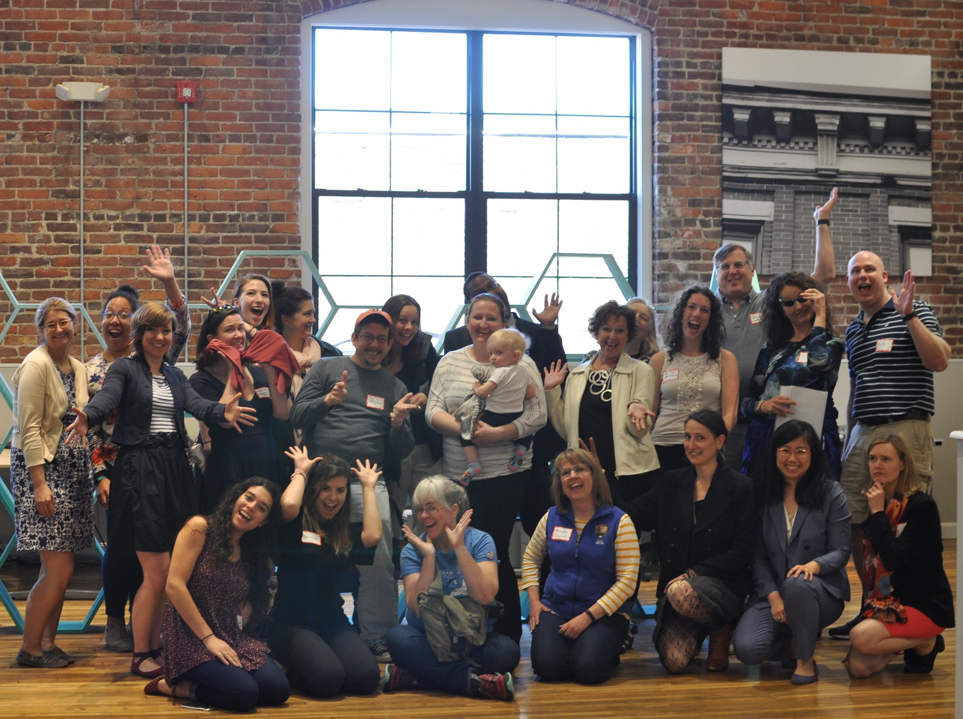
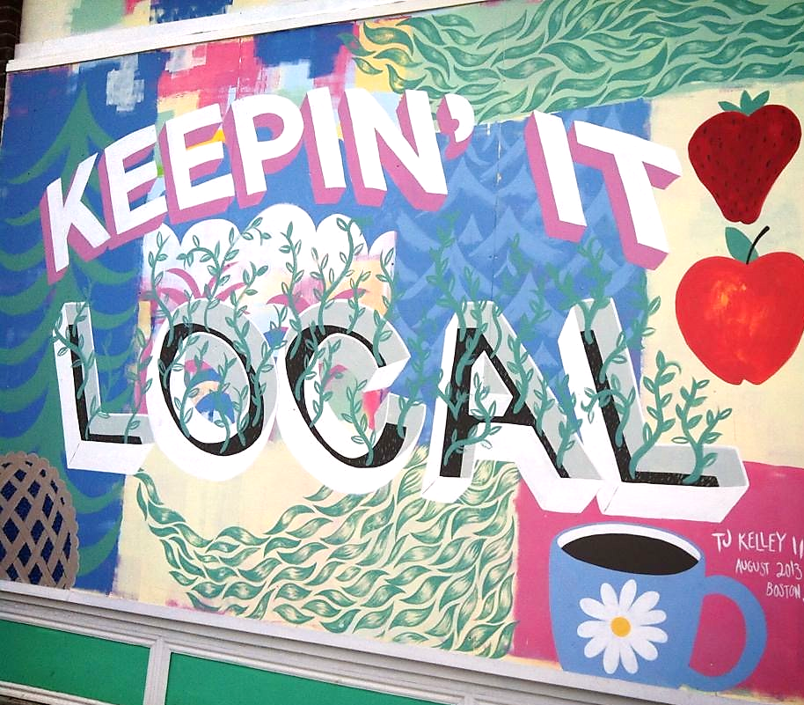
The primary goal of MAPC’s Arts and Culture Division is to establish arts and culture as a core competency for planning and community development staff in the Metropolitan Boston region.
Notes:
So the education process begins with figuring out how to get people thinking about critical questions. I needed to do some awareness-raising. Planners would be looking for the compelling reason. How is arts and culture essential and not just nice to have/if the budget allows?
What is the business of urban planning and community development?
“A planner partners with communities to help them become wonderful places to live, work, grow up, and play. Planners help decide what kinds of buildings should go where, where new parks might be needed, the transportation resources that are needed to improve how people get around to where they need to go and safely, and how to conserve, protect, and enhance natural and cultural resources.
Planning for the present and future is what we do.
Visioning exercise – think about the last time you traveled to a place. What were some of the things that are most memorable about the environments you were in? Architecture, design, culture, public art, culinary arts, music, etc.

Slide 5
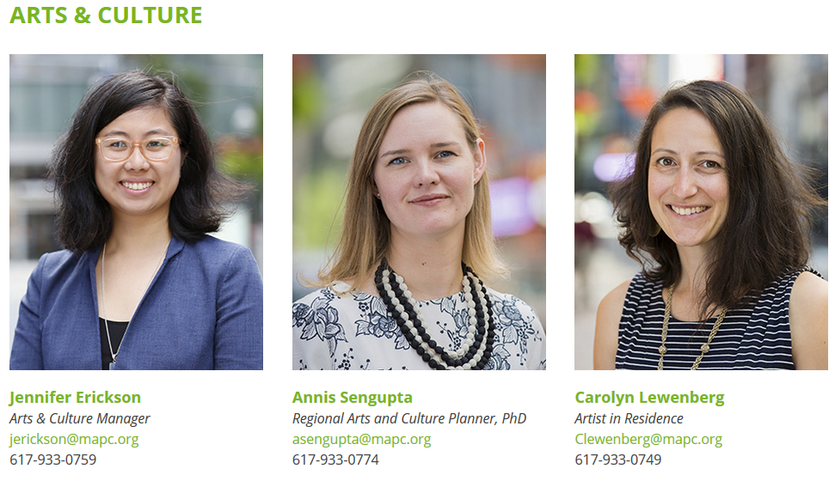
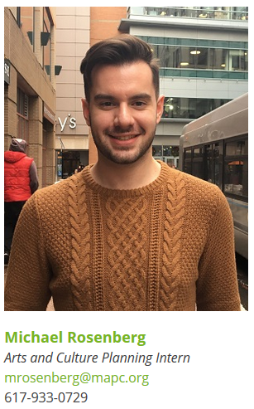
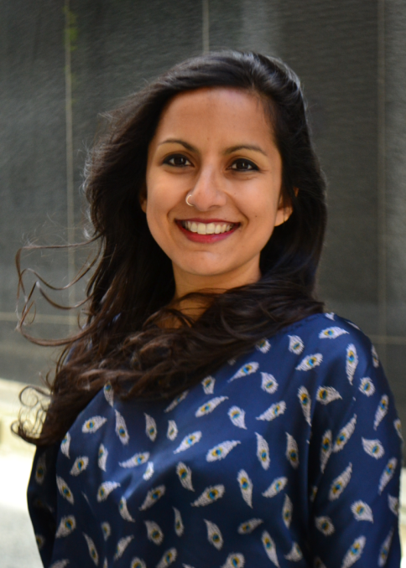
Notes:
5

Slide 6
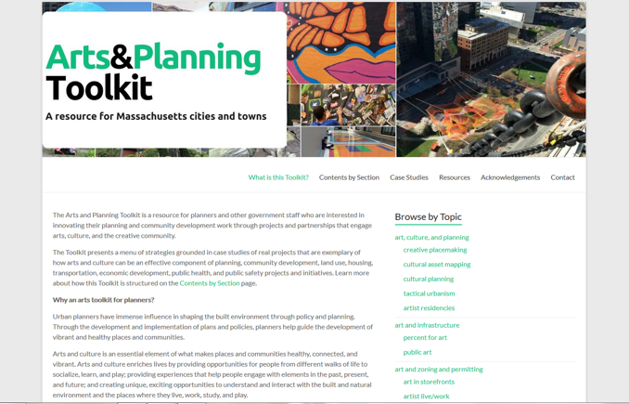
Our Services: Capacity-Building, Technical Assistance, Research, Data Collection, and Advocacy
Capacity building
Conferences, Trainings, Internal Learning Community,
External Advisory Group
Technical assistance through projects, collective purchasing
Practice areas include cultural planning, creative placemaking/creative community development, socially engaged art.
3. Research, data collection and analysis, and policy advocacy
Implementing the strategies in the Arts & Planning Toolkit…
www.artsandplanning.org
Notes:
Socially engaged art practice:
participatory public art
Bringing fun, creativity; helping plans come alive

Slide 7
The Toolkit: A framework for understanding the many ways in which arts and culture can infuse innovation and creativity into the disciplines of planning
www.artsandplanning.org
Notes:
Framework and menu of strategies grounded in case studies of real projects that are exemplary of how arts and culture can be an effective component of planning, community development, land use, housing, transportation, economic development, public health, and public safety projects and initiatives.
Planning can be participatory and dynamic and inspired and arts and culture can help us better engage people in the present to plan for the future. It would inject FUN into our profession. The Toolkit aims to be an accessible primer and source of inspiration.
Toolkit: Winner of the 2016 Planning Project Award!

Slide 8
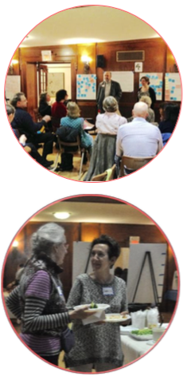
Recent and Current Projects
Town-wide cultural plan
Arts & culture elements of open space & recreation plans
Historic & cultural resources chapter of master plans
Creative placemaking workshops
Creative placemaking projects
Public art and urban agriculture demonstration project
Creative placemaking knowledge building initiative with the American Planning Association and Americans for the Arts
Notes:
Inviting new projects now for funding in late spring and start up in late spring or fall

Slide 9
Cultural Planning
Cultural planning is a place-based planning process that generates a vision and action plan for strengthening and growing arts and culture assets.
There are many types:
Cultural Asset Mapping
Comprehensive City- or Town-wide Cultural Plan
Cultural District Plan for a Neighborhood or Center
Arts and Culture Component of a Municipal or Regional Plan
Discipline-Focused Cultural Plan
Specialized Arts or Cultural Assessment
Specialized Arts and Culture Issue Plans/Studies
Notes:
Cultural Asset Mapping: An inventory and analysis of a community artistic and cultural resources and needs; this is typically the first phase of any cultural planning processes
Comprehensive Cultural Plan: Defines a broad set of goals and strategies that may align with other defined community needs and opportunities in other topic areas (e.g., economic development) and provides a framework for more specific cultural planning work that will occur in the future
Cultural District Plan: Defines a set of goals and strategies pertaining to a specific geographic area within a community, e.g., a neighborhood or town center
Arts and Culture Component of a Municipal or Regional Plan: Defines a set of arts and culture goals and strategies as part of a broader comprehensive or master plan; embedded as a section or chapter (vertical integration) and/or integrated as a strategy supportive of other plan priorities, e.g., land use, transportation, environment (horizontal integration)
Discipline-Focused Cultural Plan: Defines a set of goals and strategies focused on a specific arts sector, e.g., the visual arts
Specialized Arts or Cultural Assessment: An assessment with a specific focus, e.g., a feasibility study, an economic impact assessment, a market study pertaining to cultural tourism potential
Specialized Arts and Culture Issue Plan or Study: Defines goals and strategies pertaining to a specific issue, such as audience development

Slide 10
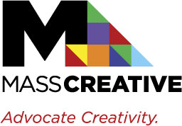
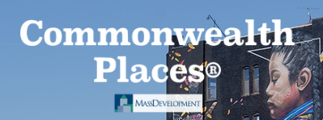
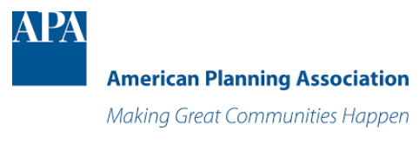
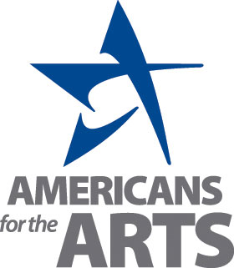
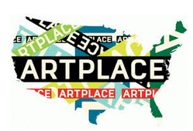
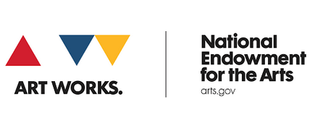
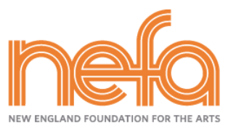
We are partnering with other orgs that provide funding, technical assistance, professional development, and advocacy
Notes:
Coordination with other regional and state agencies
Helping communities apply for Patronicity crowdfunding
Providing planning TA to municipalities to conduct cultural asset mapping in prep for cultural district designation from MCC
Partnering with ECCF on cultural planning readiness workshops in North Shore

Slide 11
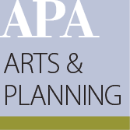
A national network of planners and artists
American Planning Association (APA) Arts & Planning Interest Group (APIG) is a collaborative space for planners and artists who believe that arts and culture is an essential element of what makes places and communities healthy, connected, and vibrant. It exists as a forum for networking, education, and identifying, developing, and refining innovative planning methods, policies, and tools.
Survey: http://bit.ly/artsandplanningsurvey
Notes:
By the end of this session, we hope that:
you walk away with inspiring, concrete examples of ways you can start to integrate arts and culture into your planning practice
you’re equipped with concrete knowledge about the tools at your disposal for infusing creativity into the civic life and physical and social environments of communities – through your planning

Slide 12
Discussion
What are some of the issues and opportunities that presenters have spoken about that resonate with you?
Could any of these issues or opportunities be advanced through a regional solution?
What could be the role of planning and community development staff in advancing regional solutions? MAPC is starting to think about regional projects and initiatives and likely partners.
Notes:
Community Identity, Character, and Sense of Place:
APA has a series of briefing papers on arts and culture’s relevance to planning on their website
One of the papers examines how arts and culture can celebrate community character and reinforce a sense of place.
Intertwined: heritage, history, community character, culture, vitality

Slide 13
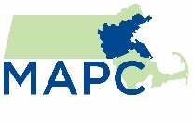
Creative Placemaking
Creative placemaking (CP) is a planning and community development process that occurs when planners, community development practitioners, artists, and others deliberately integrate art and culture into community revitalization work – placing arts at the table with land use, transportation, economic development, education, housing, infrastructure, and public safety strategies.
Definition adapted from the definition developed by Markusen and Gadwa for the National Endowment for the Arts
Notes:
Creative placemaking is planning and community development process that places arts and culture at the center of shaping the character and vitality of neighborhoods, cities, towns, and regions.
13

Slide 14
Placemaking vs Creative Placemaking
General Placemaking | Creative Placemaking
Emphasis on “Lighter, quicker, cheaper” tactical urbanism improvements Emphasis on physical transformation with focus on “plop-design” approaches to changing public infrastructure and public spaces Generally includes designers and planners at table Allows government to prototype, innovate | Emphasis on engaging human assets of place – diverse cultures, artistic traditions Emphasis on community revitalization with focus on physical transformation and programmatic approaches Generally includes artists and cultural organizations at table Allows community-based groups to engage cultures and traditions of place (placekeeping, placeholding)
Notes:
Projects in both columns can be community led, but general placemaking tends to be government-led, and designer-led
The practices are not mutually exclusive
Sometimes creative placemaking projects can involve plop art and they can be top-down
Sometimes tactical urbanism can be entirely resident-led
14

Slide 15
Discussion
Community Character and Sense of Place:
What are some of the things that contribute to and/or influence your community’s character? This can include people, places, objects, events, history, landscape, architecture, etc.
Arts, Culture, and Public Places and Spaces:
Physical planning and infrastructure impacts public/cultural life. How can we engage arts and culture to reinforce community character/cultural diversity and nurture a sense of place?
Notes:
Community Identity, Character, and Sense of Place:
APA has a series of briefing papers on arts and culture’s relevance to planning on their website
One of the papers examines how arts and culture can celebrate community character and reinforce a sense of place.
Intertwined: heritage, history, community character, culture, vitality

Slide 16
Discussion
Creative Life and Civic Life:
How can we engage creativity to stimulate public involvement and interest in civic issues: housing, environment, public health, economic development, etc.?
How can we create space for engagement with arts, culture, and creativity in planning and community development? How can we make the time and find the funding to make it happen?

Slide 17
Discussion
Supporting Arts, Culture, and Creativity:
What do we know about the infrastructure of support for arts and culture?
If creative individuals, organizations, and businesses strive to grow, what types of supports are needed in order to facilitate that growth?
How can some of the issues that prevent arts, culture, and creativity from thriving be addressed at the municipal or regional levels?

Slide 18
Keep in Touch
Jennifer Sien Erickson
Manager, Arts & Culture
Metropolitan Area Planning Council 60 Temple Place, Boston, MA 02111 617-933-0759
jerickson@mapc.org
Arts & Culture Division: www.mapc.org/artsandculture
APA Arts and Planning Interest Group (APIG): https://www.planning.org/divisions/groups/arts/

