Slide 1
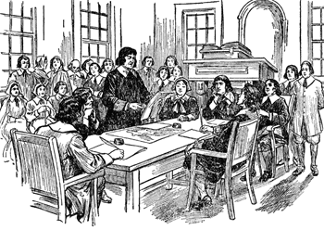
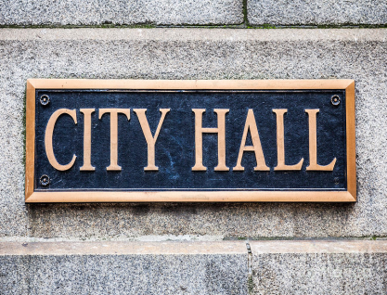
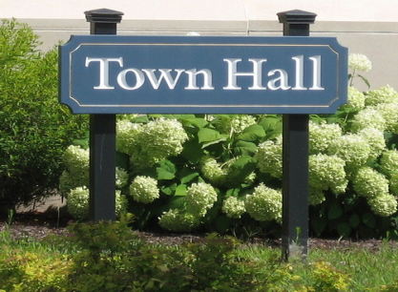
Enhancing Local Democracy
in MetroWest
September 13, 2018

Slide 2
Background
This project was developed at the request of the MetroWest Regional Collaborative (MWRC) of the Metropolitan Area Planning Council (MAPC) and follows a project completed in 2016 in which MAPC staff undertook a comprehensive review of the governance structure and civic participation levels in the nine communities that make up the MWRC.* It seeks to identify existing, underlying challenges to improving local democratic participation and effectiveness in the towns and cities of the MRWC, and it presents to the MWRC the following:
A review of Town Meeting operations and in the sub-region, a high-level review of electronic voting methods, and ideas for innovations and improvements;
A high-level review of when local elections are held across the sub-region and in other communities to determine whether elections could be conducted at times more conducive to wider participation;
A high-level review of democratic engagement approaches that have been incorporated into municipal government, and recommendations for ways for traditionally underrepresented groups to vote at higher rates in local elections and to become more involved in local government.
*Ashland, Framingham, Holliston, Marlborough, Natick, Southborough, Wayland, Wellesley and Weston

Slide 3
Annual Town Meeting

Slide 4
Annual Town Meeting
Reports
and other communities
Survey Monkey
On-line and anonymous
Distribution methods
Open April/May/June – closed July 1, 2018
Participating communities
Question paths
Disclaimers and limitations
Moderators and
other town officials
What we did…
Notes:
142 questions in total:
#1 everyone
#2-73 (OTM), with #6-11 for Rarely/Never only
#74-142 (RTM) with #75-85 current non-members only.
Not everyone fully completed
Small sampling, not a full cross-section
Wellesley and Natick open only a few weeks

Slide 5
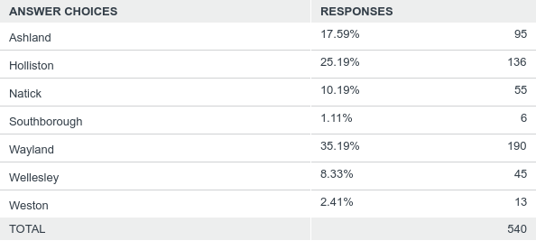
Annual Town Meeting
Q: What town do you live in?
Notes:
Weston numbers low and larger percentage were elected or appointed (see next slide)
Natick and Wellesley low numbers
Southborough and Weston did not participate as towns – both recently completed their own town meeting studies

Slide 6
Annual Town Meeting

Slide 7
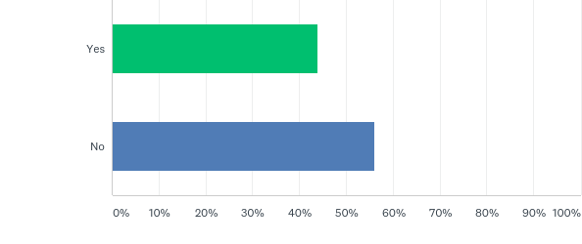
Annual Town Meeting
Q: Do you think Town Meeting is an EFFECTIVE form of government?
43.90%
OTM
56.10 %
Do Non-members think Town Meeting is Effective? (current members were not asked this question)
Natick | Wellesley
66.67% | 40.00%
RTM:
Notes:
The individual OTM responses show the effect of Wayland – drops the overall “Effective” percentage

Slide 8
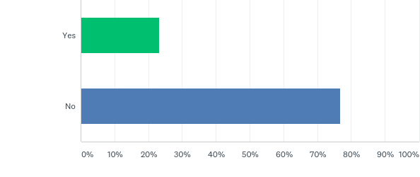
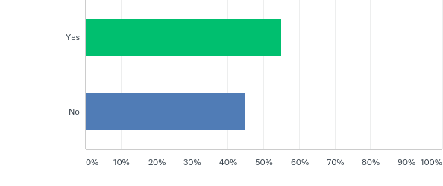
Annual Town Meeting
Q: Do you think Town Meeting is an EFFICIENT form of government?
23.23%
OTM
76.77%
55.00%
Members Only
Natick | Wellesley
56.25% | 50.00%
RTMMs:
45.00%
Non-members only
Natick | Wellesley
33.33% | 13.33%
Notes:
Again, Wayland skewed the overall percentage

Slide 9
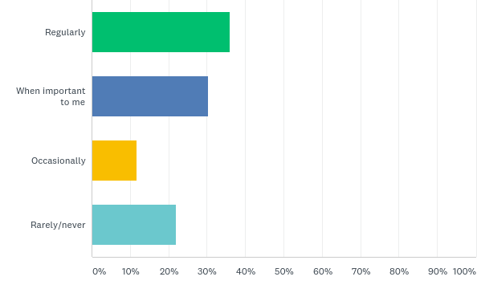
Annual Town Meeting (OTM)
Q: How often do you attend Town Meetings?
36.06%
30.29%
11.78%
21.88%
Yet 88.24% of the “rarely/never” said they understand that it’s their responsibility to approve the annual budget and enact bylaws

Slide 10
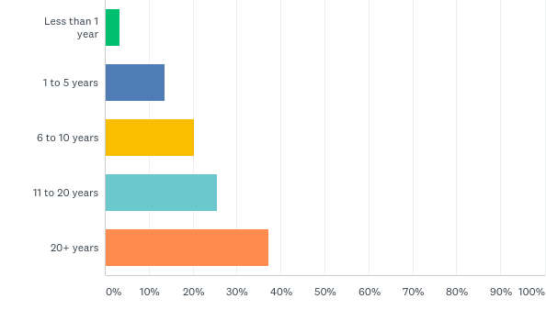
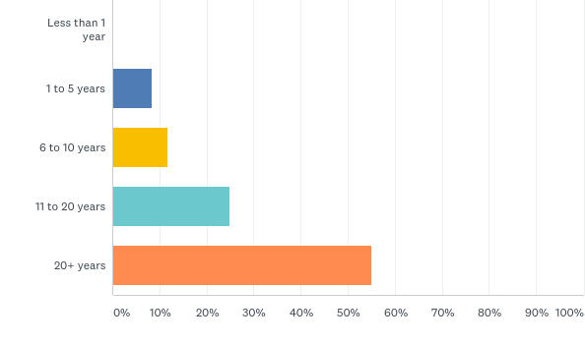
Annual Town Meeting
Q. How long have you lived in your town?
Open TMMs (all except those who “rarely/never attend):
Representative TMMs:

Slide 11
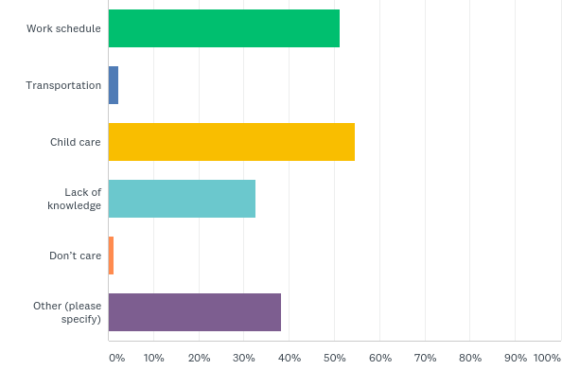
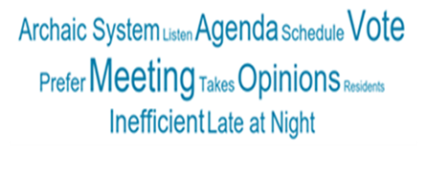
Annual Town Meeting (OTM)
(“RARELY/NEVER”)
For those who “rarely/never” attend, it’s because:
Notes:
Since a core goal is to increase attendance and participation, the next few pages are all of the responses of the “Rarely/Never” attends to the questions 1) why they don’t attend and 2) what would make them attend). All comment pages in this presentation are direct quotes.

Slide 12
Annual Town Meeting (OTM)
(“RARELY/NEVER”)
“Other” reasons for “rarely/never” attending:
Just moved from a non-town meeting town, haven't experienced the highly inefficient method except with negative result of library vote which we supported and were confused that we needed to vote again a 2nd time. Pretty archaic system.
Prefer to view it on TV.
Lack of predictability re schedule for agenda items
Confusion regarding process and scheduling
Lasts too long
too time consuming
runs to late at night, school agenda is voted on people leave and not enough people are left for a quarm.
Although town meeting is a nice way to let everyone express their opinions, it is a terribly inefficient way to govern. Modern times call for elected officials that can make these sorts of decisions. Although I was very interested in the library vote this year, I refused to fight for a parking space and to sit there waiting for the issue to come up. A new way to govern has to be explored.
Not sure on dates of town meetings
Travel
It's unclear whether issues that are important to me will even come to a vote on the day of the town meeting: it might go over into the next day. No way to organize family life in advance.
Completely archaic system benefiting only those with tons of time and resources to advocate for their passion projects--unfair to those of us that care, but have very busy lives.
health issues, such as 9 surgeries over 30 living in town. Most have made it difficult to be aware from home and toilet facilities, especially the last 2 1/2 years ago requiring a feeding tube. I I rarely leave home, no dinnerers out etc. But I have always cared about town and voted mailing yearly. I get frustrated have no voice at town meeting. My opinions would likely not have passed but it is the ability to participate that is important.
Meeting attended mostly by complainers.
would prefer to watch AND participate via web cast
Not representative of all residents.
I don't feel it's a good use of my time
It doesn't matter what residents think - small group in charge do whatever they want regardless of resident opinions
Out of date and biased
To dream out. Lots of waisted time.
Knowing that I potentially have to go to 2, 3, 4 nights of meetings to get through the agenda is not a good use of my time, with family and other commitments. I dont want to listen to every person's comments on every matter on the warrant.
Feel that my vote is useless. The one who is the most loud always win
Waste of time
Work, and meetings not widely promoted
Takes too long
Takes way too much time
I used to go all the time. But speakers have become angry, nasty and (too often) personal. It's hard to listen to.
Not Prominently Advertised
Time constraints
Limited awareness
Unacceptable time commitment (long and late at night)
Kids activities
Too late in the evening for my schedule and very inefficient
Notes:
Direct quotes

Slide 13
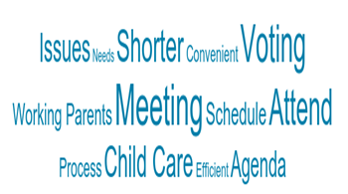
Annual Town Meeting (OTM)
(“RARELY/NEVER”)
Q: What would make the “rarely/never” more likely to attend?
More publicized meeting times, a clearer agenda
A vote to abolish the 'town meeting' style of governing. Very archaic and ineffective.
Topic
Childcare, time commitment
Change the time
Smoother Presentation
More awareness, concise schedule
Better voting process, shorter meetings
If it was for voting only, so that it was a reasonable duration (under 1 hour)
Being required to attend to vote IS 100% DISENFRANCHISEMENT
If you could vote while NOT in attendance.
understanding the process; resolving the dilemma that the small percentage of overly vocal folks don't represent the vast majority
of opinions; streamline the process to be less tedious, cumbersome, and time consuming
Weekend meetings
Internet voting
I would prefer not to attend in person.
Remote access or absentee ballot
2+ nights is unacceptable. Online/remote voting would be amazing
It would need to be much, much shorter.
Weekend Town Meeting
Start time early and school issues are voted on last.
If I saw more action take place after voting
alternate meeting times
Communication/awareness
Remote voting
Nothing would make me attend. The format has outlived its usefullness.
An agenda that was firmly adhered to (e.g. each issue will get 20 mins). A website dedicated to the issues that clearly explained
both sides, that was updated regularly, so you could inform yourself in advance
I doubt I would ever physically attend unless I was retired/semi-retired
More convenient scheduling.
Remove viewing/voting options
In my case, not really an option.
Less open microphone time.
The town meeting needs to move more quickly and decisions should not be made by the very few that do attend.
Shorter duration and scheduled at convenient time for working parents.
Nothing, that's why this type of gov needs to be eliminated. As a busy professional with a young family, it is virtually impossible.
Don't know.
1. If it wasn't on Monday night. 2. If it wasn't so long 3. If people didn't use it as their personal soapbox
When children are grown
Why bother
CONTINUED…
Notes:
Direct quotes

Slide 14
Annual Town Meeting (OTM)
(“RARELY/NEVER”)
…CONTINUED
What would make the “rarely/never” more likely to attend?
Work and child schedule prohibits participation
More efficient use of time
1 night
set schedule (we know when it will end) and my vote actually means something
end the scripting. officials are prepped and things go by the script
More notice, weekend meetings
Knowing that town meeting wouldn’t last more than one night
Weekend time or shorter weeknight meetings with a deadline of 2 hours
Shorter, not during the evening.
Nothing.
make it shorter, just vote. Have pre-reads available.
If it were better advertised
Remote meetings
More decorum.
Issues that affected my family
I would watch a stream online
Saturday meeting, faster meeting (less nights), or eVoting
I'm not sure my attendance has any value to the town meeting, that me being their has any
effect on the running of the town.
I know this is unpopular, but I'd give up a Sat or Sun morning for town meeting.
If they were shorter then I'd be more likely to hire a babysitter. There have to be ways to make it more efficient. Distribute infoonline; give the opportunity for online comments; make the meeting about voting only or something like that
Open minded forums
Ability to attend remotely
Child care;high school students could earn community service credits if they hosted care for kids.
Child care
A vote on an issue that I feel strongly about
More info
If I could afford to pay for childcare to attend live, if residents could have a time limit on their statements or be held to asking questions only
I just want to vote. I don't want to listen to hours of arguments.
The timing just never works and they run for hours. Keep separate meetings for discussion and voting if this antiquated form must stay.
Not sure
IDK, the timing is awful for me, but probably better for most
Nothing. It is an antiquated form of town govt and disproportionately effects working parents, caretakers, travelers, etc
online voting watching meeting on tv
Important vote relating to the budget or schools
remote voting. better yet, move to representative town meeting....
Knowing the agenda ahead of time, plenty of notice, reminders on social media
knowing when and what they were about
Notes:
End of the “rarely/never”

Slide 15
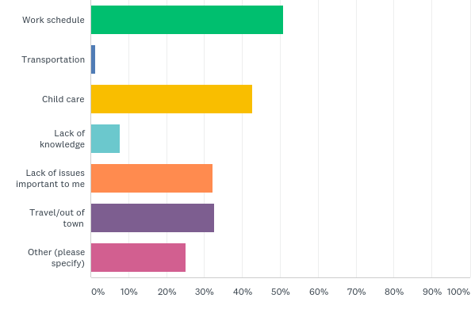
Annual Town Meeting (OTM)
(ALL EXCEPT “RARELY/NEVER”)
Q. If you miss attending Town Meeting in person, what are the reasons?

Slide 16
Annual Town Meeting (OTM)
(ALL EXCEPT “RARELY/NEVER”)
“Other” reasons for missing Town Meeting:
to many speakers w/ lack of substance
Forget, illness,too long over days
Health
When dates for the meeting are not made available well in advance. Setting a standard time for Town Meeting to begin each year would be ideal.
other things scheduled at same time
Have to attend some other meeting occasionally.
Attendance at children’s sports
Length
I never miss town meeting
Too lazy
have never missed TM in 30 years
Meetings run too long and too late
As someone elderly and retired I do not feel comfortable to be out at night
Weather
Never miss it but sometimes gets boring
Time
I travel for work. My wife often works night and is unavailable and we have small children who need a sitter
Too time consuming and runs much later than I usually go to bed.
Child care child care child care
just too long, I usually go for 2 out of 4 nights
Sickness, weather, lack of parking, the frustration of the complete inefficiencies of the meeting, listening to crazy members of the public talking, the fact they go on for hours
other things scheduled at same time
religious holidays
Other commitments during specific time of meeting
Long and drawn out with terrible seating
I regularly attend
I never miss town meeting (why is that not a choice!)
I find direct town meeting to be non-democratic, extremely inefficient, and poorly managed. If we are to have town meetings,
they should be "representative" in format.
other conflicting meetings or guests
make a point of being available for town meeting and never missing
It is simply exhausting after a work day, especially when it lasts for more than one night.
I would only miss it if ill.
illness
pure laziness
Conflicts with family schedule, lack of parking at town meeting, lack of willingness to spend 3-4 hours on multiple nights to cast my single vote
emergency
Too frustrating if the issue is not very important to me.
Rarely miss going to TM
Inconvenient and indefinite time commitments
Length of meetings
sick
CONTINUED….
Notes:
Direct quotes

Slide 17
Annual Town Meeting (OTM)
(ALL EXCEPT “RARELY/NEVER”)
…CONTINUED
“Other” reasons for missing Town Meeting:
Too long, too boring.
I don't get reliable information of when it is. I usually only find out the timing only a day or two before or sometimes after the fact
I do attend.
It's a circus, and sometimes I don't want to deal with the drama
meetings too long
Takes SOOOOO long
Physically Unable
lazy
runs too late at night
illness
Don't miss town mtg
Conflict with a course
Snow storm
Sometimes the weather
other commitments that night
Frustration
They continue too late into night, & practically always never make decisions. They keep carrying over a subject!
Too tired after work
Procedural red tape
Other obligations
Privacy, I don’t want people judging me
Tired. I know I will get home late and have to get up early.
2nd job, previous engagement
I am dead.
Other schedule commitments
Time
Illness
Don't think it is efficient or fair.
Didn’t plan ahead/know in advance to attend
Don’t want to sit through 5 looms turning a 60 minute meeting into a 6 hour meeting by ranting on every topic
sick
illness
goes too long and too late at night
.
Notes:
Direct quotes

Slide 18
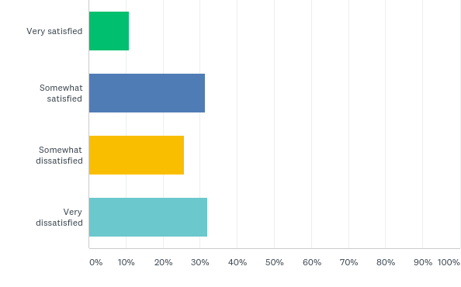
Annual Town Meeting (OTM)
OPERATIONS
Q. Overall, how satisfied are you with the way Town Meeting operates?
10.89%
31.35%
25.74%
32.01%
Notes:
“Very dissatisfied” is highest percentage. Again Wayland responses are disproportionate to the others.

Slide 19
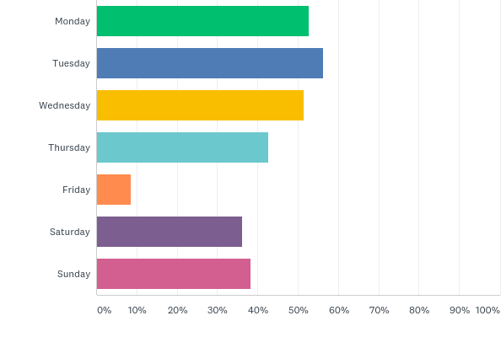
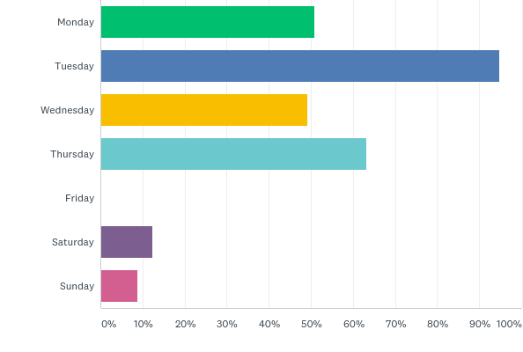
Annual Town Meeting
OPERATIONS
MORE survey highlights . . .
Satisfaction with date of Town Meeting:
OTM: Yes 67.33%, No 32.67%
RTM: Yes 86.21%, No 13.79%
Satisfaction with time of Town Meeting:
OTM: Yes 64%, No 36%
RTM: Yes 77.19%, No 22.81%
Satisfaction with location of Town Meeting:
OTM: Yes 89.56%, No 10.44%
RTM: Yes 94.83%, No 5.17%
Preferred days that Town Meeting be held:
d
OTM
RTM

Slide 20
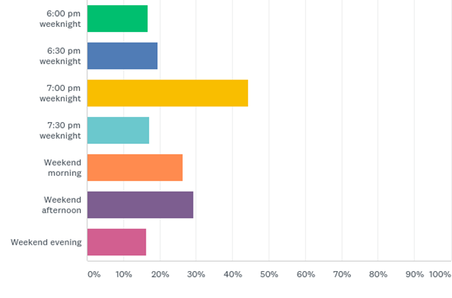
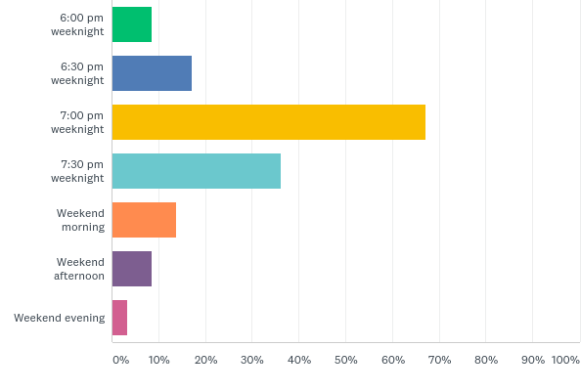
Annual Town Meeting
OPERATIONS
Preferred time to start Town Meeting:
How often they leave early…
Always: 24.75%
Sometimes: 42.81%
Rarely 16.72%
Never 15.72%
Always: 3.45%
Sometimes: 13.79%
Rarely 27.59%
Never 55.17%
OTM
RTM
OTM
RTM

Slide 21
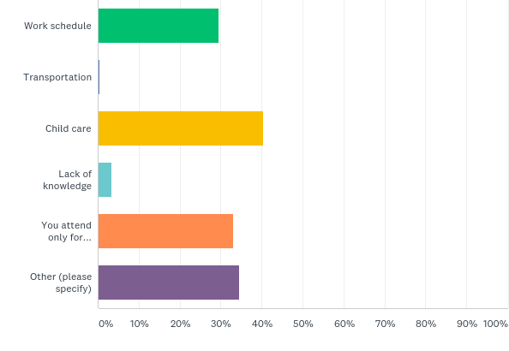
Annual Town Meeting (OTM)
OPERATIONS
Why are they leaving early?

Slide 22
Annual Town Meeting (OTM)
OPERATIONS
“Other” reasons for leaving early:
Too long with uncertain timing and comments by same people every year.
Goes to late, past my bedtime. And they just keep talking.....
Need to get home
Bedtime...I get up early and meetings sometimes run late
not efficient; should also allow voting online
Am feeling too tired; it was too long.
Meeting hijacked by group seeking to delay vote to lower # of working parents able to attend/vote
Minority has hijacked the meeting and time wasting to delay votes until working parents cannot attend
never leave early
I never leave town meeting early
meeting is too long/too late
Not comfortable being out late as someone elderly
town meeting going very late
Meetings run past the time I need to get to bed to get adequate sleep
Frustration at the people who deliberately try to slow things down
Sports
I’m exhausted and need to get up early the following morning
Too long and inefficient meetings
It's running too late
It gets late.
Goes on too long
Too late
Inefficient presentation of articles
Tired
can't take it anymore
they just run too late.
Go on too long and the articles are minor or I know will pass
Never
Meetings are too long
I never leave early
late hour
I don't
Length of meeting
Goes on too long
don't remember ever leaving early
usually stay to the end
It goes too late
You are missing the point. The meetings are long arduous and really boring. The seats are uncomfortable. Give me a polling booth and a sheet with check boxes. Give me a mail in vote. I have no interest in these town meetings. If I can vote someone into the highest office in the land from a check box I can certainly vote on a town issue that way.
CONTINUED…
Notes:
Direct quotes

Slide 23
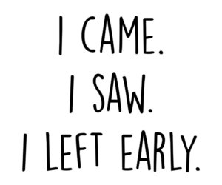
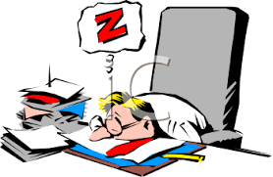
Annual Town Meeting (OTM)
OPERATIONS
…CONTINUED
“Other” reasons for leaving early:
past my bedtime, late at night. 10pm should be the deadline
Letting people drone on and on (usually the same ones) only wastes everyone's time
Goes long
Tired
Meeting is too late and I need to get up early
Meetings last too long/lose focus/have to go to bed
Never leave early but I wasn't allowed to skip this question.
It is running very late
Drags on too long, too much drama
I don't leave early
Topics going off on a tangent
town places items of interest at end of agenda so that discussion carries over to the following day
just tired
If I have work the next day and we're done with articles I'm interested in, I sometimes leave early
Just gets too late for me (& no, I'm not that old)
I am exhausted by 10:00 and would have difficulty working the next day if I stayed past then
Going too late
Bored
need to get up the next day
They run too late
Frustration bored
It goes too late and I have to get up early for work
Gets too late, & very dark.
Meetings run very late
Don't leave early
Tired, Frustrated with discussion etc.
Nothing productive left
They are just too long, go too late, and I need to wake up early
I am a morning person and 10 pm or later is too late for me.
Illness - can't stay for long periods
People talking too much
got too tired
Need to get to bed
it goes long...past 3 hours and I just can't take it anymore
Don't leave early
Exhaustion
they run way too late as a result of too many Town "ramblers"
Just goes on way too long and way too late at night!
running too lateI regularly stay until the end
Fatigue
it's a work day the next day and it often runs too late- 11 or 11:30
i don't leave early
Again, it is exhausting.
TIRED
late hour
don't leave early
They go on for too long
Fatigue
Never
Too late!!!!!
Running very late
Too long, too tired
Do not leave early
simply too long to sit
Late time
unimportant articles left
Notes:
Direct quotes

Slide 24
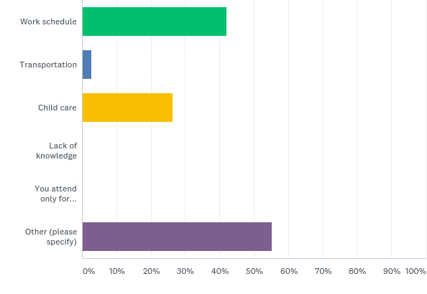
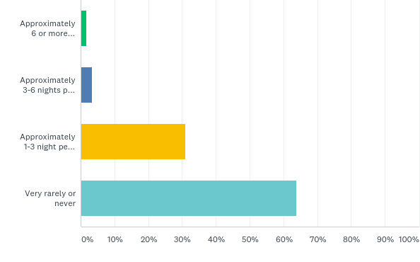
Annual Town Meeting (RTM)
OPERATIONS
Why are they leaving early?
How often they miss nights of Town Meeting?

Slide 25
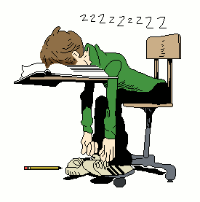
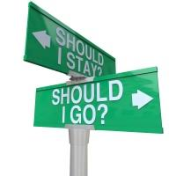
Annual Town Meeting (RTM)
OPERATIONS
“Other” reasons for leaving early:
Health reasons
I don't leave early
fatigue
n/a
I don't leave early.
n/a
dont leave early
Never have left TM early, I feel it is insulting to those presenting.
I don't leave early
Merdical
Boring and I'm tired
i don't leave early
Just find it drags along too slowly.
usually ends too late and I have to work in the morning
Personal wellbeing - need to go bed early to get enough sleep before waking up to go to work/be a parent
We run so late sometimes and my kid will wake me up early no matter what
I have to rise early for my job and must tend to a good nights sleep
Health
It's so late I'm worried about not getting enough sleep before work the next day
I tend to leave when debate & motions get out of hand.
Agenda runs too long for me to be up for work the following morning
Notes:
Direct quotes

Slide 26
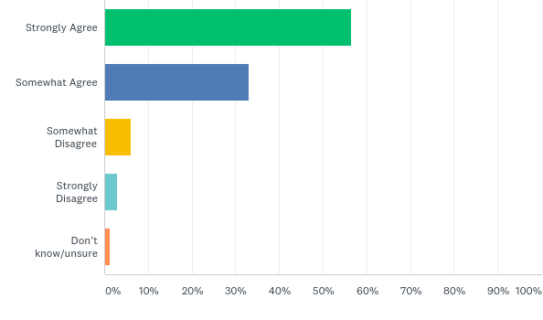
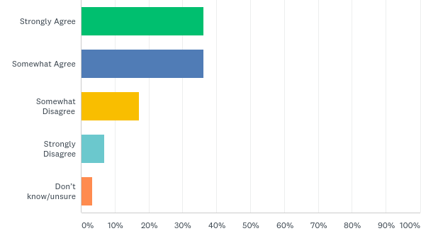
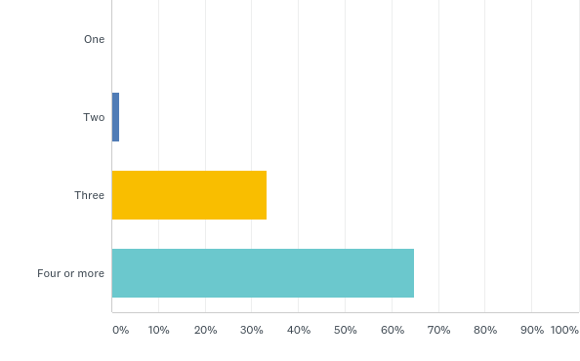
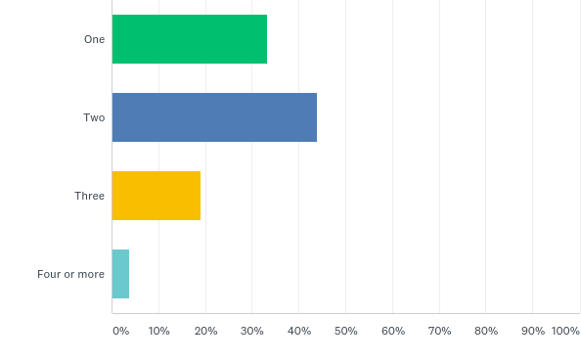
Annual Town Meeting
OPERATIONS
Town Meetings are too long:
The maximum number of days considered to be reasonable for Town Meeting:
OTM
RTM
OTM
RTM

Slide 27
Annual Town Meeting (OTM)
OPERATIONS
Some additional statistics:
Who reads the Town Meeting materials before coming to Town Meeting: 85.92%. The materials arrive on time: 39.05% are very satisfied, and 45.62% percent are somewhat satisfied They are complete and informative: 30.18% are very satisfied, and 49.09% percent are somewhat satisfied
Methods for learning of the issues, other than materials: Listen to debate at Town Meeting – 50.92 % Discuss with others prior to Town Meeting – 74.91% Attend/watch Selectmen/Finance/Advisory other meetings – 35.42% Other – 27.31%
The highest percentage response that attend or watch meetings/hearings of the Selectmen, Finance/Advisory Committee/Planning Board/School Committee in preparation for Town Meeting: “Never”
Those who ever have read the Secretary of State’s “Citizen Guide to Town Meeting”: 24.69%
Greatest percentage who understands parliamentary procedure: 58% somewhat knowledgeable (only 25.10% are very knowledgeable and 16.87% are not at all)
Member speaking time limits: 46.09% are satisfied 38.68% think they are too long
Notes:
RTM comparisons:
Reads materials prior to meeting 87.93%; listen to debate at TM 77.59%; discuss with others prior to TM 75.86%; attend/watch Selectmen/Finance/Advisory other meetings 63.79%; have read Citizen’s Guide 32.73%; greatest percent somewhat knowledgeable about parliamentary procedure 59.65%, very knowledgeable 36.65% and not at all knowledgeable 3.5%

Slide 28
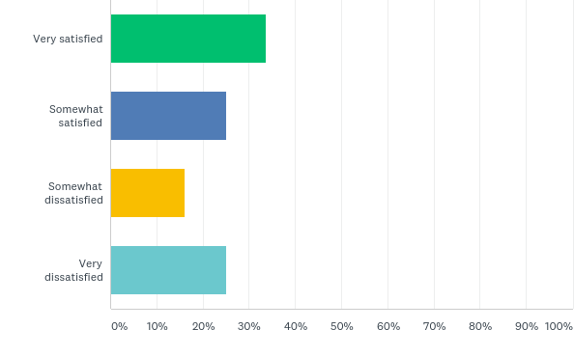
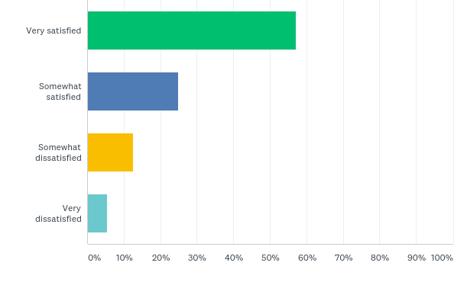
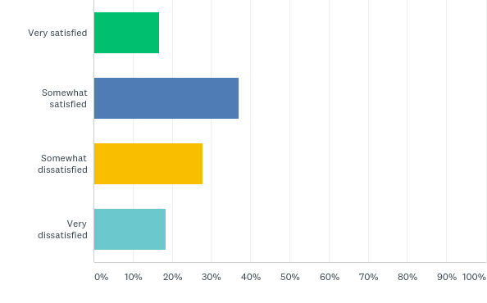
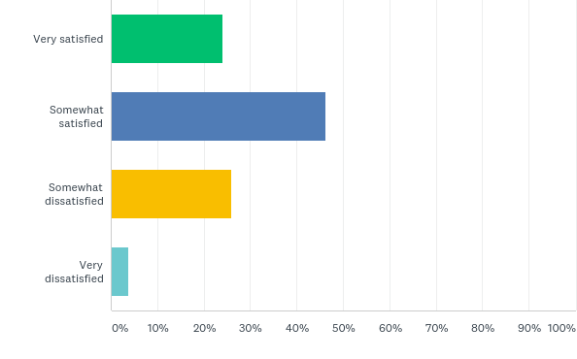
Annual Town Meeting
OPERATIONS
Satisfaction with voting process:
Satisfaction with process to amend motions:
OTM
RTM
OTM
RTM

Slide 29
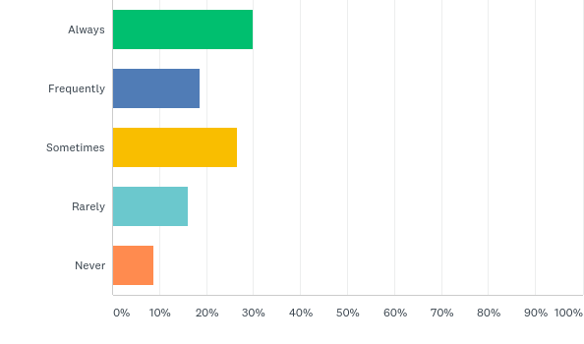
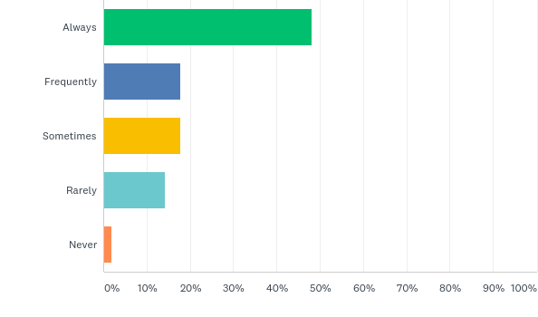
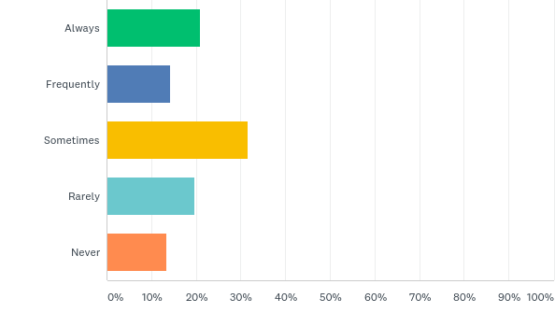
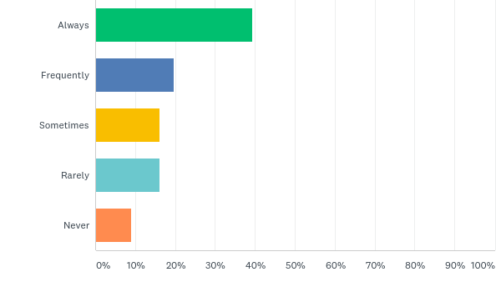
Annual Town Meeting
PARTICIPATION
Comfortable participating at Town Meeting:
Comfortable expressing opposing/minority view:
OTM
RTM
OTM
RTM

Slide 30
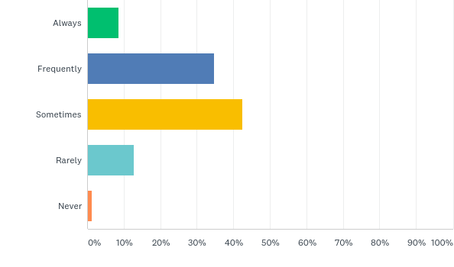
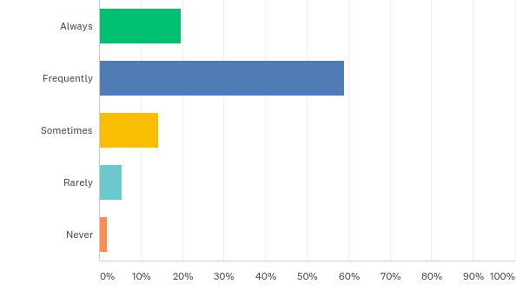
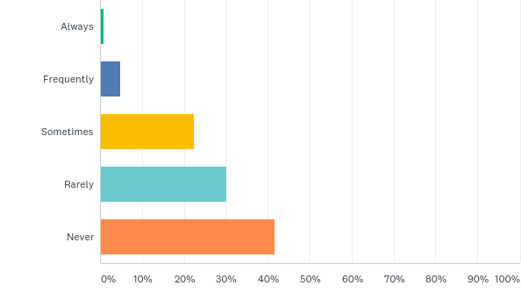
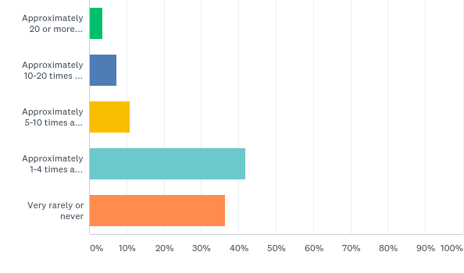
Annual Town Meeting
PARTICIPATION
TMM’s are respectful/listen to others’ comments:
How often those speak in support or opposition of an article:
OTM
RTM
OTM
RTM

Slide 31
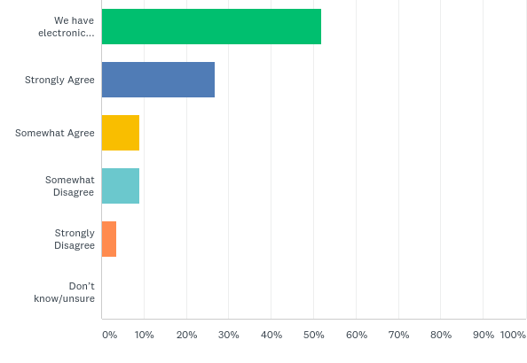
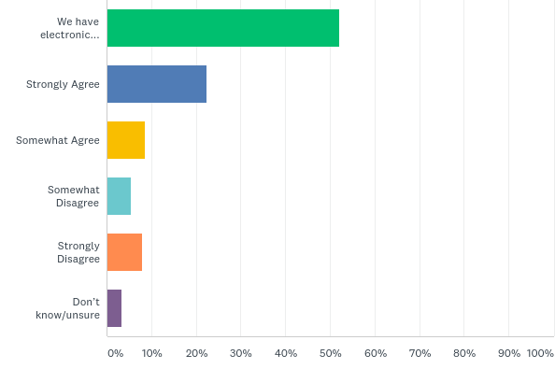
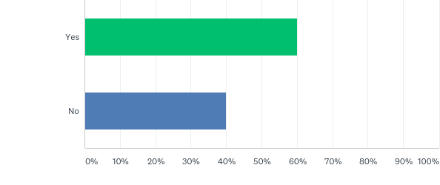
Annual Town Meeting
VOTING
Electronic voting should be investigated:
Would be more likely to vote if electronic voting were used:
OTM
RTM
OTM
RTM

Slide 32
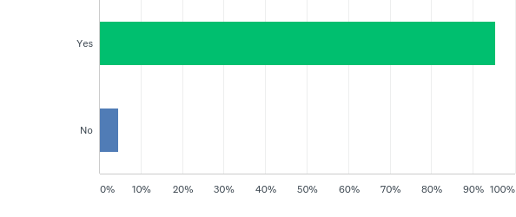
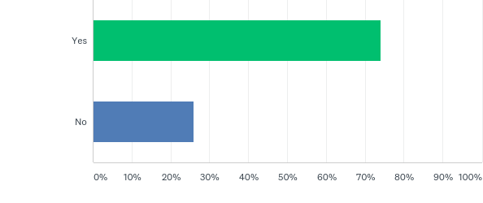
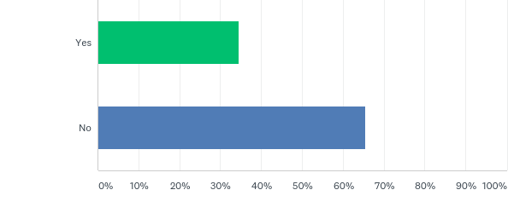
Annual Town Meeting
VOTING
If remote internet-voting for registered voters were available for Town Meeting (from your home or anywhere) while viewing Town Meetings live via a webcast or TV, would you be more likely to participate?
OTM
(rarely/never)
OTM
(all others)
RTM

Slide 33
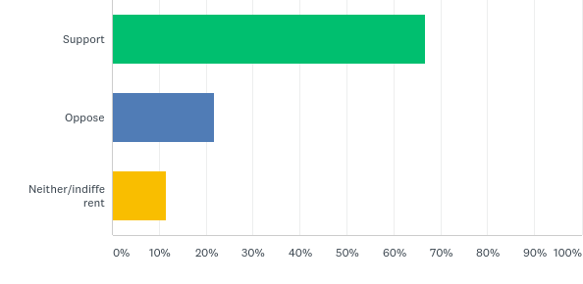
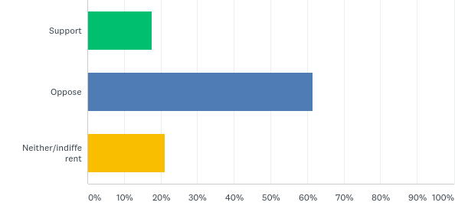
Annual Town Meeting
VOTING
Would you be willing to support or oppose the town or residents seeking changes in state law and town bylaws, and taking other necessary steps, to allow remote internet-voting while viewing Town Meeting live via a webcast or TV?
RTM:
OTM
RTM

Slide 34
Annual Town Meeting (OTM)
VOTING
Would you support or oppose the following two-step Town Meeting process if it were permitted by law? Step one: A deliberative meeting where articles are presented and debated (and possibly amended on the floor) as in Town Meetings today. Residents could attend and participate in person or they could view the meeting via TV or webcast. Step two: a vote one or two weeks later by paper ballot in person at town hall or by absentee ballot. (variations in use in New Hampshire and Vermont)

Slide 35
Annual Town Meeting
WHAT ARE OTHER TOWNS DOING?
GETTING THERE
Provide childcare
Invite food trucks
Volunteer groups bring water bottles
COA van/ transportation
Establish a facilities committee
New resident welcome letter or email/Town Clerk packet
Robocalls/ automated emails
Establish a community outreach committee
School/parent emails
Investigate alternate days and times. Currently, there is no legal mechanism to allow off-site voting (MGL c. 39). However, some towns have established committees to explore remote voting and Australian ballot form of voting.

Slide 36
Annual Town Meeting
WHAT ARE OTHER TOWNS DOING?
INFORMATION
Social media is BIG! Have a Facebook page to
Community discussion groups
preview warrant articles
provide additional town meeting information
show short informational videos
For RTMMs, provide bus tours to see major capital items and areas to be impacted by zoning changes
Take questions electronically/ remotely
Availability of Secretary of the Commonwealth’s “Citizen’s Guide to Town Meetings”
Live/CATV Moderator & TA/TM meeting and article preview/review

Slide 37
Annual Town Meeting
WHAT ARE OTHER TOWNS DOING?
PROCESS
Shorten announcements and introductions
Microphone control and strategic placement
Limit the number of reports and presentations
Time limits for speakers and presenters
Eliminate awards and recognitions
Combine spring STM with ATM
Increase the number of signatures required for citizen petitions (special legislation)
Consent agenda
Bundle group for one vote
Use articles that tend not to change, house- keeping, straight- forward (action but no policy). Examples:
Accept Chapter 90 funds
OPEB appropriations
Continue revolving funds
If opposition (1, 10 or any number of voters), pull and debate separately

Slide 38
Annual Town Meeting
WHAT ARE OTHER TOWNS DOING?
Motions for reconsideration - require substantive change in facts that as determined by the moderator may impact a potentially different result, or other compelling reason such as a material procedural error, 2/3 vote
Amendments to articles – require submission in writing/email at least 30 minutes, or 24 or 48 hours, prior to start of session at which article is to be considered. Allows time for Moderator and Town Counsel review
Once at the microphone, unless it’s a budget discussion
Articles not allowed out of order
Allow questions to be sent in ahead of time from those who can’t attend; questions are read aloud if no one else has asked the same question
Adopt alternate rules of procedure:
“Robert’s Rules of Order”
“Town Meeting Time”
“My rules”. For example. . .
PROCESS

Slide 39
Annual Town Meeting
WHAT ARE OTHER TOWNS DOING?
Boston-based, mobile-focused voting start-up company using technology such as biometrics and the blockchain.
The Town of Hopkinton piloted the use of Voatz at its annual Town Meeting earlier this year to increase participation, ensure accuracy, and allow for a prompt tally of votes. The decision was made to pilot with Voatz due to the technology, ease of use, security, and on-site support provided at meetings.
Residents voted on their own personal compatible devices (Android 2016 or newer or iPhone 5s or newer) or on Voatz-provided tablets.
When registered voters arrive at Town Meeting, they are checked in and receive a voter card with a QR code (quick response) on it in addition to the color coded voting card they received in the past. This QR code is unique and is the voter’s “ticket to vote” electronically.
Comments from Town Clerk: Voatz was great about providing a lot of staff and tablets Millennials, boomers, seniors, and those with all different tech levels could use There were a few issues that easily can be resolved
. . . What is Voatz?
Electronic Voting:
Natick, Weston, Wayland use (hand-held devices)
Advantages: speed, improved accuracy, anonymity for OTM, accountability for RTM
Disadvantages: cost (rent v. own options), bylaw amendment, anonymity, potential difficulty in use, potential reliability, little or no improvement in speed, maintenance and technological obsolescence, need to over-order as turnout is always an unknown
Voatz . . .
PROCESS

Slide 40
Town Elections
 | Ashland | Holliston | Framingham | Malborough | Natick | Southborough | Wayland | Wellesley | Weston
Election Date | Tue 5/16/2017 | 5/23/2017 | 4/4/2017 | 11/7/2017 | 3/28/2017 | 5/9/2017 | 3/28/2017 | 3/7/2017 | 5/6/2017
Weekday | Tuesday | Tuesday | Tuesday | Tuesday | Tuesday | Tuesday | Tuesday | Tuesday | Saturday
Reg. Voters | 11,272 | 10,089 | 39,910 | 22,726 | 22,680 | 7,373 | 9,945 | 16,363 | 8,220
Voter Turnout | 399 | 1,672 | 11,341 | 4,544 | 2,249 | 1,727 | 1,300 | 3,642 | 1,027
Percentage | 3.50% | 16.57% | 28.42% | 20.23% | 9.70% | 23.42% | 13.07% | 22.26% | 12.49%
18+ Population | 12,750 (est) | 11,759 | 48,840 | 39,000 (est) | 25,129 | 7,000 (est) | 10,000 (est) | 20,400 (est) | 8,800 (est)
 |  |  | Tues11/7/2017
 |  |  | 40,162
 |  |  | 15,734
 |  |  | 39.18%
 | Ashland | Holliston | Framingham | Marlborough | Natick | Southborough | Wayland | Wellesley | Weston
Election Date | 5/15/2018 | 5/22/2018 | 9/4/2018 | 9/4/2018 | 3/27/2018 | 5/8/2018 | 3/27/2018 | 3/6/2018 | 5/5/2018
Weekday | Tuesday | Tuesday | Tuesday | Tuesday | Tuesday | Tuesday | Tuesday | Tuesday | Saturday
Reg Voters | 11,370 | 10,089 (2017) |  |  | 22,680 | 7,220 | 9,391 | 16,325 | 8,220
Voter turnout | 2,372 | 1,164 |  |  | 5,821 | 1,203 | 2,757 | 3,175 | 509
Percentage | 21% | 11.50% |  |  | 25.70% | 16.70% | 29.35% | 19.44% | 6.10%
18+ Population | 12,750 (est) | 11,759 | 48,840 | 39,000 (est) | 25,129 | 7,000 (est) | 10,000 (est) | 20,400 (est) | 8,800 (est)
Notes:
2018 MA town elections by month: March – 19, April – 8, May -178, June – 19, and November – 1.

Slide 41
Underrepresentation
E-Democracy
Increasing Participation
How can we recapture the spirit of community engagement that built America? In a rapidly changing world, traditional approaches seem less effective.
Voter participation has been falling since the 1960’s. We increasingly are disconnected from our democratic structures, belong to fewer organizations, and meet and know fewer of our neighbors.
Minorities, while prevalent in local business and community organizations, typically are absent from government and civic engagement.
Millennials have taken an interest in national politics and grassroots movements but generally not in local politics, which deals with decisions closest to home - from how public safety is funded to what roads are updated.
Only 18 members of color in the MA House & Senate, accounting for only 9 percent of all seats.
Boston Globe 8/7/2018
The headlines.
The statistics.
The realities.
We know too well . . .
Notes:
Barriers to running for office: income and ability to take off from work, lack of time (young children), and lack of connections to tap for fundraising

Slide 42
Underrepresentation
E-Democracy
Increasing Participation
Has a new movement begun?
The Boston Globe, Sept 6, 2018
“On the day after, Pressley hailed as sign of the times”
“This is really a historic moment, a historic shift where we’re seeing the inclusion of women, of people of color, of people of different generations, sexual orientations, finally get better representation and have a voice,” said Ann Bookman, director of the Center for Women in Politics and Public Policy at UMass Boston.

Slide 43
Underrepresentation
E-Democracy
Increasing Participation
From the Center for Active Design’s *
Assembly: Civic Design Guidelines, “Foster Local Democracy”
IMPROVE VOTING ACCESS AND AWARENESS
SUPPORT COMMUNITY-DRIVEN DESIGN PROCESSES
INCREASE ACCESS TO COMMUNITY INFORMATION
ELEVATE THE VISIBILITY OF LOCAL GOVERNMENT
Use signage to enhance visibility of polling locations.
Hold Election Day festivals outside polling locations.
Ensure government information is easy to access and navigate.
Provide real-time, location-specific information about government services such as transit or sanitation schedules.
Install information boards to share details about community issues and events.
Promote community meetings by increasing advertising and testing new venues.
Stage on-site events and design activities that appeal to a diversity of participants.
Engage community members in participatory budgeting processes that help set public space priorities.
Display design concepts and elicit feedback through interactive posters, suggestion boxes, or comment boards.
Collaborate with community members to create tactical, temporary design elements such as moveable seating, play spaces, and artwork.
Ensure polling locations are easily accessible to all residents.
Ensure signage and messaging acknowledge the role of local government in improving and maintaining public spaces and buildings.
At the outset of a design project, work with community members to research and assess the strengths and weaknesses of the site.
*The Center for Active Design is an international non-profit organization using design to foster healthy and engaged communities. https://centerforactivedesign.org/assembly

Slide 44
Underrepresentation
E-Democracy
Increasing Participation
Asians increasingly voting
in Quincy
The Patriot Ledger in 2018 reported that while the percentage of Asians who vote remains low to the general population, it is steadily rising. The first two Asian-Americans were elected to the council in 2015. Former long-time city clerk says it is that group no Quincy politician can afford to ignore.
Braintree works on improving website access for all
In May 2018 the town first observed Global Accessibility Awareness Day.
Programs are developed with an emphasis on inclusion – everyone is a part of the community without requesting special assistance.
In addition, the town’s Smart 911 alert system is compatible with TTY-TDD; is using SeeClickFIx to meet the requirements of the ADA.
Mayor’s Office in Framingham advertises for
Citizen Participation Officer
The town relaunched its websites to make more information more accessible for people with disabilities.
In July 2018, Mayor Spicer’s began to advertise for a Citizen Participation Officer, a full-time position mandated by the new City Charter.
Per the job posting, the CPO works with City departments, boards and commissions to engage the public using communication and outreach strategies to enhance public engagement, to process citizen complaints and inquiries, and ensure compliance with public notice requirements. This position will also analyze data on citizen engagement, complaints and inquires, and shall regularly submit reports on such data.
LOCAL LEVEL

Slide 45
Underrepresentation
E-Democracy
Increasing Participation
What is it?
Boston
2018 marked its 5th year
Cambridge
Now in its fifth Participatory Budgeting cycle
Runs from May-Dec 2018. The City will set aside $900,000 of the FY20 Budget for one-time capital projects to improve the community.
IL, NJ, NY, PA
In FY19 ($867,000): 100 trees, homeless kits, flashing crosswalks, drinking water in parks, school musical instruments, living moss wall to combat pollution, youth center upgrade.
Other places:
Philadelphia has not adopted but has taken similar steps by surveying residents on which city service needs the most work.
The Mayor’s Youth Council runs the process and shares rule-making authority with youth organiza-tions across the City. Anyone can submit ideas. Change Agents change ideas into projects.
New York City Council in its 8th cycle; at least $1 million.
It helps make budget decisions clear and accessible. It gives real power to people who have never before been involved in the political process.
Community members brainstorm ideas, formal project proposals are developed, and those that are vetted by staff and approved by city manager appear on public ballot for a vote.
Voting polls were stationed at local train stations, youth centers and school buildings for the city-wide vote; also online voting.
For 2018, $1,000,000: fans in schools, building solar panels, community gardens, City Hall youth Wi-Fi lounge, blue box emergency lights.
A democratic process through which community members directly decide how to spend part of a public budget, typically discretionary capital funds.
Chicago was 1st to formalize in the US in 2009.
Freemont Borough, NJ ($200,000).
Local Participatory Budgeting

Slide 46
Underrepresentation
E-Democracy
Increasing Participation
RANKED CHOICE VOTING
Ranked choice voting (RCV) is claimed to make democracy more fair and functional. It works in a variety of contexts. It is a simple change that can have a big impact.
MASSACHUSETTS
Bills that would make it easier for municipalities to adopt RCV and that would establish statewide ranked-choice voting recently died in the legislature. If no progress is made legislatively next year, advocates reportedly will consider launching a November 2020 ballot initiative.
HOW IT WORKS … generally, voters mark a first choice, a second choice, and so forth. If a candidate earns more than 50 percent of first-choice votes, the election is over. But, where no candidate reaches a majority, the candidate with the fewest first-choice votes is eliminated, and his or her votes are redistributed according to the second choices voters marked on their ballots, until a candidate hits 50 percent. When used as an "instant runoff" to elect a single candidate like a mayor or a governor, RCV helps elect a candidate that better reflects the support of a majority of voters. When used as a form of fair representation voting to elect more than one candidate like a city council, state legislature or even Congress, RCV helps to more fairly represent the full spectrum of voters.
RCV may not in all cases help minority candidates, but it does encourage less negative campaigning as candidates have an incentive to be voters’ second or third choice
AMHERST
In 2018, Amherst adopted ranked-choice voting as part of its new town charter and expects to use the method in its first town council election in 2021
CAMBRIDGE
In use since the 1940’s in multi-winner RCV form for the nine seat city council and six seat school board elected citywide
Notes:
RCV lowers barriers for those who make up a smaller percentage of populations
Amherst change from Select Board to Council (no mayor but a town manager)
Sec. of State Galvin has expressed an interest for primaries (in use in Maine)

Slide 47
Underrepresentation
E-Democracy
Increasing Participation
Establish a civics leadership program
Hold meetings in community clubs or wherever convenient for the missing demographics
Partner with non-profits/orgs. to provide information days, etc. for ethnic minorities
Establish a youth council or commission
Invite student to attend meetings and speak on youth issues and school issues
Boston Office of Civic Engagement
Provide non-voting seats for youth members on various advisory boards (esp. ones related to parks, libraries, human services, the arts)
Love Your Block
Civic Engagement Week
Office of Neighborhood Services
More ideas…

Slide 48
Underrepresentation
E-Democracy
Increasing Participation
E-Democracy:
What are other communities using?
TELEPHONE TOWN HALL
VOATZ
Provided phone numbers are rapidly dialed. The targeted audience receives a personalized, pre-recorded message inviting them to remain on the line if they wish to be transferred to a live telephone town hall event.
Erin Stewart, A 30-year old mayor of New Britain CT, elected at age 26.
Can also be used for surveys and information gathering.
Referred to as a “Survey Monkey Meets Twitter”
Used to inform and get input from constituents.
When joining the meeting, participants have the opportunity to ask questions live, as well as to respond to integrated survey questions using their phone keypads.
Using a customized web interface, can control which participants ask their questions live on the conference as well as when to pose survey questions to your audience. Participants unable to ask their questions live have the option to leave a personal message.
Post event: detailed report with participant statistics as well as a digital recording of your event that may be posted to your website.
A digital space to share feedback, ask questions, creates polls and surveys, verifies data, cross-references against voter registration database, breaks down by district, demographic and more.
An hour before each city council meeting, she sits in front of her computer and launches Facebook Live to update residents on the agenda and answers questions in real time. Her videos can get 100’s of comments and more than 3,000 views in a city of 73,000. “We’re averaging all these views, but we can’t get two people to show up to city hall” “That’s fine, I’ll bring government to you.” (Time, “We Can Do it Better: Met the Millennials Taking Over City Hall)
A private social network for individual neighborhoods. Users sign up with addresses and see a feed of info specific to their local area.
D.C. uses to improve voter participation, gets info to voters about polling places, requirements to vote and changes to ballots in a timely manner.
POLCO.US
NEXT DOOR
Notes:
Making local government and wired and tech/social media savvy as its residents

Slide 49
Underrepresentation
E-Democracy
Increasing Participation
More on Millennials
Starting to plant flags at local level, where government tends to be most accountable and least partisan
Some local govts are starting to pick up slack on national issues important to millennials – immigration, climate change
National politics requires too much fundraising
Interview of 11 Millennial Mayors plus dozens of other young elected officials
New lobby: Association of Young Americans (AYA), billed as the AARP for young people…
Millennial attitude: ambition bordering on arrogance, insistence on getting things done
Push for action on climate change, student debt, criminal justice reform, and voting rights.
All have in common
preternatural ease with technology, appetite for collaboration, impatience with reflexive partisanship
TIME, “ ‘We Can Do It Better.’ Meet the Millennials Taking Over City Hall” (October 2017)
Notes:
Not as much about youth as it is working in different ways.
As of 2015 millennials have overtaken % of boomers. While each account for roughly 30% of Americans, boomers hold 55% of seat in state legislatures; millennials hold only 5%.

Slide 50
Underrepresentation
E-Democracy
Increasing Participation
MA S2650 - An act to promote civic engagement
Massachusetts Voter Registration Law
In August Massachusetts became the 14th state in the country to adopt an automatic voter registration system, according to Secretary of State William Galvin. measure.
Gov. Baker signed into law a bill that will automatically register eligible voters when they interact with the Registry of Motor Vehicles and MassHealth, unless they opt out.
Questions can be texted to automated help.
City mailed a ballot to every registered voter. Fill out at home and mail in or put in drop box.
Door-to-door campaigns to increase black voting.
Those who voted in person could go anywhere.
Could register and vote same day.
New York Times, “Increasing Voter Turnout for 2018 and Beyond,” 6/13/2017
Denver, Colorado 2016 Denver General Elections Review
72% of registered voters voted
92% voted a mail ballot
8% voted in person
Lays out specific subjects that schools must teach as part of their civics education; students have to complete a hands-on civics project; creates a program where student volunteers run voter registration drives on their high school campuses.
8/6/2018 Senate Referred to the committee on Bills in the Third Reading
Gov. Baker's amendment: the voter registration program must be non-partisan, and schools are to make the hands-on civics project non-partisan and offer an alternative civics education opportunity to any student who chooses not to participate in the project.
STATE LEVEL
Notes:
MA voter registration – makes system work better: saves $, cleans up voter rolls, reduces chance of fraud/error, and hopefully increases turnout.
MA S2560 – Section 6 requires state secretary to disseminate information to cities/towns to promote youth membership on municipal boards, committees and commissions
Denver also worked in partnership with a Spanish language advisory board
Run for Something – recruits and support diverse, young first-time candidates for local and state office.
Emily’s List

Slide 51
Conclusion
Thank You For This Opportunity
Questions and comments?
Individual town surveys for your review
Opportunities for MAPC to discuss results with others in your town
Areas for MAPC to explore further

