Slide 1
COMMONWEALTH OF MASSACHUSETTS
Deval L. Patrick, Governor
Richard K. Sullivan, Jr., Secretary
Mark Sylvia, Commissioner
Green Communities Division – State Investments, Local Impact
Joanne Bissetta
Green Communities Division
MAPC Inner Ring
May 2012

Slide 2
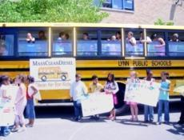
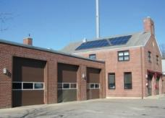
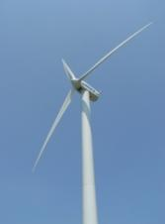
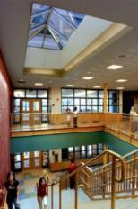
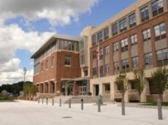
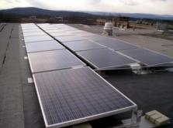
Serves as the hub for all Massachusetts cities and towns on energy matters
Green Communities Division

Slide 3
Green Communities Division - Programs & Resources for Municipalities
Green Communities Designation and Grant Program
MassEnergyInsight energy tracking and analysis tool
Municipal Energy Efficiency Program
Energy Management Services Technical Assistance
ARRA stimulus funding for cities and towns
Mass Municipal Energy Group (MMEG)
Clean Energy Results Program (CERP)
Website filled with tools & resources www.mass.gov/energy/greencommunities
Email updates via listserv – Sign up by sending an email to: join-ene-greencommunities@listserv.state.ma.us
Notes:
Won’t address ARRA

Slide 4
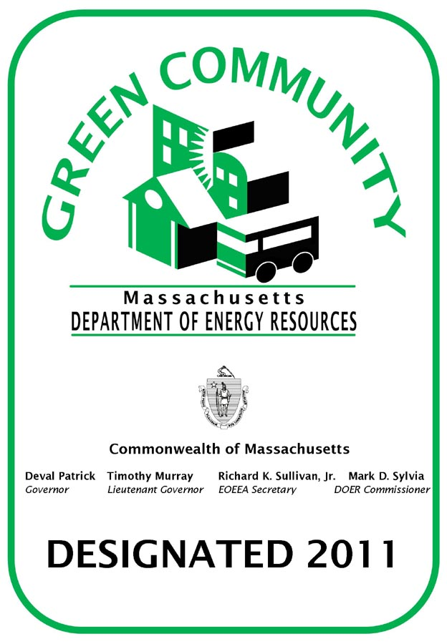
Green Communities Designation and Grant Program
Qualification Criteria - Designation
Adopt as-of-right siting for RE/AE generation, R&D, or manufacturing
Adopt expedited permitting process
Create an Energy Reduction Plan to reduce energy use by 20% in 5 years
Purchase only fuel-efficient vehicles
Minimize life cycle cost in new construction → adopt the Stretch Code
Grant Funding
Energy Efficiency Projects
Renewable Energy Projects on municipal land
4
Notes:
- High bar, set by statute, added clarity where needed, guidance mat’ls on our website. Doing the work here can help municipalities address some of the challenges municipalities face – schools and municipal gov’t have to work together on this. ERP – will educate you on how to become more energy efficient, will know your buildings.

Slide 5
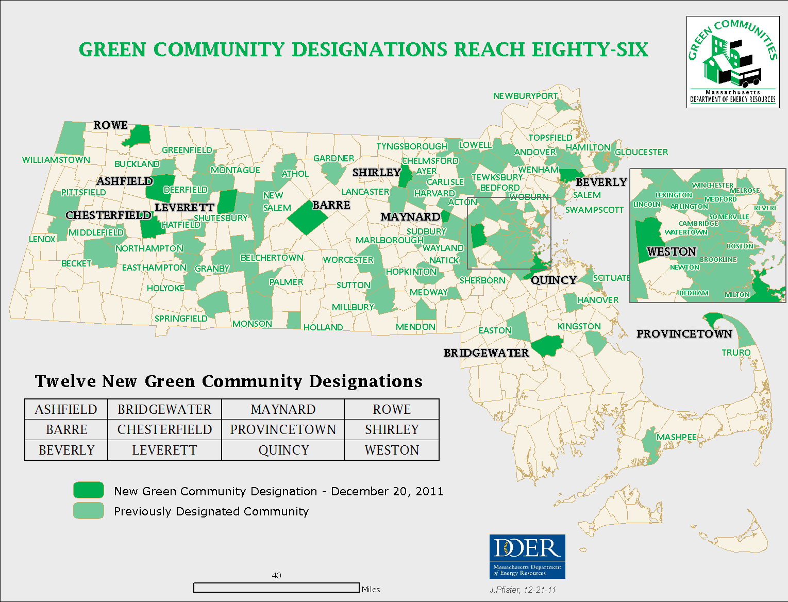
Meet the Green Communities!
Notes:
Next deadline May 29^{h}!

Slide 6
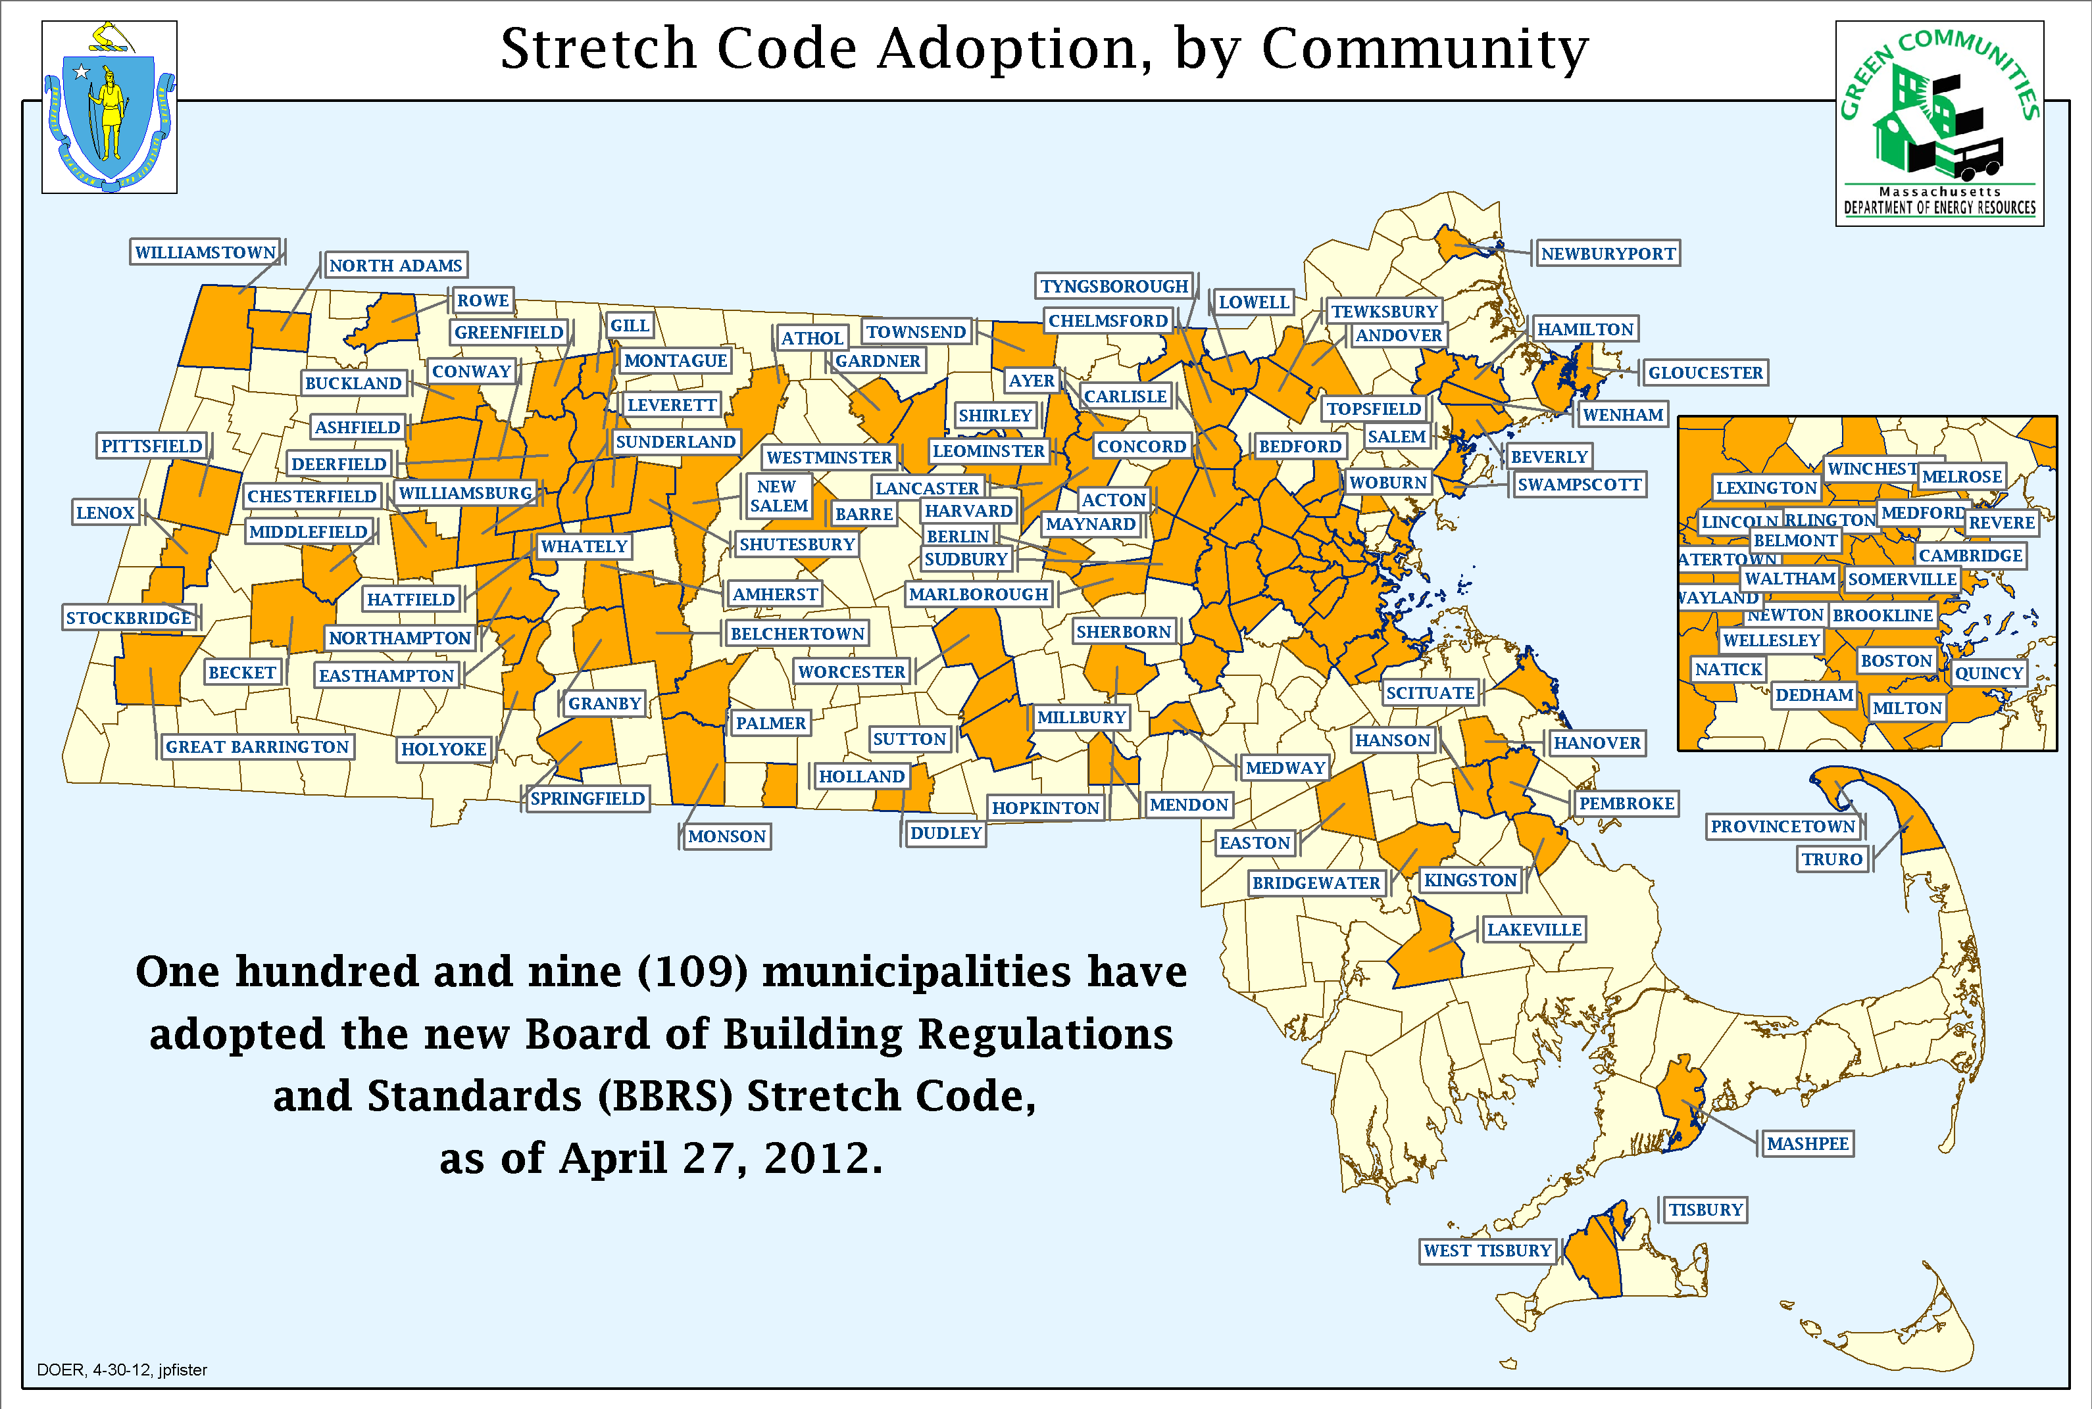
Green Communities Impact
Notes:
Recommended way for meeting criteria 5, adoption of the Stretch Code. ~20% better than code. We are here to support, RC’s and Ian F

Slide 7
Green Communities Designation and Grant Program – the 86
Range in size from 393 to 617,594.
37 communities enacted as-of right zoning for renewable generation
32 provide for ground mounted PV of 250 kW
5 provide for wind of 600 kW
1 provides for both wind and PV
Total Energy Reduction for all 86 Energy Reduction Plans – 1,699,063 MMBtus
7
Notes:
Small – Rowe; largest - Boston
ERP - 13,130 MA households

Slide 8
Green Communities Designation and Grant Program – the 86
Communities receive 4 metal road signs and an official certificate
Grant allocations based on a $125K base plus a population/per capita income formula; maximum $1M.
Range from $130,725 in Hatfield to $1M for Boston
Projects being funded include energy conservation measures, performance contracts, solar PV projects, incremental costs for hybrid vehicles.
23 grants complete to date
Grants $5.4M
Total Projects Costs $7.4M; utility incentives $768K
Annual savings of $1.085M
8
Notes:
Annual Designation Deadline of May 29th

Slide 9
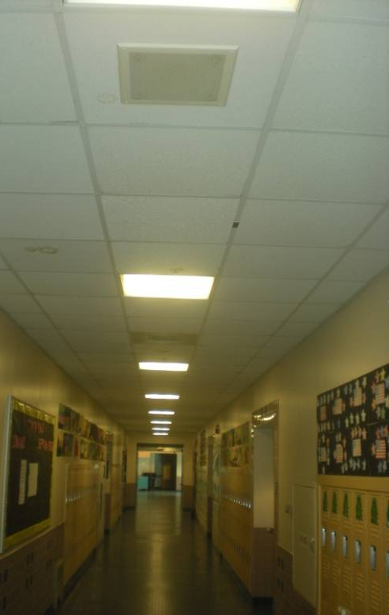
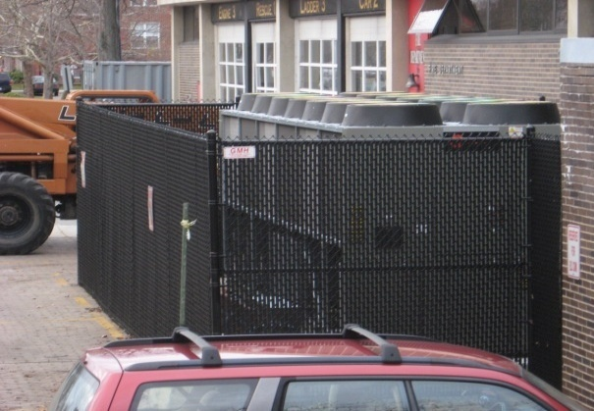
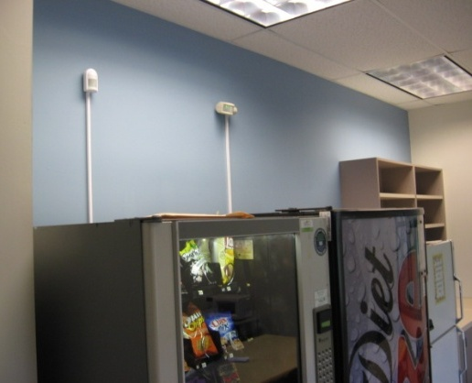
Green Communities Designation and Grant Program – the 86
Lowell - JFK Civic Center Chiller Replacement & Four School Lighting Improvements
Grant towards Performance Contract measures allowed Lowell to do additional energy measures in City Hall
National Grid rebates applied to lighting fixture upgrades, lighting controls, and vending machine controls in schools
9
Notes:
Highlight 3
Grant = $546,506
Annual cost savings of $76,000

Slide 10
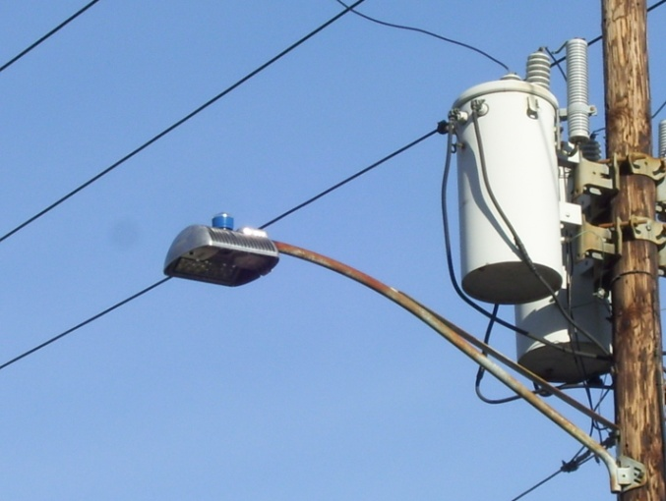
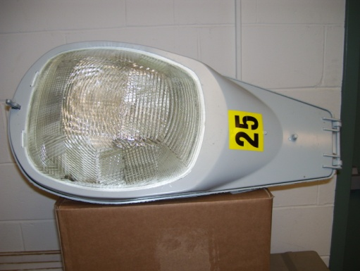
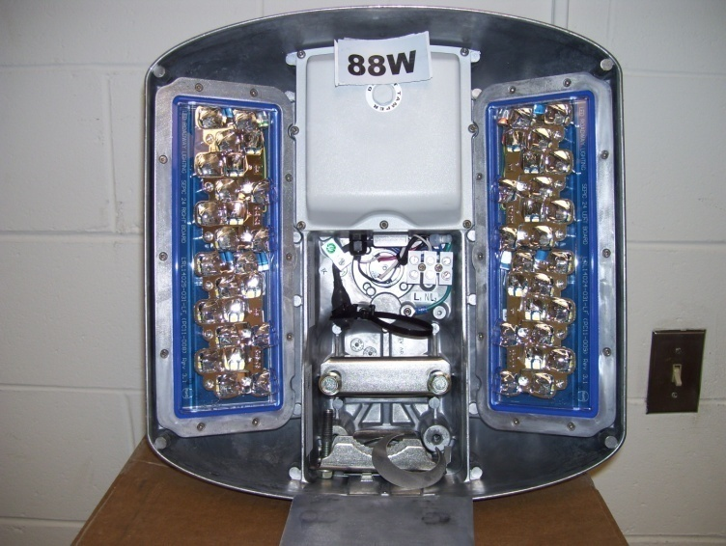
Green Communities Designation and Grant Program – the 86
Easthampton - LED Streetlight Replacement Project
~ 1/3 of the streetlights replaced with LED technology
Incentive grant from WMECO augmented grant $$
City set up a review committee to assess available products, vendors, and costs
Replaced 250w HPS lamp
New 88w LED lamp and installed
10
Notes:
Grant $174,985
Annual Savings $23,735
$5.4M grants, $7.4M in total installed costs – more than $750K in utility incentives
Grant amount = $174,985
Annual cost savings of more than $23K from this project.

Slide 11
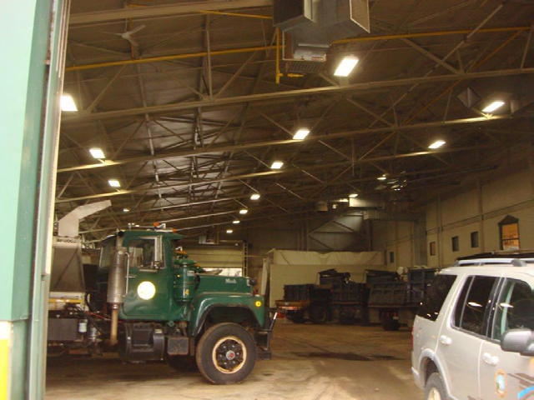
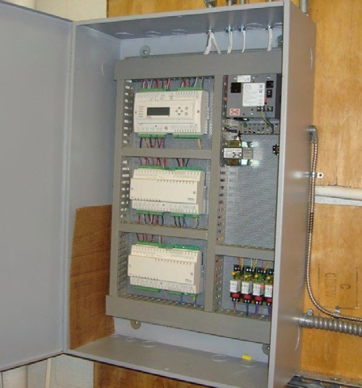
Green Communities Designation and Grant Program – the 86
Sudbury - New Lighting, HVAC & Lighting Controls, New Efficient Vehicle
NSTAR rebates for lighting and/or HVAC or lighting controls in 6 schools and 4 municipal facility buildings
11
Notes:
$136,238
Annual Savings = $45,559

Slide 12
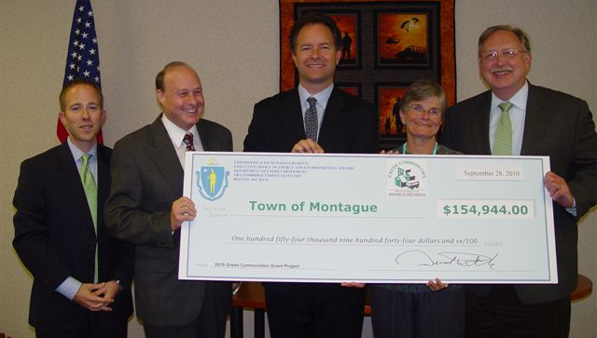
Why Become a Green Community?
Economic Benefits – reduce energy consumption, reduce energy costs
Environmental benefits – reduce greenhouse gas emissions
Recognition – Sustainability leader in the Commonwealth
Recognized on DOER website, printed materials
Recognition sign placed in each community
Grants - to become even greener $$

Slide 13
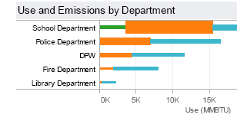
FREE online tool for MA cities, towns, RSD & WTP
Provides:
Automated electronic download of utility data
All energy costs and accounts in one place
Standard and custom reporting
One tool to do it all:
Benchmark: track energy use by town, department or building
Identify: least efficient buildings for efficiency action
Measure and verify: energy use trends by building over time
Notes:
Inform decision making around energy, before can make any decisions, need data, need to know what you are consuming.
Online tool, available at now cost
Automatic download of IOU data, user-friendly
Looking toward creating a MA benchmark – how does my school compare to simlar schools?
Criteria 3 – establishing baseline

Slide 14
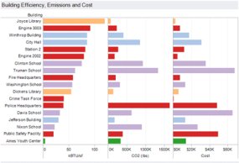
To date more than 400 individuals in more than 200 towns trained to use MassEnergyInsight to benchmark and monitor ongoing energy use, costs, and emissions
Notes:
More than half of all towns

Slide 15
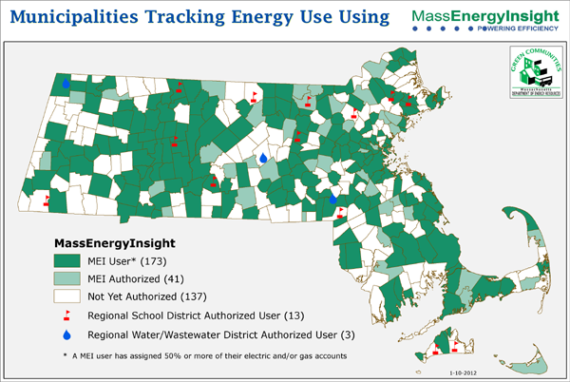

Slide 16
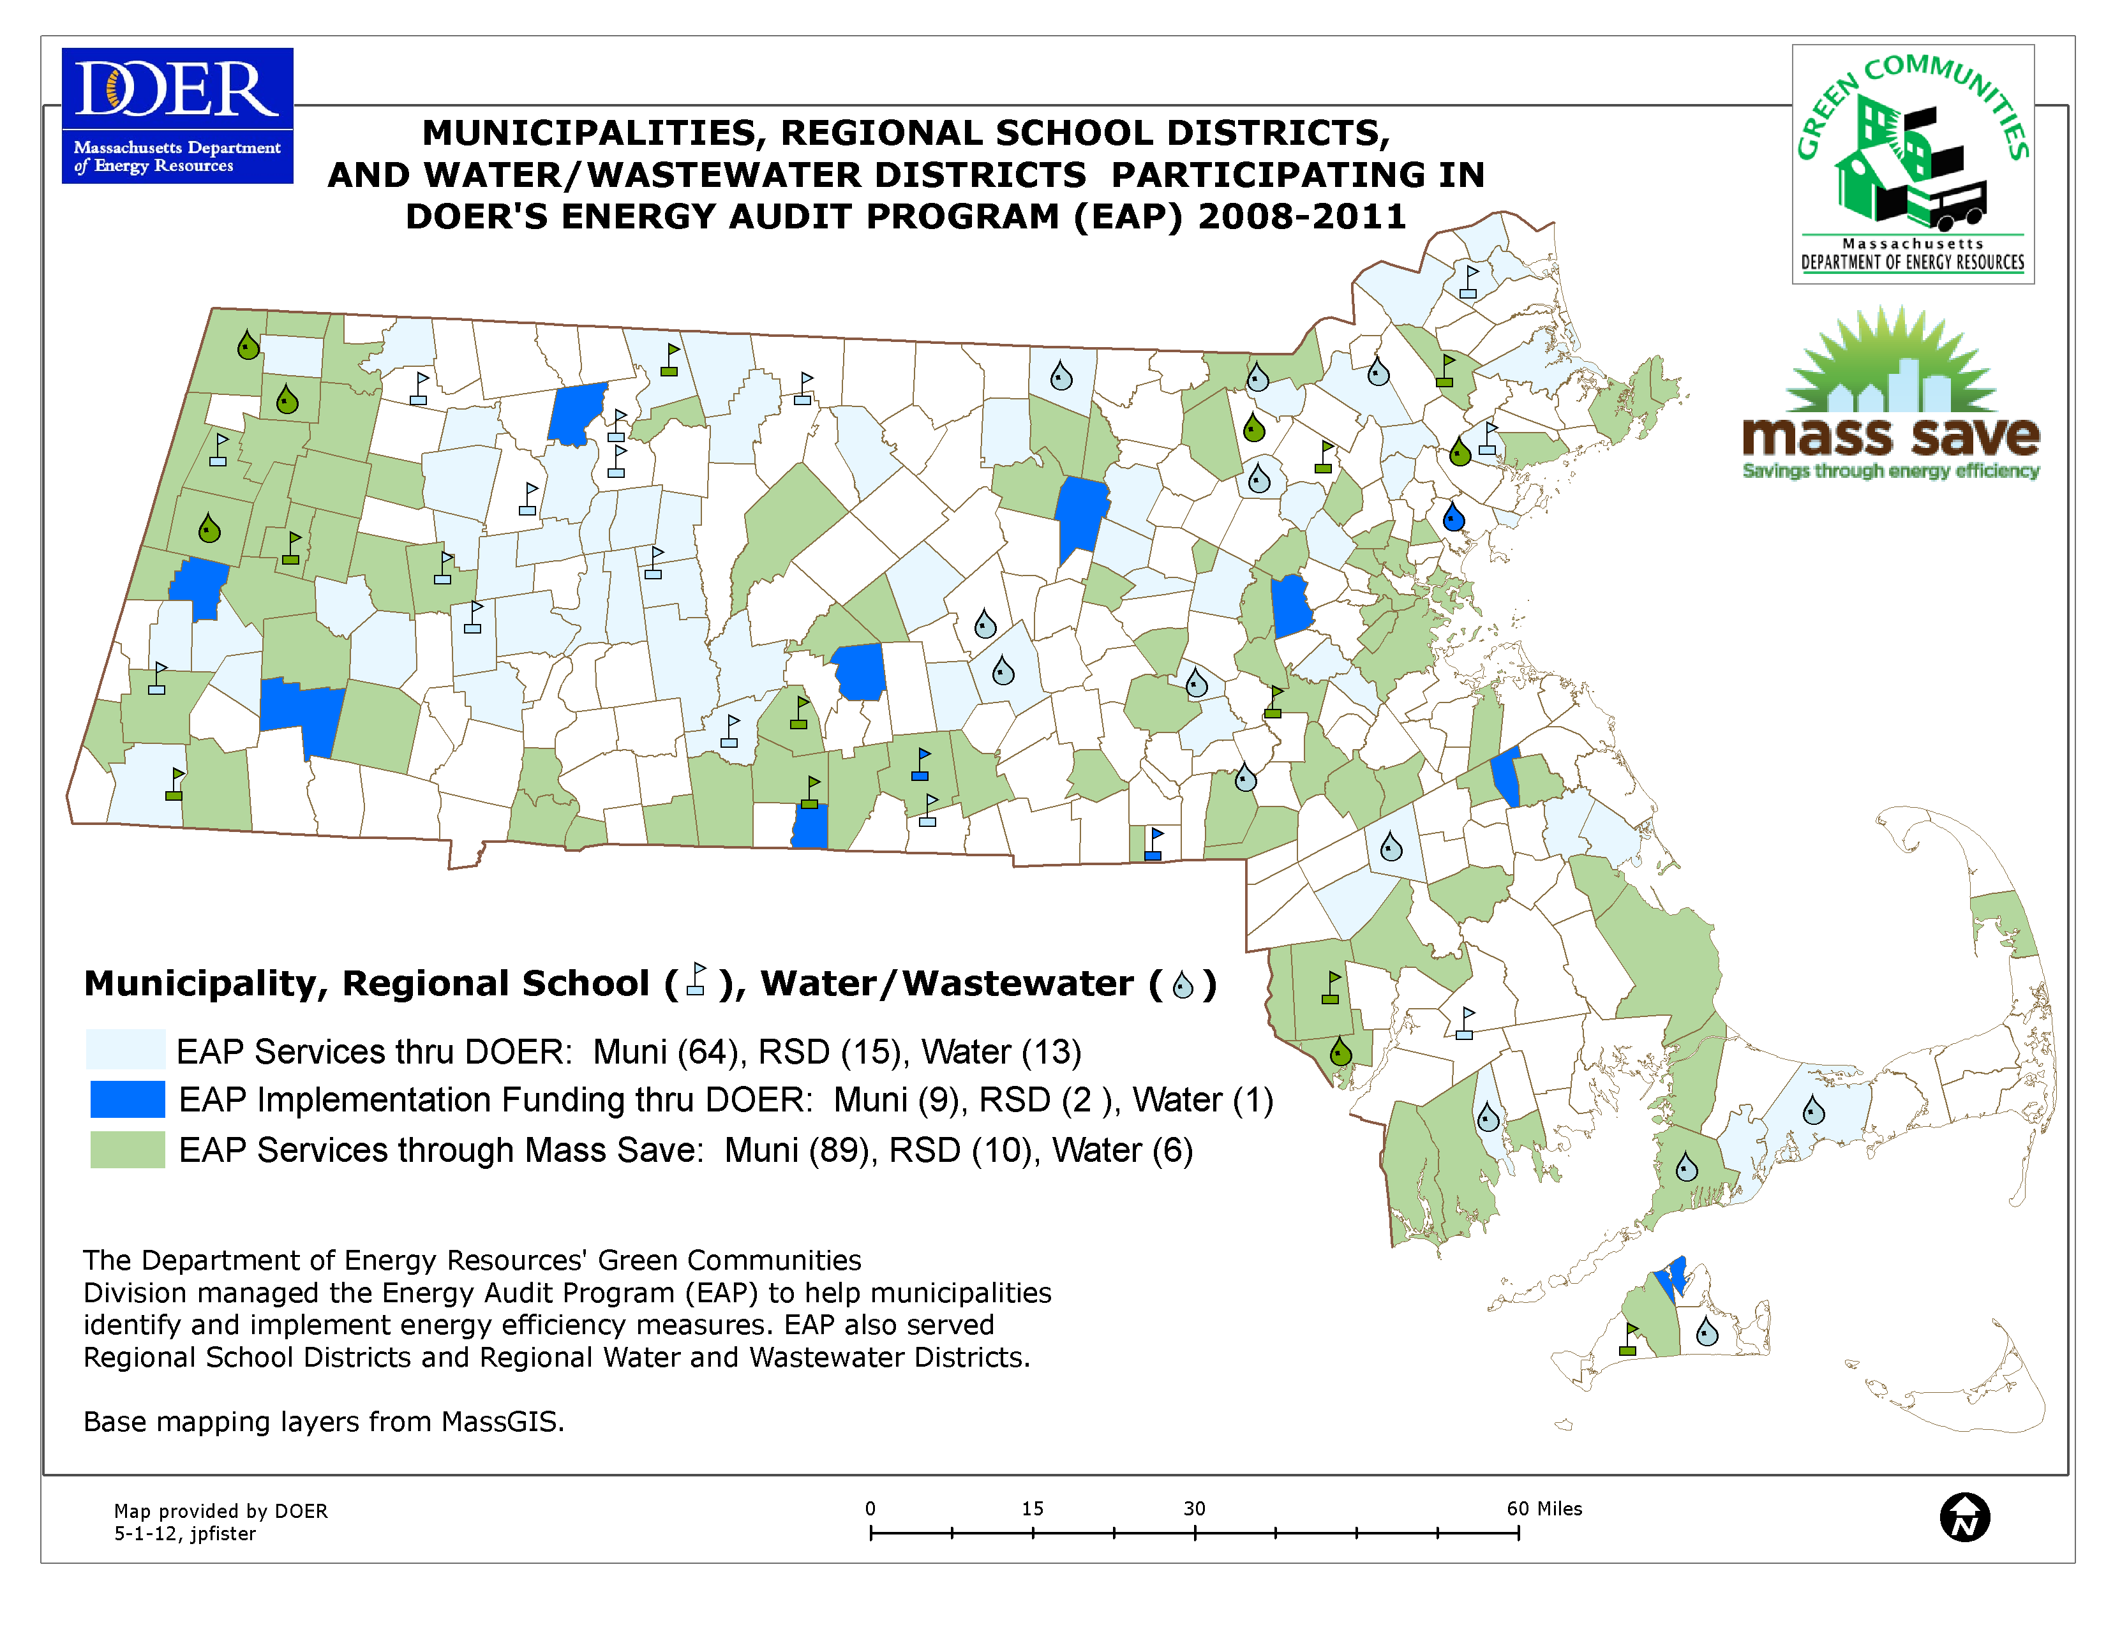
Municipal Energy Efficiency - EAP
Helping municipalities, school districts, water and waste water districts identify and implement energy efficiency measures
Notes:
Partnership with PAs
GCA, utilities have significant goals they must meet for EE along with $$ to do so, municipalities provide opportunity

Slide 17
Energy Management Services Assistance – MGL c25A sections 11C and 11i
Also known as Energy Savings Performance Contracting
Provide a guide, model RFR/RFQ and model contract documents
Review bid documents & contracts
Educate and guide communities through the process
Contact: Eileen McHugh at eileen.mchugh@state.ma.us,
617-626-7305
Notes:
Massachusetts has a mature ESPC market, with 160 cities, towns, or regional school districts (both municipal and regional technical schools) having issued solicitations.
Sixty-four of the 160 awarding authorities have selected an ESCO.
Thirty-two have reported energy cost savings of $10.7 million per year.
Total investment is $178 mil.
The state has blazed the trail (nationally) for aggregated regional projects such as CVEC using this process; other regional projects include FRCOG, PVPC, MVPC, MAPC.
Website has a wealth of information

Slide 18
Green Communities Division – What’s New?
Massachusetts Municipal Energy Group
Made possible by a grant from the Green Communities Division
What
Web-based community
Managed by MMA
Goal
Help Commonwealth's cities and towns exchange information and knowledge to reduce local energy use and carbon footprint
Who
Mayors, town managers, boards of selectmen, building inspectors, school superintendents, school board members, members of energy or sustainability committees . . . and others
MMA CONTACT: Victor Nascimento, vnascimento@mma.org
Notes:
Who: and others that work for the benefit of munis’ energy activities – employees and volunteers. Not a full launch, will do soon

Slide 19
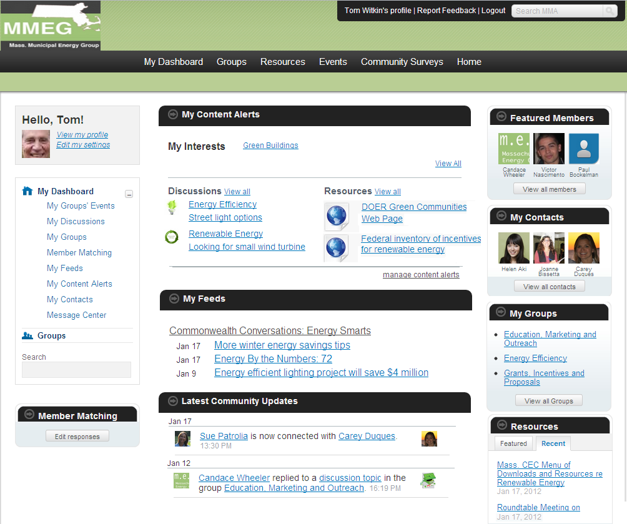
Massachusetts Municipal Energy Group
Made possible by a grant from the Green Communities Division
Notes:
The Here’s an idea of its social networking contents, and look and feel.

Slide 20
Clean Energy Results Program
DEP/DOER partnership
Goal: To reduce regulatory and other barriers to clean and energy efficient development across the state
Sample Activities:
DEP/DOER Clean Energy Support Teams, similar to that provided for PV on Landfill Development
Create fact sheets and conduct outreach through workshops, seminars, other public forums
Conduct studies to assess clean energy potential, e.g. Anaerobic Digestion on public lands.
Contacts:
Green Communities Regional Coordinator –
Joanne.bissetta@state.ma.us
Catherine Finneran, MassDEP Clean Energy Director catherine.finneran@state.ma.us
Notes:
For both commercial and private

Slide 21
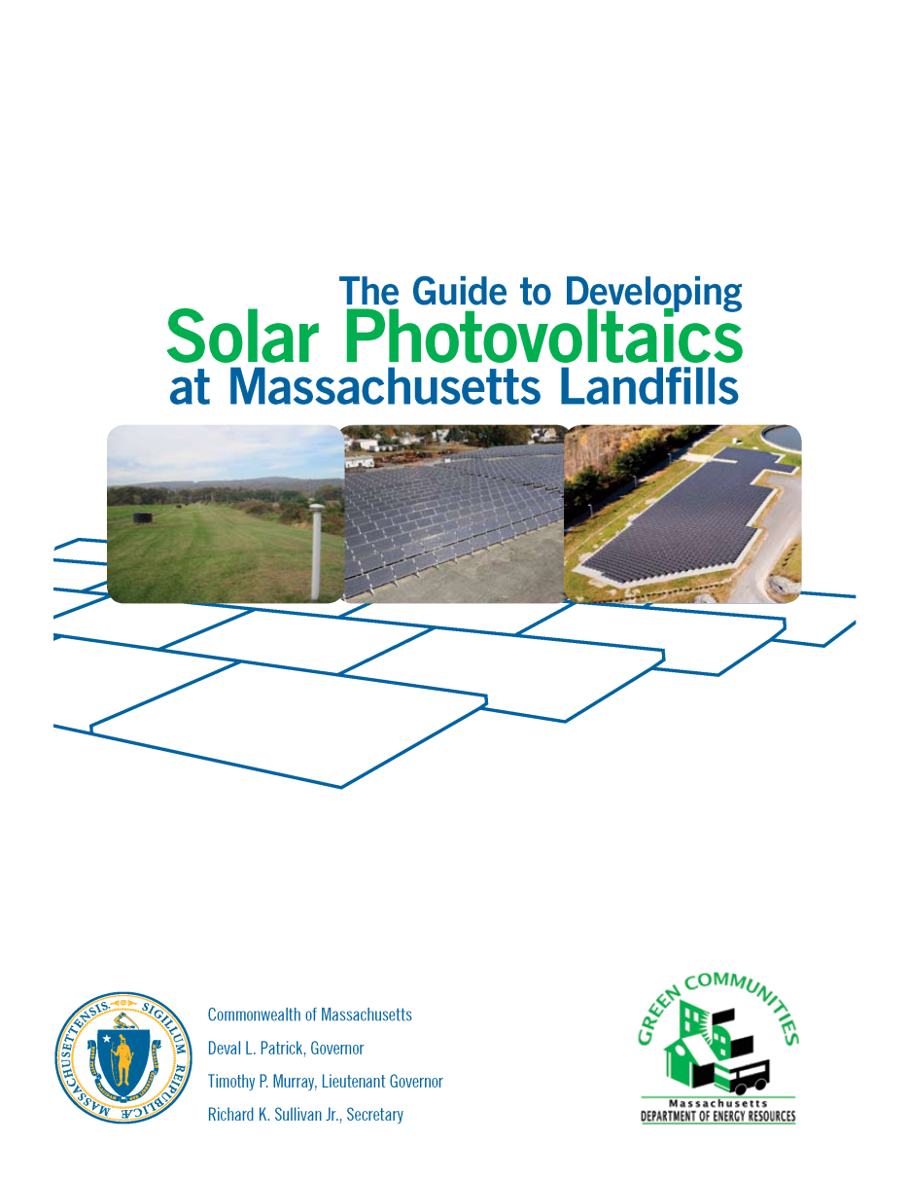
Green Communities Division – What’s new?
More Guidance Materials!
PV on Landfill Handbook
More webinars, posted on website
April 19th, Net Metering
More to come!
Notes:
Posted on our website today!
Net Metering – close to 300 people participated

Slide 22
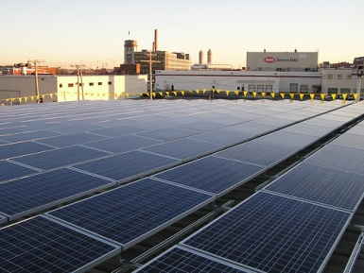
Green Communities Division – What’s new?
U.S. Department of Energy SunShot Award:
Mass Solar – Making it EZ
DOE SunShot Rooftop Solar Challenge to
Induce Market Transformation
Award: $566,354
Develop model local permitting process, including guidance for structural review
Develop model zoning bylaws
Design community solar financing model
Partners: Massachusetts Clean Energy Center (MassCEC); City of Boston; City of Cambridge; Town of Harvard; Town of Hatfield; Town of Winchester; Solar Energy Business Association of New England (SEBANE); Massachusetts Board of Building Regulations and Standards (BBRS); Massachusetts Development Financing Agency (MassDevelopment)

Slide 23
Green Communities Division – What’s new?
More Opportunities for Green Communities!
Competitive Grant Program
Application Deadline March 30th
22 applications under review
$2M available in total, max award of $250K
Annual Program in Fall, pending available funds
Solarize II
13 applications from 17 communities
selected
RFP issued for installers
Solarize I in 4 communities – increased total installations from 29 to 162
Notes:
Solarize for both commercial and private, systems up to 15 kW, Comm Solar II Rebate, first 5 kW; tech asst provided. Rebate is .40/kw with adders to get up to .85, Mass components/moderate income.
Harvard the winner – from 13 systems to 75

Slide 24
What Can YOU Do?
Organize an Energy Committee
Contact your Regional Coordinator
Get trained on Mass Energy Insight
Contact your utility about an audit
Talk to other municipalities in your region
24

Slide 25
Contact Information
Meg Lusardi, Director
meg.lusardi@state.ma.us
Joanne Bissetta, Regional Coordinator
(978) 694-3315
joanne.bissetta@state.ma.us
Email updates via listserv – Sign up by sending an email to:
join-ene-greencommunities@listserv.state.ma.us
www.mass.gov/energy/greencommunities

