Slide 1
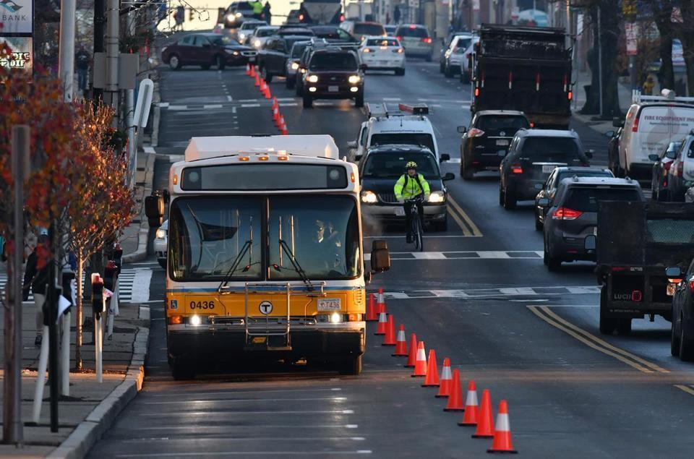
Tactical Transit:
Pop-up Bus Lanes and Do-it-Yourself Transit Improvements
Photo: Boston Globe

Slide 2
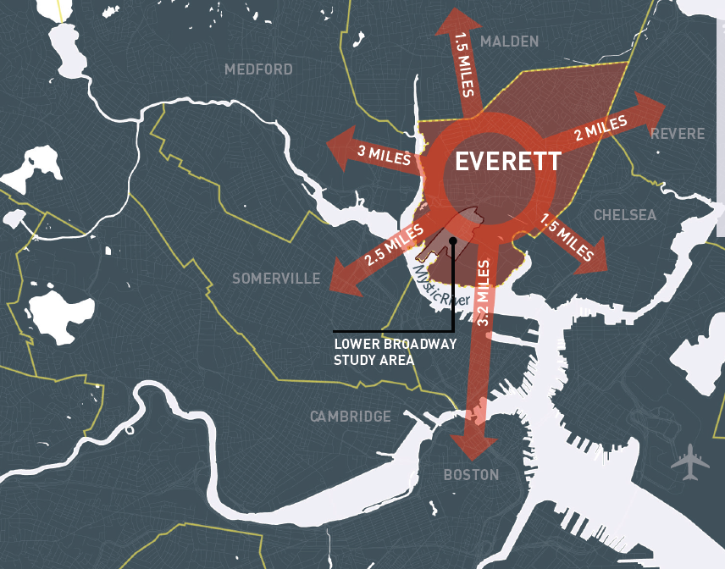
City of Everett Snapshot
Population: 45,000-50,000 (approx.)
Land Area: 3.4 Sq. Miles
Transit:
7 Bus Routes
15,000 Daily Boardings & Alightings
No Rapid Transit
No “Key” Bus Routes

Slide 3
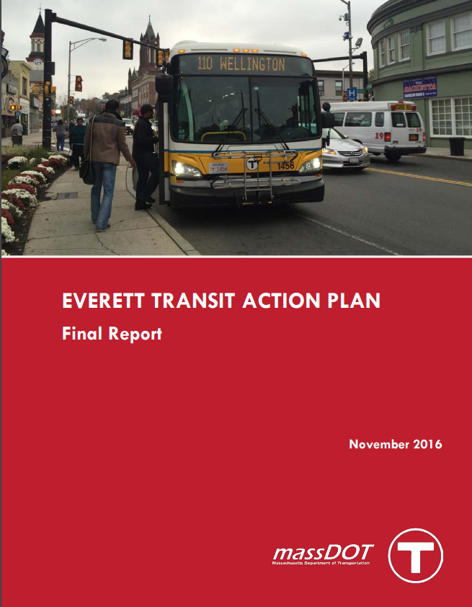
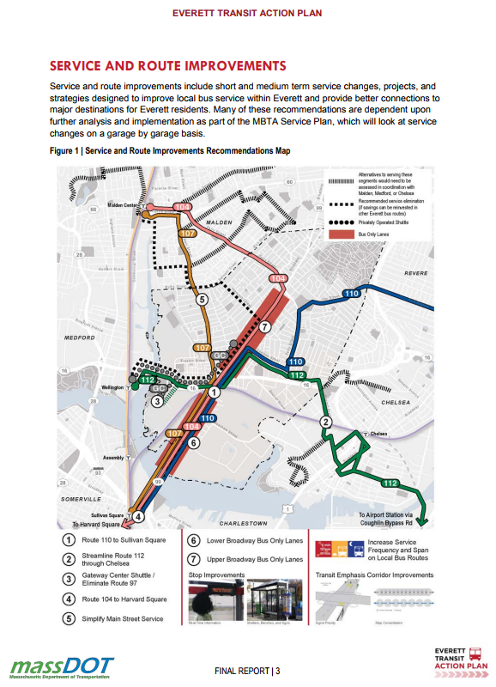
From study to action

Slide 4
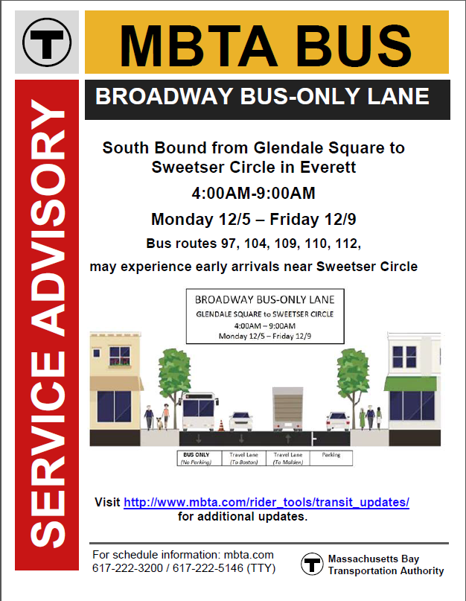
Coordination and Logistics
MBTA/MASSDOT

Slide 5
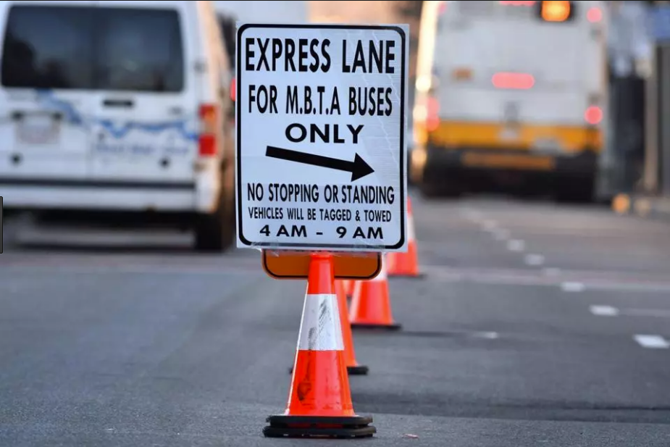
Coordination and Logistics
Everett DPW and Parking Enforcement
Photo: Boston Globe

Slide 6
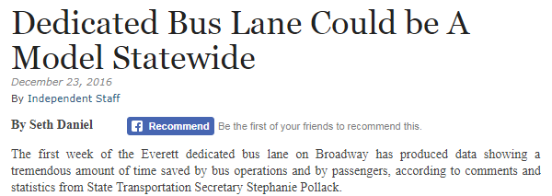
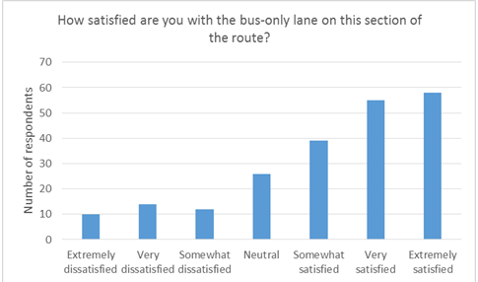
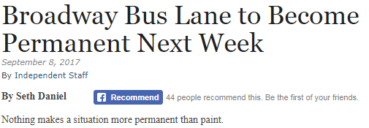
Coordination and Logistics
PRESS AND PUBLIC RELATIONS

Slide 7
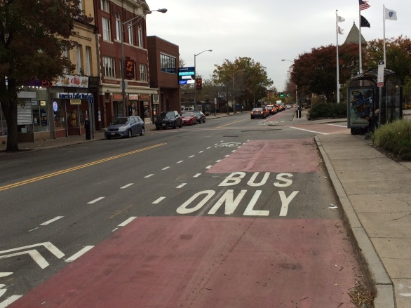
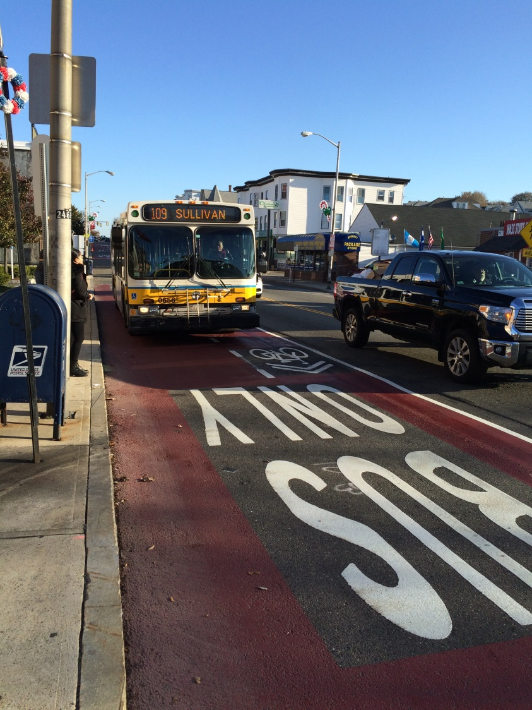
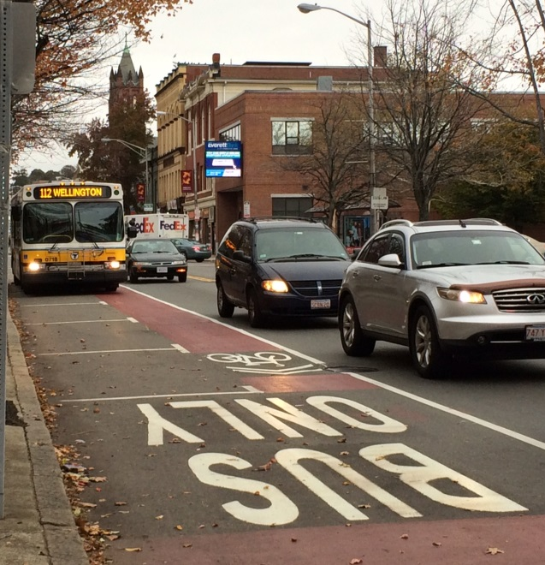
From Pilot to permanent

Slide 8
Takeaways
Pilot as a Public Process
Utilizing Existing Practices
Don’t Expect Perfection
Perception is as Important as Reality
Fringe Benefits to Other Modes
Enforcement

Slide 9
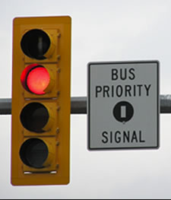
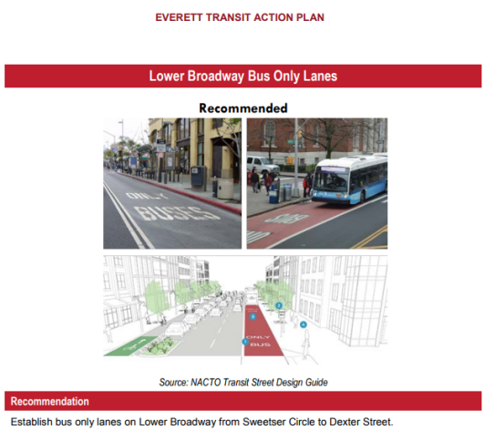
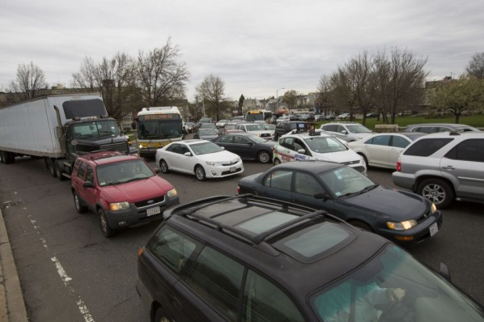
What next?
Signal Priority
Stop Improvements
Cooperation with State Partners
Expansion to Lower Broadway

