Slide 1
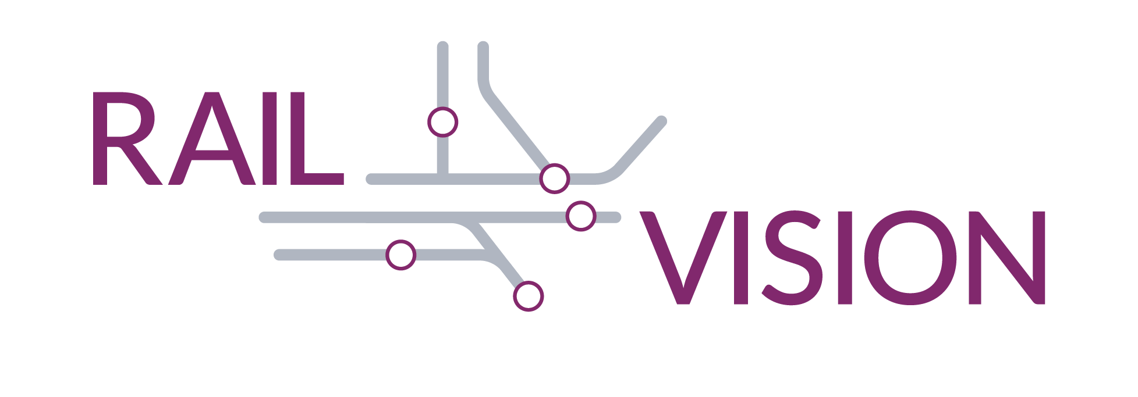
North Suburban Planning Council
April 11, 2019

Slide 2
Presentation Agenda
Project Overview
Seven Service Alternatives
Next Steps
2

Slide 3
Project Goal
Leverage the MBTA’s extensive commuter rail network to best meet the transportation and economic growth needs of the region.
Project Objectives
Match service with the growing and changing needs of the region
Enhance economic vitality
Improve the passenger experience
Provide an equitable and balanced suite of investments
Help the Commonwealth achieve its climate change resiliency targets
Maximize return on investment (financial stewardship)
3

Slide 4
Where We Are Now
We are here
Ideas Developed
Qualitative Screening: Do concepts meet one or more of the Objectives? If yes…
Long List of Concepts
Concept Evaluation: Uses sketch models to evaluate ideas against Objectives
7 Service Alternatives
Alternatives Evaluation: Uses traditional ridership and operations analysis models
The Vision
4

Slide 5
Advisory Committee
22 member Advisory Committee represents diverse MBTA service area perspectives and provides informed advice to agency leadership
Local, state and federal elected officials, transportation and business organizations, transit and advocacy groups
Members review information and provide advice to MassDOT and MBTA at key milestones
Members have attended five meetings and provided comments and concerns
5

Slide 6
What We Heard – Riders and Non-Riders
Keolis surveys Commuter Rail riders annually – most recently in February 2018
4,000 individual comments on topics ranging from wi-fi to reliability to increasing seat capacity
Results showed that most respondents are likely to continue to use Commuter Rail in the future
Fare promotions and special ticket deals were well rated
Rail Vision developed a survey for non-riders to ask what factors affect their decision to drive versus switch to rail
Nearly 3,000 non-riders completed the survey
Closed March 29, full results will be posted on our website
Lack of convenience was a bigger barrier than cost
6

Slide 7
Elements Covered in Rail Vision Service Alternatives
Alternatives aim to reduce travel time, increase service frequency, and improve system connectivity based on results from the first phase
Alternatives to consider mix of service and investment elements:
New vehicle technology
System electrification
High level platforms
Station typology and frequency
Double and triple tracking
Facility needs and expansions
Station locations
More express service
Span of service
Transfer hubs
Operational feasibility
Order of magnitude operating and capital costs
7

Slide 8
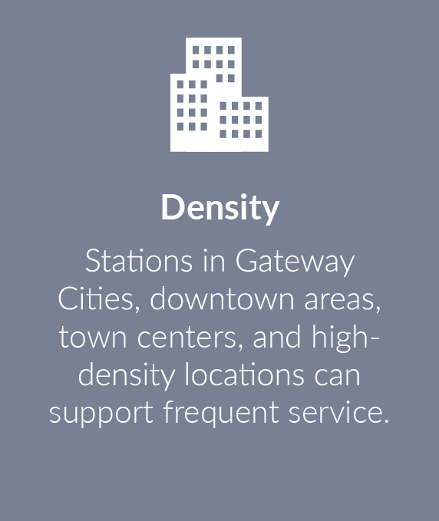
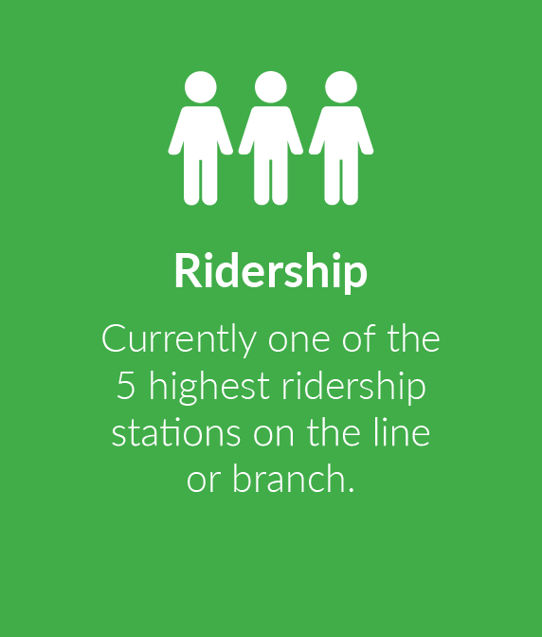
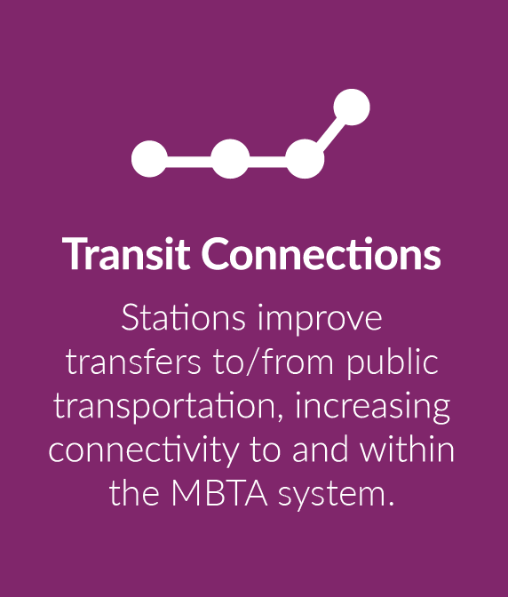
Station Typologies
Alternatives will consider a mix of service and investment elements to provide higher levels of service to:
Key stations, due to their density, regional access, and transit connectivity
Inner core stations, in and around Boston
Outer stations, outside the Inner Core
Typical Characteristics of Key Stations
8
Notes:
Anticipating questions

Slide 9
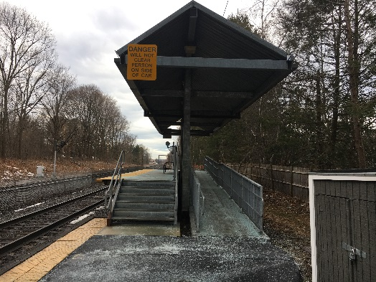
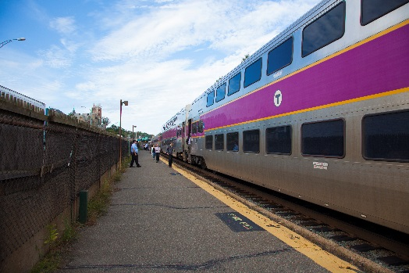
High Level Platforms / Accessibility Upgrades
Existing system has a mixture of platform types:
High-level, with a level boarding surface
Mini-high, with a portion of the platform at a high-level to provide a level boarding surface
Low-level, requiring use of stairs or ramp
High-level boarding and powered doors on trains could reduce dwell times at stations
The project will assume different levels of platform upgrades across the alternatives to test a range of capital improvements.
9
Notes:
Anticipating questions

Slide 10
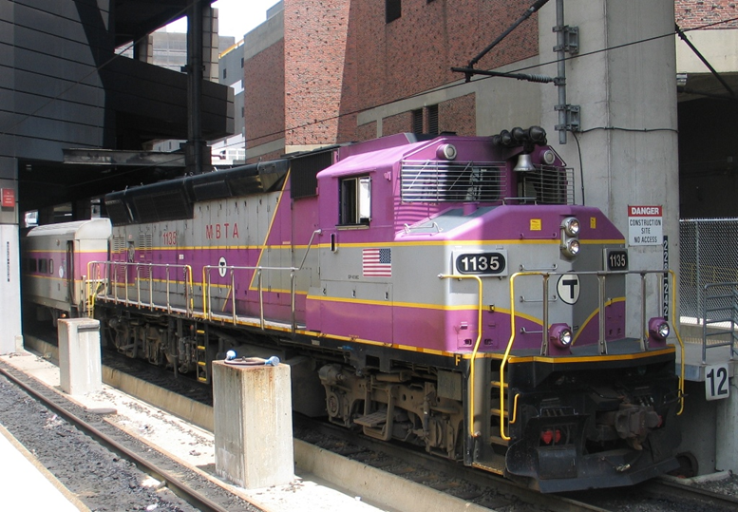
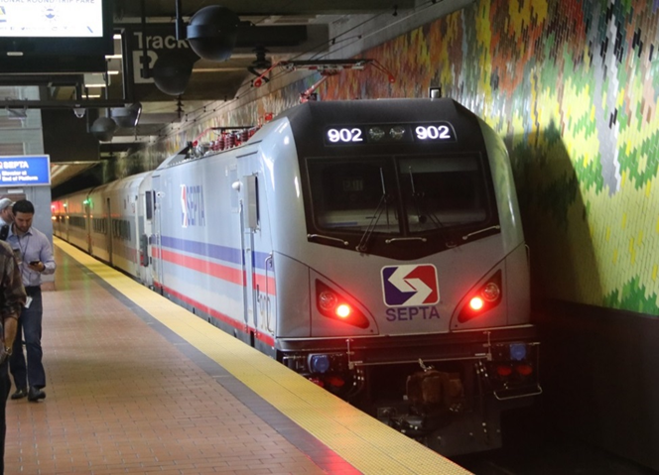
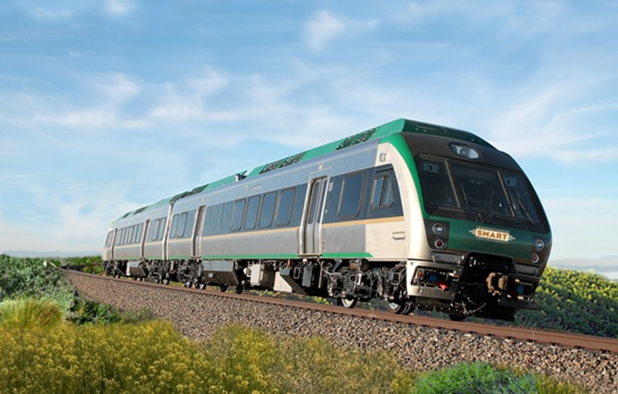
Electrification and Vehicle Technology
Some alternatives will consider full or partial system electrification
Vehicle options include locomotives paired with coaches or multiple units (multiple self-propelled vehicles) – either can be diesel, electric, or dual mode
Vehicle powered by electricity produce lower emissions
Multiple unit trains can provide travel time savings
Procurement and O&M costs vary across the range of vehicle types
10

Slide 11
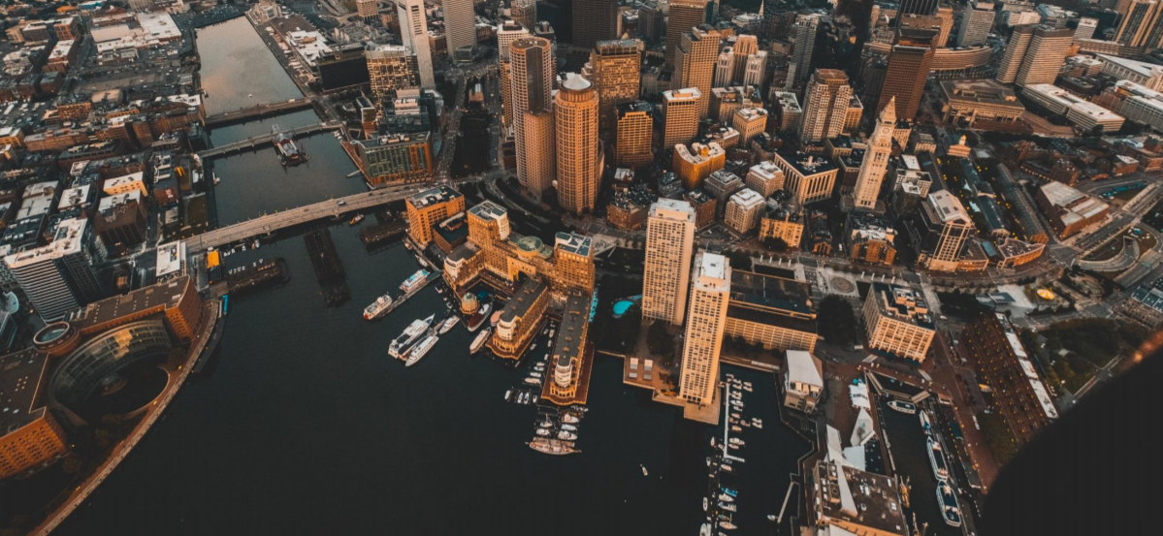
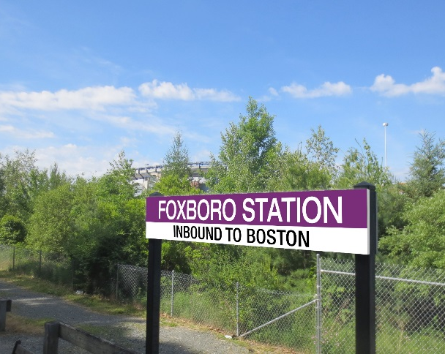
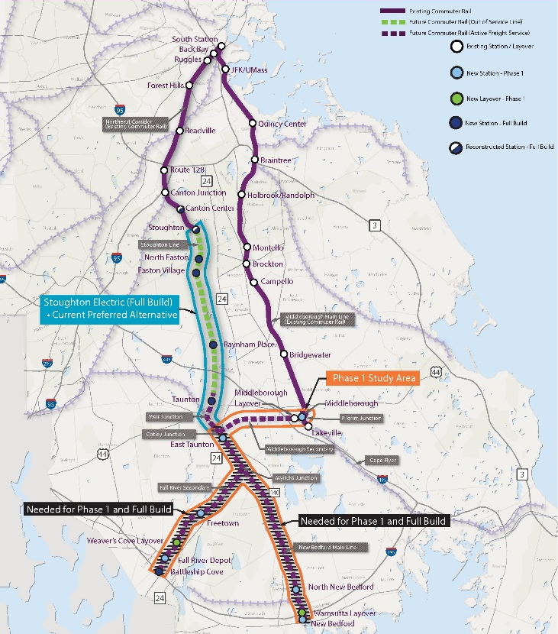
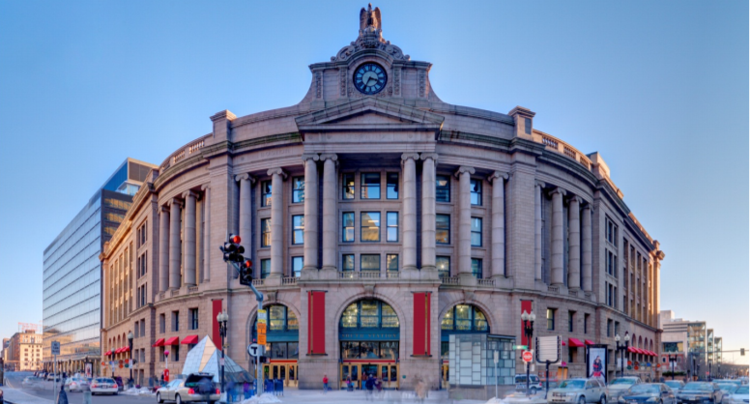
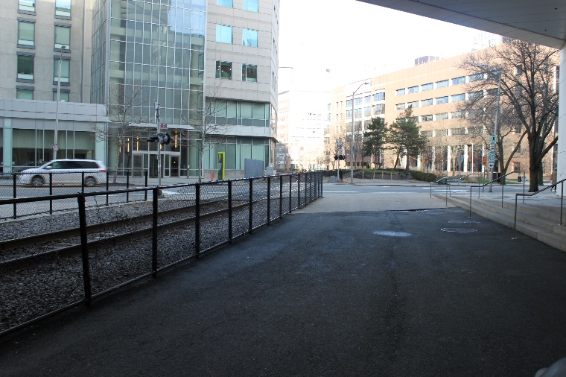
Terminal Capacity and System Expansions
Examples include North South Rail Link, South Station Expansion, South Coast Rail (Phase 1 and Full Build), Foxborough, Grand Junction
11

Slide 12
Seven Rail Vision Service Alternatives
Handouts provide more detail on alternatives:
Alternative 1: Optimize Existing System
Alternative 2: Regional Rail to Key Stations (Diesel)
Alternative 3: Urban Rail (Diesel)
Alternative 4: Urban Rail (Electric)
Alternative 5: Regional Rail to Key Stations (Electric)
Alternative 6: Full Transformation
Alternative 7: Hybrid System

Slide 13
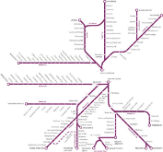
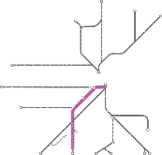
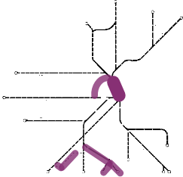
Comparing Alternatives
1: Optimize Existing System
2: Regional Rail
to Key Stations (Diesel)
3: Urban Rail
(Diesel)
4. Urban Rail
(Electric)
5. Regional Rail
to Key Stations (Electric)
6. Full
Transformation
7. Hybrid System
Typical Frequency
(Peak/Off-Peak)
Key Stations
30/60
15/15
30/60
30/60
15/15
15/15
30/60
Inner Core
30/60
30/60
15/15
15/15
30/60
15/15
15/30
Outer Stations
30/60
30/60
30/60
30/60
30/60
15/30
30/60
Fully Accessible High-Level Platforms
Key Stations
Existing or Programmed Upgrades Only
✓
-
-
✓
✓
✓
Inner Core
-
✓
✓
-
✓
✓
Outer Stations
-
-
-
-
✓
-
Electrification
Major Expansions

Slide 14
Next Steps: Alternatives Evaluation
Develop robust ridership estimates for all 7 Alternatives using the CTPS Travel Demand Model
Model operations, infrastructure and capital costs with Rail Traffic Controller (RTC) modeling tools
Identify potential land-use and demographic effects of one or more Alternatives using the Regional Dynamic Model (RDM)
Develop capital and operating cost estimates
Share results with Advisory Committee and public
14

Slide 15
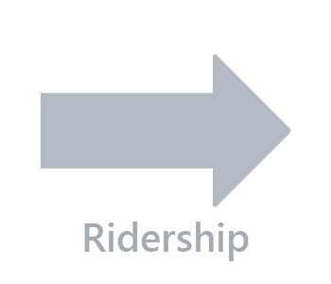
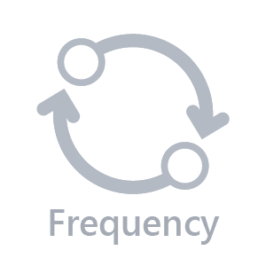
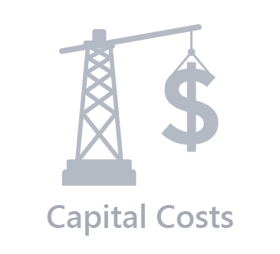
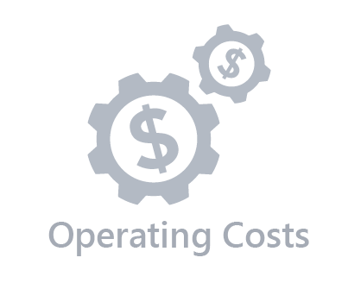
What the Alternatives Analysis Will Tell Us
15

Slide 16
Integrating Parking and Fare Policy
Parking Constraints
Test the effects of un-constraining parking supply at some stations, in some alternatives
Fare Policy Analysis
Work with the MBTA team conducting a network-wide analysis of fare policy, which will identify and evaluate potential alternative fare structures
Test the effects of implementing a different fare structure in at least one alternative
16

Slide 17
Project Contacts & Website
Scott Hamwey
Manager of Transit Planning
Scott.Hamwey@state.ma.us
857-368-9800
Project Website
www.MBTA.com/railvision
17

