Slide 1
Bus Shelters and Amenities
September 18, 2019
MAPC

Slide 2
Agenda
Public Engagement
Learnings
Program Goals
Timeline
Municipal Partnerships

Slide 3
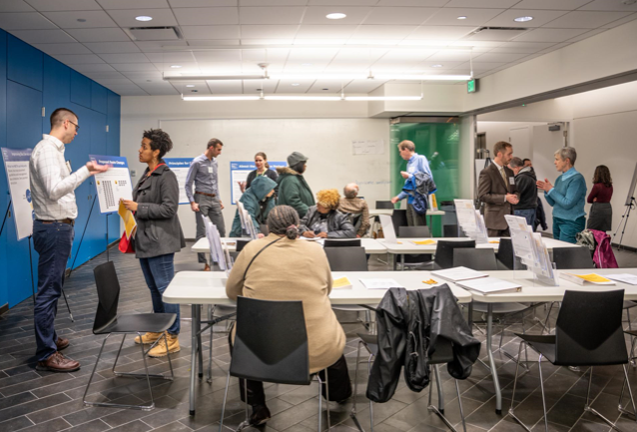
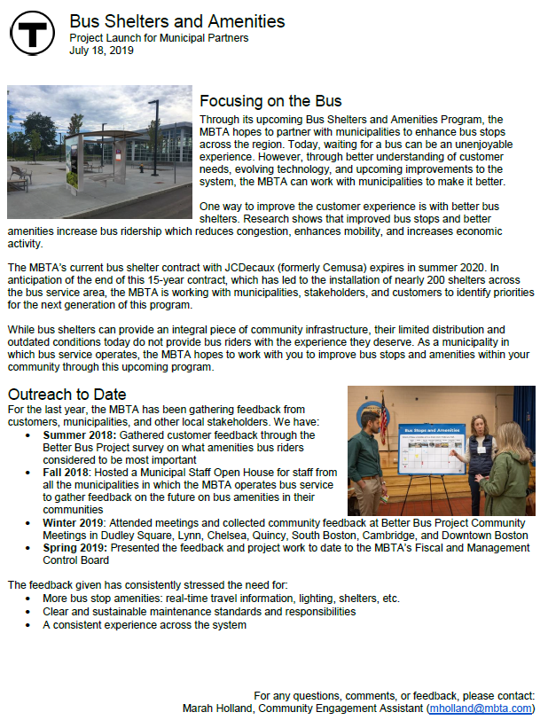
Public Engagement to Date
Summer 2018
Winter 2019
Spring 2019
Collected feedback from customers through the Better Bus Project on which amenities they considered to be most important
Attended and collected rider feedback at Better Bus Project Community Meetings in Dudley Square, Lynn, Chelsea, Quincy, South Boston, Cambridge, and Downtown Boston on how different amenities would improve their bus experience
Presented to the Fiscal and Management Control Board on the project work to date
Began conversations with municipalities
Fall 2018
Held a Municipal Staff Open House to gather feedback from municipal staff members on the future of bus amenities in their communities
Summer 2019
Began procurement process (qualification stage only)
Reached out to cities and towns with MBTA bus service about the upcoming program

Slide 4
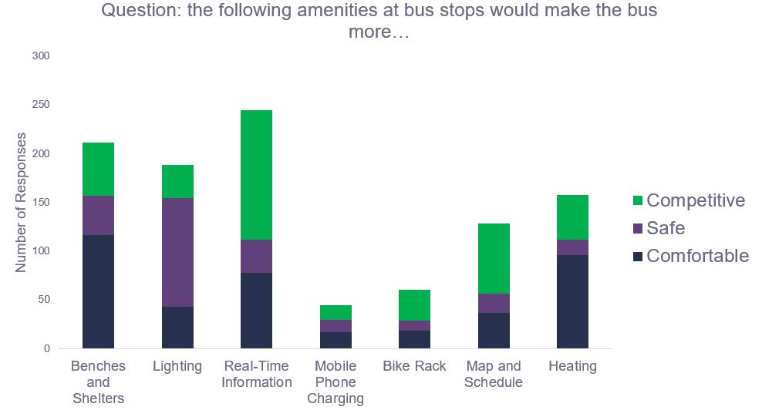
What have we learned?
Bus Shelters and Amenities are important for customers and communities
Studies, customers, and municipal staff have consistently told us that more and better shelters, seating, lighting, and real-time travel information would make the bus more appealing, comfortable, and feel safer
Question: How would the following amenities impact your experience of waiting for the bus?
More Appealing
Feel Safer
More Comfortable
Source: MBTA Better Bus Project Community Meetings. (2019).

Slide 5
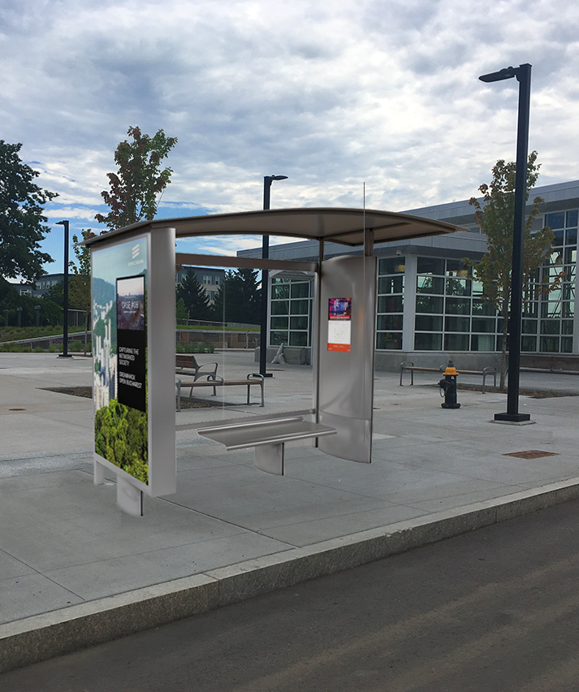
Program Goals
Provide better bus amenities for the 400,000 riders that use the service daily
Implement a human-centered network of amenities that meets customer and community needs
Deliver a consistent customer experience across the municipalities in which the MBTA operates bus service
Enforce ironclad and clear maintenance responsibilities to ensure the system is kept to a high standard

Slide 6
Timeline
First Phases of Procurement
Request for Letters of Interest released on July 17
Request for Qualifications released on August 1
Industry Conference held on August 15
Present Project Update to MBTA’s Fiscal and Management Control Board on September 23
Statements of Qualification due on September 26
Request for Responses (RFR) will be released this fall

Slide 7
Municipal Partnership Timeline
Partnerships with municipalities are vital to the success of the Bus Shelters and Amenities Program. Outreach and communication is at the core of our efforts.
July
August
September
Sent a project introduction to municipal staff members notifying them about the upcoming partnership opportunity
Shared information on bus stops to municipal staff to begin conversations about shelter location priorities
Beginning conversation with municipal partners on program needs and terms
Enter into partnership agreements
Fall 2019
Fall 2018
Held Municipal Staff Open House to gather feedback from municipal staff members on the future of bus amenities in their communities
If you haven’t heard from us, please be in touch!
Marah Holland mholland@mbta.com
Elizabeth Winters Ronaldson ewronaldson@mbta.com

