Slide 1
Public Forum #1 Draft Findings
For Discussion Only
December 5, 2019

Slide 2
Agenda
Forum Assessment/General Feedback (5 min)
Priority Rankings & Qualitative Feedback (5-10 min)
Working Group Takeaways (15-20 min)
Next Steps (5-10 min)

Slide 3
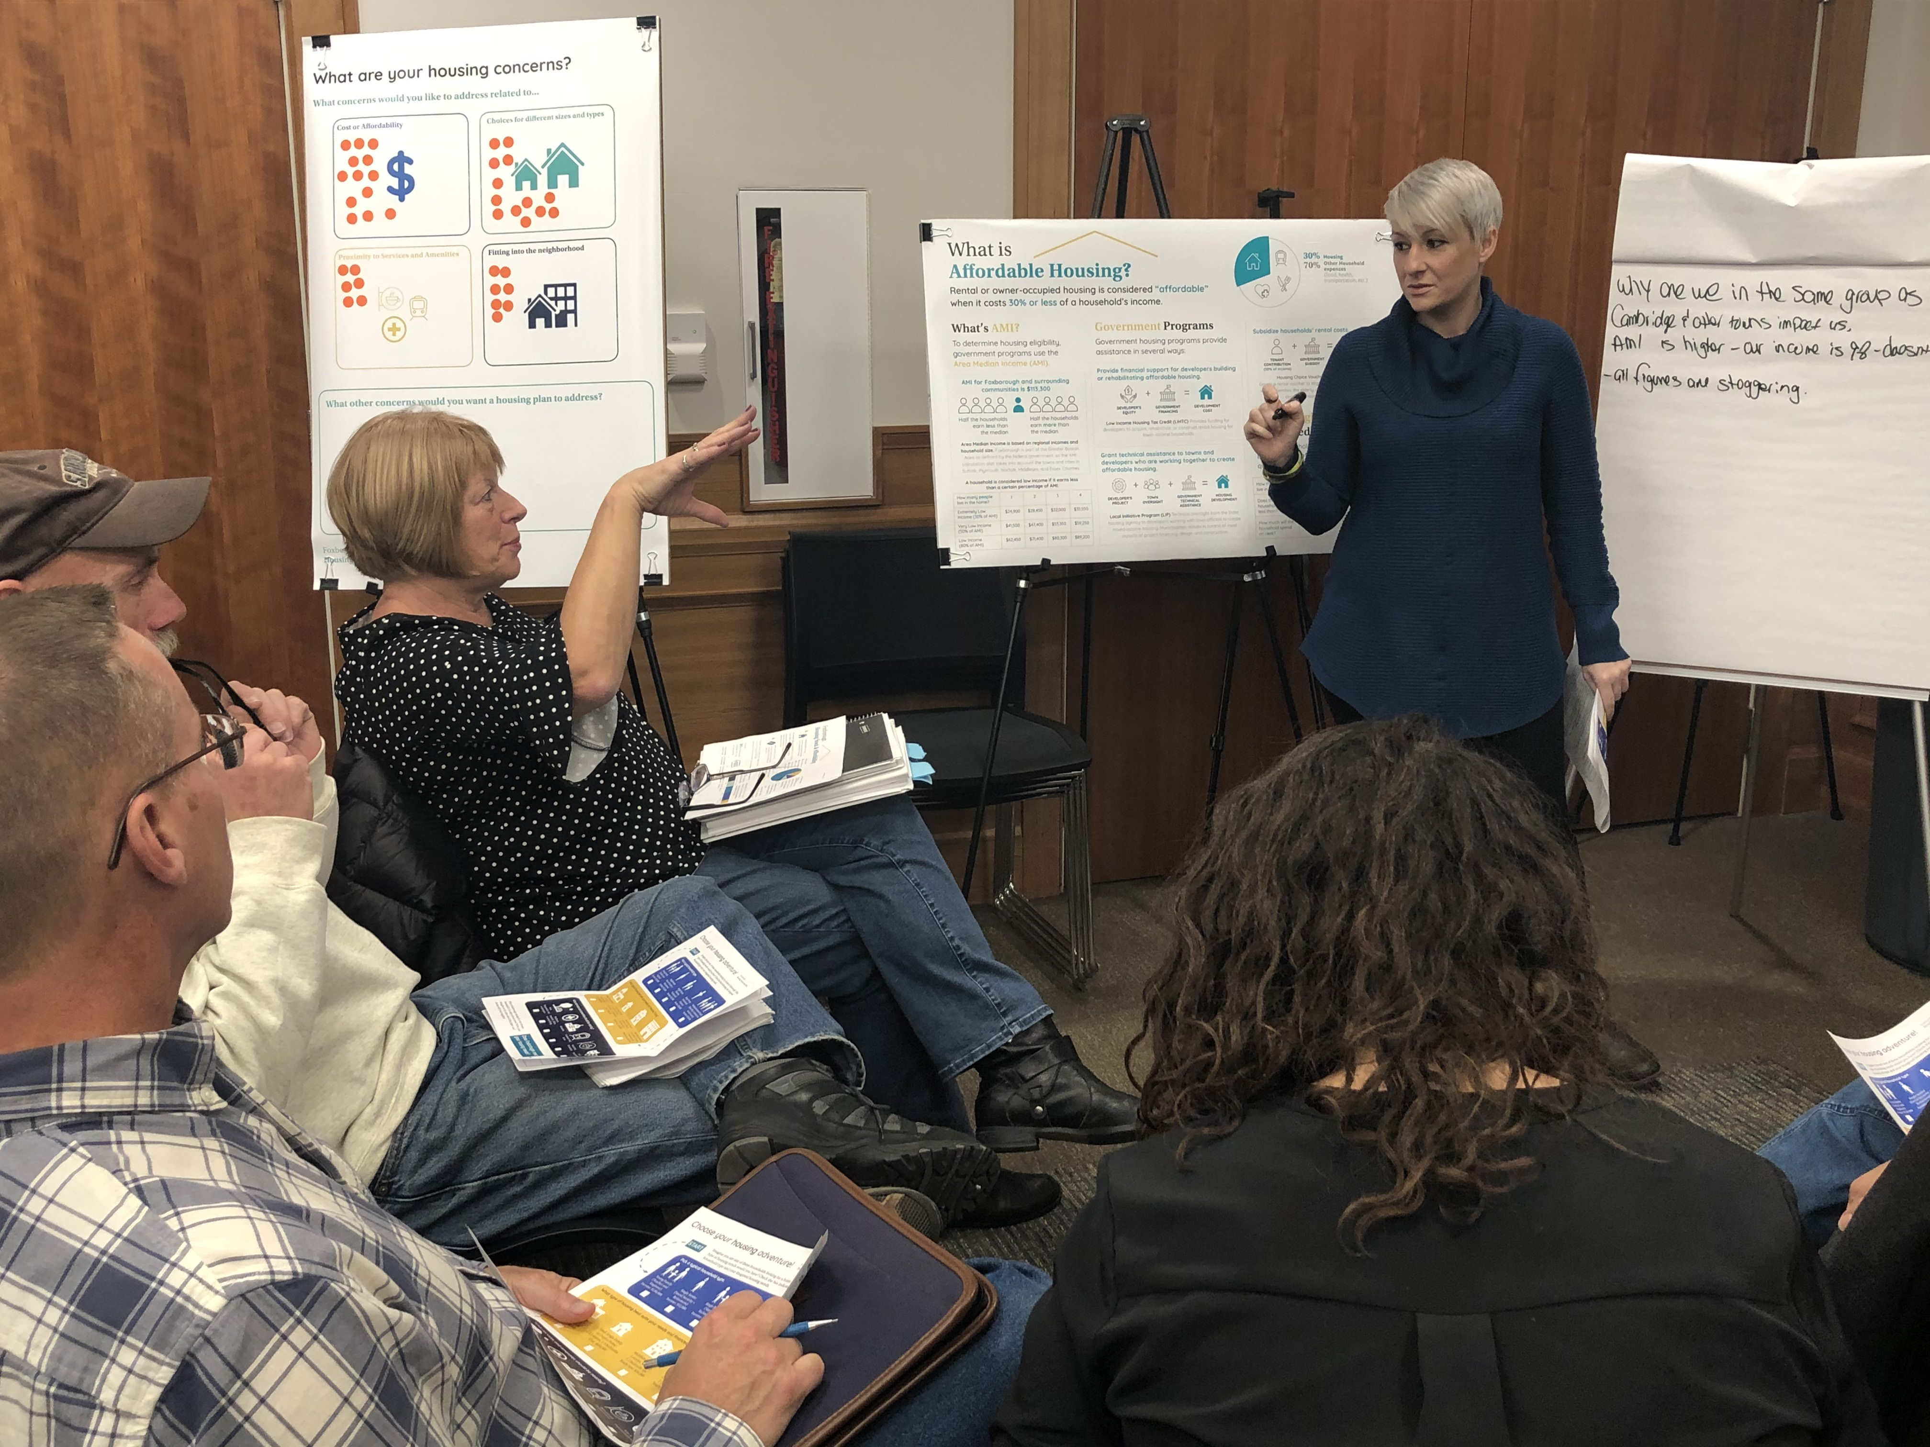
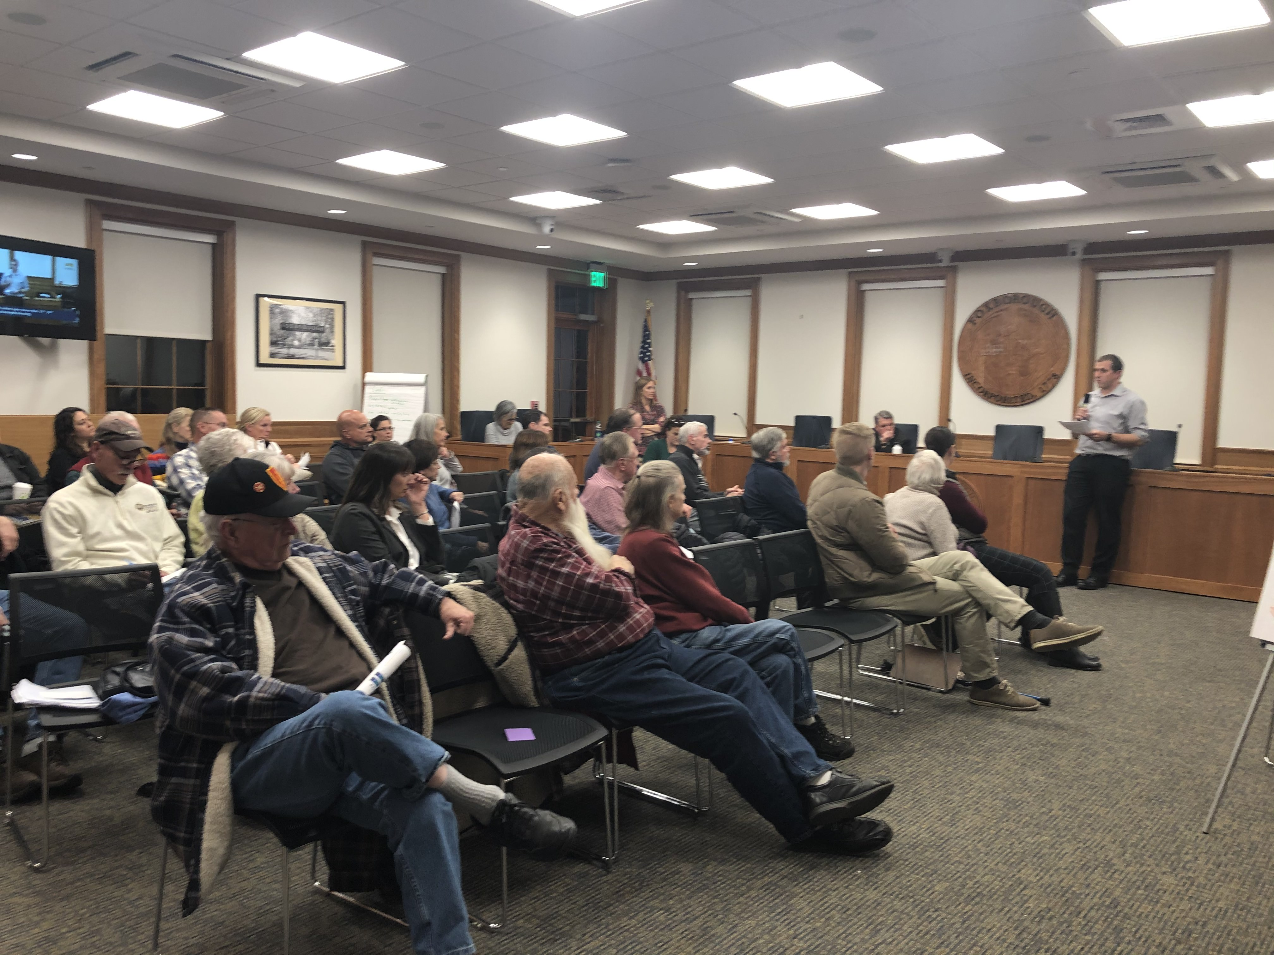
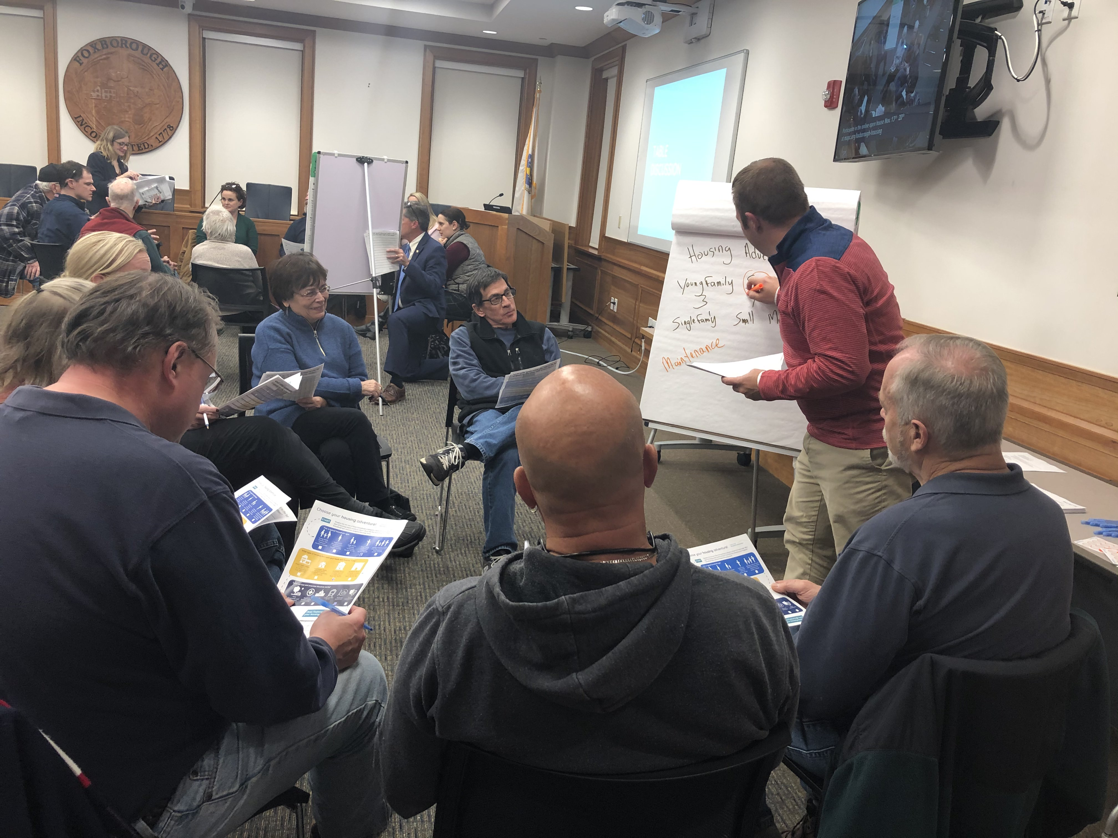
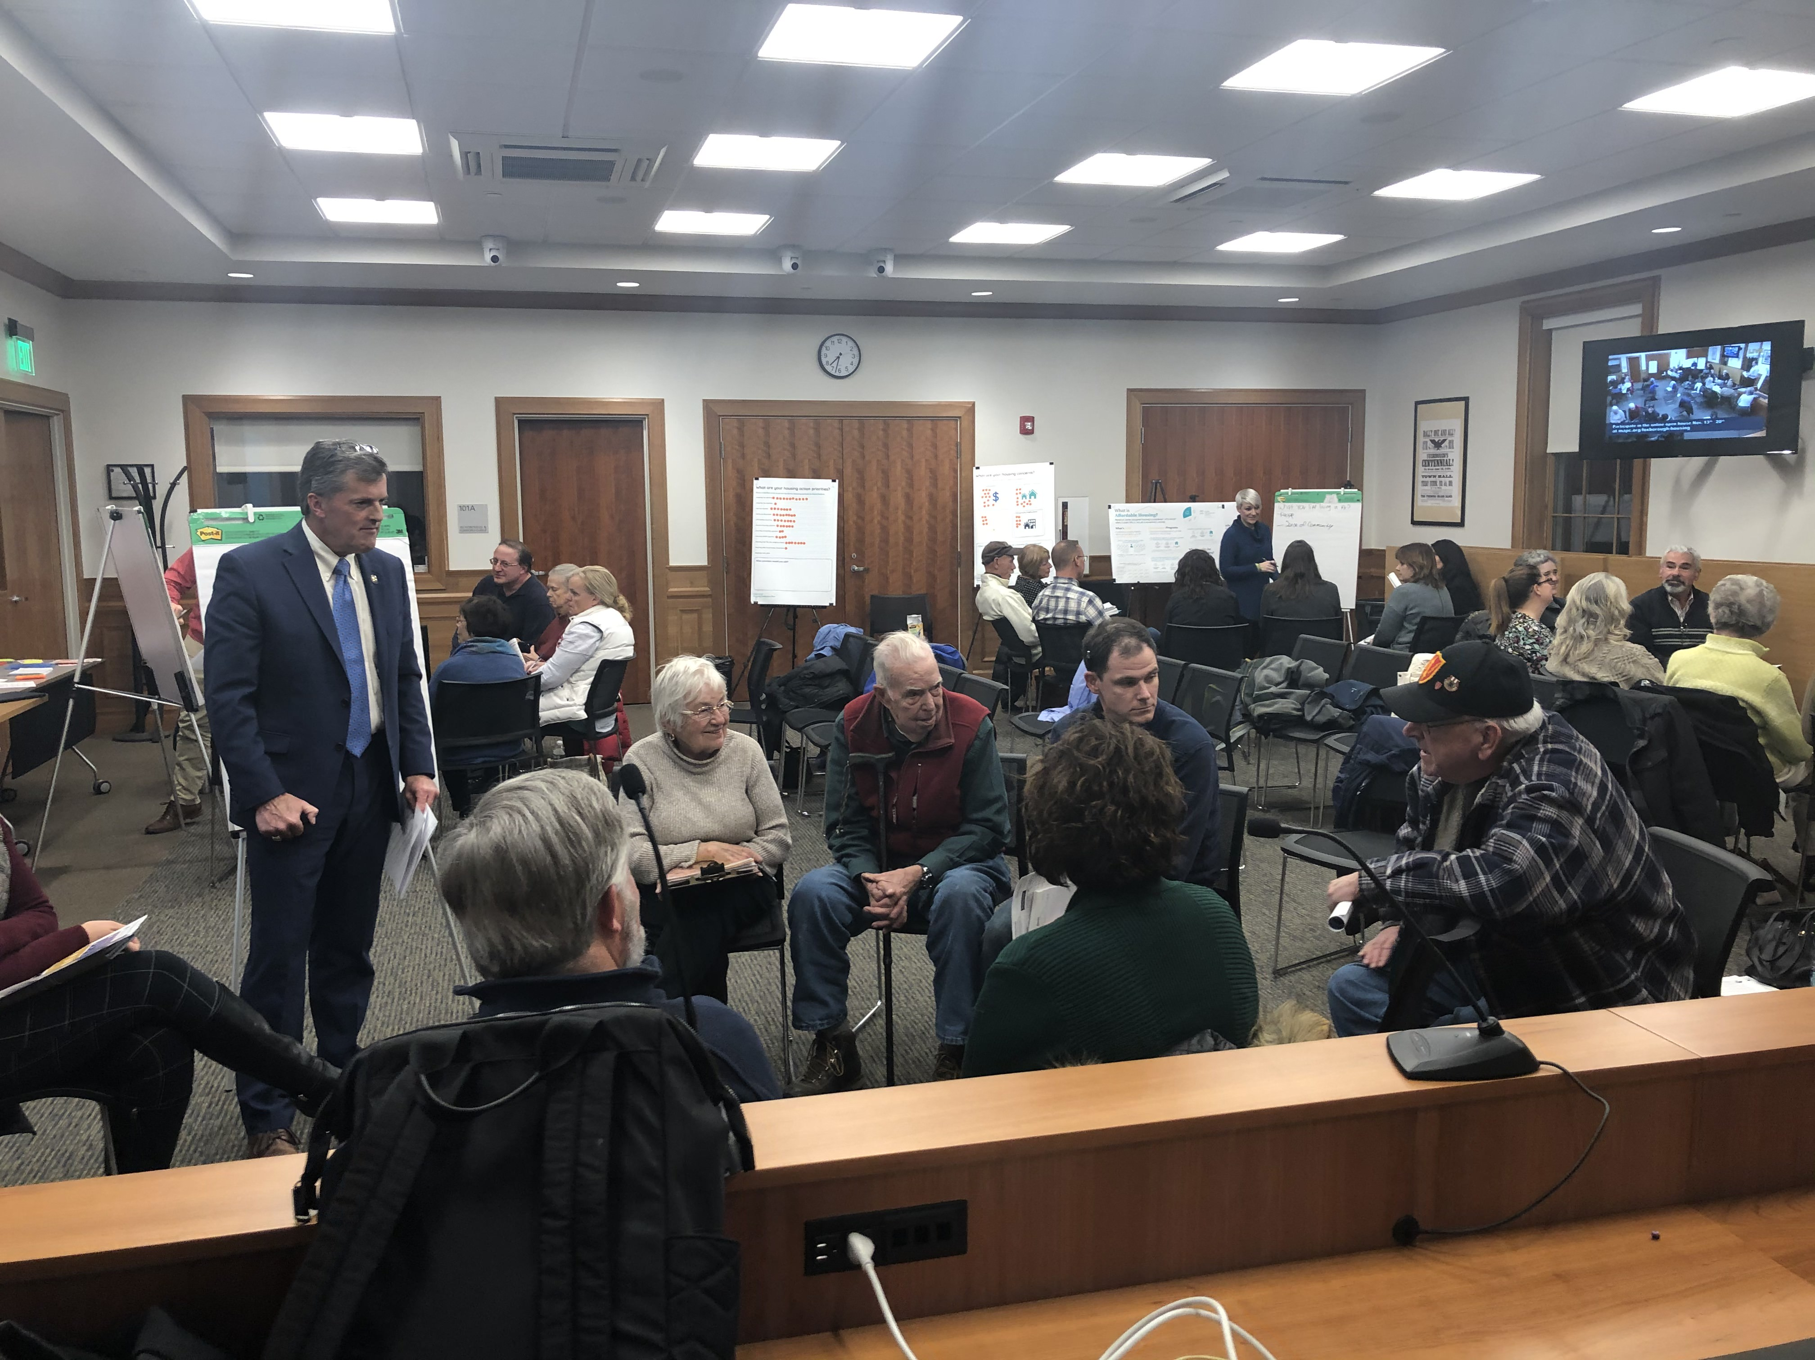
General Feedback

Slide 4
Who was in the room?
Mostly homeowners (19 out of 21)
Most live in single-family housing (17 out of 20)
Two-thirds live by themselves or with one other person; one-third live in households of 4+ people
Future housing hopes: downsizing, less home maintenance, walking distance to shops

Slide 5
Who was in the room?
Housing Concerns:
Cost or affordability (13 votes)
Choices for different sizes and types (13 votes)
Fitting into the neighborhood (7 votes)
Proximity to services and amenities (6 votes)

Slide 6
Average Priority Scores Ranks 3 = High 2 = Medium 1 = Low In-person : 24 responses Online: 97 responses
Options | In-Person | Online | Combined
Support for seniors to stay in their homes | 2.43 | 2.36 | 2.37
Housing for families | 2.00 | 2.45 | 2.36
Housing that fits the neighborhood | 2.11 | 2.39 | 2.33
Housing ownership choices | 2.34 | 2.25 | 2.27
Range of different types of housing | 2.33 | 2.23 | 2.25
Housing affordable to moderate-income households | 2.19 | 2.22 | 2.21
Age-restricted senior housing | 2.37 | 2.13 | 2.18
Choices for downsizing | 2.46 | 2.08 | 2.15
Homes for young people starting out | 2.24 | 2.13 | 2.15
Housing affordable to low-income households | 2.23 | 1.96 | 2.01
Housing rental choices | 1.79 | 2.01 | 1.97
Housing near retail/amenities | 1.86 | 1.91 | 1.90
Housing near jobs | 1.32 | 1.91 | 1.80
Response Count | 24 | 97 | 121

Slide 7
Ranked Priorities by Venue
Rank | In-Person | Online | Combined
1 | Choices for downsizing | Housing for families | Support for seniors to stay in their homes
2 | Support for seniors to stay in their homes | Housing that fits the neighborhood | Housing for families
3 | Age-restricted senior housing | Support for seniors to stay in their homes | Housing that fits the neighborhood
4 | Housing ownership choices | Housing ownership choices | Housing ownership choices
5 | Range of different types of housing | Range of different types of housing | Range of different types of housing
6 | Homes for young people starting out | Housing affordable to moderate-income households | Housing affordable to moderate-income households
7 | Housing affordable to low-income households | Age-restricted senior housing | Age-restricted senior housing
8 | Housing affordable to moderate-income households | Homes for young people starting out | Choices for downsizing
9 | Housing that fits the neighborhood | Choices for downsizing | Homes for young people starting out
10 | Housing for families | Housing rental choices | Housing affordable to low-income households
11 | Housing near retail/amenities | Housing affordable to low-income households | Housing rental choices
12 | Housing rental choices | Housing near retail/amenities | Housing near retail/amenities
13 | Housing near jobs | Housing near jobs | Housing near jobs

Slide 8
Less mega mansions, more single floor housing. Tear downs of older ranch style and building a more expensive large house is not something we'd like to see.
Unaffordable - affordable housing. Working for 20+ years, I could not even afford the affordable housing prices.
Options for seniors frees up existing housing stock
Housing for families should be right-sized.

Slide 9
Next Steps
Community meeting (January)
Public discussion with architect and developer about realistic possibilities in Foxborough
Housing types and lot sizes
Housing Needs Assessment
Will eventually require review by committee

