Slide 1
The COVID-19 Layoff Housing Gap
Inner Core Committee Meeting
Sarah Philbrick, Socioeconomic Analyst II
April 22, 2020

Slide 2
Background
571,000 unemployment claims filed in Massachusetts between March 16 and April 11
~ 16% of all employed workers
Federal CARES Act signed into law on March 27
Extra $600/week for unemployment benefits
Unemployment covers independent contractors
One-time direct payments of ~$1,200/ adult and $500/child
Policy questions:
Who is affected by crisis?
What is expected gap between income and housing costs?
How much does the CARES Act help?
Who’s not included and what happens in a few months?

Slide 3
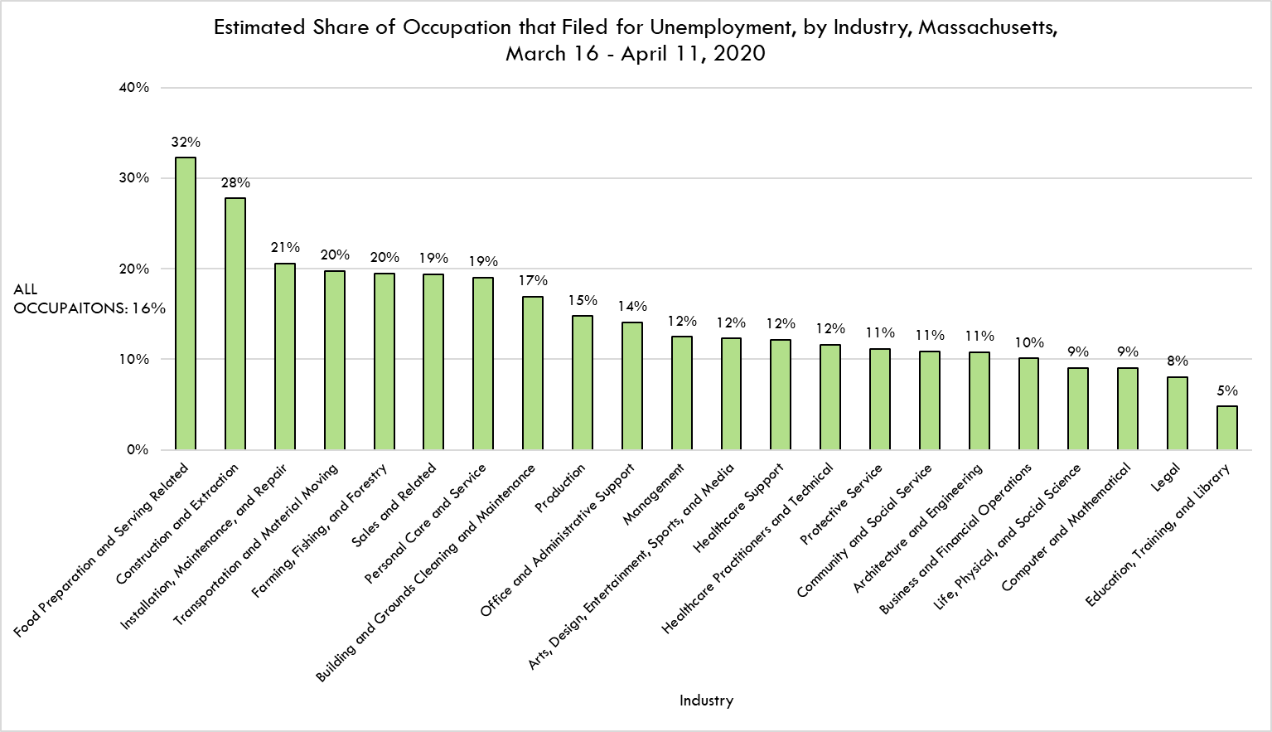

Slide 4
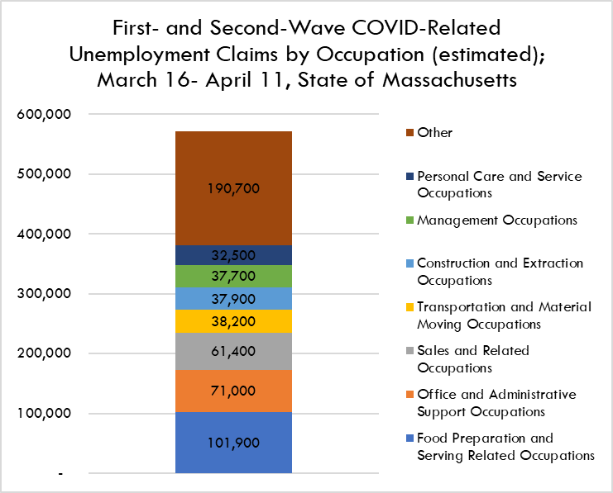
Turning Unemployment Filings into Layoffs by Occupation*
*These unemployment numbers do not contain those who are self employed

Slide 5
Estimated demographics of claimant households
An estimated 440,0000 households have at least one worker filing for unemployment
These households are more likely to be low-moderate income
Laid off workers are younger than all workers
Laid off workers more likely to speak language other than English at home
71% of laid off workers received health insurance from their employer
Job losses in the top-5 laid off occupations would reduce household income by an average of 57%
287,700 households wouldn't be able to cover housing costs and basic needs without any government assistance
Notes:
32% compared to 27% of all working households
27% vs 23%
26% vs 23%

Slide 6
Assistance Needed After the CARES Act
The CARES Act one-time payment provides relief for almost all households the month of the check, leaving 1,700 households in need of assistance totaling $2.3 million
After the one-time payment, even with expanded unemployment benefits, 11,500 households will need $10.2 million monthly to make ends meet

Slide 7
CARES Act Provides Moderate Improvements for Some Households
Current program offers 50% of pre-layoff wages plus $600 a week
Any worker making less than $62,400 /year before layoffs is seeing an increase in income
Estimate 62% of all eligible workers will experience an increase in wages from unemployment benefits
Many workers in “essential” positions are receiving less income than they would be if unemployed

Slide 8
Disproportionate Impacts for Households with Children

Slide 9
Disproportionate Impacts for Households That Speak a Language Other Than English at Home

Slide 10
Disproportionate Impacts for Workers by Race

Slide 11
Stress for Ineligible Households
Not all affected households will be eligible to receive government benefits
Undocumented workers, workers with irregular or seasonal income most at risk
Monthly assistance of approximately $1,440 per affected household or $725 per unemployed worker is needed if similar to unemployment claimants
Based on an estimate that undocumented immigrants comprise 5.1% of the Massachusetts labor force, we estimate over 30,700 undocumented workers in the first month of layoffs would need approximately $22.3 million in housing assistance per month

Slide 12
What Happens when the CARES Act Ends?
When expanded unemployment benefits expire at the end of July, standard benefits would be insufficient for 30% of impacted households (133,300 total) to make ends meet
Total estimated gap is $144.3 million monthly
If 40% of currently unemployed Food Preparation and Sales workers and 15% of all other workers are still out of work, 31,200 households would need housing assistance totaling $34 million monthly.

Slide 13
Data Resources To Come out of this Project
We looked at what a layoff in any particular industry might do to households across the state
We can't do this analysis for any particular municipality, but we can provide more regionally-specific data
Example: Project with Cambridge, Chelsea, Everett, Revere, Somerville, (includes Winthrop data)
Estimated demographics of each occupation to see which ages, races, etc are most impacted by layoffs
Analysis by tenure

Slide 14
Updated and expanded report out today at https://www.mapc.org/covid19-layoffs/ Register for our webinar happening at 2:00!
Sarah Philbrick
Socioeconomic Analyst II
sphilbrick@mapc.org

