Slide 1
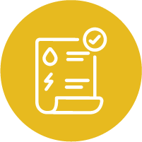



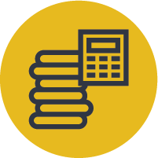
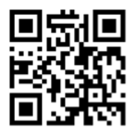



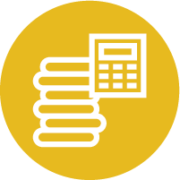


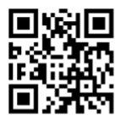

UTILITY BILL ASSISTANCE AND WEATHERIZATION
Utility Bill Assistance
Low Income Home Energy Assistance Program
Are you a Massachusetts resident in need of utility bill assistance? If you or your family are receiving support from SNAP, School Breakfast/Lunch Program, Mass Health, or other assistance programs you may qualify for a discount on your gas and/or electric bills.
If you need assistance paying your winter heating bill, you may be eligible for Low-Income Home Energy Assistance Program’s (LIHEAP) fuel assistance program. See if you qualify here and check out the Massachusetts Cold Relief brochure here or call the Cold Relief Hotline at 800-632-8175.
Eversource
Learn more about Eversource’s discounted rates here or call 800-592-2000.
Weatherization
National Grid
National Grid’s Low-Income Discount Rate offers discounted electricity bill rates to income-eligible residents. Apply here or call 800-322-3223.
Mass Save: Low or No-cost Upgrades to Improve Health and Reduce Your Utility Bill
Are you a Massachusetts resident living in single family home or a 2-4-unit apartment building? You may be eligible for energy efficiency upgrades to your home that will lower your gas and electric bills. See if you qualify and schedule your free Home Energy Assessment here or call 866-537-7267.
Monthly Payment Plans and Bill Forgiveness
Eversource
Eversource offers monthly and income-based assistance programs to Massachusetts residents who have found themselves struggling with their utility expenses. See which program is right for you or call 800-592-2000.
LEAN Multifamily Program
If you live in a multifamily apartment building with 5 or more units, talk to your building manager about the LEAN Multifamily Program. The LEAN program offers no-cost energy efficiency upgrades for Massachusetts residents living in multi-family affordable housing units. Check your eligibility and apply here or call 617-348-6425.
National Grid
If you are struggling to pay your utility bills, consider opting into one of National Grid’s payment plans or deferral options. Learn more here or call 800-322-3223.
COVID-19
COVID-19 and Affordable Housing Resources
Are you Impacted by COVID-19 and need immediate assistance? Click here for more information from Citizens’ Housing and Planning Association (CHAPA) or call 617-742-0820.

