Slide 1
Flooding
A C3 CLIMATE READINESS TRAINING MODULE​
Notes:
Hi Everyone, my name is ____, and today we will be discussing Flooding

Slide 2

Name
How long have you been with C3?
What do you think of when you think about flooding?
INTRODUCTIONS
Notes:
Please share your name, how long you have been with C3, and what you think about when you think of flooding

Slide 3
Agenda
Why do we care? Climate Change & Flooding
The common types of floods
Break!
Exploring flooding vulnerability in Cambridge
Interventions
Debrief & Closing
Notes:
Today's agenda: we will be talking about why we care about flooding and how climate change will impact flooding, the common types of floods that the Cambridge area currently experiences or will experience due to climate change, we will take a short break, and then we will explore different flooding vulnerability in Cambridge, ways that we can stop flooding and be more resilient to flooding events in Cambridge, followed by a quick debrief and closing
Does anyone have any questions?

Slide 4
Activity: What’s the Flooding Story?
In groups of 2-3, look at the flooding related images and describe:
  What do you see in these images?
  What does it say about flooding in Cambridge?
  What does it say about climate change?
Notes:
We will begin with what's the flooding story. So everyone will get into groups of 2-3 and look at the flooding related images and discuss the following:
What do you see in these images?
What does it say about flooding in Cambridge?
What does it say about climate change?
Would anyone like to share what their group discovered while looking at the images?
Is there anything about these images that you noticed in Cambridge that is no longer here in current day? How do we think this connects to climate change?

Slide 5
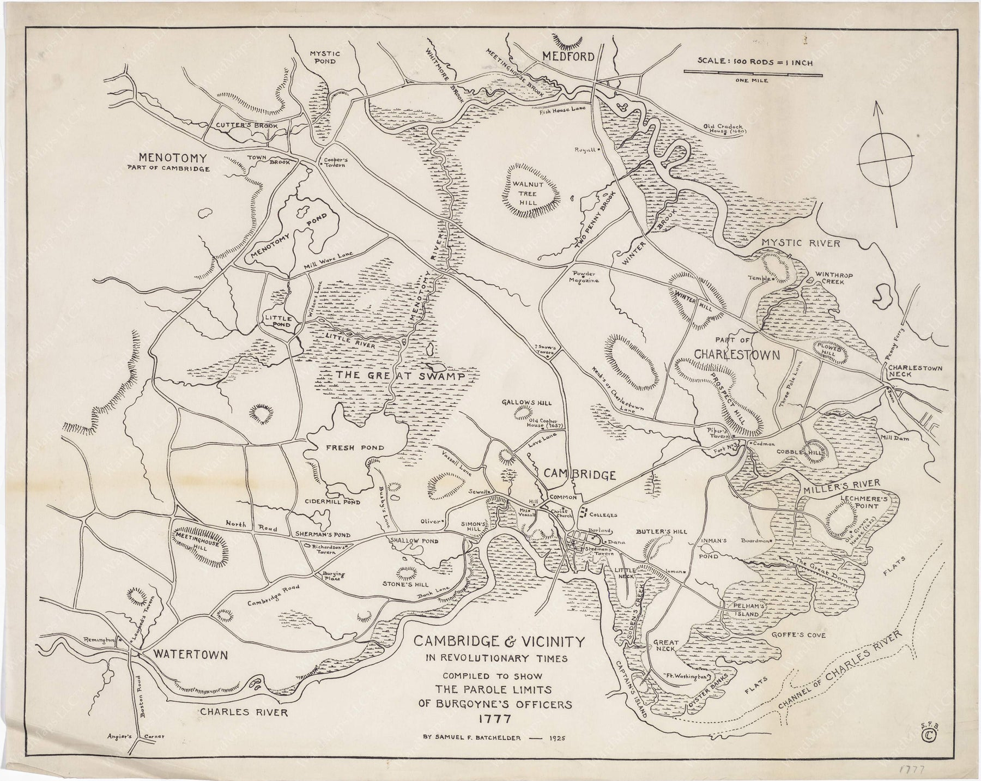
Swamp
Hill
Road
Notes:
Remind participants that we saw this image during our Climate Equity training, the prompts:We will begin with what's the flooding story. So everyone will get into groups of 2-3 and look at the flooding related images and discuss the following:
What do you see in these images?
What does it say about flooding in Cambridge?
What does it say about climate change?
Would anyone like to share what their group discovered while looking at the images?
Is there anything about these images that you noticed in Cambridge that is no longer here in current day? How do we think this connects to climate change?

Slide 6
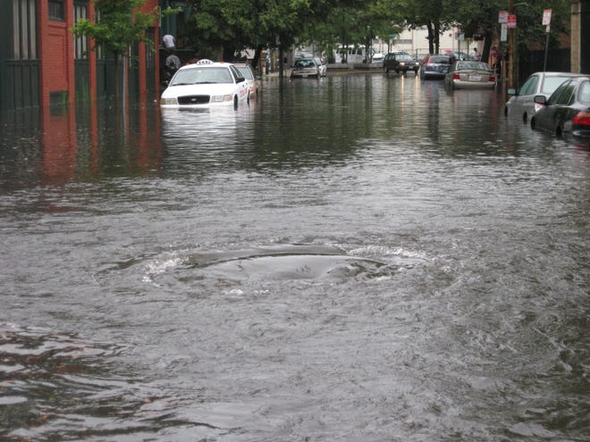
Notes:
We will begin with what's the flooding story. So everyone will get into groups of 2-3 and look at the flooding related images and discuss the following:
What do you see in these images?
What does it say about flooding in Cambridge?
What does it say about climate change?
Would anyone like to share what their group discovered while looking at the images?
Is there anything about these images that you noticed in Cambridge that is no longer here in current day? How do we think this connects to climate change?

Slide 7
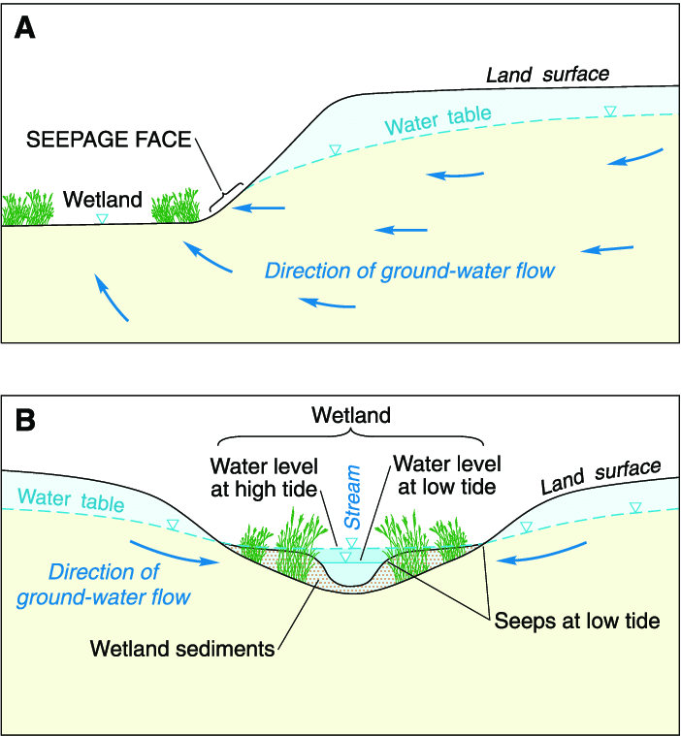
What's the flooding Story
https://www.researchgate.net/publication/249010976/figure/fig1/AS:669517785092117@1536636887772/Conceptual-model-of-seep-and-spring-formation-in-wetlands-at-A-the-edge-of-the-wetlands.png
Notes:
Wetlands are submerged or permeated by water -- either permanently or temporarily -- and are characterized by plants adapted to saturated soil conditions. Wetlands include fresh and salt water marshes, wooded swamps, bogs, seasonally flooded forests -- any land area that can keep water long enough to let wetland plants and soils develop.
Wetlands are extremely valuable because:
they absorb the impact of hydrologic events such as large waves or floods;
they filter sediments and toxic substances;
they supply food and essential habitat for many species of fish, shellfish, shorebirds, waterfowl, and furbearing mammals;
they also provide products for food (wild rice, cranberries, fish, wildfowl), energy (peat, wood, charcoal), and building material (lumber); and
they are valuable recreational areas for activities such as hunting, fishing, and birdwatching.
In the past, wetlands were considered wasteland, and many of Massachusetts’ wetlands were drained or filled in so that they could be farmed or built upon. Recently the value of wetlands has been recognized and efforts have been made to protect these ecosystems. However, they are still disappearing under the pressure of human activity, and are being threatened by air pollution and climate change.
From the diagram, you can see that wetlands in upper watershed areas capture and slowly release snowmelt and spring rainfall. When these wetlands are removed, more water moves more quickly downstream, causing flood waters to rise higher and flow faster.

Slide 8
Agenda
Why do we care? Climate Change & Flooding
The common types of floods
Break!
Exploring flooding vulnerability in Cambridge
Interventions
Debrief & Closing
Notes:
Thank you everyone for participating in the Flooding Story activity. I hope this has made you start connecting the dots between climate change, flooding, and equity. We are next going to talk about why we care about flooding and how climate change is intensifying flooding. Before we begin, does anyone have any questions?

Slide 9
  RECAP!
  How is flooding connected to climate change?
  What are the impacts of flooding?
PAIR & SHARE
Notes:
Based on the previous activity, and the news clip and headlines that were shared on the previous slides, how do we think that flooding is connected to climate change, and what do we think are some of the impacts of flooding? Do we think climate change is making flooding more common?

Slide 10
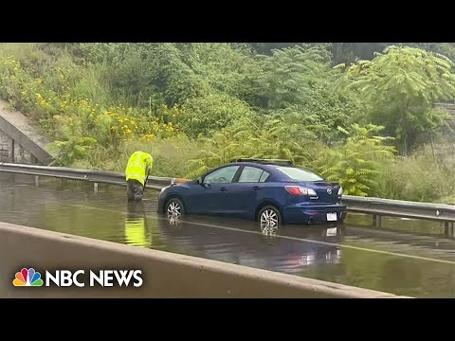
Flooding in the News: Summer 2023
Source: NBC News, August 8th, 2023
Notes:
In this past summer (Summer 2023), there has been countless instances of major flooding events throughout the US and the rest of the world. But major flooding events also happen close to home. A more recent example is the 11 inches of rain that happened in Leominster in September (2023). Check out this video about flooding that happened from the August 8th storm in different parts of Massachusetts.

Slide 11
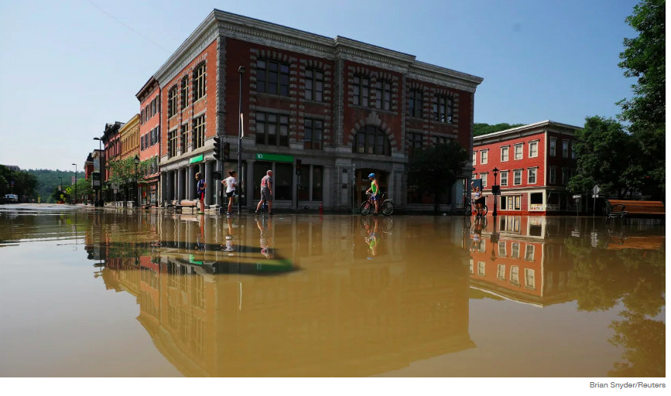
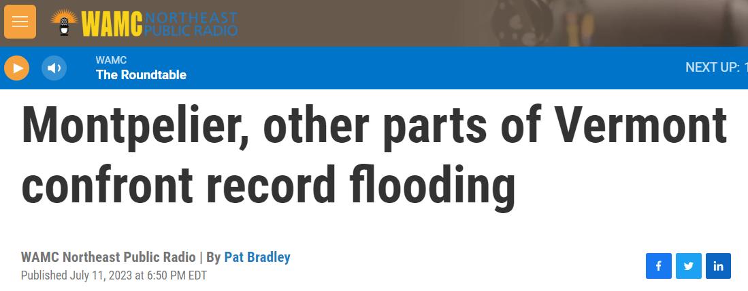
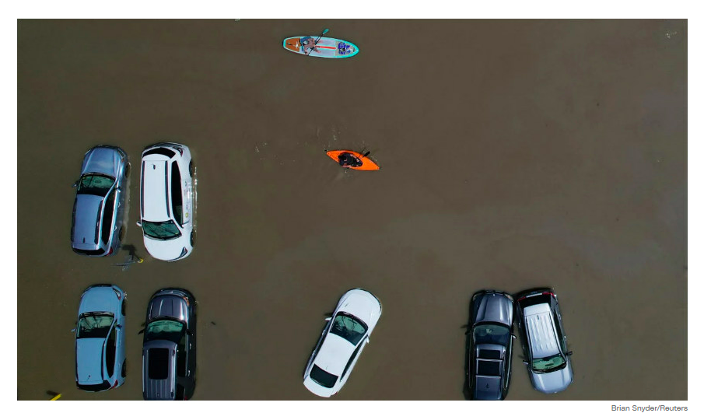
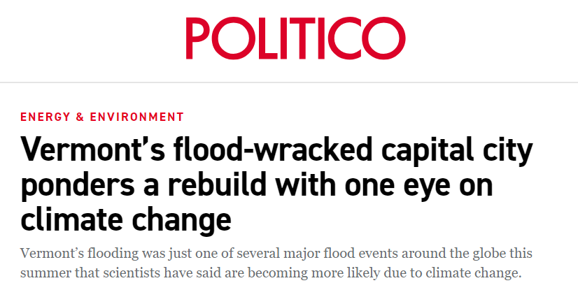
Flooding in the News: Summer 2023
Images Source: Brian Snyder/Reuters
Notes:
You also may remember the major rain event that produced floods that wiped out countless farms and the capital of Vermont this past summer too. By a show of hands, does anyone experience flooding when it rains or experienced flooding for the first time this summer? Feel free to share your experience if you feel comfortable.

Slide 12
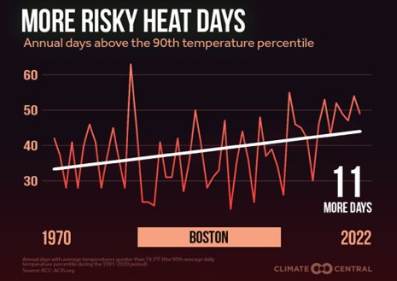
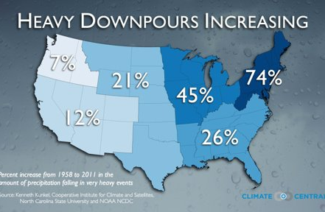
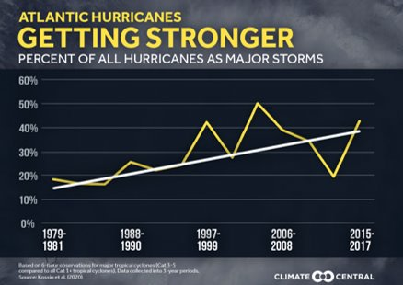
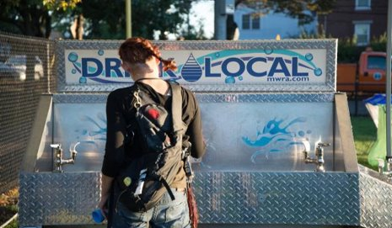
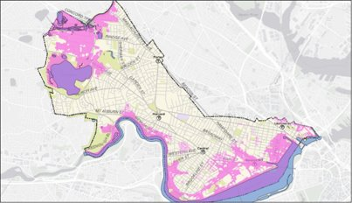
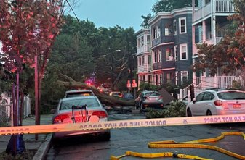
Effects: WARMER, WETTER, and WEIRDER
Notes:
I know you have seen this slide in previous presentations, but to refresh everyone's memories, climate change is making the world warmer, wetter, and weirder, and today we are focusing on the wetter part and why its getting weirded from climate change.

Slide 13
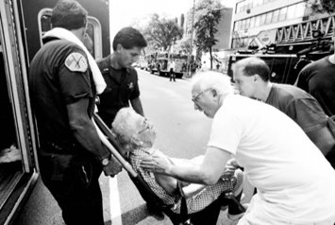
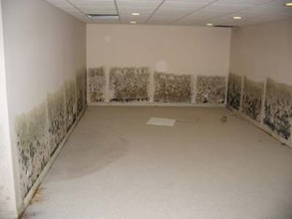
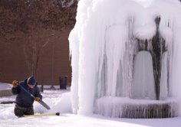
Impacts: WARMER, WETTER, and WEIRDER
Notes:
The impacts of these changes will be felt directly in the moment and indirectly, after the event or over time.
Climate will impact everything from health to housing. From increases in heat illnesses and diseases from ticks due to heat, damaged roads/housing from storms or heat, disruptions to essential services and power or communication networks.
Economy and mental health impacts that radiate out from that.
Today we are going to focus on the wetter part of warmer, wetter, and weirder

Slide 14


Impacts of Flooding: Health & Infrastructure
FLOOD WATER IS NOT CLEAN WATER
Source: The Noun Project
Notes:
Climate change will worsen the impacts of flooding by intensifying heavy precipitation events, sea level rise, and become more destructive and dangerous
Impacts of flooding on health:
During flooding events, there is the risk of accidents and drowning
Water-borne infectious diseases – FLOOD WATER IS NOT CLEAN WATER. All flood waters contain pathogens. This is dangerous if you are in the flood water, but it can also be dangerous if you swim or fish in rivers, lakes, ponds after. Drain water is not cleaned before moving it to the river.
The displacement that occurs – financial implications, disruptions to routine, need to pull heavily on resources (this is particularly complicated in renter situations)
Longer term health impacts - Trauma and mental health impacts. Floods create conditions for indoor mold growth, negatively impacting air quality and respiratory illnesses.
Damage to infrastructure
Road closures, flooded buildings/train stations, etc.
Homes: basement flooding (chronic moisture), potential septic backflow
Disruption to essential services
Constrained utility, medical services, emergency response
Economy
Property damage to local businesses, supply chain interruptions

Slide 15
Agenda
Why do we care? Climate Change & Flooding
The common types of floods
Break!
Exploring flooding vulnerability in Cambridge
Interventions
Debrief & Closing
Notes:
I want to pause to see if anyone has any questions about what we covered so far about the impacts of flooding and how climate change will intensify flooding as we know today.
If no one has any further questions, we will move on to the different types of floods that are common or will become common in Cambridge

Slide 16
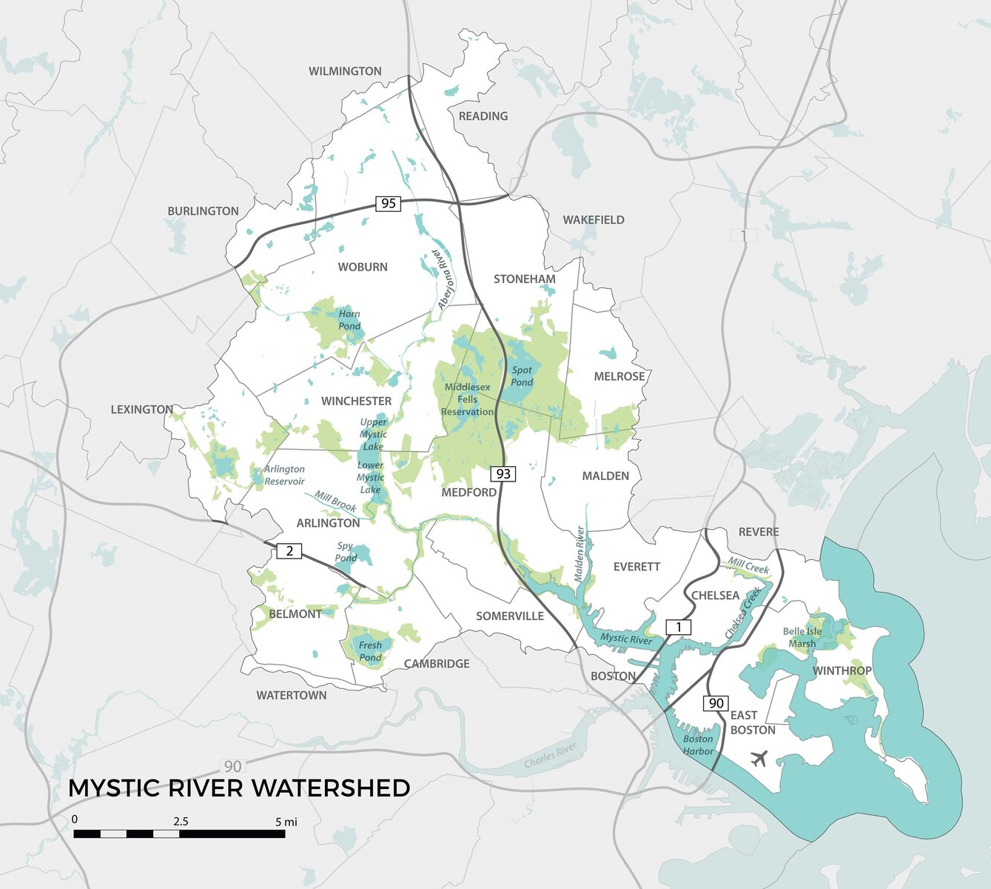
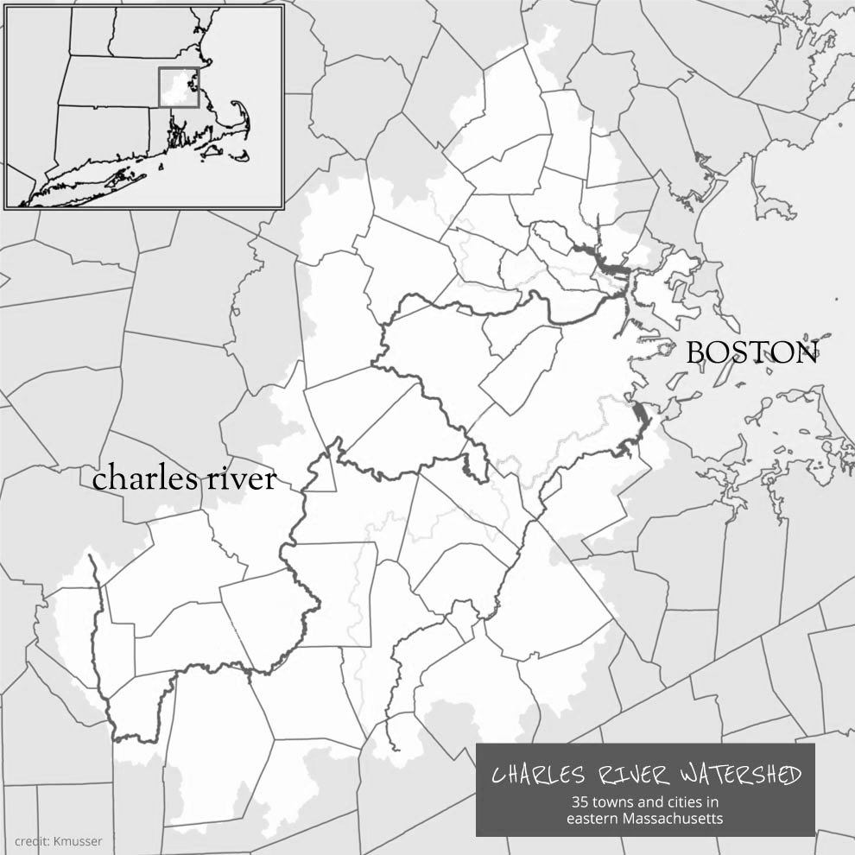
A watershed is an area of land that drains water into a common body of water
Source: Charles River Careers & Mystic River Watershed Association
Notes:
A watershed is an area of land that drains water into a common body of water. For example, if we are in the Charles River watershed, and you are washing your car in the street, that water will go from the street into the storm drain to the Charles River
Cambridge is a part of the Mystic River Watershed and Charles River Watershed
Watersheds are more than just drainage areas in and around our communities. They are necessary to support habitat for plants and animals, and they provide drinking water for people and wildlife. They also provide the opportunity for recreation and enjoyment of nature.
Healthy watersheds provide many ecosystem services including, but not limited to: nutrient cycling, carbon storage, erosion/sedimentation control, increased biodiversity, soil formation, wildlife movement corridors, water storage, water filtration, flood control, food, timber and recreation, as well as reduced vulnerability to invasive species, the effects of climate change and other natural disasters. These goods and services are essential to our social, environmental and economic well-being.
Does anyone have any questions about watersheds? Does it make sense why Cambridge is in both the Charles River and Mystic River watersheds?
How do we think that knowing your watershed is important and related to flooding?

Slide 17
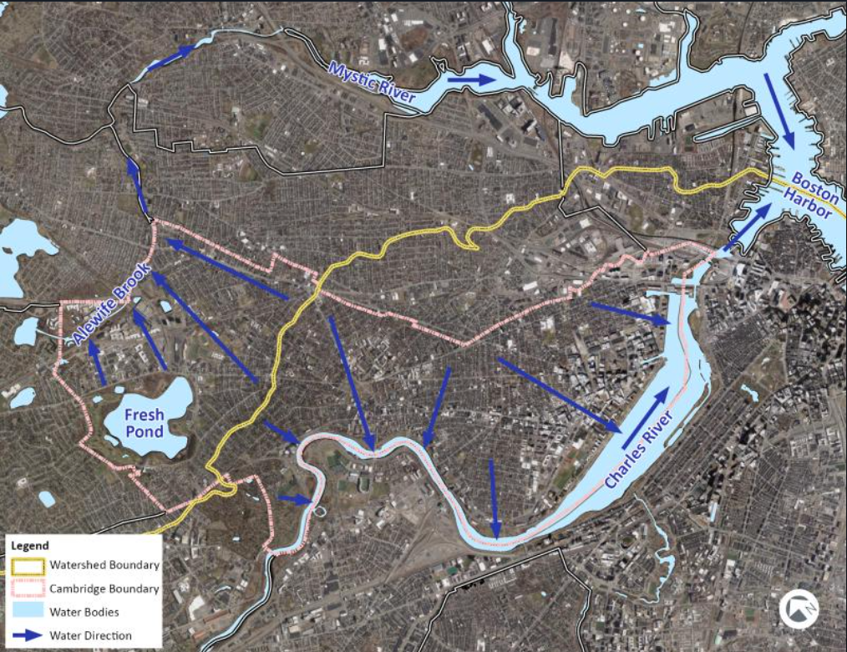
Lets zoom into Cambridge…
Notes:
Let’s zoom in on Cambridge.
You see the yellow is the line between the two watersheds, pink is the outline of Cambridge. Blue arrows are how rain and snow melt flow.
As you can see, depending on where you are in Cambridge, water is moving towards different bodies of water.

Slide 18
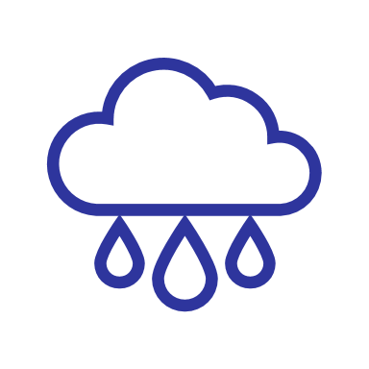
The connection between watersheds & flooding
A watershed is a system.
When it rains on land, water can be absorbed into the ground or flow into drains, then rivers, on the way to the ocean.
Heavy rain can lead to a lot water in the system.
If the water cannot be absorbed or moved quick enough, the system breaks down and it floods.
Notes:
Watersheds in areas with lots of concrete, pavement, and roofs, shed water quickly, while forested and grassy rural areas absorb more water.
When water enters the watershed too quickly for the land to absorb it, flooding can occur. During a downpour, rainwater hits pavement and flows into drains, picking up pollutants like oil, fertilizers, and road salts along the way. These pollutants can flow into nearby water bodies, where they can harm wildlife, make swimming and boating unsafe, or even contaminate drinking water.
When heavy rain occurs or snow melts quickly, or both occur at the same time, the capacity of the systems to move water towards the ocean can be overwhelmed
Areas of Cambridge have a high amount of concrete and pavement that can't absorb water from a rainstorm, this means

Slide 19
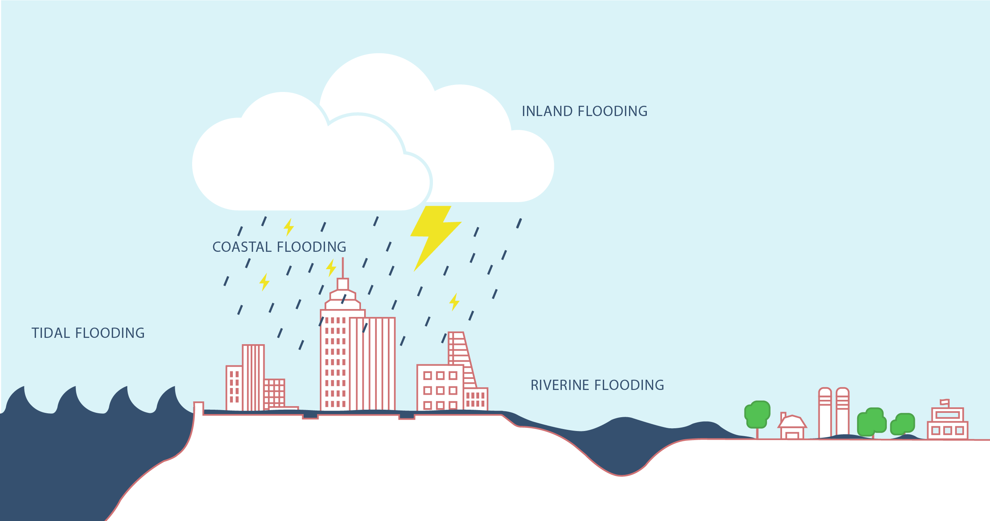

3 Main Types of Flooding:
Riverine Flooding
Coastal Flooding
Inland Flooding
Source: NYC Hazard Mitigation
Notes:
Picture: Flooding – What is the hazard? – NYC Hazard Mitigation
Cambridge is most likely to experience extreme precipitation or inland flooding, riverine flooding, and coastal flooding
Cambridge has not experienced coastal flooding, yet. These others we are experiencing already.

Slide 20
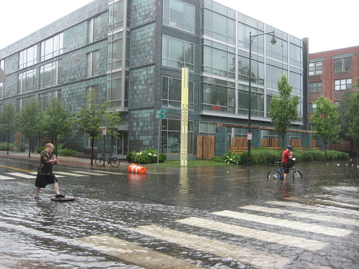
Inland Flooding
Rain can lead to inland flooding if it rains so heavily that:
The ground cannot absorb water quick enough, and/or
Drain systems cannot move the water towards the rivers quick enough.
Climate change has increased the frequency of these intense downpours.
Source: Flickr
Notes:
You experience this type of flooding when rainfall overwhelms the capacity of drainage systems, and you see flooding on streets and in basements.
Climate change impacts stormwater flooding because with more frequent and intense downpours leads to sewer backups that cause localized flooding or lead to greater runoff of contaminants such as trash, nutrients, sediment or bacteria into local waterways.
Primarily when you have these high precipitation short duration storm events. We've seen a lot this summer.

Slide 21
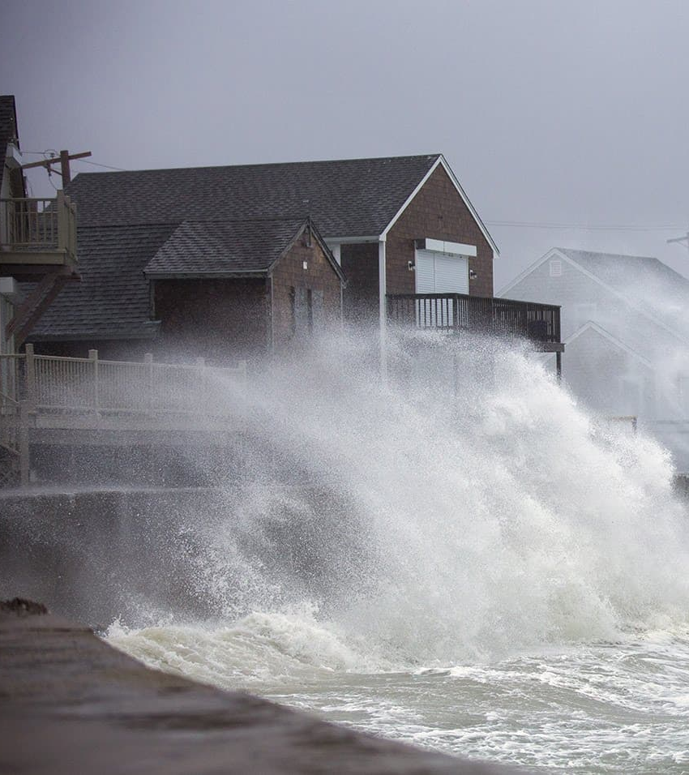
Coastal Flooding
Coastal flooding is when seawater covers land areas near the coast
This flooding is common during a hurricane or tropical storm
Climate change is increasing coastal flooding in several ways:
Warmer temperatures are more favorable to hurricanes.
Sea level rise creates favorable conditions for storm surge
Source: WBUR
Notes:
Coastal flooding is when seawater covers land areas near the coast
This flooding is common during a hurricane or tropical storm
Climate change is increasing coastal flooding in several ways:
Warmer temperatures are more favorable to hurricane.
Sea level rise creates favorable conditions for storm surge
In the future, we expect the dams to breached (over top or flanked) first Alewife, then Charles

Slide 22
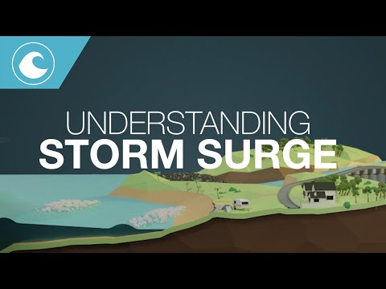
Climate Change & Storm Surges
Storm surge is a rise in sea level that occurs during intense storms. It caused by the storm's winds pushing water onshore, leading to flooding
Source: Australian Bureau of Meteorology
Notes:
Storm surge is a rise in sea level that occurs during intense storms. It caused by the storm's winds pushing water onshore, leading to flooding

Slide 23
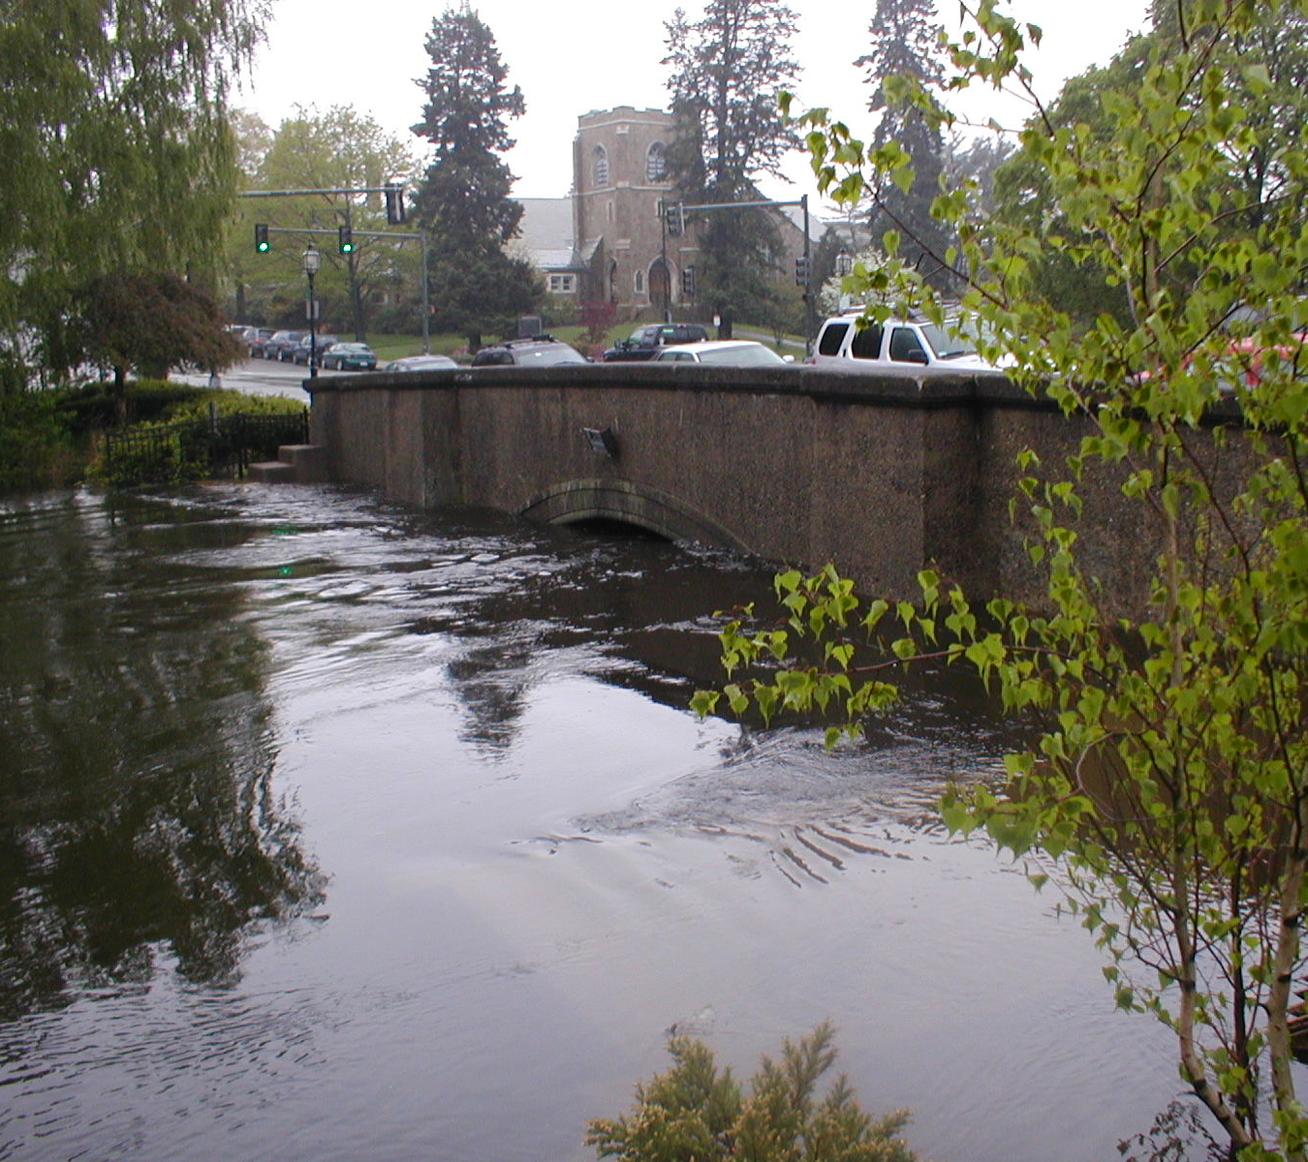
River Flooding
River (or Riverine) flooding is when consistent rain or snow melt overwhelm the capacity of a river
This type of flooding is common in late winter or early spring, when snow and ice melt
River floods have become larger and more frequent in the Northeast due to climate change
Image Source: Alewife Brook, Cambridge DPW
Notes:
River (or Riverine) flooding is when consistent rain or snow melt overwhelm the capacity of a river
This type of flooding is common in late winter or early spring, when snow and ice melt
River floods have become larger and more frequent in the Northeast due to climate change
Additionally, riverine flooding also occurs with storm surge/sea level rise on tidally influenced rivers. The Charles/Mystic Rivers are tidally influenced rivers (or at least were before the dams).

Slide 24
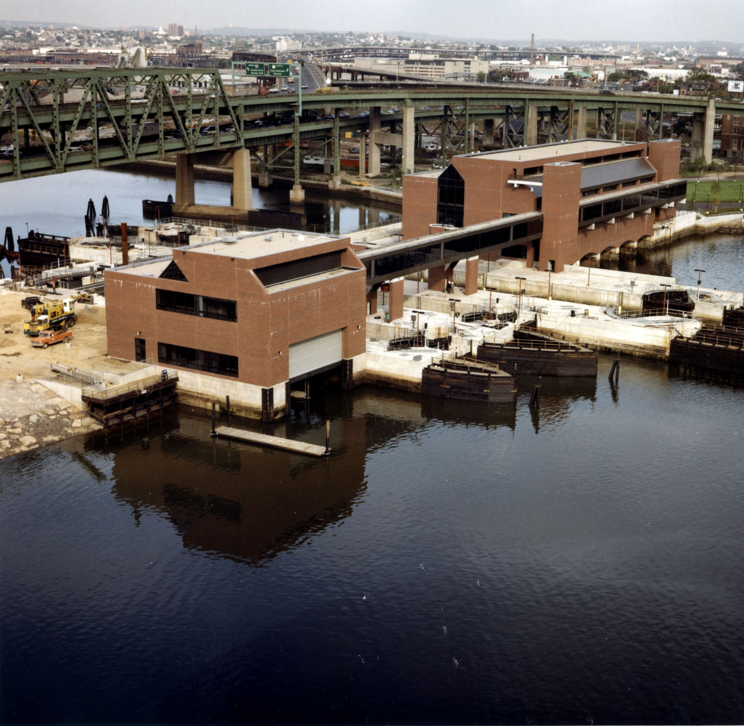
Climate Change, Coastal Flooding, & Watersheds: oh Dam!
The Charles River dam and the Amelia Mystic Dam were built to prevent flooding upstream.
Today dams protect Cambridge, in the future they may be a vulnerability!
More frequent downpours and sea level rise will result in more water than the dams were designed to handle.
Water can spill over the top or around the sides into the surrounding cities.
Notes:
Cambridge is located in between two tidally influenced rivers, which two dams were built to reduce flooding upstream – not from storm surges, just storms - where construction occurred on sites that were previously wetlands.
More frequent and intense downpours can also challenge cities with combined stormwater and wastewater drainage systems. These systems can be overwhelmed by large amounts of rainfall or snowmelt and lead to more combined sewer overflows (CSOs) into waterways. An increase in CSOs can reduce water quality and make meeting water quality standards more difficult.
Stormwater runoff can also wash sediment, nutrients or other pollutants into water sources. Increased sediment, nutrients and other pollutants can diminish water quality, threaten drinking water sources, and complicate water treatment processes
Based on sea level rise predictions, the dams will be overtopped with water. This means, that if there extreme precipitation or a storm surge event, there will be flooding in Cambridge because the water from the dams will travel upwards from storm drains back into neighborhoods, causing economic and public health issues due to increased pollution, the contamination of drinking water sources, and also diminishing overall water quality in the Charles River and Mystic River watersheds.
Today they are a protection, in the future they are a vulnerability. Good news there's work going on!

Slide 25
Reflect on your experience with Flooding in Cambridge:
Have you experienced any of the different types of flooding? How about your family & friends?
What information is new to you?
Any unanswered flooding questions?
PAIR & SHARE
Notes:
Reflect on your experience with Flooding in Cambridge:
Have you experienced any of the different types of flooding? How about your family & friends?
What information is new to you?
Any unanswered flooding questions?

Slide 26
Agenda
Why do we care? Climate Change & Flooding
The common types of floods
Break!
Exploring flooding vulnerability in Cambridge
Interventions
Debrief & Closing
Notes:
Ho take a break, and we will explore flooding vulnerability in Cambridge and different intervention measures

Slide 27
Agenda
Why do we care? Climate Change & Flooding
The common types of floods
Break!
Exploring flooding vulnerability in Cambridge
Interventions
Debrief & Closing
Notes:
Welcome back from the break, let's discuss the exploring flooding vulnerability in Cambridge

Slide 28
Flooding Vulnerability
Vulnerability
=
Sensitivity
+
Exposure
-
Ability to Cope
Who you are, what you do
Where you are
What you have access to
Sensitivity
Exposure
Ability to Cope
Notes:
Can either reduce exposure/sensitivity AND/OR increase adaptive capacity
Who do we think are groups more sensitive to flooding and who would be the most exposed to flooding impacts?

Slide 29
Some people are more sensitive to flooding
Older Adults (65+)
Low-income Households
Infants & Young Children
People with Disabilities or Limited Mobility
People with Chronic Illnesses
People who Live Alone or Are Bedridden
People Experiencing Homelessness
Households with limited English language skills
People who live in lower levels of buildings
People who live in flood zones
Notes:
Light blue is sensitivity, dark blue is vulnerabilities
We are all sensitive at certain times
Go around the room and pick a box to explain why more flood sensitive
For the people who live in floodplains - note the floodplains, as the US gov't defines it (FEMA), are not reflective of the entire area we expect future flooding in Cambridge

Slide 30
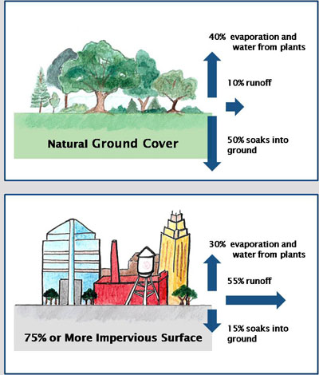
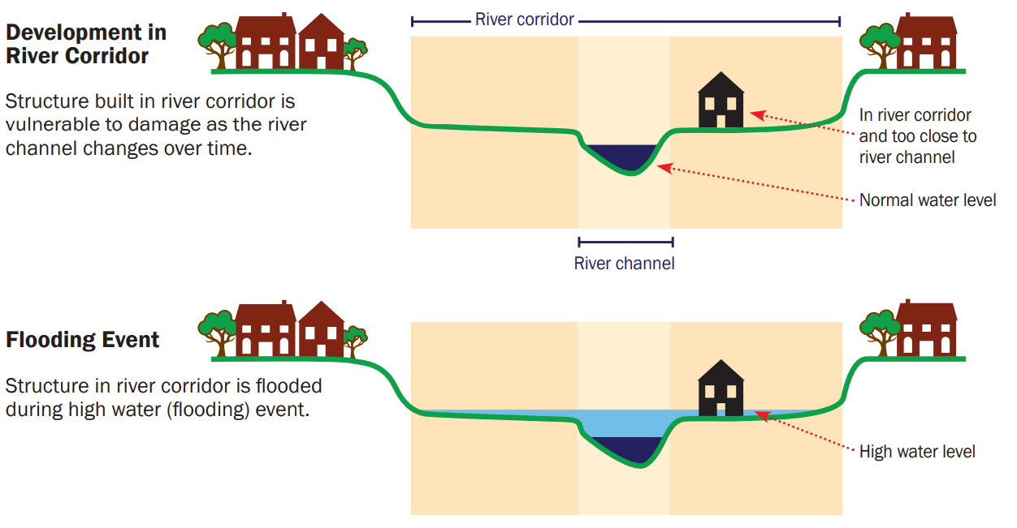
Some areas are more exposed to flooding
Image source: Vermont, Agency of Commerce & Community Development
Image source: City of Durham, NC
Notes:
Natural landscape elements such as wetlands, forests, and grasslands, absorb rainwater and prevent flooding
Increased urbanization adds pavement and other impermeable/impervious surfaces, which alters natural drainage systems, causing flooding in urbanized areas such as cities
Development in floodplains and low-lying areas are more susceptible to riverine flooding
Under-maintained infrastructure can also lead to stormwater flooding
However, with many of these elements now gone due to development, there is no place for this rainwater to go, so instead of absorbing at the surface, the rainwater will run off impervious surfaces (such as roads) and lead to flooding conditions from extreme precipitation
There are underground flows of water, Historic swamp, shallow water table.

Slide 31

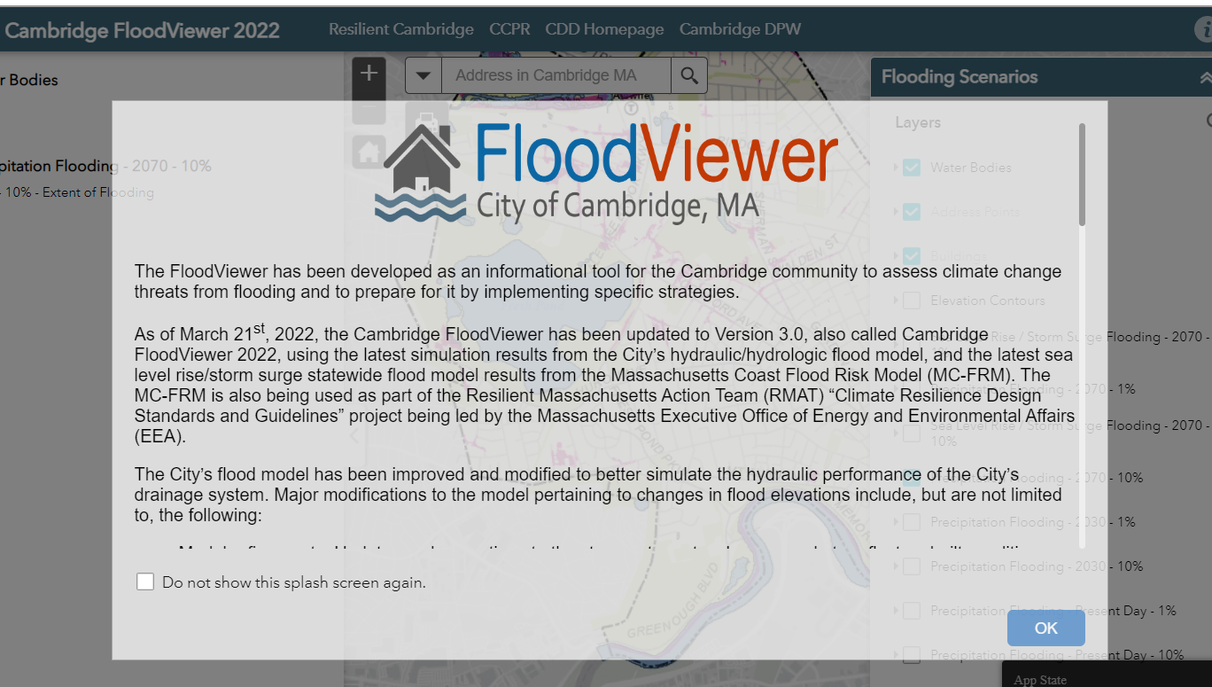
Activity: Exploring flooding vulnerability in Cambridge
On a map, we will look at which areas of Cambridge we think are more susceptible to flooding, and match that with the Flood Viewer
Understanding Flood Risks & Protecting Your Property - City of Cambridge, MA (cambridgema.gov)
Notes:
The flood viewer is an interactive map - we can zoom in/pan around/turn on diff layers

Slide 32
Agenda
Why do we care? Climate Change & Flooding
The common types of floods
Break!
Exploring flooding vulnerability in Cambridge
Interventions
Debrief & Closing
Notes:
Please let me know if you have any questions. Now that we have explored flood vulnerability, we will discuss the interventions

Slide 33

Dos & Don’ts of Flooding
Each group will receive an envelope, inside are the dos and don’ts of coping with flooding – but they’re all mixed up!
Read each action and ask:
Before, during, or after a flood, is this something to do or to avoid?
The first to sort all actions correctly wins!
Notes:
Each group will receive an envelope, inside are the dos and don’ts of coping with flooding – but they’re all mixed up!
Read each action and ask:
Before, during, or after a flood, is this something to do or to avoid?
The first to sort all actions correctly wins!

Slide 34
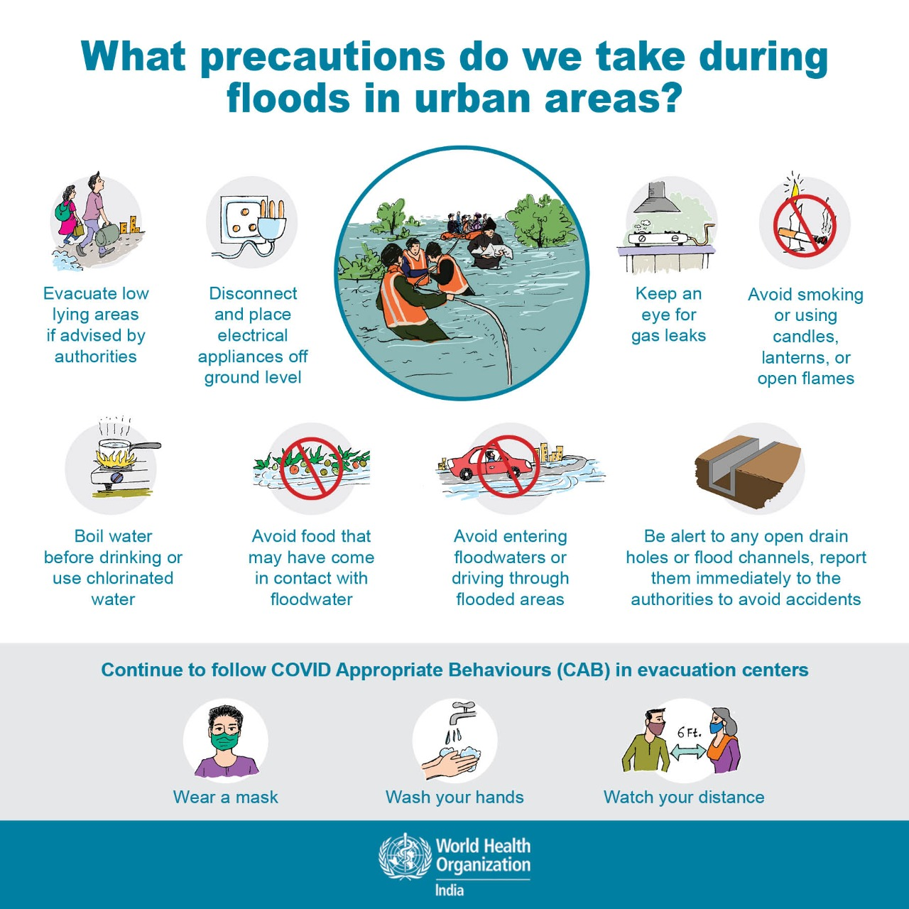
During the Floods

Slide 35
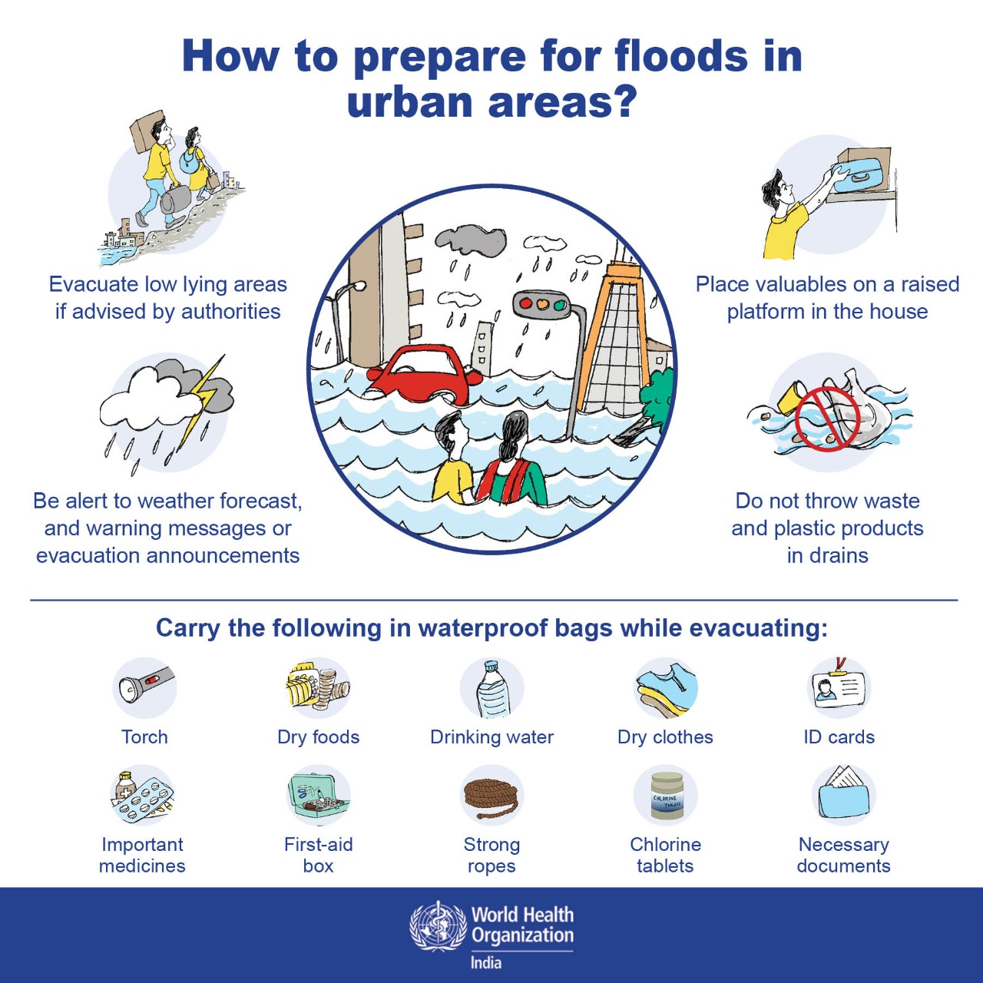
Impacts of Flooding: How to Prepare Before the Floods
Source: 1_flood_preparing-for-floods.jpeg (1280×1280) (who.int)

Slide 36
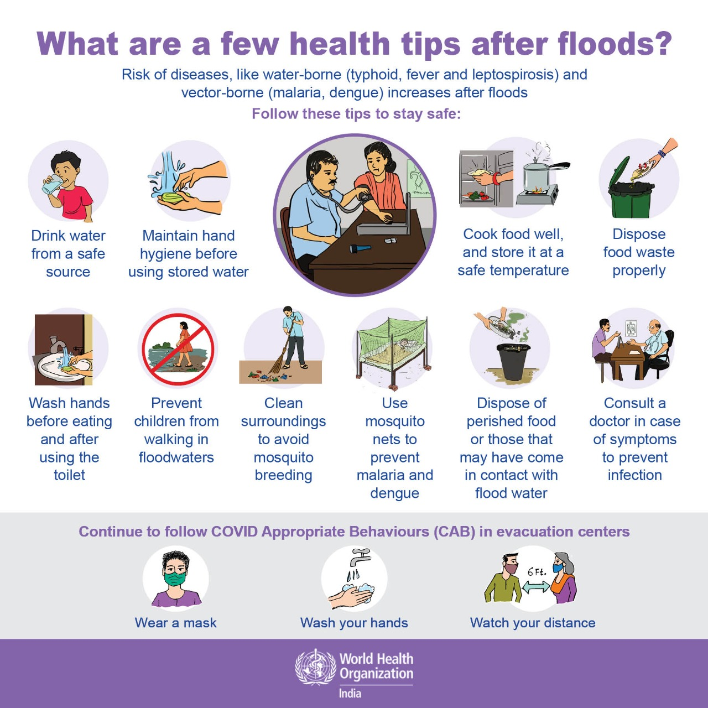
After the Floods
Source: 3_flood_health-tips-after-floods.jpeg (1280×1280) (who.int)

Slide 37
What YOU can do to reduce flood risk
Do's | Don'ts
Avoid or limit direct contact with flood water After a flood, report cuts, open wounds, or symptoms of illness Buy flood insurance Get rid of standing water Throw out damaged materials that aren't usually outdoors Drain or dry out wet areas and puddles of water in & around your home. Clean up mold If you own your home: protect your property with flood resistant materials and by building floodwalls, installing backwater valves, and elevating utilities | Drink flood water Play in flood water Bury or burn flood-damaged items Flush your toilet (before flooding goes down) Leave standing water in dry indoor areas Keep wet items that can grow mold
Notes:
Avoid contact with flood water due to potentially elevated levels of contamination associated with raw sewage and other hazardous or toxic substances that may be in the flood water.
Flood water may have high levels of raw sewage or other hazardous substances. Early symptoms from exposure to contaminated flood water may include upset stomach, intestinal problems, headache and other flu-like discomfort. Anyone experiencing these and any other problems should immediately seek medical attention.
Do not use the sewage system until water in the soil absorption field is lower than the water level around the house. If you have a home-based or small business and your septic system has received chemicals, take extra precautions to prevent contact with water or inhaling fumes. Proper clean-up depends on the kinds of chemicals in the wastewater.
Be sure children are protected from chemicals and diseases in flood water. Behavior such as crawling or placing objects in their mouths can increase a child's risk of exposure and sickness.
Mosquitos can sharply increase after a flood, due to the sudden availability of standing water which they require for breeding -- even very small amounts of water. As flood waters recede be sure to drain, overturn, or empty areas -- no matter how small -- to reduce mosquito breeding areas and help reduce the spread of mosquito-borne diseases.
Mold can cause serious health problems. The key to mold control is moisture control. After the flood, remove standing water and dry indoor areas. Remove and discard anything that has been wet for more than 24-48 hours.

Slide 38
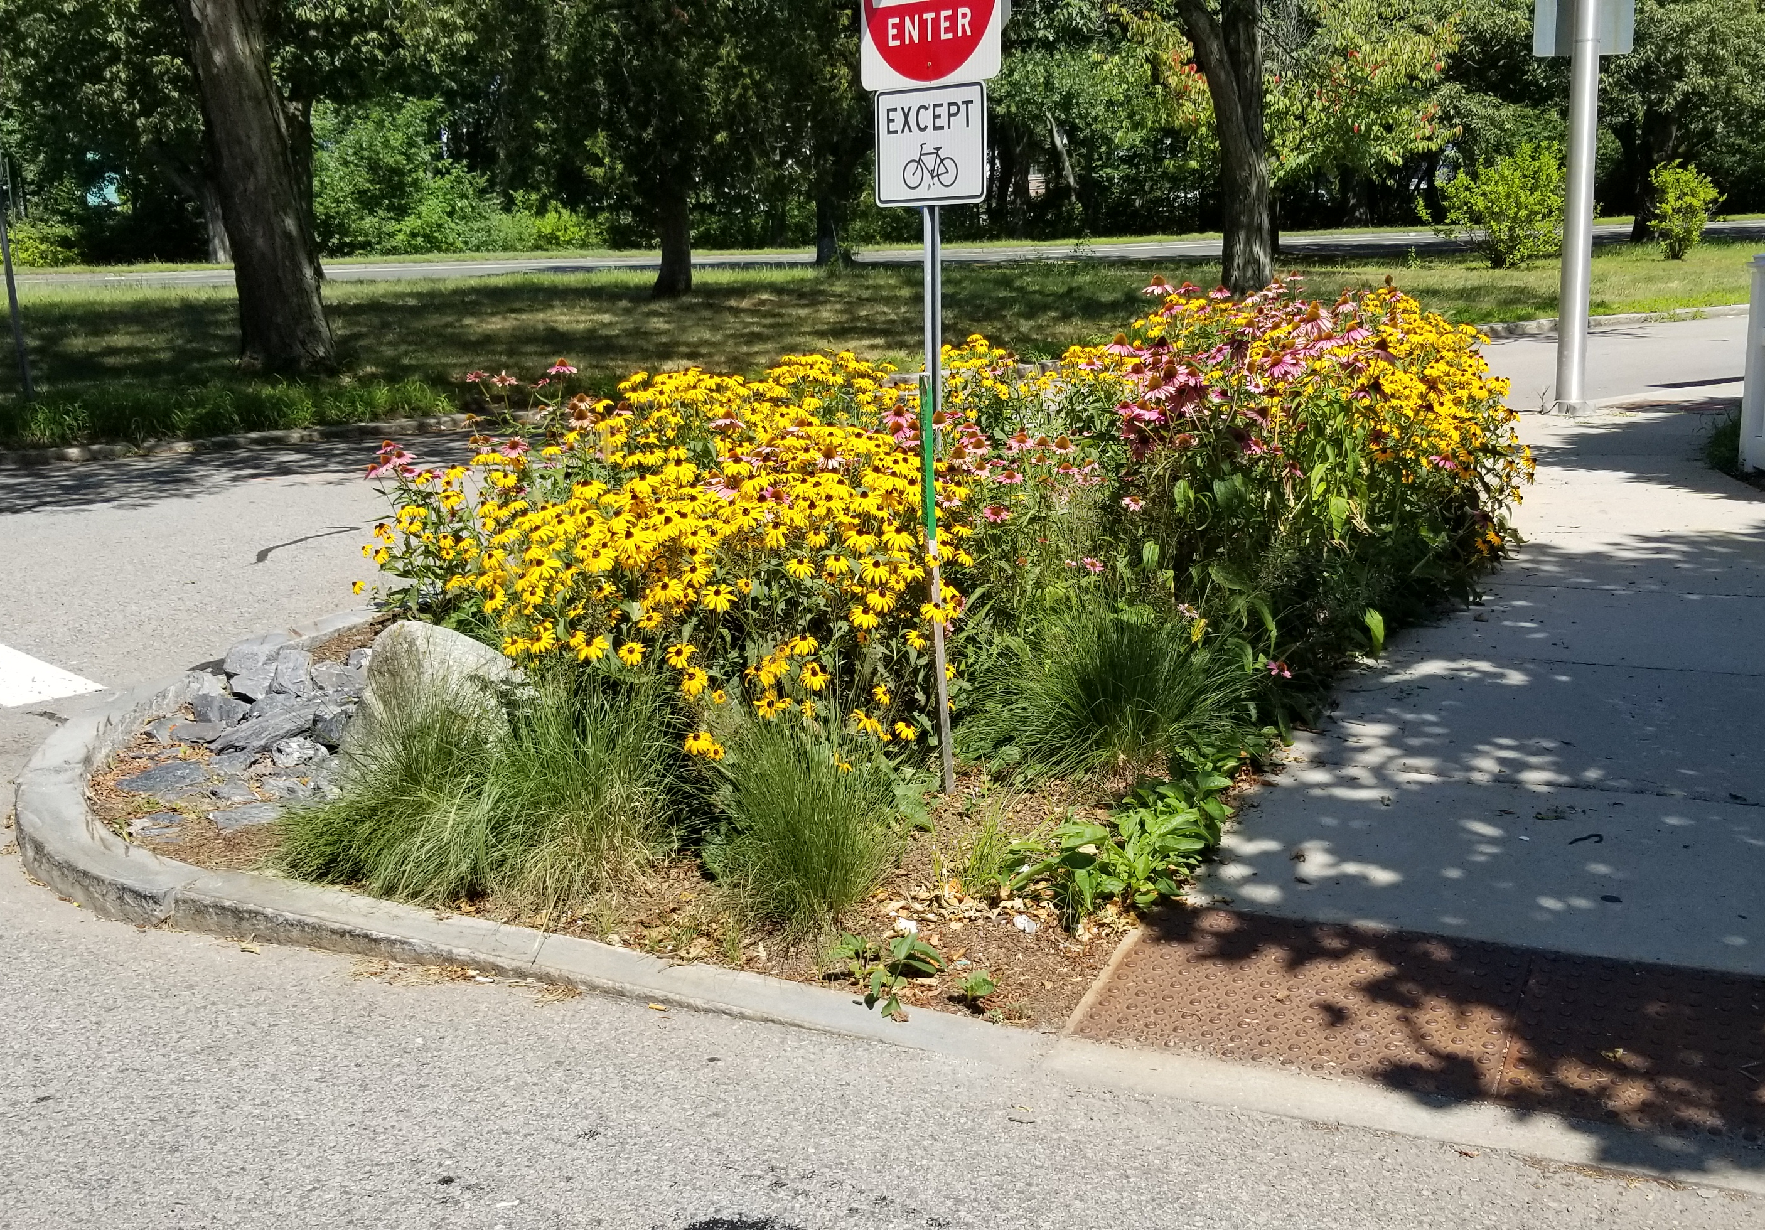
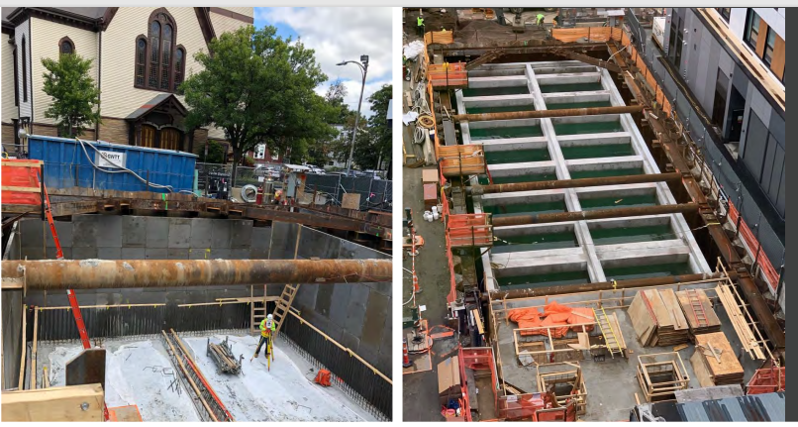
Flooding Interventions: Green & Gray
Green infrastructure are green spaces that help reduce, slow, and clean stormwater (they can also help with extreme heat!)
Gray Infrastructure are engineered structures, such as dams, drains, pipes or water storage tanks.
Image Source: Whittemore St. green space and The Port Infrastructure Project, Cambridge DPW
Notes:
Green infrastructure are vegetated landscapes and other green spaces contributing to the reducing, slowing, and cleaning of stormwater and cooling urban heat island
Rain garden
Bioswale
Improvements to green spaces will help improve water quality in downstream water bodies
Gray Infrastructure is human-engineered infrastructure for water resources
Pipe upsizing
Flow re-routing
Storage tank installation

Slide 39
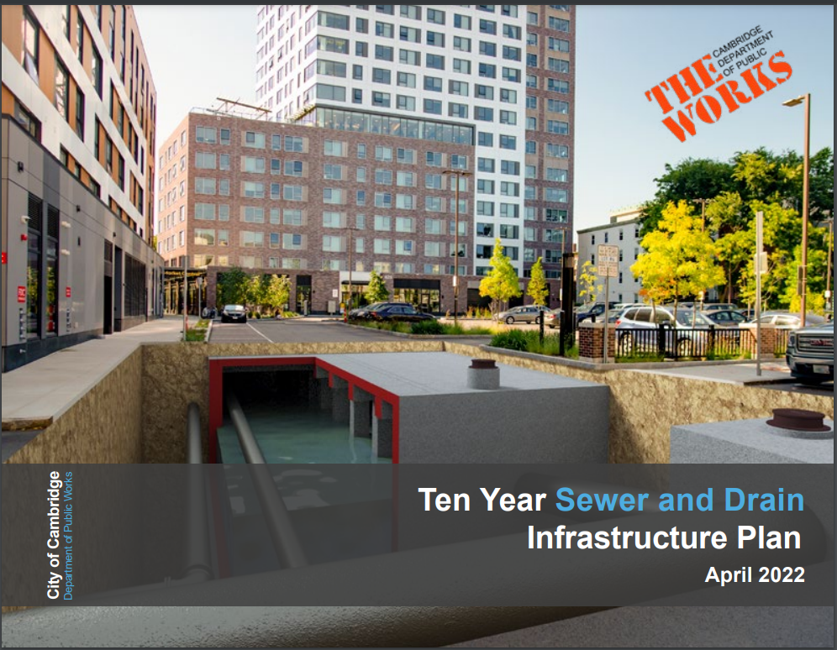
What’s Cambridge doing about flooding?
Plan to manage improvements to sewers & drains.
Includes planning efforts specific to climate readiness
Notes:
Because not all flood risk can be eliminated, this means that some measures will need to be taken to make people, buildings, and infrastructure more resilient to flooding
Cambridge is committed to implement measures for the 10% risk of flooding today

Slide 40
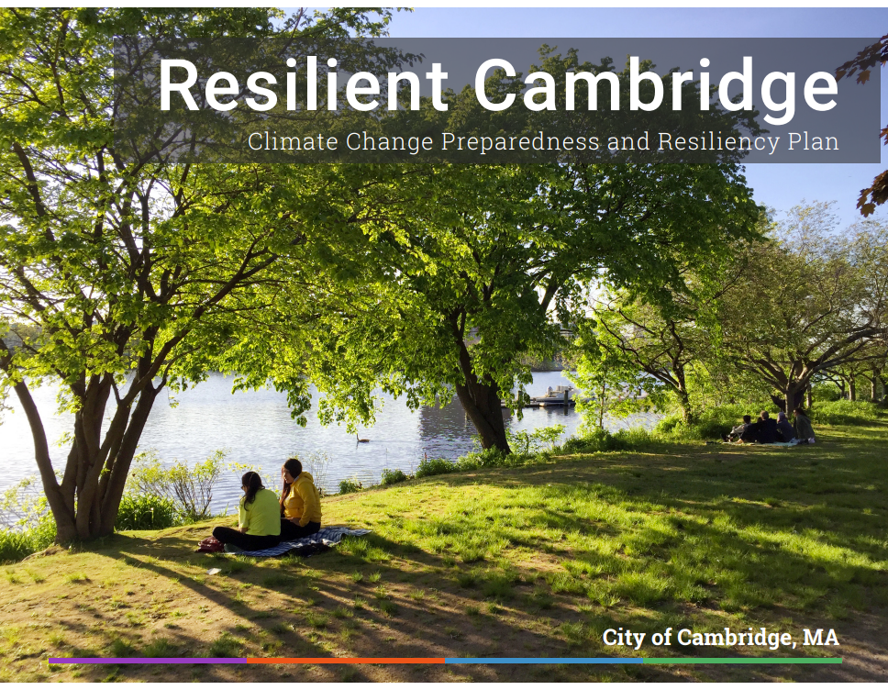




What’s Cambridge doing about flooding?
Greener City
Retrofitted Buildings
Infrastructure
Resilient Communities
Source: Resilient Cambridge, City of Cambridge
Notes:
Because not all flood risk can be eliminated, this means that some measures will need to be taken to make people, buildings, and infrastructure more resilient to flooding
Cambridge is committed to implement measures for the 10% risk of flooding today

Slide 41
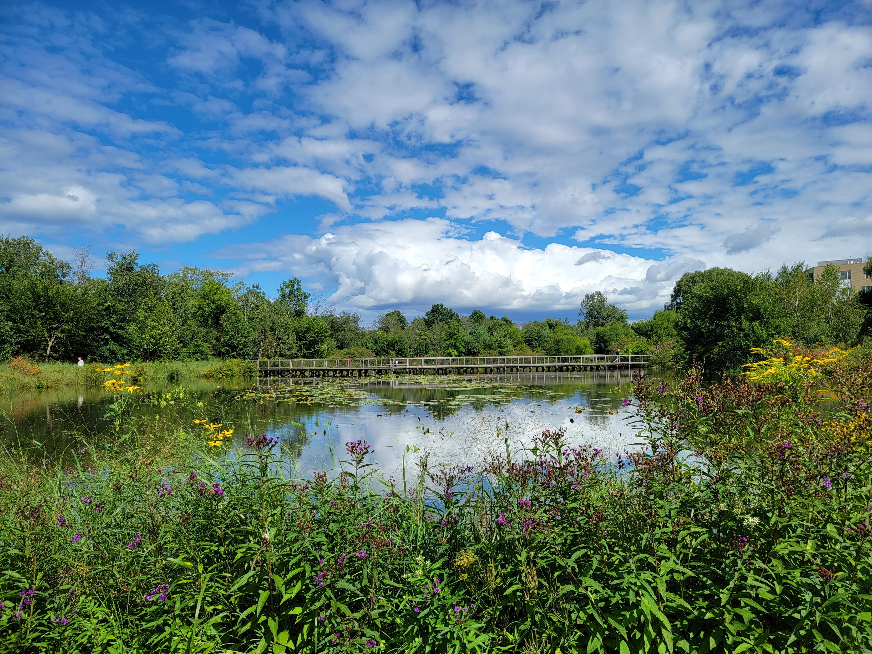
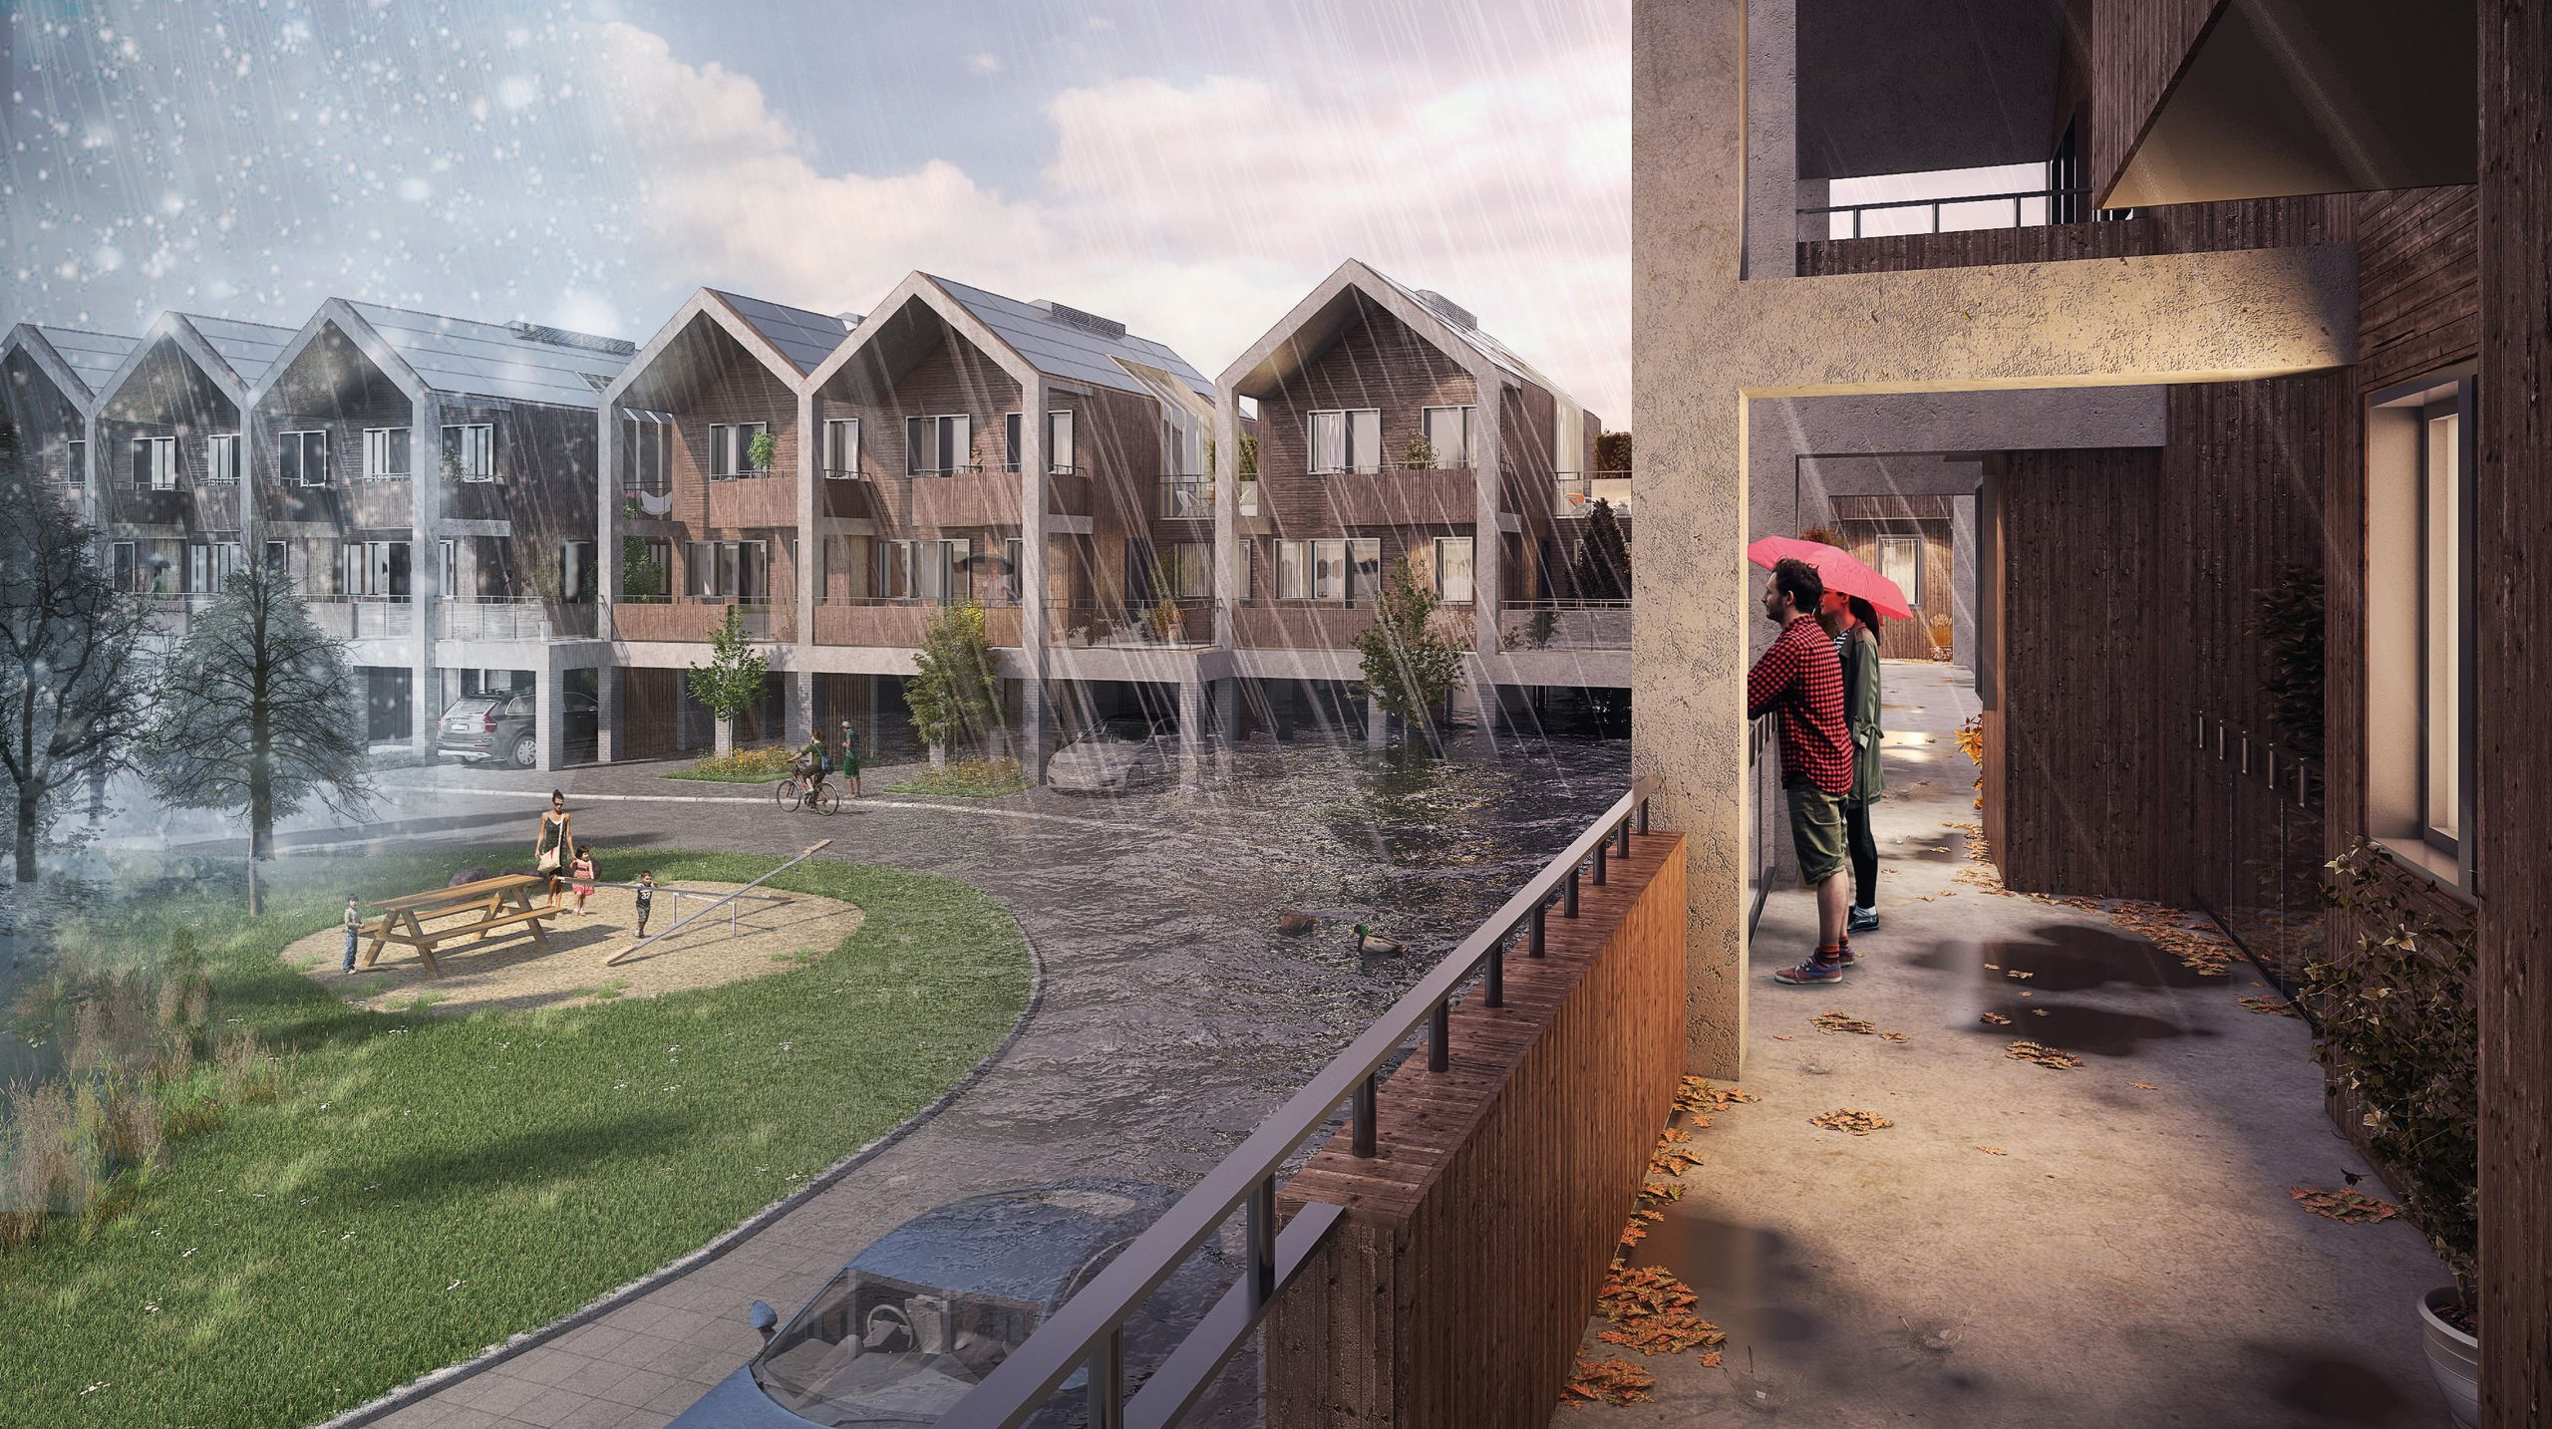
What’s Cambridge doing about flooding?
Greener City:
  Nature based solutions
  Alewife Stormwater Wetland
Retrofitted Buildings & Spaces:
  New buildings to be designed for flood risks projected for 2070
  Elevation of critical infrastructure
Image Source: Alewife basin, Cambridge DPW
Source: Retrofitting for Flood Resilience by Edward Barsley
Notes:
Greener City:
Increase plantings, including rain gardens
Map out soil conditions, groundwater, and slope for green infrastructure implementation
Alewife Stormwater Wetland – picture is of the Alewife basin! It’s both a park and fixes flooding problems
Retrofitted Buildings & Spaces:
Increased flood storage by using more detention basins, infiltration systems, and storage tanks
New buildings to be designed for flood risks projected for 2070
Elevation of critical infrastructure

Slide 42
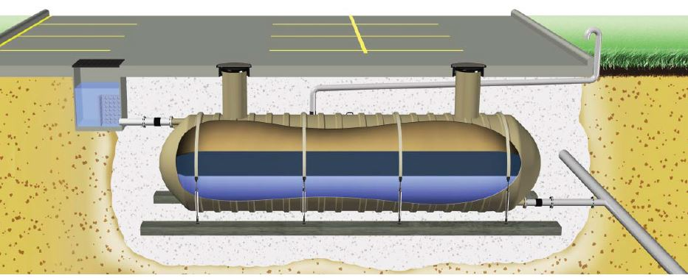

What’s Cambridge doing about flooding?
Resilient Communities:
  Community organizations develop a strong support network
  Residential, commercial, institutional, and city collaboration
  Safe & affordable homes to guarantee shelter from climate hazards
Green/Gray Infrastructure
  Infrastructure investments to prevent runoff
    500,000 gallons under parking lots in Central Square
    1.2-million-gallon stormwater tank under Tobin Schools
Source: Liquid Planner
Source: Rain Harvesting Supplies
Notes:
Green/Gray Infrastructure
Infrastructure investments to prevent runoff
500,000 gallons under parking lots in Central Square
1.2-million-gallon stormwater tank under Tobin Schools
Resilient Communities:
Community organizations develop a strong support network
Residential, commercial, institutional, and city collaboration
Safe & affordable homes to guarantee shelter from climate hazards

Slide 43
Agenda
Why do we care? Climate Change & Flooding
The common types of floods
Break!
Exploring flooding vulnerability in Cambridge
Interventions
Debrief & Closing

Slide 44
On Your Own
Strike up a conversation with at least 2 people about flooding topics (E.g., Extreme precipitation flooding vs. Coastal flooding, strategies to minimize flooding, action Cambridge is taking, etc.).
How did the conversation go?
What questions did they ask?
How did they feel?
We’ll open the next session by talking about what you heard!
Notes:
Strike up a conversation with at least 2 people about flooding topics (E.g., Extreme precipitation flooding vs. Coastal flooding, strategies to minimize flooding, action Cambridge is taking, etc.).
How did the conversation go?
What questions did they ask?
How did they feel?
We’ll open the next session by talking about what you heard!

Slide 45
Thank you
Please take a minute to tell us how today went & fill out an evaluation form!
Notes:
Please take a minute to tell us how today went & fill out an evaluation form!

Slide 46
Dos & Don’ts
Printed List for In-Person activity

Slide 47
  Get rid of standing water
  Empty water from damaged materials that aren't usually outdoors
  Drain wet areas and puddles of water, or fill them with dirt
  Clean up mold
  Drink flood water
  Encourage children to play in flood water
  Buy a home in a floodplain
  Sign up for City of Cambridge alerts
  Seek medical attention if you have an upset stomach, intestinal problems, headache and other flu-like discomfort

Slide 48
  Avoid or limit direct contact with contaminated flood water
  Report cuts, open wounds, or symptoms of illness
  Consider buying flood insurance
  Bury or burn flood-damaged items
  Turn on electricity/use home sewer system when flood waters are still in house
  Leave standing water in dry indoor areas
  Keep wet items that can grow mold
  Avoid or limit direct contact with contaminated flood water
  Report cuts, open wounds, or symptoms of illness
  Consider buying flood insurance

