Slide 1
Heat & Health
A C3 CLIMATE READINESS TRAINING MODULE​

Slide 2
Icebreaker!
Name
How long you’ve been with [organization]
Q: What do you hope to get out of our heat-health training toady?

Slide 3
Agenda
Extreme Heat 101
Heat & Public Health
Heat Strategies
Debrief & Closing

Slide 4
What is extreme heat?
Extreme heat is a prolonged period of very hot weather, which may include high humidity.
In Massachusetts, a “heat wave” is defined as a period of 3+ consecutive days above 90 °F
Extreme heat becomes more dangerous the longer it lasts
Notes:
During a heat wave, there is less cooling that happens at night, which prolongs the heat stress.
Continuous heat days, with little nighttime cooling, causes cumulative impacts of prolonged heat exposure (e.g., consider the impacts of extreme heat on the 2nd day of a heat wave vs the 8th).

Slide 5
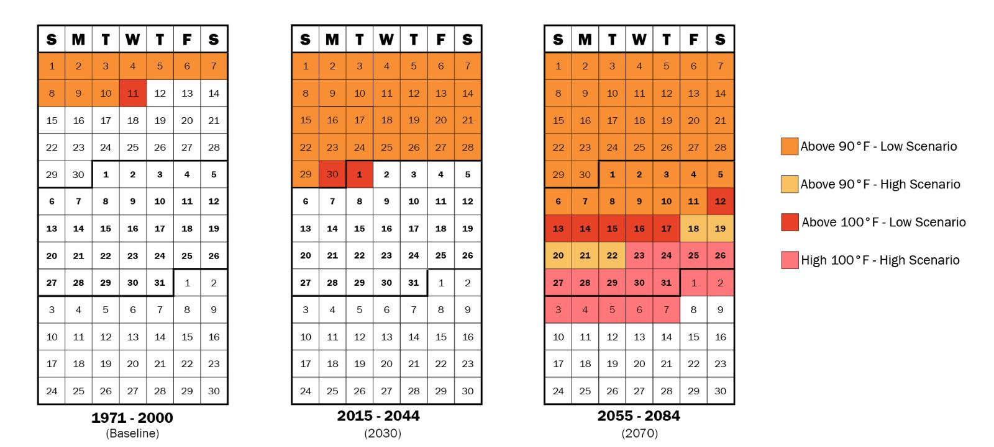
Why do we care about heat?
Heat waves are becoming more frequent, more severe, and longer lasting
Notes:
We care about extreme heat because it is the greatest cause of climate-related deaths, more than flooding, hurricanes, and tornadoes. A majority of these deaths are preventable with proper education and care.
Worrisomely, heat waves are becoming more frequent, more severe, and longer lasting as a result of climate change. For example, we are projecting the # of days above X degrees F to increase from Y to Z by YYYY. (Cambridge example: we are projecting the # of days above 90 degrees F to increase from 10 days per year historical average to 29 by 2030, approximately tripling).
This is why it is crucial for people and local governments to take appropriate action now to stay cool and safe.

Slide 6
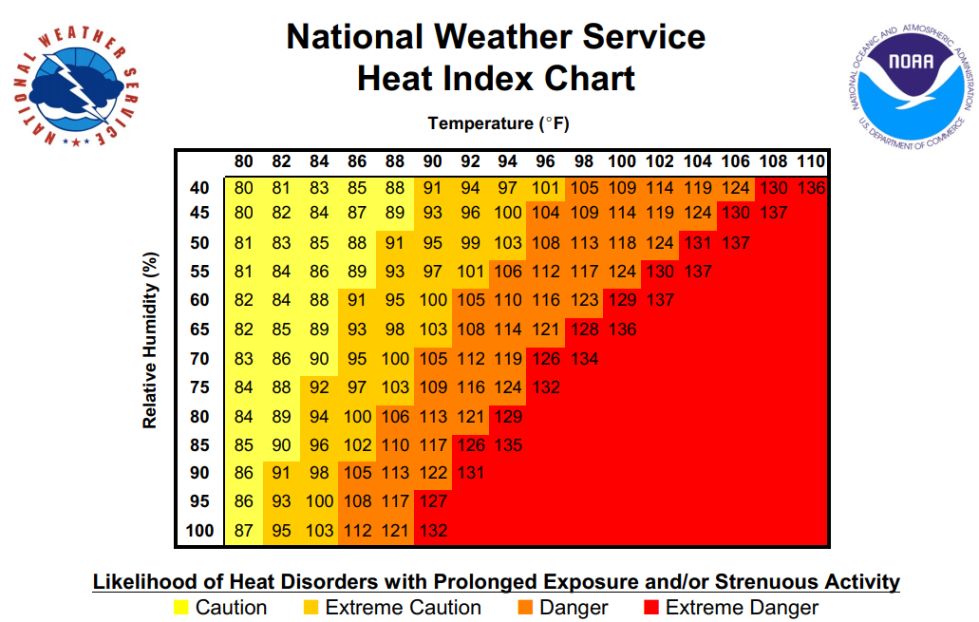
Heat index is a measure of how heat feels
Heat index combines air temperature and relative humidity to represent the “feels like” temperature.
Notes:
Extreme heat can be tricky because we tend to think of heat as the current temperature, when we should be thinking of it as the heat index, or the “feels like” temperature. The heat index incorporates the relative humidity, which is important because humid days can substantially worsen the perception of extreme heat.
To calculate the heat index, check the weather for the temperature and humidity, and line them up on the chart displayed to determine the heat index. For example, a 90 degree F day with a humidity of 70% produces a heat index of 105.
Studies have shown that a sustained increase of internal body temperatures reaching 104 degrees can lead to heat stroke and death (orange and red numbers).

Slide 7
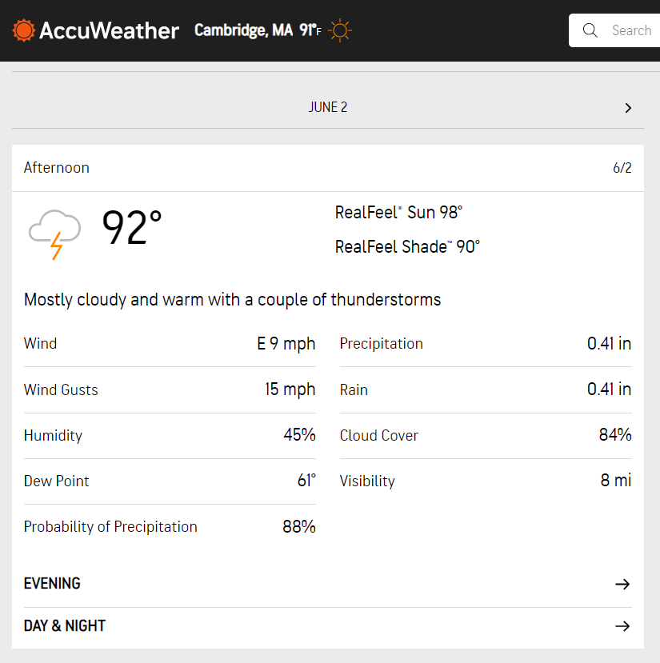
Let’s practice! Last week’s heat index
Notes:
Now let’s practice using the heat index. What is the heat index for a 92-degree F day with 45% humidity?

Slide 8
Heat Vulnerability
Vulnerability
=
Heat Sensitivity
+
Heat Exposure
-
Ability to Cope
Who you are, what you do
Where you are
What you have access to
Heat Sensitivity
Heat Exposure
Ability to Cope
Notes:
Now that we understand extreme heat, it’s time to talk about heat vulnerability. Vulnerability is a function of heat sensitivity, heat exposure, and one’s ability to cope.
Heat sensitivity is influenced by who you are and what you do (for example, older adults and people who work outdoors are more sensitive to extreme heat). Heat exposure is a product of where you are located (for example, some neighborhoods are hotter due to the urban heat island effect, lack of trees, etc.). Heat Sensitivity and Heat Exposure increase or worsen heat vulnerability. Ability to Cope, however, can lessen your vulnerability by protecting you from extreme heat. For example, a home with central AC is better “able to cope” with extreme heat, than one that does not.
To reduce your vulnerability to extreme heat, one can either reduce exposure/sensitivity AND/OR increase ability to cope.

Slide 9
Some people are more sensitive to heat
Wearing inappropriate clothing (heavy, dark clothing)
Consuming alcohol
Exercising outdoors
Eating hot, heavy meals
Not staying hydrated
Older Adults (65+)
Pregnant Women
People on Certain Medications
Low-income Households
Infants & Young Children
People with Disabilities or Limited Mobility
People with Chronic Illnesses
People who Live Alone or Are Bedridden
People Experiencing Homelessness
People without AC
People who Work or Train Outdoors
Notes:
Every single person is sensitive to extreme heat, but some people are more sensitive. The boxes on this slide indicate certain characteristics or behaviors that may cause someone to be more heat sensitive.
Pick 3 boxes on the screen. Why do you think this characteristic/behavior makes someone more sensitive to extreme heat? Are you surprised by any of these?

Slide 10
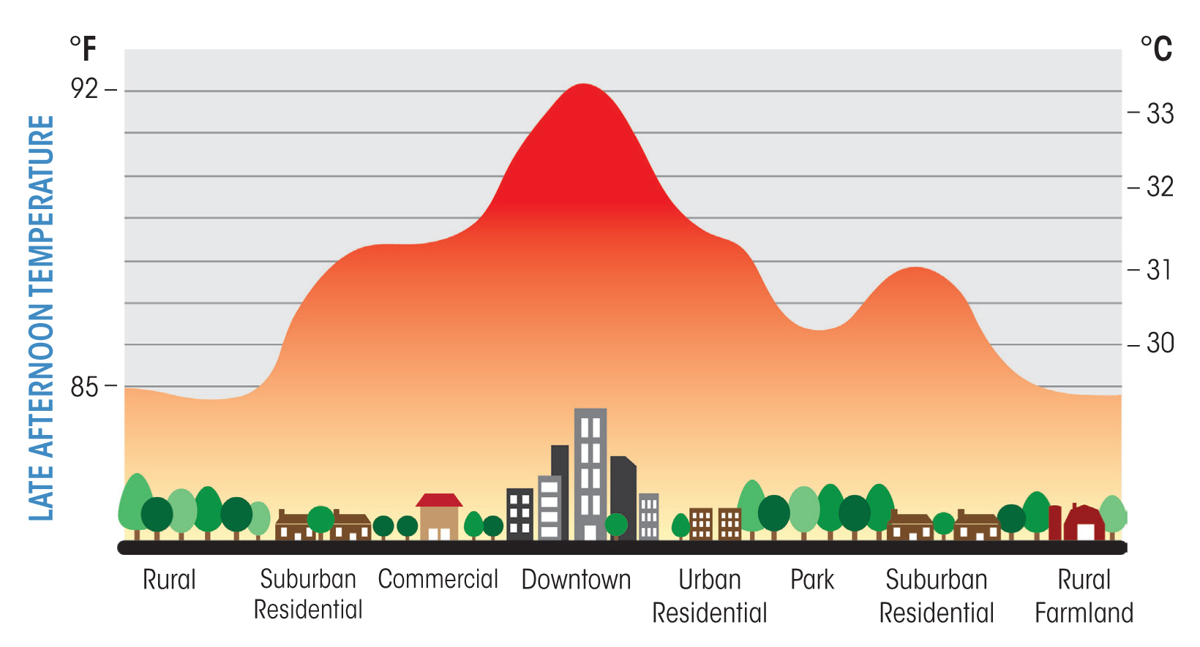
Some areas are more exposed to heat
Photo cred: FirstGreen
Notes:
In the same way certain people are more sensitive to heat, certain locations are most exposed to heat too. Certain factors, like more impervious pavement (buildings, sidewalks, roads, etc.) and fewer trees, can make a neighborhood hotter. That is why dense urban centers tend to be hotter than their rural surroundings (this is the urban heat island effect).

Slide 11
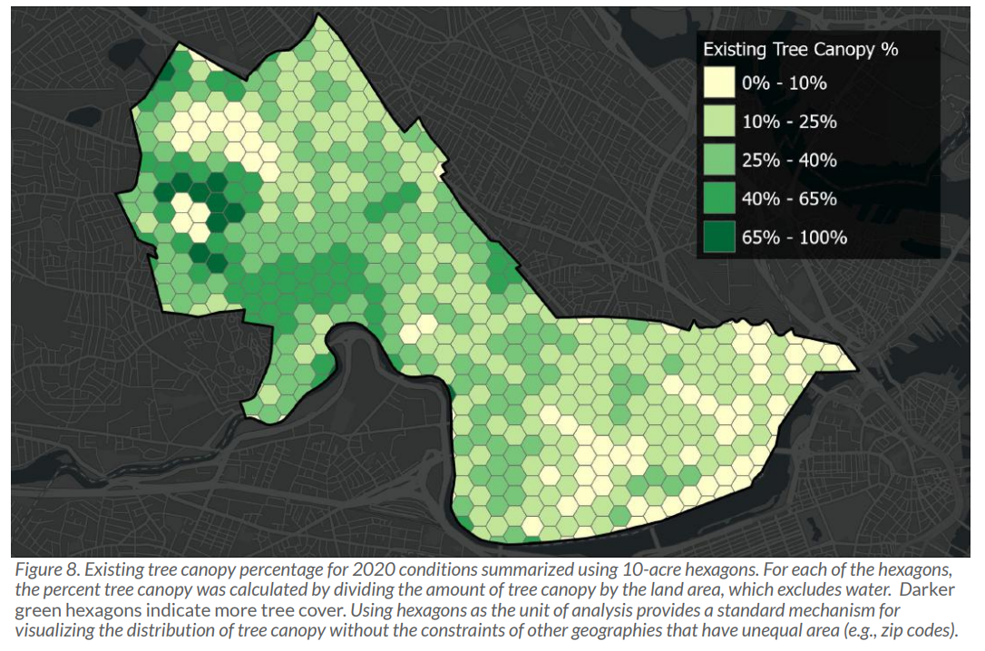
Heat Exposure: the power of trees
Notes:
Trees play an important role in how hot a neighborhood feels.
Using the City of Cambridge as an example, you can see how the 5 hottest areas in the City (circled in blue on the map on the right) also have the least amount of tree canopy cover. Similarly, the regions with highest tree canopy cover are cooler.
Photo cred 1: Cambridge Tree Canopy Assessment 2009-2020 (cambridgema.gov)
Photo cred 2: This map shows the estimated ambient air temperature adjusted for 2018 tree canopy, impervious and cool roof conditions on a 90-degree day. The circles highlight areas that exceed ambient air temperatures of 100 degrees. HEAT STRATEGIES (arcgis.com)

Slide 12
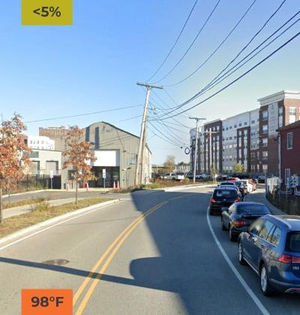
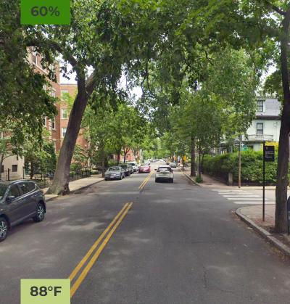
Notes:
Ready to see how influential trees actually are?
The 2 images were taken on the same day, at the same time, on 2 different streets. One, with 60% tree canopy and another with <5% tree canopy. What do you think the temperature difference between these two temperatures are?
[Advance animation to reveal answer]
These 2 streets have a 10 degree difference despite being in the same city on the same day and time. Some cities have seen over a 20 degree difference in their hottest and coolest areas!

Slide 13
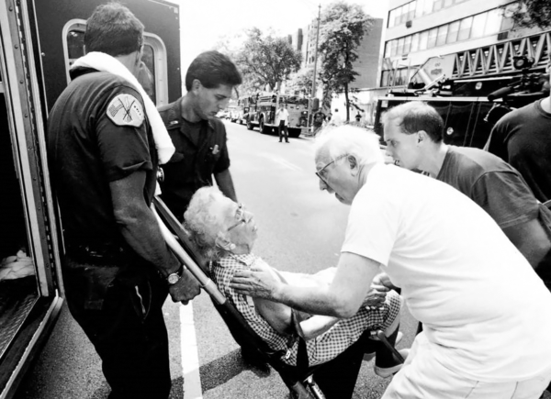
Impacts of Extreme Heat
Health
Heat related illnesses, more mosquitos & ticks, longer allergy season, mental health impacts, worse air pollution
Damage to infrastructure
Damaged roads/buildings, train derailments
More need for AC
Higher energy bills, increased risk of power outage
Drought
Water shortage, crop damage, financial damages
Notes:
We’ve learned what extreme heat is, who is most sensitive to heat, where heat is felt the greatest, and the power of trees. But let’s talk about what some of the impacts of extreme heat are.
For example,
- Health: heat can cause direct illness (we’ll get more into these later); longer summers and milder winters are leading to longer allergy seasons, more mosquitos and ticks surviving in a larger area (i.e., increasing the risk for lyme disease); mental health impacts; and worsening air pollution which aggravates respiratory illnesses.
- Infrastructure: heat also damages infrastructure like roads and buildings, causing cracks in asphalts; heat can also cause train tracks to buckle, causing more derailments.
- AC: Given the greater need for AC, residents are facing higher energy bills in the summer; this also increases the risk of power outages.
- Drought: Warmer weather can coincide with drought, leading to water shortages which can impact food availability and compromise water quality.

Slide 14
Agenda
Extreme Heat 101
Heat & Public Health
Heat Strategies
Debrief & Closing

Slide 15
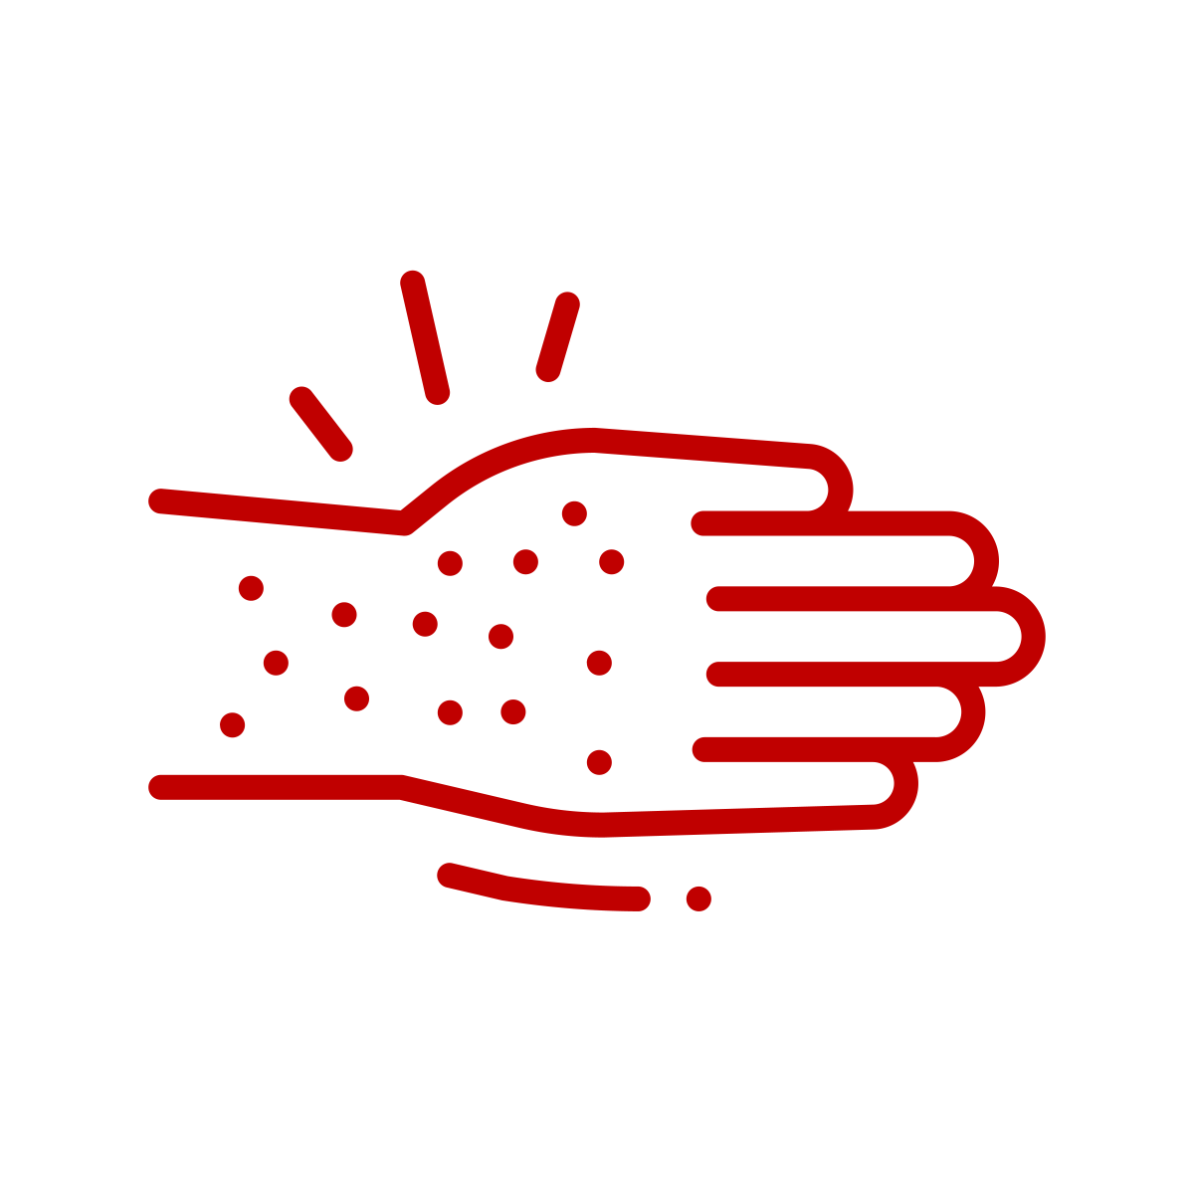
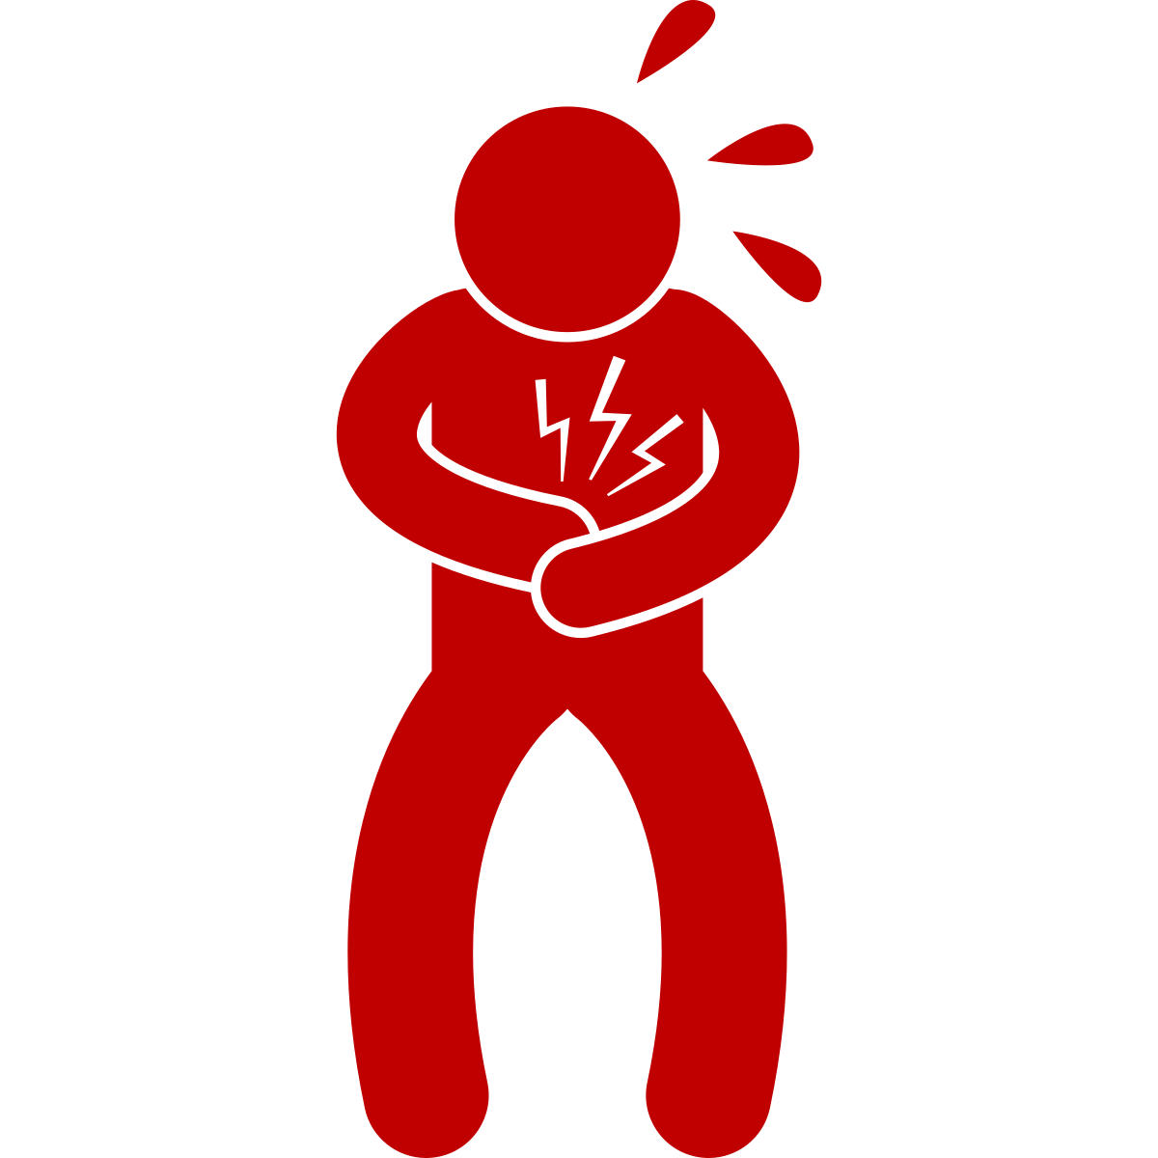
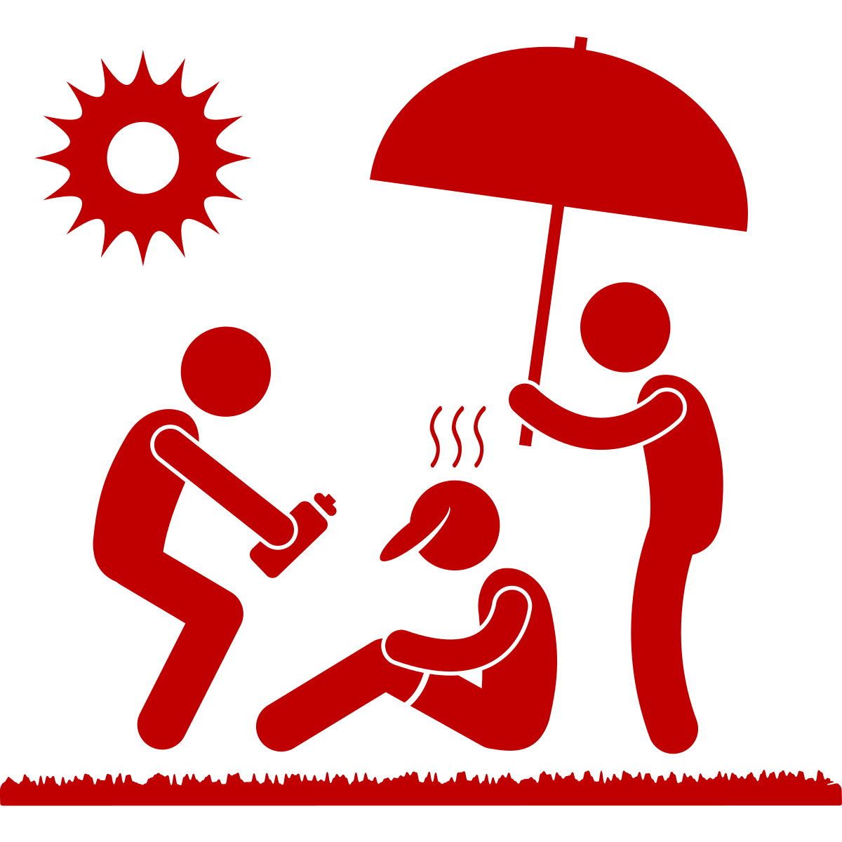
Heat Illnesses
 | SIGNS
Heat Rash | Red, itchy skin; small bumps or blisters
 | SIGNS
Heat Rash | Red, itchy skin; small bumps or blisters
Heat Cramp | Muscle pains or spasms in stomach, arms, or legs
Heat Exhaustion | Heavy sweating, paleness, muscle cramps, weakness, headache, nausea, vomiting, fainting, weak pulse
Heat Stroke | Extremely high body temperature (<104), hot skin with or without sweat, strong rapid pulse, dizziness, confusion, unconsciousness
Notes:
The 4 most common heat illnesses are heat rash, heat cramp, heat exhaustion, and heat stroke.
[Read the signs/symptoms for the 4 illnesses.]

Slide 16
Heat Illnesses
 | SIGNS | WHAT TO DO
Heat Rash | Red, itchy skin; small bumps or blisters | Gently dry off skin Put cold compress on skin Seek medical help if symptoms don’t improve
Heat Cramp | Muscle pains or spasms in stomach, arms, or legs | Stop physical activity and move to a cooler air-conditioned place Drink water Seek medical attention if cramps last longer than 1 hour
Heat Exhaustion | Heavy sweating, paleness, muscle cramps, weakness, headache, nausea, vomiting, fainting, weak pulse | Move to a cooler area, out of sun Loosen clothing Drink cool water Seek medical help if symptoms do not improve
Heat Stroke | Extremely high body temperature (<104), hot skin with or without sweat, strong rapid pulse, dizziness, confusion, unconsciousness | Call 911 immediately (delay can be fatal) Move individual to cooler, air-conditioned place Loosen clothing Cool body with fan, ice, or mister Do not give person anything to drink
Can be fatal
Notes:
[Review the treatment options for the 4 heat illnesses.]
Heat stroke is serious and can be fatal. If someone is having a heat stroke, call 911 and do not give them anything to drink (a person's ability to regulate their body temperature is compromised, and their internal organs may be under stress. In some cases, giving fluids orally can increase the risk of vomiting or aspiration, where fluid enters the lungs instead of the stomach).

Slide 17
Heat Illnesses
Red, itchy skin; small bumps or blisters
Heat Exhaustion
Heat Stroke
Gently dry off skin; Apply cold compress on skin
Stop physical activity and move to a cooler-air-conditioned space; Drink water; Seek medical attention if cramps last longer than 1 hour
Move to a cooler area, out of the sun; Loosen clothing; Drink cool water; Seek medical help if symptoms do not improve
Call 911 immediately (delay can be fatal); Move individual to cooler, air-conditioned space; Loosen clothing; Cool body with fan, ice, etc.; Do NOT give person anything to drink
Heat Rash
Heat Cramp
Extremely high body temperature (<104), hot skin with or without sweat, strong rapid pulse, dizziness, confusion, unconsciousness
Muscle pains or spasms in stomach, arms, or legs
Heavy sweating, paleness, muscle cramps, weakness, headache, nausea, vomiting, fainting, weak pulse
1
2
3
4
5
6
7
8
9
10
11
12
Notes:
To practice, let’s play a matching card game. We have to match the heat illness name, to its symptom and treatment.

Slide 18
Heat Illnesses
Red, itchy skin; small bumps or blisters
Heat Exhaustion
Heat Stroke
Gently dry off skin; Apply cold compress on skin
Stop physical activity and move to a cooler-air-conditioned space; Drink water; Seek medical attention if cramps last longer than 1 hour
Move to a cooler area, out of the sun; Loosen clothing; Drink cool water; Seek medical help if symptoms do not improve
Call 911 immediately (delay can be fatal); Move individual to cooler, air-conditioned space; Loosen clothing; Cool body with fan, ice, etc.; Do NOT give person anything to drink
Heat Rash
Heat Cramp
Extremely high body temperature (<104), hot skin with or without sweat, strong rapid pulse, dizziness, confusion, unconsciousness
Muscle pains or spasms in stomach, arms, or legs
Heavy sweating, paleness, muscle cramps, weakness, headache, nausea, vomiting, fainting, weak pulse
1
2
3
4
5
6
7
8
9
10
11
12
Notes:
Matching game results.

Slide 19
Agenda
Extreme Heat 101
Heat & Public Health
Heat Strategies
Debrief & Closing

Slide 20
Beat the Heat
Notes:
Here are some tips individuals can do to stay cool and safe during periods of extreme heat.

Slide 21
[Placeholder]
In 3-4 slides, describe the actions [YOUR CITY/TOWN] is taking to combat extreme heat and protect health, safety, and wellbeing.
Slides 25-28 are an example from the City of Cambridge, MA.
We recommend keeping slide 28 as a strong example of Resilience Hubs, an emerging …

Slide 22
What’s Cambridge doing about heat?
Greener, Cooler City
Cool Buildings
Cool Streets
Cool Communities
Notes:
Example slide of what [CITY/TOWN] is doing about extreme heat.

Slide 23
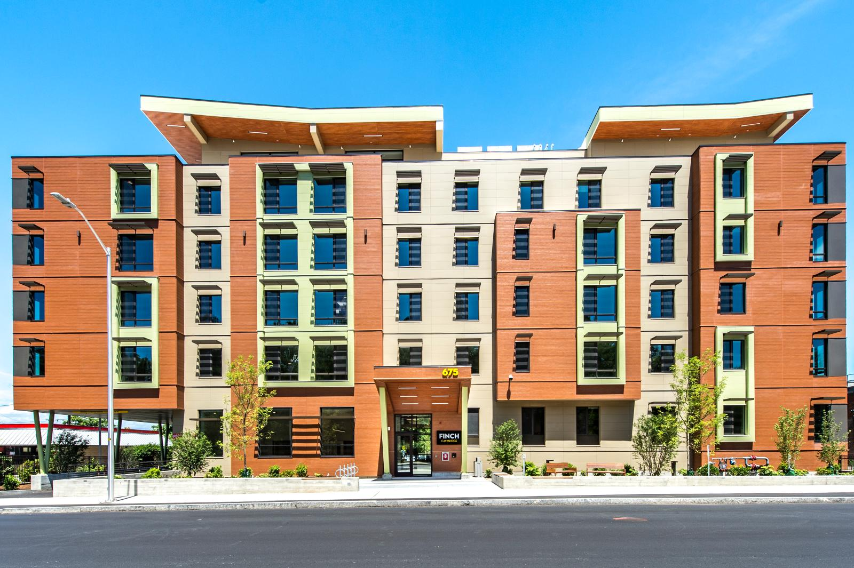
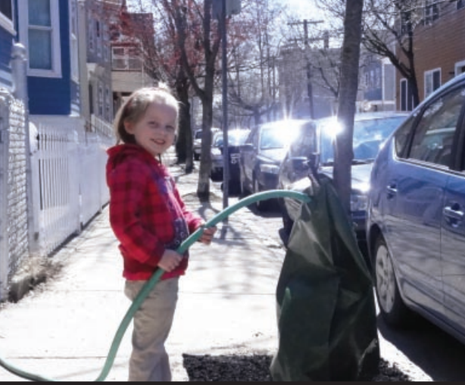
What’s Cambridge doing about heat?
Greener, Cooler City:
Increase plantings, including roof gardens
Expand tree canopy cover and shade
Improve access to open space
Cool Buildings:
New buildings/renovations must be able to stay cool during hot temperatures
Notes:
Example slide of what [CITY/TOWN] is doing about extreme heat.

Slide 24
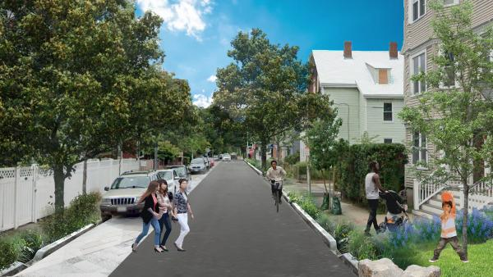
What’s Cambridge doing about heat?
Cool Streets:
Implementing a “Complete Streets” design
More trees on streets and near bus & train stops
Cool Communities:
Adding shading/cooling to community spaces so they can remain open to the community during times of high heat
Working with Eversource to increase resilience of electrical equipment
Building out “resilience hubs”
Notes:
Example slide of what [CITY/TOWN] is doing about extreme heat.

Slide 25
What is a resilience hub?
Notes:
Start at 1:03, end at 6:10 for overview of resilience hub.

Slide 26
Agenda
Extreme Heat 101
Heat & Public Health
Heat Strategies
Debrief & Closing

Slide 27
Optional Activity
Strike up a conversation with at least 2 people about extreme heat topics (E.g., Heat risk, heat illnesses, strategies to stay cool, action [YOUR CITY/TOWN] is taking, etc.).
How did the conversation go?
What questions did they ask?
How did they feel?
We’ll open the next session by talking about what you heard!

Slide 28
Thank you
Please take a minute to tell us how today went & fill out an evaluation form!

