Slide 1
Heat & Health
A C3 CLIMATE READINESS TRAINING MODULE​

Slide 2
Icebreaker!
Name
How long you’ve been with C3?
Q: What do you hope to get out of our heat-health training toady?

Slide 3
Agenda
Climate Justice Pair & Share
Climate Change & Justice Recap
Extreme Heat 101
Break!
Heat Illnesses & Interventions
Debrief & Closing

Slide 4
Cooked: Survival by Zip Code
Notes:
In July 1995, a heatwave overwhelmed most of the Midwest.
Temperatures paired with high humidity led to dangerous conditions.
Highest temperatures on record since the dust bowl at 106 with extremely high humidity, resulting in a feels like temperature of 124
In Chicago, the characteristics of the heat island effect prevented temperatures from cooling over night = no relief.
Over a 5-day period, the heat wave claimed over 700 lives in Chicago alone, making this one of the deadliest climate disasters. Most of the victims were older adults, people of color, and poor.

Slide 5
From the Chicago example or your Cambridge observations this past week, discuss:
1. What did you observe related to climate change, vulnerability, or resilience? (or share videos/photos)
2. Was there anything that surprised you?
PAIR & SHARE
Notes:
Before breaking into groups:
What questions do you have? What does this bring up for you?

Slide 6
Agenda
Climate Justice Pair & Share
Climate Change & Justice Recap
Extreme Heat 101
Break!
Heat Illnesses & Interventions
Debrief & Closing

Slide 7
What are the effects & impacts of Climate Change?
Globally?
In Cambridge?
RECAP

Slide 8
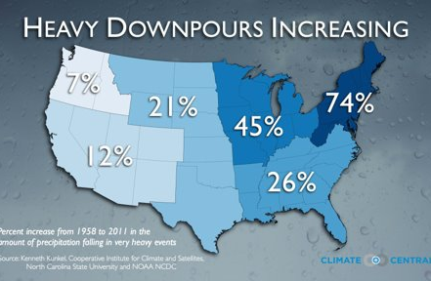
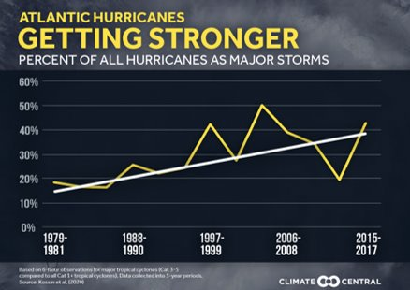
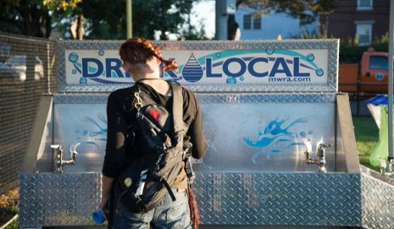
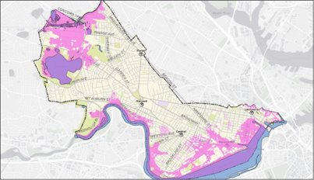
Effects: WARMER, WETTER, and WEIRDER
Notes:
Compared to historic trends, metro boston is and will continue to experience:
warmer summers and winters and more risky heat days,
Frequent and severe rain and snow event. More frequent/severe Flooding caused by these events and sea level rise
More flash floods, strong storms, cold snaps, just weird weather

Slide 9
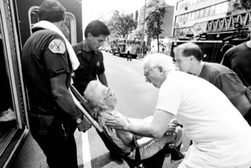
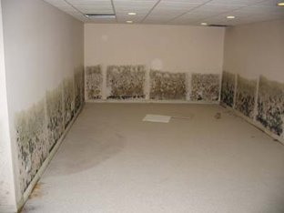
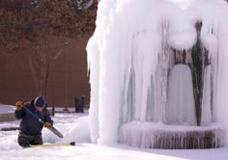
Impacts: WARMER, WETTER, and WEIRDER
Notes:
The impacts of these changes will be felt directly in the moment and indirectly, after the event or over time.
Climate will impact everything from health to housing. From increases in heat illnesses and diseases from ticks due to heat, damaged roads/housing from storms or heat, disruptions to essential services and power or communication networks.
Economy and mental health impacts that radiate out from that.

Slide 10
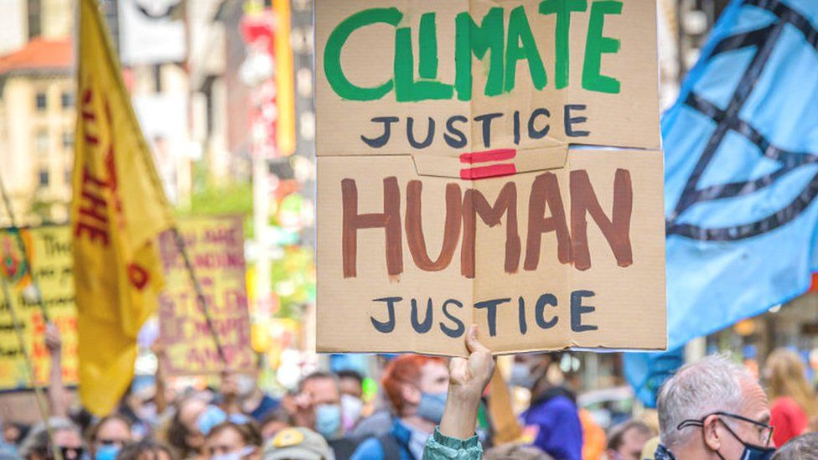
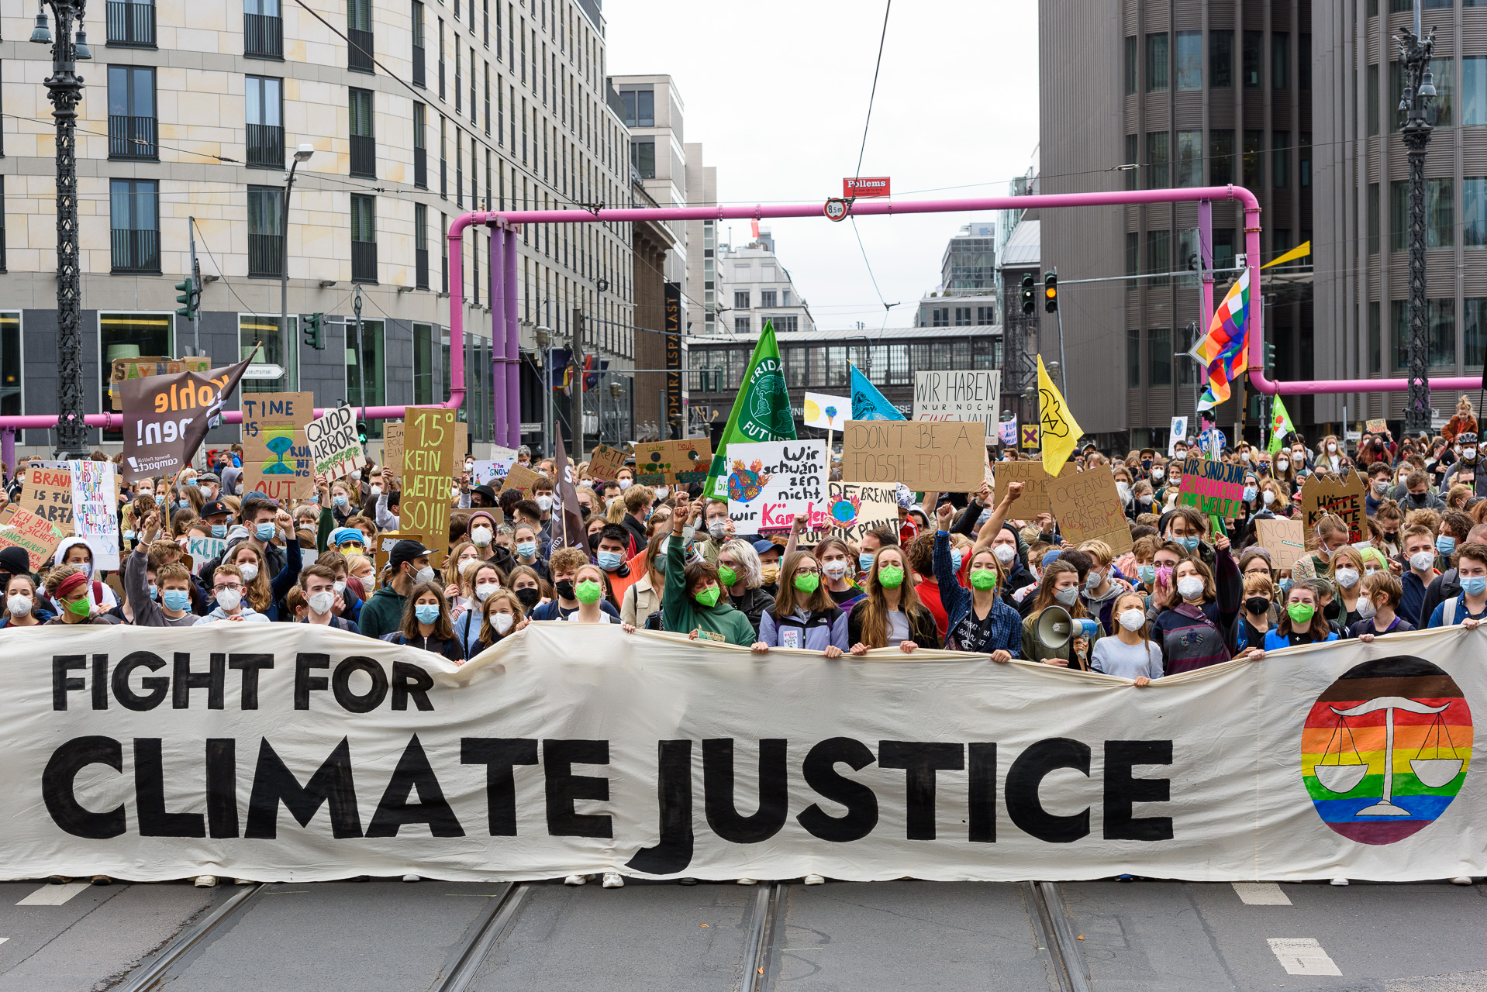
Climate Justice
Climate Injustice occurs when…
Climate Justice means…
Notes:
Climate justice acknowledges how privilege, power, and oppression are integral to our understanding of how we are impacted by climate change and our environment

Slide 11
Climate Justice
Climate Injustice occurs when…
Vulnerable communities are hit the hardest by the effects of the climate crisis despite being the least able to prepare for or cope with the impacts.
Climate Justice means…
Equal protection from harm
Equal access to benefits
Notes:
Climate justice acknowledges how privilege, power, and oppression are integral to our understanding of how we are impacted by climate change and our environment

Slide 12
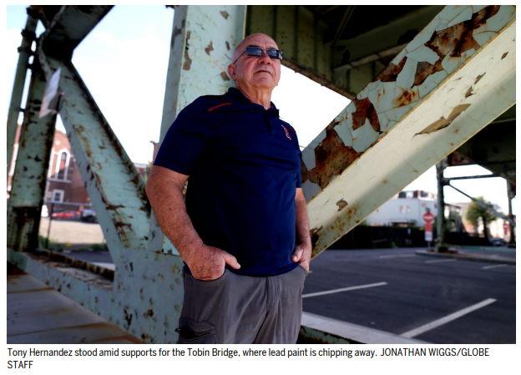
Climate Injustice in the news
“It was Hernandez who first raised the alarm in February. An immigrant from Cuba, the former union rep spent his whole career painting bridges, including the Tobin from 1979 to 1983. So he knew right away what had happened: A frigid snap, followed by a warmup, had bubbled the paint loose and dropped poisonous green and rust-colored confetti all over the neighborhood.”
Notes:
Enraged, he told Roseann Bongiovanni at the environmental justice group GreenRoots.
“All of us thought, ‘Oh no, it can’t be, the state couldn’t have left lead on the bridge,’” she recalled. But the city tested the paint chips, and Hernandez was right. We’ve known for a long time that lead paint is toxic, especially to babies and kids.”
Lead paint banned in 1978, but continued to be used in public projects until 1990s
Lead dust blows through windows, carried in on bottom of shoes/pets
PH notes: All children who are at risk for lead exposure should be tested for lead poisoning. Some children are more likely to be exposed to lead than others. These include children who:​
live or spend time in a house or building built before 1978​
are from low-income households​
are immigrants, refugees, or recently adopted from less developed countries​
live or spend time with someone who works with lead or has hobbies that expose them to lead​
Lead Poisoning: Venous blood levels ≥ 10 μg/dL (reduced from 25 μg/dL)​
Blood Lead Level of Concern: Venous Blood Levels 5 to <10 μg/dL

Slide 13
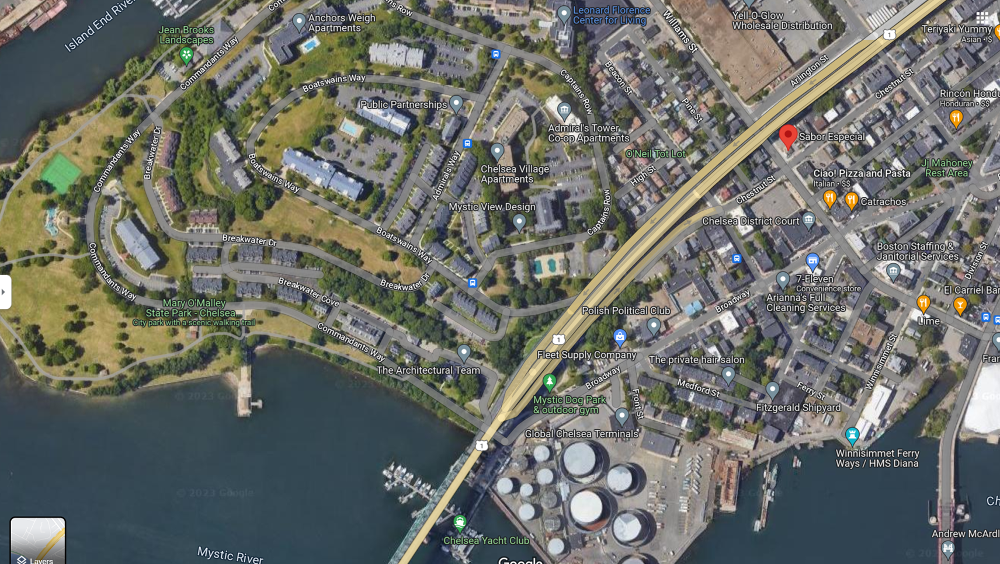
“The wind had carried it blocks away — onto gardens, parking spots, porches, and stairs, along the streets, and all over the patio at Restaurante Sabor Especial, by the courthouse.”
Notes:
Since the DOT took it over in 2010, parts of the bridge have been deleaded and improved, but this Chelsea section is not one of them, said Lavallee. That work — a four-year, $100 million project — was supposed to start in the fall. Now it will begin in early summer.
DOT workers spent weeks collecting the paint chips
continue to inspect the area twice a week.
They’ve distributed fliers and set up a hot line (857-492-0221) for residents to report debris and other concerns.
Advocates have pushed the state to do more: to encase the crumbling paint immediately, offer easy access to blood tests, and apologize to a community still paying for the state’s neglect.
Note: Of the 5000 bridges DOT inspects in MA, about 1500 have lead paint. Who lives near these bridges and roads?

Slide 14
Agenda
Climate Justice Pair & Share
Climate Change & Justice Recap
Extreme Heat 101
Break!
Heat Illnesses & Interventions
Debrief & Closing

Slide 15
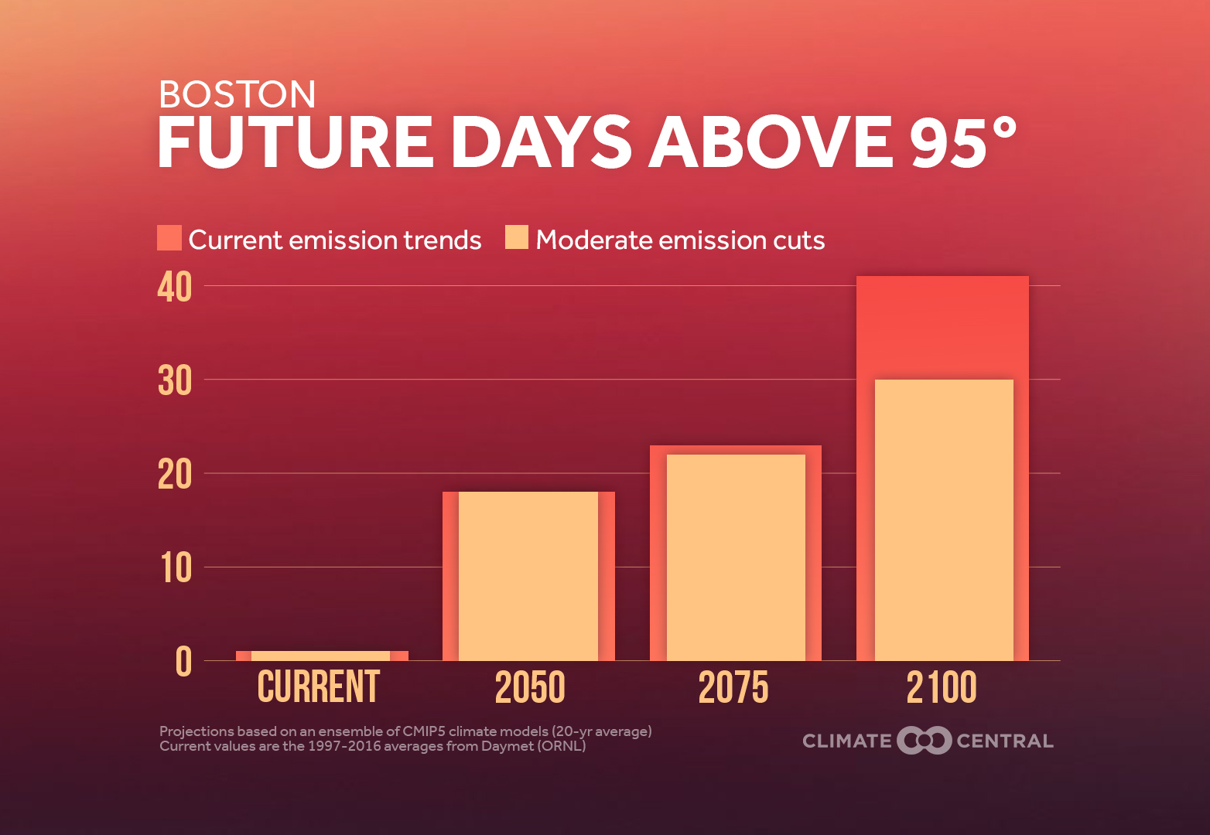
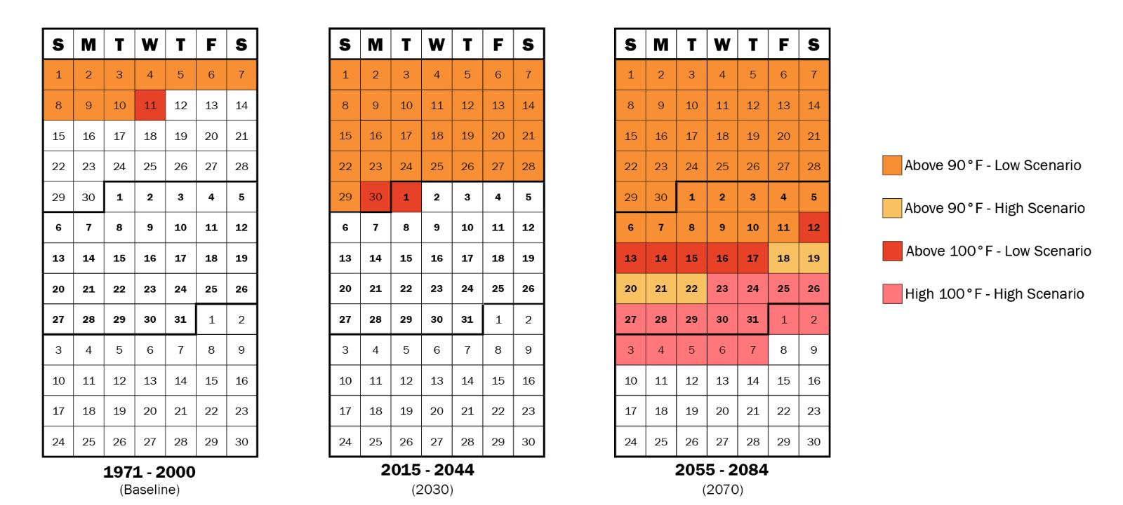
Why do we care about heat?
Notes:
Julia

Slide 16
Why do we care about heat?
Heat waves are becoming more frequent, more severe, and longer lasting
Notes:
Heat = greatest rate of climate related deaths, deaths mostly preventable

Slide 17
What is extreme heat?
Extreme heat is a prolonged period of very hot weather, which may include high humidity.
In Massachusetts, a “heat wave” is defined as a period of 3+ consecutive days above 90 °F
Extreme heat becomes more dangerous the longer it lasts
Notes:
Less cooling at night = prolonged heat stress
Night time temps – not cooling at night
Cumulative impacts of continuous heat days
Prolonged exposure = day 2 vs day 5.

Slide 18
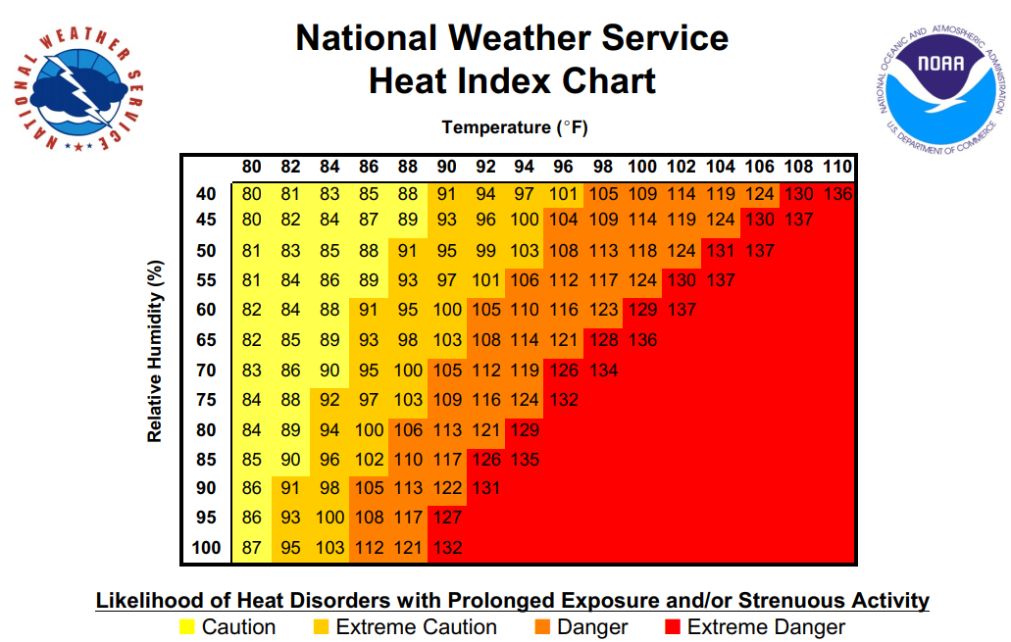
Heat index is a measure of how heat feels
Heat index combines air temperature and relative humidity to represent the “feels like” temperature.
Notes:
A sustained increase of internal body temperatures reaching 104 degrees can lead to heat stroke and death (orange numbers).

Slide 19
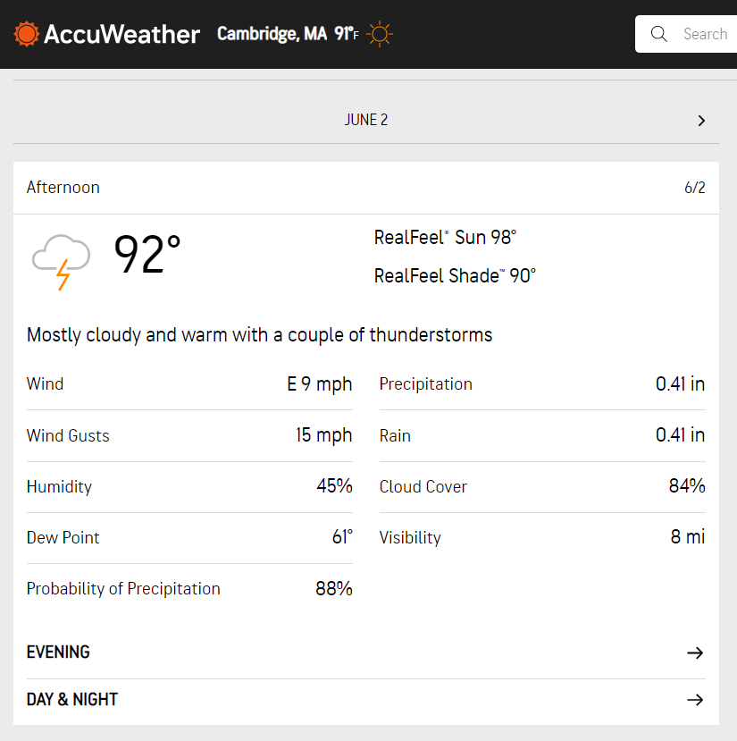
Let’s practice! Last week’s heat index

Slide 20
Heat Vulnerability
Vulnerability
=
Heat Sensitivity
+
Heat Exposure
-
Ability to Cope
Who you are, what you do
Where you are
What you have access to
Heat Sensitivity
Heat Exposure
Ability to Cope
Notes:
Can either reduce exposure/sensitivity AND/OR increase adaptive capacity

Slide 21
Some people are more sensitive to heat
Wearing inappropriate clothing (heavy, dark clothing)
Consuming alcohol
Exercising outdoors
Eating hot, heavy meals
Not staying hydrated
Older Adults (65+)
Pregnant Women
People on Certain Medications
Low-income Households
Infants & Young Children
People with Disabilities or Limited Mobility
People with Chronic Illnesses
People who Live Alone or Are Bedridden
People Experiencing Homelessness
People without AC
People who Work or Train Outdoors
Notes:
We are all heat sensitive at certain times
Go around the room and pick a box to explain why more heat sensitive

Slide 22
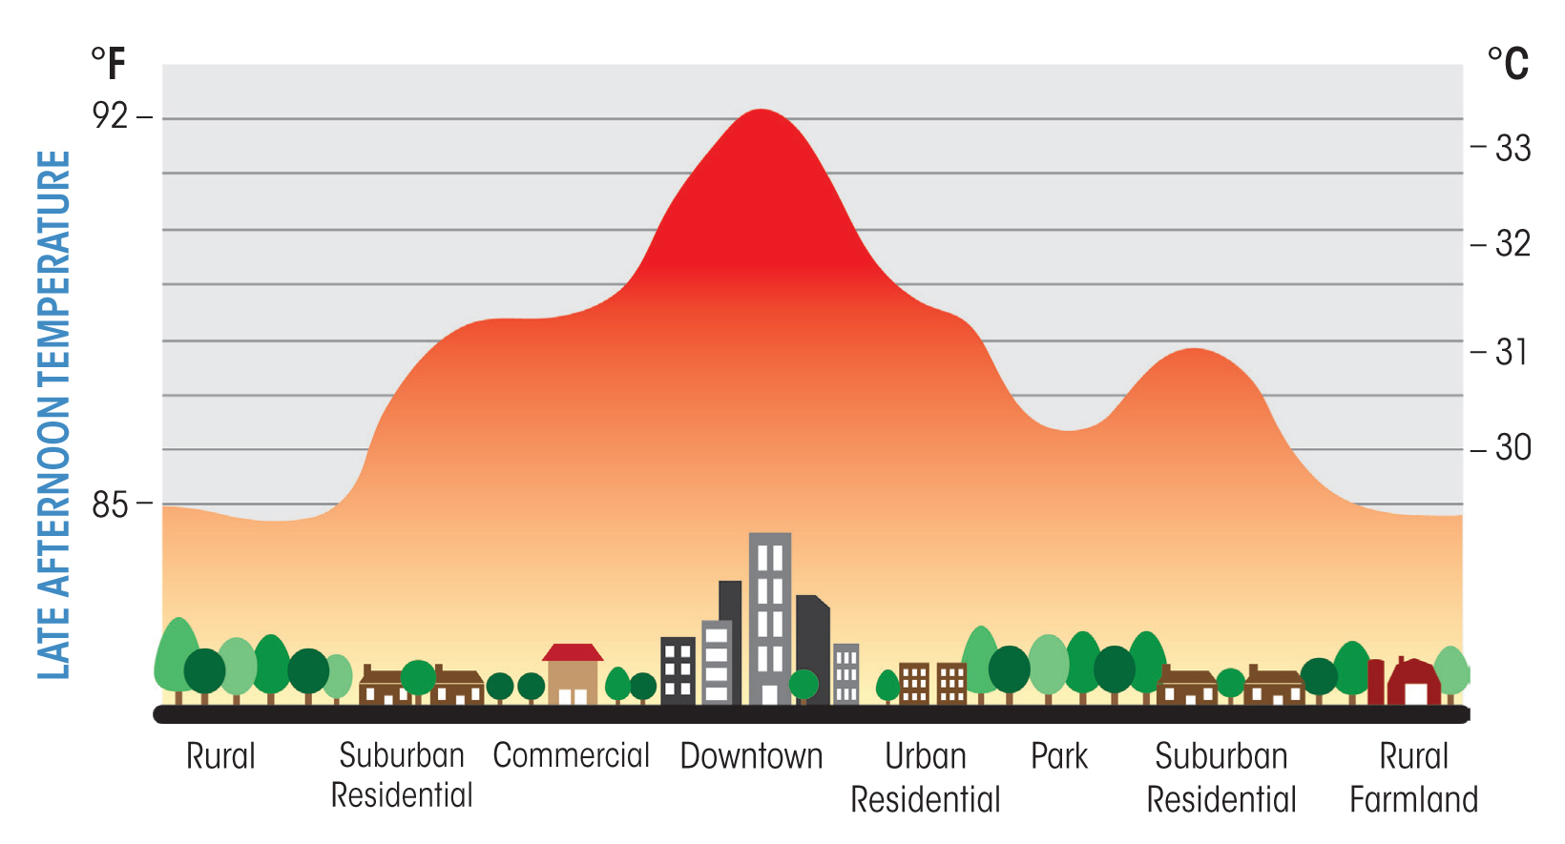
Some areas are more exposed to heat
Notes:
Photo cred: FirstGreen

Slide 23
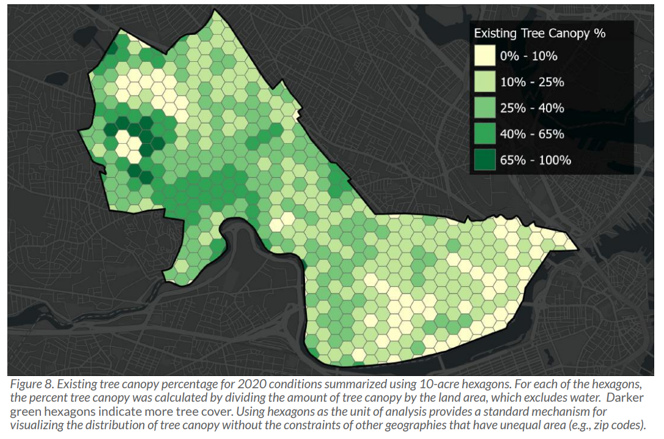
Heat Exposure: the power of trees
Notes:
Photo cred 1: Cambridge Tree Canopy Assessment 2009-2020 (cambridgema.gov)
Photo cred 2: This map shows the estimated ambient air temperature adjusted for 2018 tree canopy, impervious and cool roof conditions on a 90-degree day. The circles highlight areas that exceed ambient air temperatures of 100 degrees. HEAT STRATEGIES (arcgis.com)

Slide 24
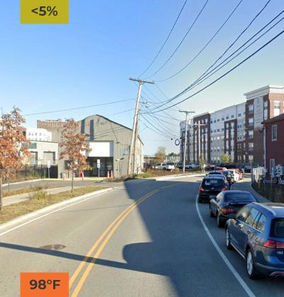
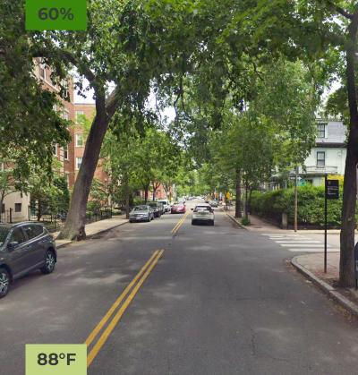
Notes:
Some cities have a 20+ degree diff

Slide 25
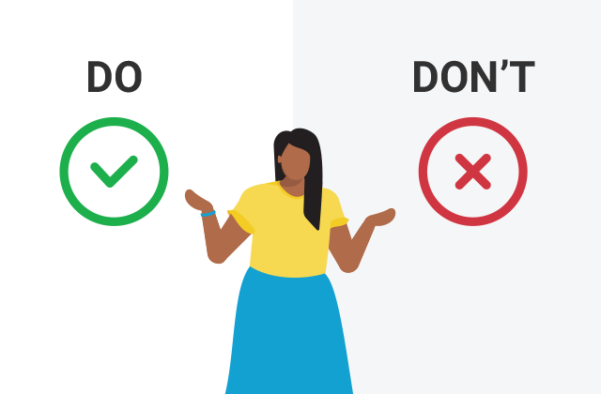
Dos & Don’ts of Extreme Heat
Each group will receive an envelope, inside are the dos and don’ts of coping with extreme heat – but they’re all mixed up!
Read each action and ask:
When its hot outside, is this something to do or to avoid?
The first to sort all actions correctly wins!
Notes:
Reflect: which of these do you do?
Which of these are harder to do?
Which of these would you feel comfortable recommending someone do?

Slide 26
What do you do to stay cool?
Pair & Share

Slide 27
Agenda
Climate Justice Pair & Share
Climate Change & Justice Recap
Extreme Heat 101
Break!
Heat Illnesses & Interventions
Debrief & Closing

Slide 28
Agenda
Climate Justice Pair & Share
Climate Change & Justice Recap
Extreme Heat 101
Break!
Heat Illnesses & Interventions
Debrief & Closing

Slide 29
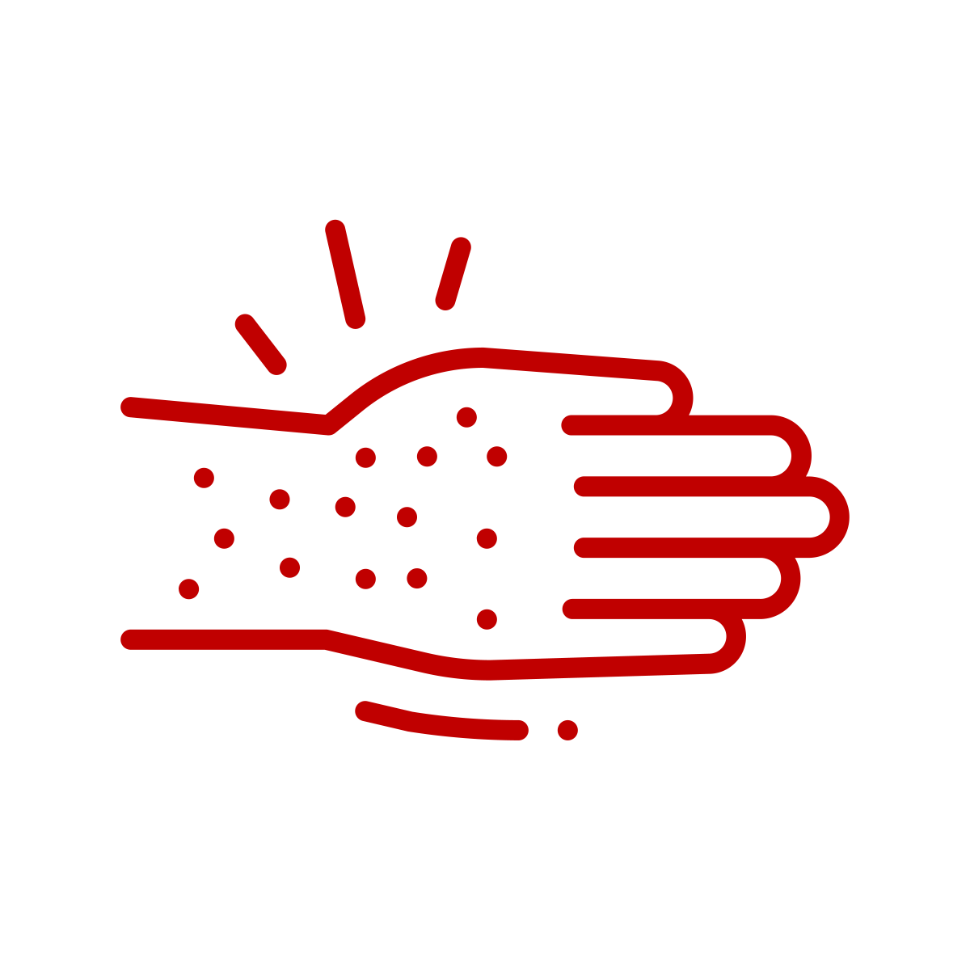
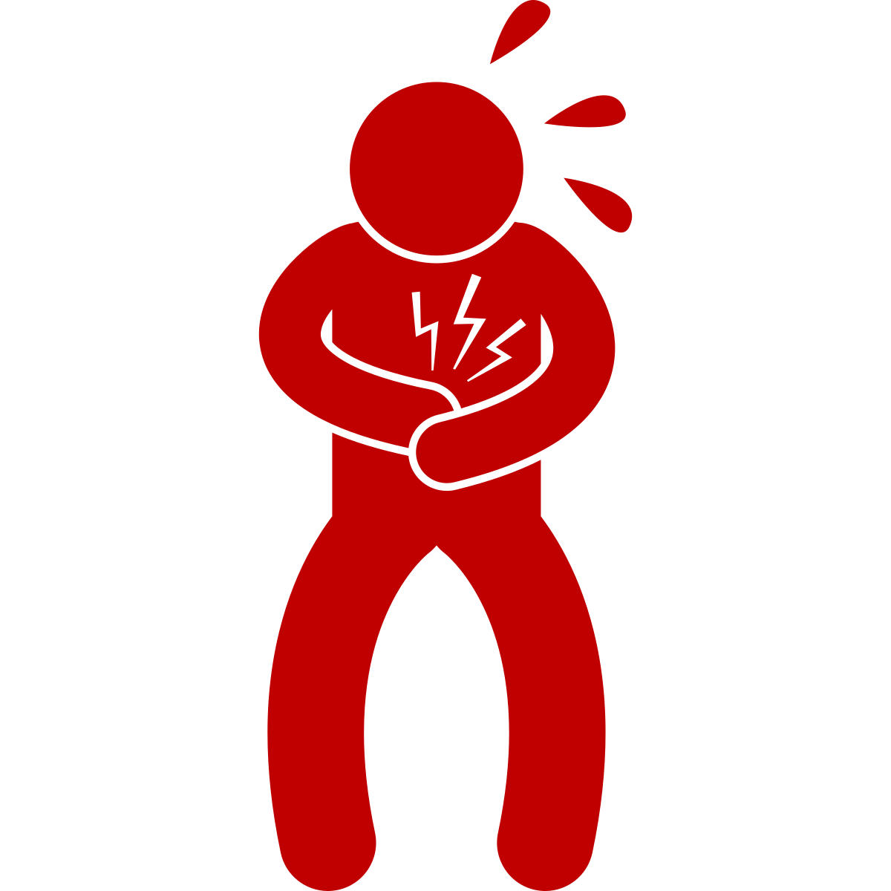
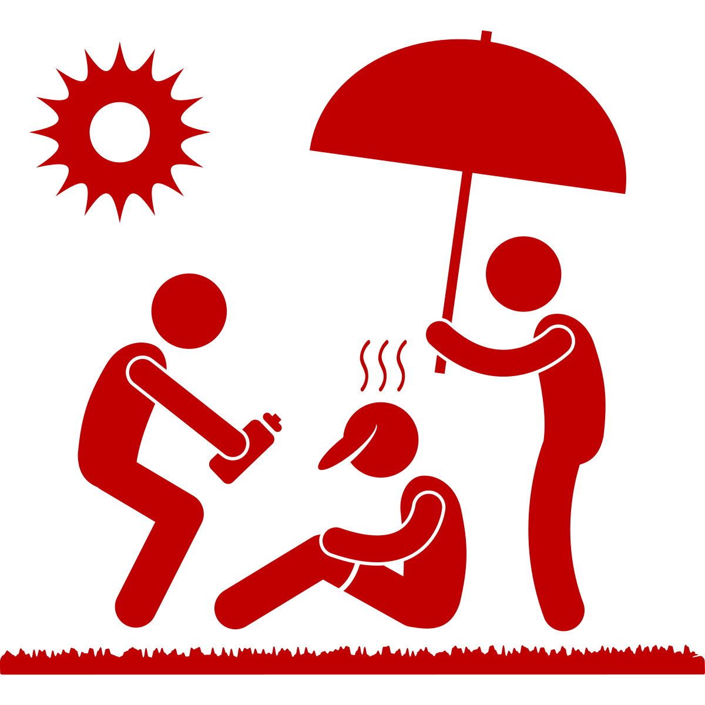
Heat Illnesses
 | SIGNS
Heat Rash | Red, itchy skin; small bumps or blisters
 | SIGNS
Heat Rash | Red, itchy skin; small bumps or blisters
Heat Cramp | Muscle pains or spasms in stomach, arms, or legs
Heat Exhaustion | Heavy sweating, paleness, muscle cramps, weakness, headache, nausea, vomiting, fainting, weak pulse
Heat Stroke | Extremely high body temperature (<104), hot skin with or without sweat, strong rapid pulse, dizziness, confusion, unconsciousness
Notes:
Julia
Why not to give fluids to heat stroke: person's ability to regulate their body temperature is compromised, and their internal organs may be under stress. In some cases, giving fluids orally can increase the risk of vomiting or aspiration, where fluid enters the lungs instead of the stomach.

Slide 30
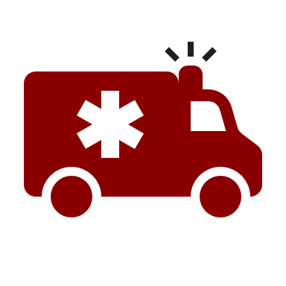
Heat Illnesses
 | SIGNS | WHAT TO DO
Heat Rash | Red, itchy skin; small bumps or blisters | Gently dry off skin Put cold compress on skin Seek medical help if symptoms don’t improve
Heat Cramp | Muscle pains or spasms in stomach, arms, or legs | Stop physical activity and move to a cooler air-conditioned place Drink water Seek medical attention if cramps last longer than 1 hour
Heat Exhaustion | Heavy sweating, paleness, muscle cramps, weakness, headache, nausea, vomiting, fainting, weak pulse | Move to a cooler area, out of sun Loosen clothing Drink cool water Seek medical help if symptoms do not improve
Heat Stroke | Extremely high body temperature (<104), hot skin with or without sweat, strong rapid pulse, dizziness, confusion, unconsciousness | Call 911 immediately (delay can be fatal) Move individual to cooler, air-conditioned place Loosen clothing Cool body with fan, ice, or mister Do not give person anything to drink
Can be fatal
Notes:
Why not to give fluids to heat stroke: person's ability to regulate their body temperature is compromised, and their internal organs may be under stress. In some cases, giving fluids orally can increase the risk of vomiting or aspiration, where fluid enters the lungs instead of the stomach.

Slide 31
Matching Cards: Heat Illness Edition
Objective: Match the (1) heat illness name to its (2) symptom and (3) treatment.
Rules: Each player can only lift 3 cards per turn.
If all 3 cards are matching: remove the cards from the board
If all 3 cards are NOT matching: turn the cards back around and go to the next player.
First team to match all cards wins!
Heat Rash
Heat Cramp
Heat Exhaustion
Heat Stroke

Slide 32
What’s Cambridge doing about heat?
Greener, Cooler City
Cool Buildings
Cool Streets
Cool Communities
Notes:
Sharon
Focused on reducing exposure except cool communities (reducing sensitivity/improving adaptive capacity)

Slide 33
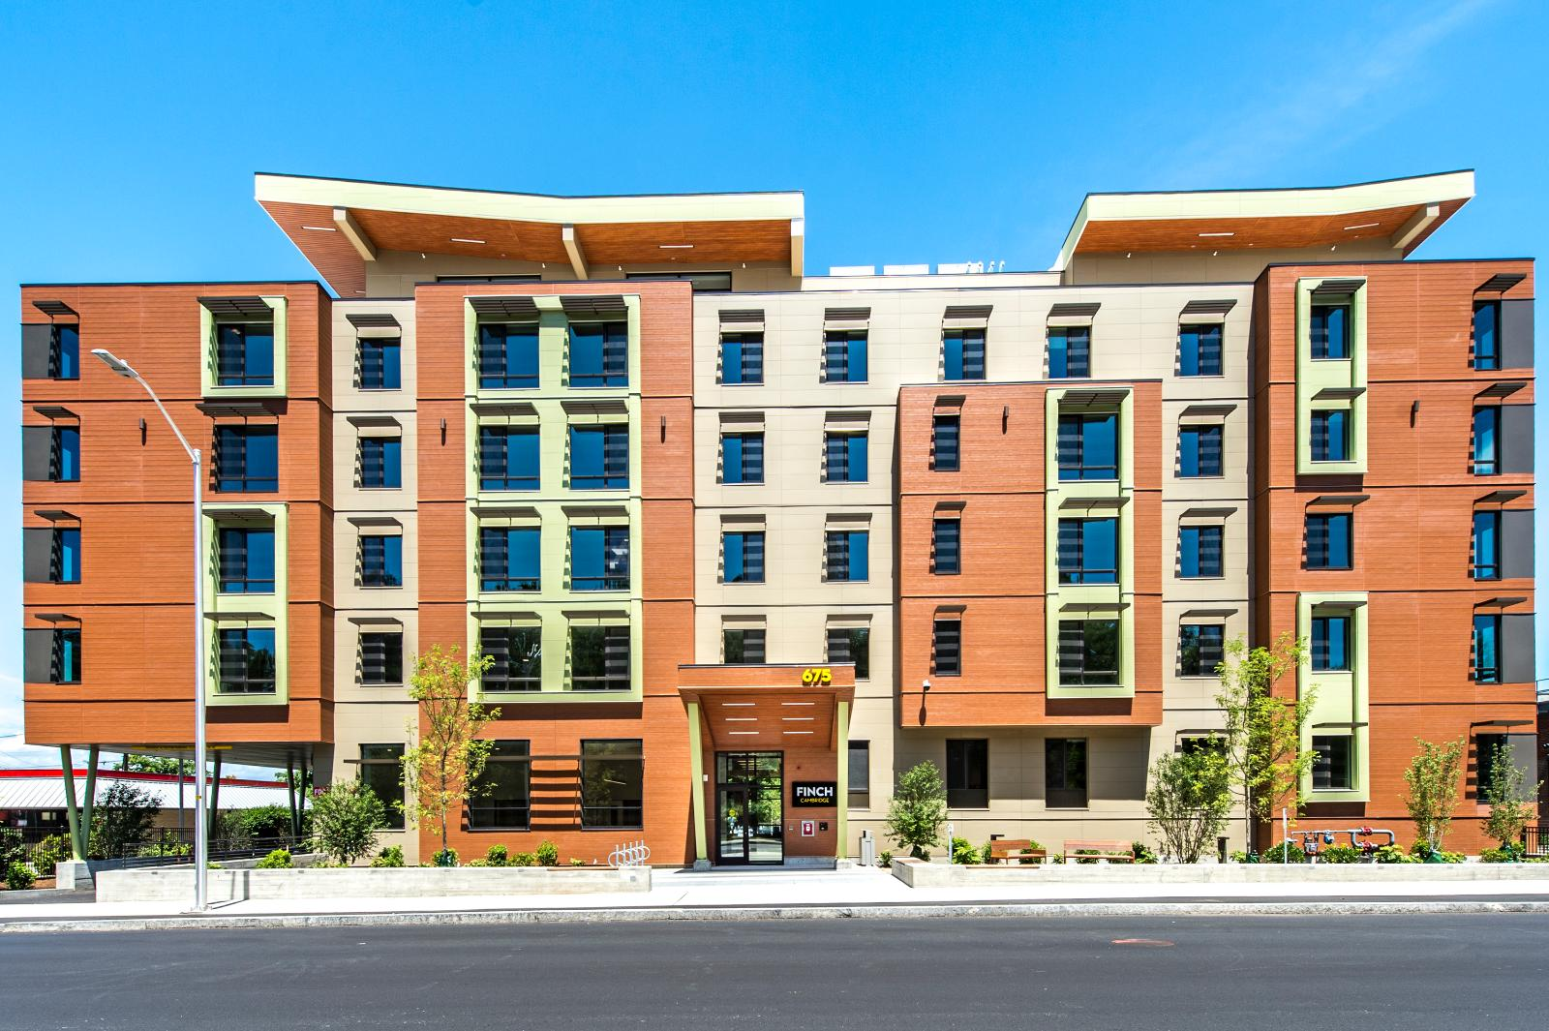
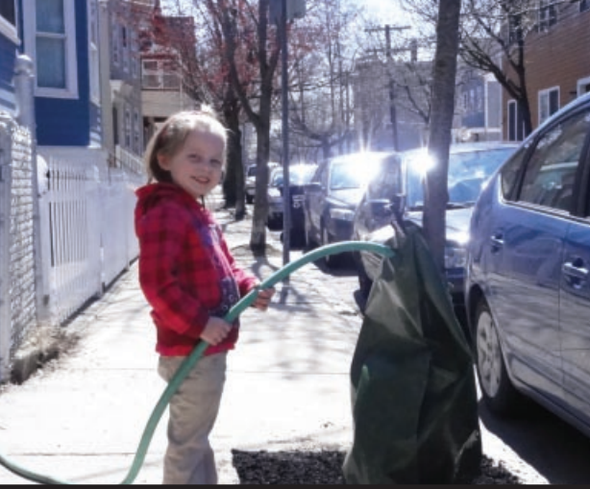
What’s Cambridge doing about heat?
Greener, Cooler City:
Increase plantings, including roof gardens
Expand tree canopy cover and shade
Improve access to open space
Cool Buildings:
New buildings/renovations must be able to stay cool during hot temperatures

Slide 34
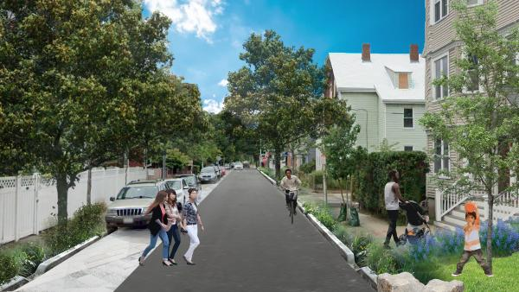
What’s Cambridge doing about heat?
Cool Streets:
Implementing a “Complete Streets” design
More trees on streets and near bus & train stops
Cool Communities:
Adding shading/cooling to community spaces so they can remain open to the community during times of high heat
Working with Eversource to increase resilience of electrical equipment
Building out “resilience hubs”

Slide 35
What is a resilience hub?
Notes:
Start at 1:03, end at 6:10 !

Slide 36
Agenda
Climate Justice Pair & Share
Climate Change & Justice Recap
Extreme Heat 101
Break!
Heat Illnesses & Interventions
Debrief & Closing

Slide 37
What did you hope to get out climate readiness trainings as a whole?
PAIR & SHARE
Notes:
Sharon
Before breaking into groups:
What questions do you have? What does this bring up for you?

Slide 38
On Your Own
Strike up a conversation with at least 2 people about extreme heat topics (E.g., Heat risk, heat illnesses, strategies to stay cool, action Cambridge is taking, etc.).
How did the conversation go?
What questions did they ask?
How did they feel?
We’ll open the next session by talking about what you heard!

Slide 39
Thank you
Please take a minute to tell us how today went & fill out an evaluation form!
Notes:
Next Steps:
Heat round table June 21st, we’ll be presented with scenarios you might encounter as a C3 member and walk through what we would do in them.
Cambridge emergency prep folks did something similar last year.

Slide 40
Printed materials
Do’s & don’ts strips
Heat illness matching game
DC overexposure flyer
How to stay cool - extremeheatflyerenglish.pdf (cambridgema.gov)
Eval forms
Pens
Name tags

Slide 41
Heat Illness Matching
Printed for In-Person activity

Slide 42
Heat stress match game, here: https://mapc365.sharepoint.com/:p:/s/PublicHealthTeam/EXtGBZHFHuNFmbuW7WUQJVcB9YltGcGhJxDDb9oyTjolPQ?e=u6mVcF

Slide 43
Dos & Don’ts
Printed List for In-Person activity

Slide 44
Use air conditioners, if possible
Spend time in air-conditioned locations (ex. The mall or library)
Increase air flow and clear hot air by opening doors or windows a few inches and facing fans outside to create cross-ventilation
Use a window fan facing inside when it is cooler outside (ex. In the early morning)
Take a cool bath or shower
Stay hydrated – regularly drink water
Eat light, cool, easy-to-digest foods (ex. Fruit)

Slide 45
Wear loose-fitting, light-colored cloths
Be a good neighbor - check in with people who may need help responding to heat
Know the symptoms of excessive heat exposure and how to respond
Cover windows with shades or drapes during the hottest part of the day
Use window reflectors (ex. aluminum foil-covered cardboard) to reflect heat
Provide your pet shade & water
Weather-strip doors and windows to keep the heat out and cooled air in

Slide 46
Use a portable fan to direct air flow onto yourself or other people
Leave people and pets in the car
Drink alcohol to stay cool
Eat a heavy meal
Wear heavy clothing
Do outdoor activities or exercise during the hottest part of the day
Leave windows and blinds open

Slide 47
Set your ceiling fan to spin counterclockwise and push air down
Set your ceiling fan to spin clockwise and pull air up
Schedule strenuous activities for morning and evening
Sign up for City Code Red Alerts
Monitor local weather
Spend a lot of time in the sun

