Slide 1
Vector-Borne Disease
A C3 CLIMATE READINESS TRAINING MODULE​

Slide 2
Name
Where do you like to spend time outside during the warmer months?
ICEBREAKER

Slide 3
Agenda
Vector-Borne Disease 101
Mosquitos
Break!
Tick-Borne Disease Prevention and Control

Slide 4
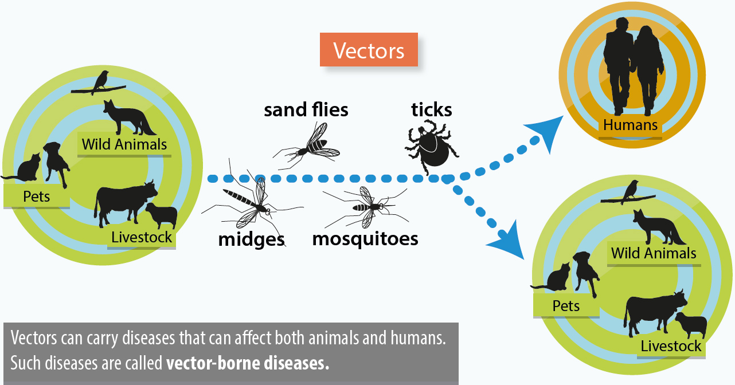
What’s a Vector?
A vector is any blood-feeding organism that carries serious diseases and transmits them to another organism.
Vectors carry diseases to and between humans and other animals
Diagram Source: European Food Safety Authority

Slide 5
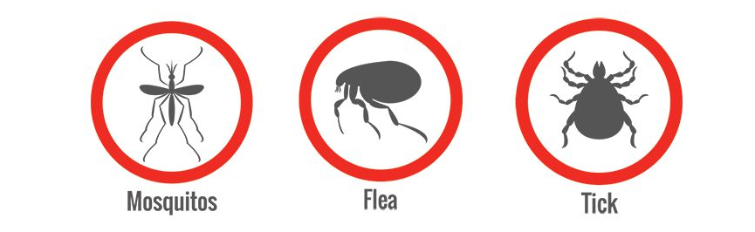
Notes:
In practice, In MA we are usually talking about diseases transmitted via mosquitoes, ticks and fleas
Spiders are not considered “vectors”, because they don’t transmit pathogens, only poisons

Slide 6
Vectors carry human illnesses
The human and other animal illnesses carried by vectors are called Vector Borne Diseases (VBD). Vector borne diseases include:
Viral diseases like Dengue fever, West Nile Virus, EEE, and Zika
Parasitic (or, protozoal) diseases like Malaria, schistosomiasis, and Chagas
Notes:
VECTOR-BORNE DISEASES (VBD) account for one-sixth (1/6th) of all cases of infectious disease globally
TICKS Tick-borne Diseases Account for 77% of all VBD in the US . Most important are Lyme, Anaplasmosis, and Rocky Mountain Spotted Fever
Wewill discuss tick-borne diseases and basic precautions later on.

Slide 7
Refresher: The effects of Climate Change
A warming Earth disturbs the long-standing climate patterns, resulting in WARMER, WETTER, and WEIRDER weather

Slide 8
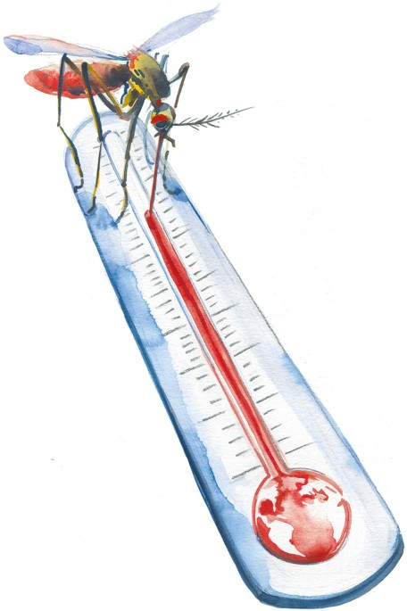
Climate is expanding VBD risk
There are 3 main ways:
Warmer weather creates longer breeding seasons and an increased range for species
Wetter weather means more standing water from flooding and storms
Global travel, loss of native habitats, and changing local climates make VBD risk more global and less predictable
Image Source: Chris Sharp via Nature

Slide 9
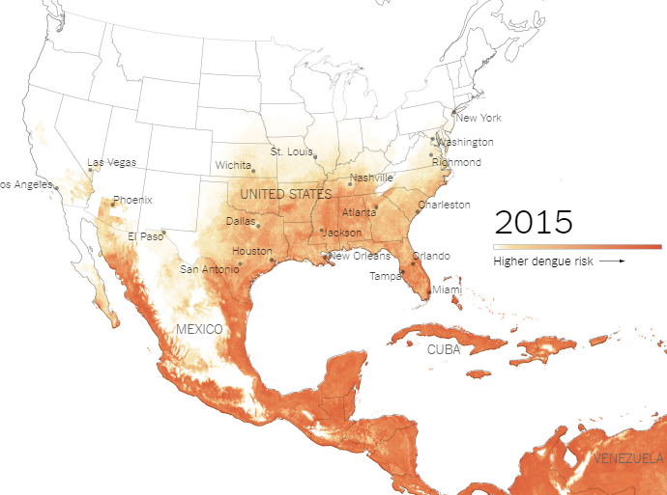
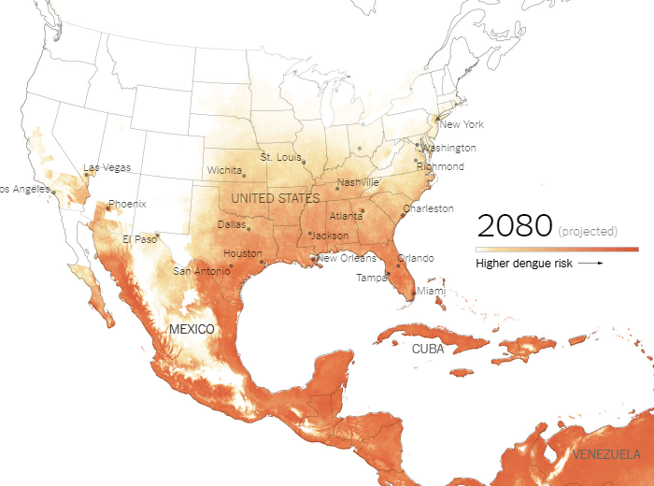
Notes:
Worldwide each year, there are 100 million cases of dengue infections severe enough to cause symptoms, which may include fever, debilitating joint pain and internal bleeding. There are an estimated 10,000 deaths from dengue — also nicknamed breakbone fever — which is transmitted by Aedes mosquitoes that also spread Zika and chikungunya.
Research has found a likelihood for significant expansion of dengue in the southeastern United States, coastal areas of China and Japan, as well as to inland regions of Australia.
Warming temperatures help expand dengue’s range because, in part, as it gets warmer mosquitoes can thrive in more places where they couldn’t previously. Warming temperatures also shorten the time it takes a mosquito to become a biting adult and accelerate the time between when a mosquito picks up a disease and is able to pass it on
Other Examples:
2023 Malaria returns to Florida and Texas
2023 - First locally acquired case of Maria in the UA in 20 yrs
Increasing temperatures and increases in heavy rainfall have made new areas suitable for the species of mosquito that carries maleria (Anopheles mosquito)
1999: West Nile virus (NYC, NE, national)
2014: Chikungunya virus first in US
2016-17: Zika virus first in US

Slide 10
Agenda
Vector-Borne Disease 101
Mosquitos
Break!
Tick-Borne Disease Prevention and Control

Slide 11
Why are we more worried about mosquitos?
Long human history with fleas, mosquitoes and ticks, but mosquitoes have been the biggest VBD threat for the last 600 years.
Dozens of insect species carry diseases that can infect people, but only a few actually transmit to people directly.
Even among mosquitos, only a few species are human vectors. Some species transmit pathogens to other animals.
For example, sparrows and crows carried west nile virus to our region where local mosquito populations transmit the virus to people.
Notes:
Before mosquitos, fleas carrying plague and protozoal disease (malaria, sleeping sickness) dominated.
We have much better surveillance for mosquitoes than ticks

Slide 12
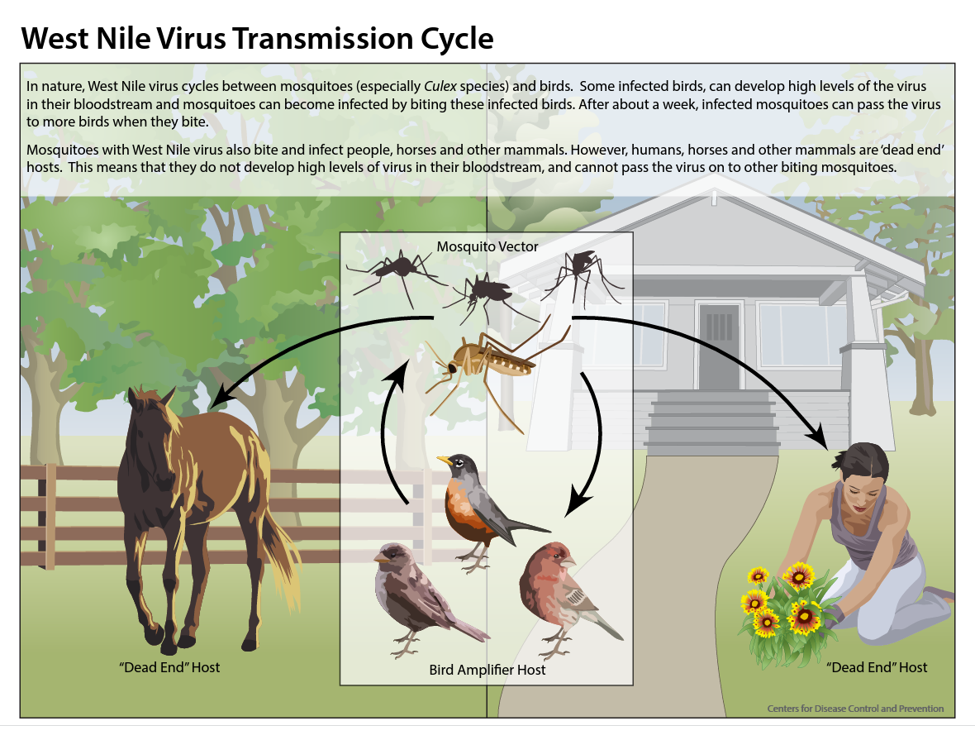
Mosquito-borne Diseases in New England: West Nile Virus
Notes:
WNV transmits between birds, people and horses
The misquto species in New England that carries WNV is Culex pipens
Most cases are now in Midwest and West of US, but New England has bad years too

Slide 13
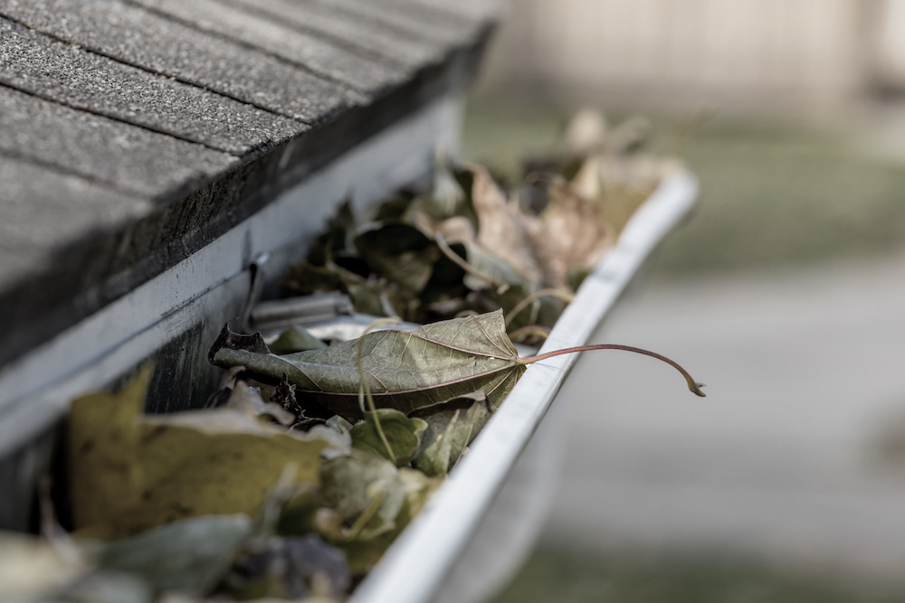
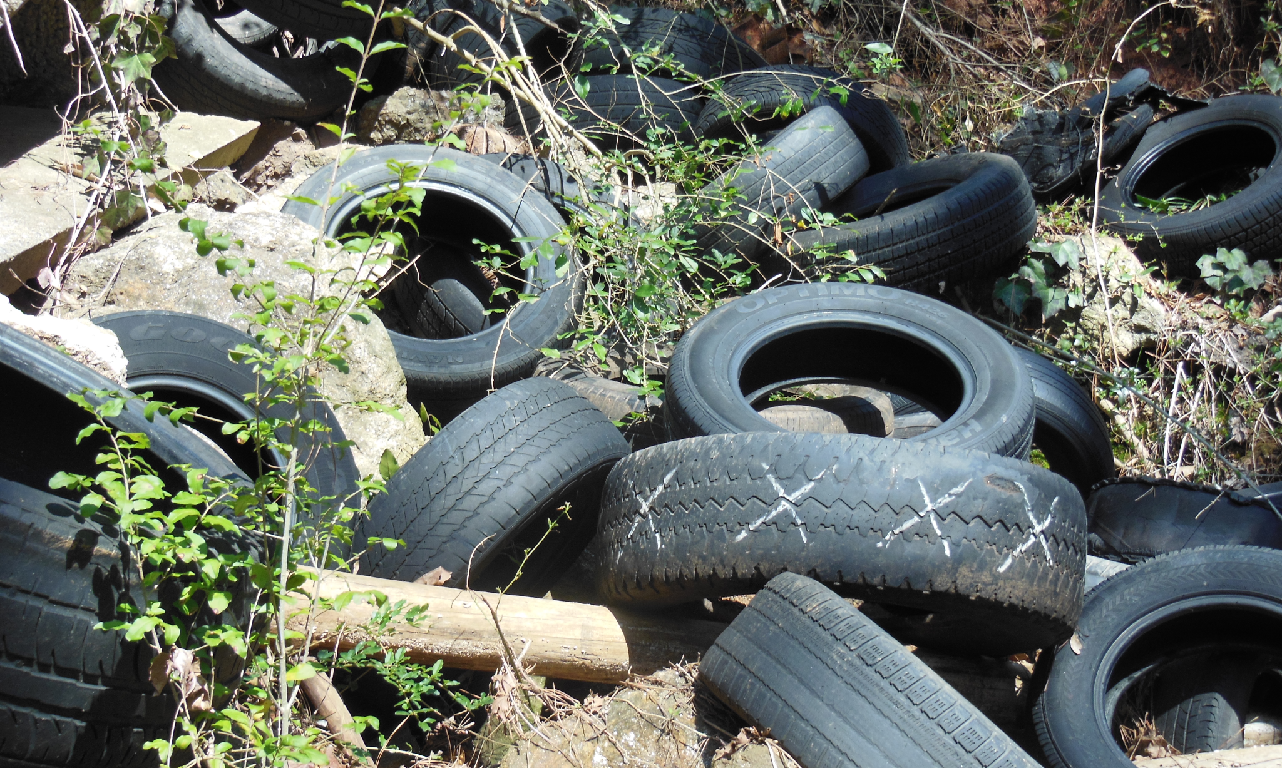
What is West Nile Virus?
West Nile Virus (WNV) is a viral infection and the leading cause of mosquito-borne illness in the US
WNV causes fevers and can cause neurological impairment
The mosquitos who transmit breed in a container, urban/suburban habitat
Notes:
US mortality rate from WNV is estimated to be 1% and higher in older residents
1 in 5 infected get fever and other neurologic symptoms
Initial response in 2000 caused high anxiety
CDC didn’t offer clear guidance, data was slow
Many feared truck spray

Slide 14
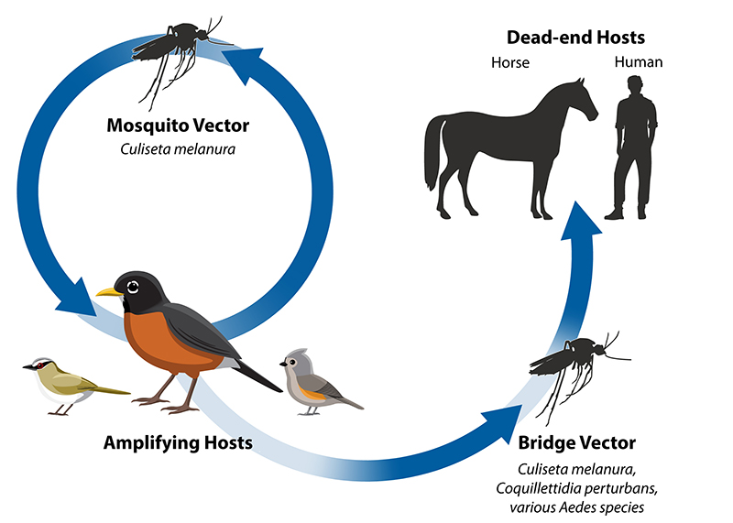
Mosquito-borne Diseases in New England: Eastern Equine Encephalitis (EEE)
Image Source: CDC
Notes:
Eastern Equine Encephalitis (EEE)
Wetlands-breeding Culiseta Melanura (transmission to/from birds)
The misquto species in New England that carries WNV is Culex pipens
Aedes, Culex, and Coquillettidia (direct bridge vector to humans/horses)

Slide 15
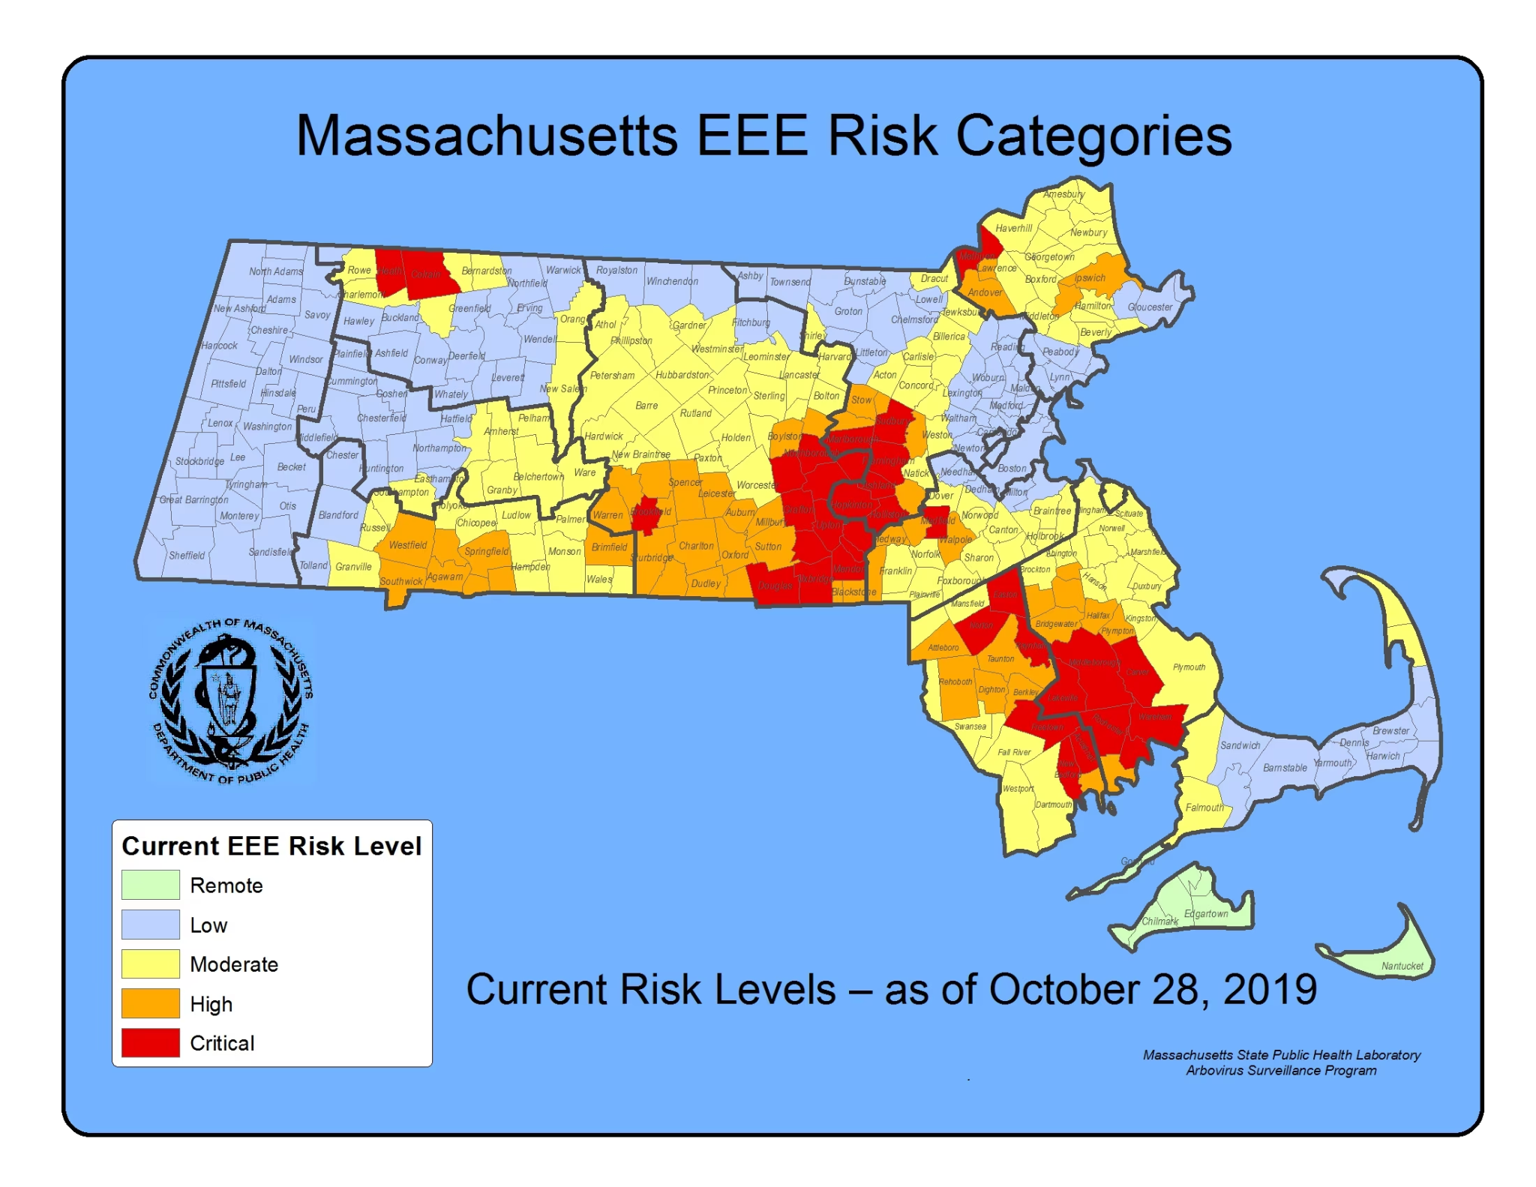
Mosquito-borne Diseases in New England: Eastern Equine Encephalitis (EEE)
Although rare, EEE is a very serious disease. 1 in 3 people with EEE die and survivors often have neurological damage
The mosquitos who transmit it to birds breed in wetlands
Notes:
Eastern Equine Encephalitis (EEE)
Mostly in SE Mass and RI, (moving into Central MA)
There were 12 human cases of EEE in Massachusetts in 2019 with six deaths and 5 human cases with one death in 2020. there have been no EEE case in MA this summer
30%+ mortality rate, 70% neurological damage

Slide 16
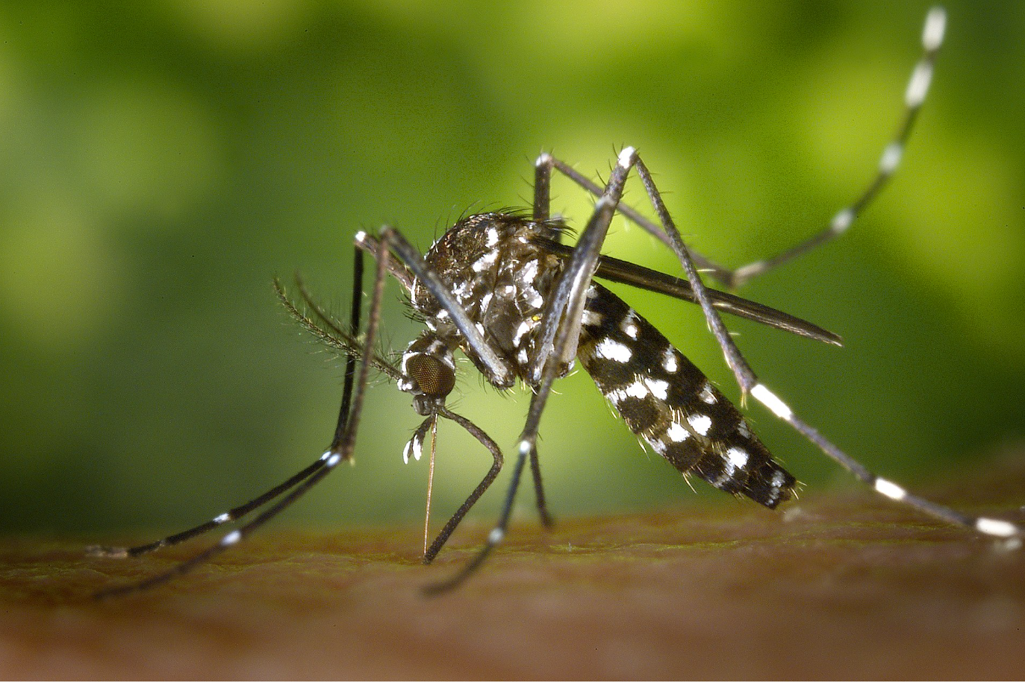
Welcome the Tiger Mosquito (Aedes albopictus) to New England!
Notes:
Aedes albopictus, also known as the Asian tiger mosquito is from Southeast Asia. Human activity has allowed Ae. albopictus to expand its range throughout much of the world.
Currently, the Asian tiger mosquito is found in localized areas of Massachusetts. The Centers for Disease Control (CDC) predicts that the mosquito will expand its range into all of Massachusetts.
The Asian tiger mosquito is distinctive for several reasons. The mosquito is a very aggressive human biter and is capable of transmitting many diseases.

Slide 17
[Placeholder]
On 1-3 slides, describe the actions [YOUR CITY/TOWN] is taking to combat extreme heat and protect health, safety, and wellbeing.
Slide 20 is an example from the City of Cambridge, MA.
If you have an outreach group, consider 1-2 slides on messaging about mosquitos for the general public
Slide 21 and 22 are an example from the Cambridge Community Corps – they were asked to think about who their outreach should reach and what their messaging could be.

Slide 18
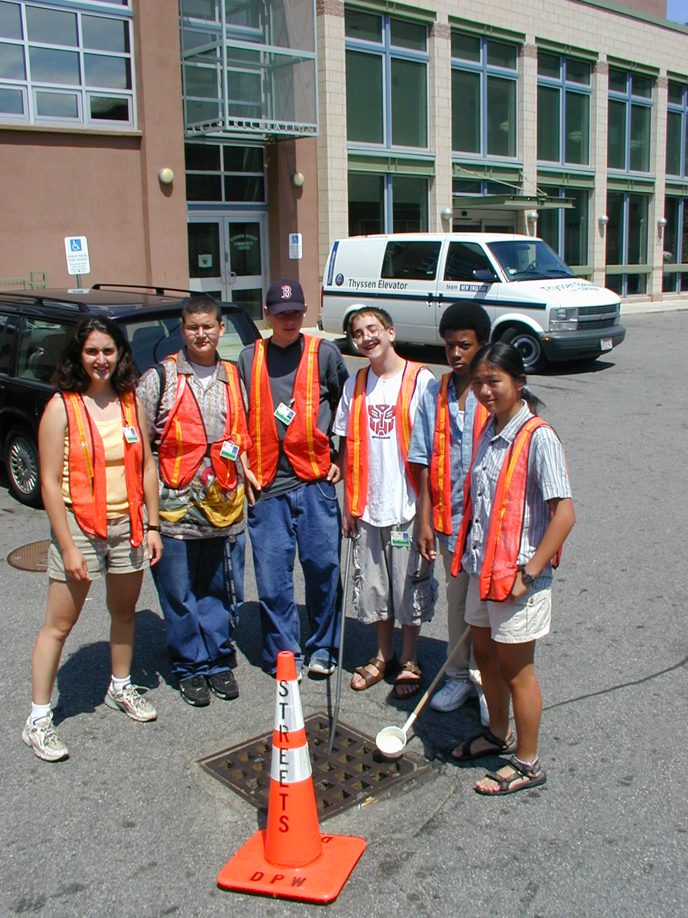
Puddle Patrol: mosquito habitat control
In previous summers, Cambridge established crews to survey storm drains for mosquito larva
Storm were then treated to prevent larvae from becoming adults
The City also educates the public on the risks of standing water
Notes:
Was it reasonable to worry more about this insecticide applications than this new mosquito-borne virus in 2000?
Why haven’t we sprayed for WNV from trucks since 2000?

Slide 19
In smaller groups, discuss:
Who might be at higher risk for mosquito-borne diseases, like WNV and EEE?
PAIR & SHARE

Slide 20
Mosquito risk messaging when talking with residents
WNV risk is low so far in 2023. Will increase through October, but likely to remain low this year
Culex pipens: Urban, container-breeding (can breed in small pool, very gentle, night-time active)
Not an aggressive biter, most likely at night while sitting still or gaps in screens
Wear long sleeves/pants sitting outside in August-September. use repellent, fix screens, eliminate habitat in yard and gutter, notify City if you observe standing water (not in street)
Container vs Wetlands-breeding mosquitoes
Why wetlands are not a major WNV risk, but your gutters and backyard might be
EEE is not a risk in Metro Boston. Overall MA risk is low this year, Last surge in 2012.
EEE generally isolated to marshy areas in SE Mass, Central MA and NW of Boston
No known infections acquired in Metro Boston in recent decades. Habitat could shift
When risk is high there are major public info campaigns, event cancellations
Cambridge residents should protect themselves following public health guidance: long-sleeves, repellent, habitat control, screen repairs (especially late Aug-Oct)
Sitting quietly outside at night in Aug-Oct is risky behavior if not protected. Very gentle biters
Aedes albopictus (now local species) carries Dengue, Zika, Chikungunya. No local infections seen

Slide 21
Agenda
Vector-Borne Disease 101
Mosquitos
Break!
Tick-Borne Disease Prevention and Control

Slide 22
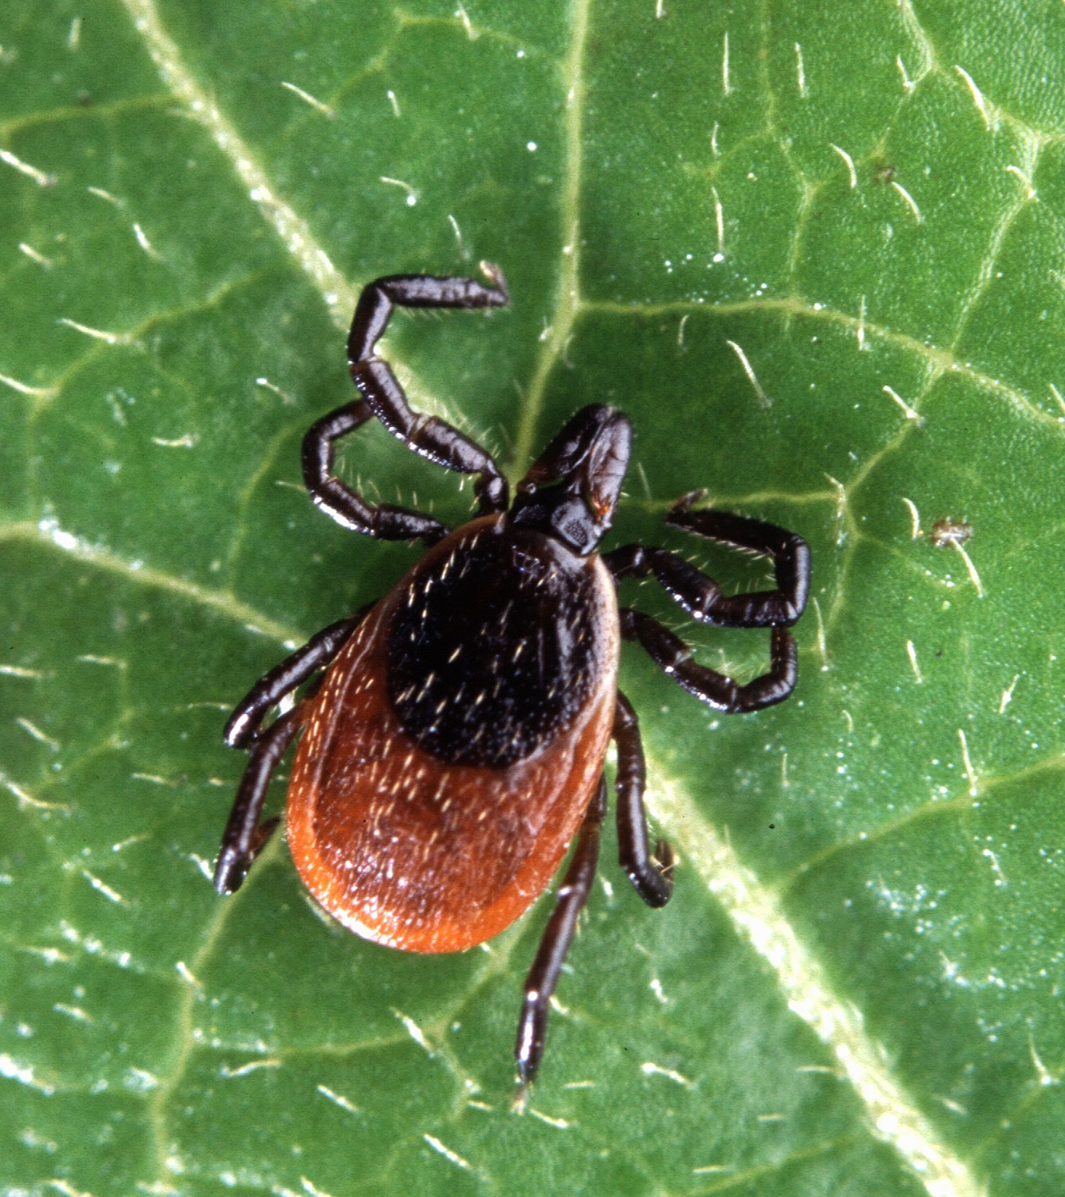
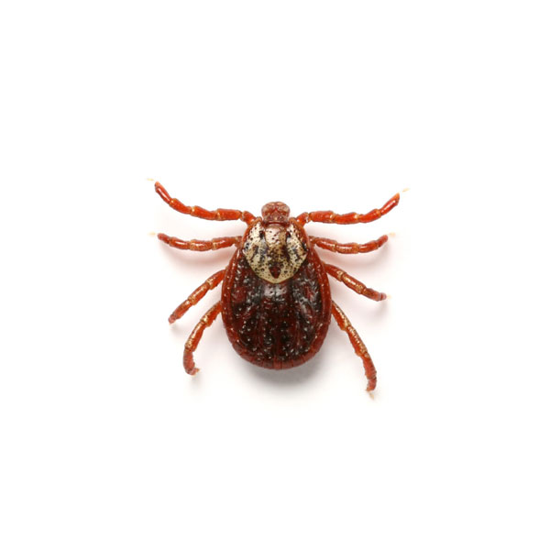
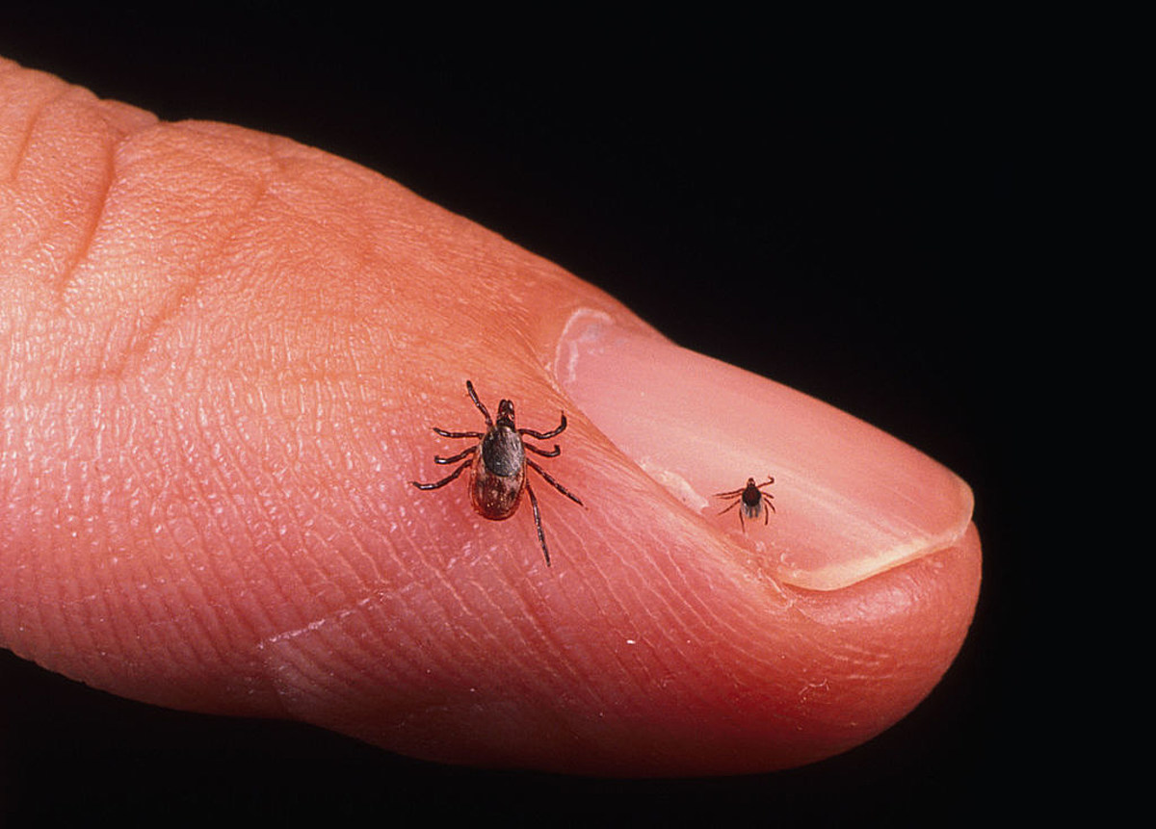
Tick-Borne Disease
Prevention and Control

Slide 23
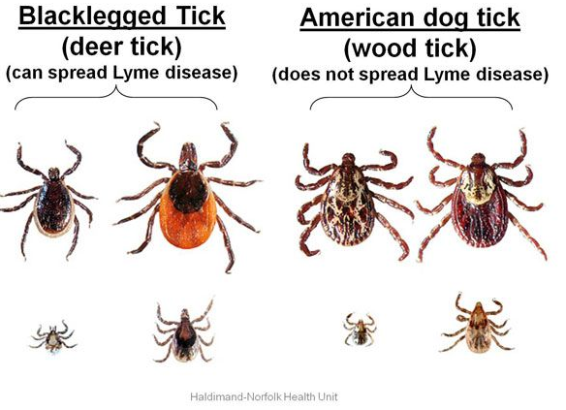
What are Ticks? Deer vs. Dog
Deer Ticks
Sesame seed size
Orange/rusty colored abdomen
Carries Lyme Disease
Dog Ticks
Apple seed size
All brown
Carries Rocky Mountain Spotted Fever

Slide 24
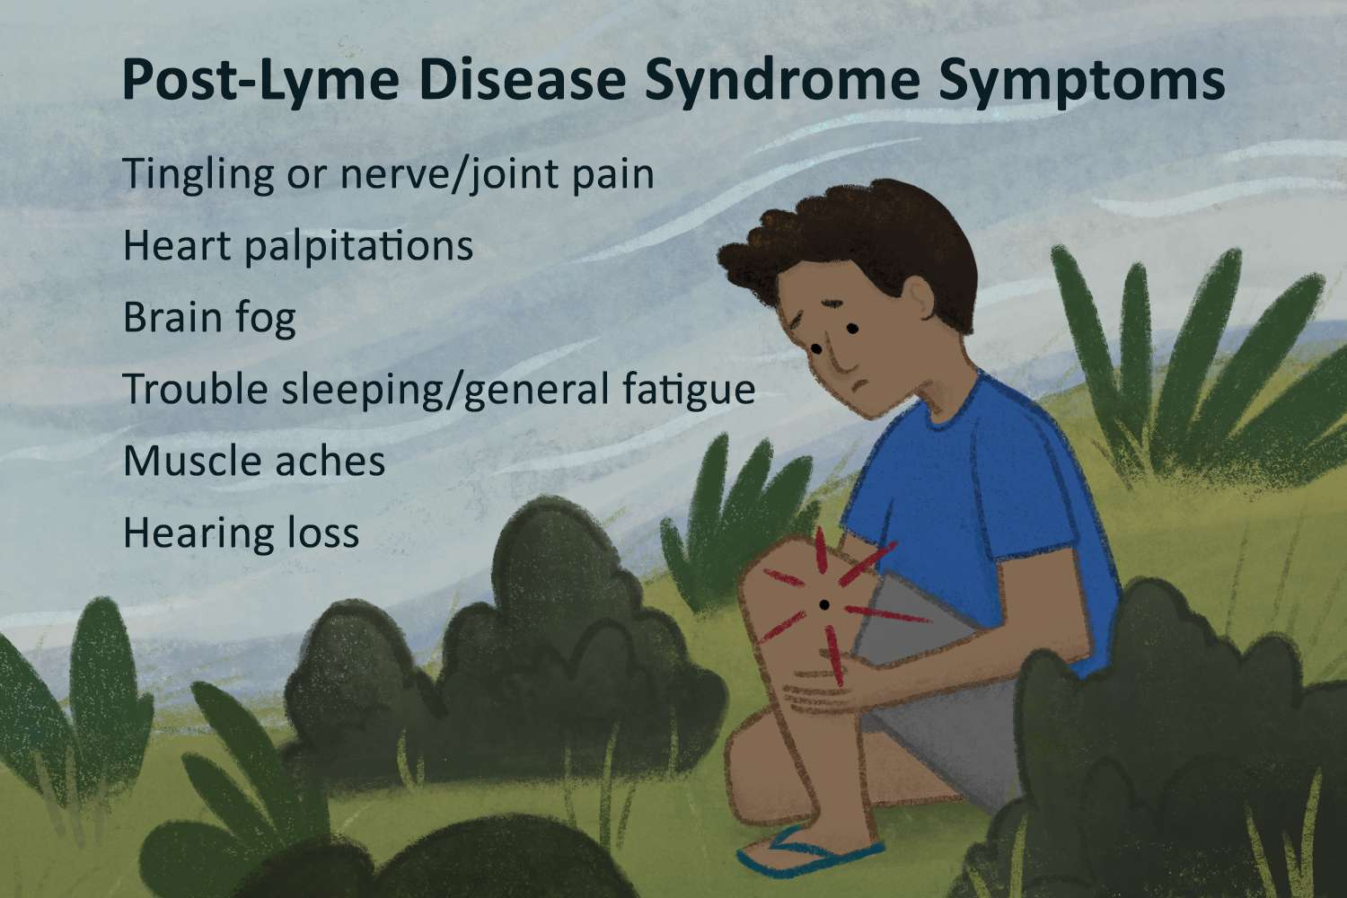
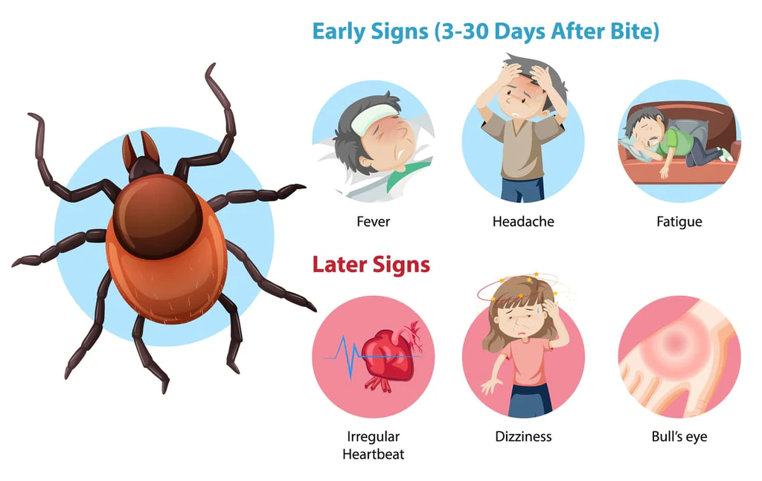
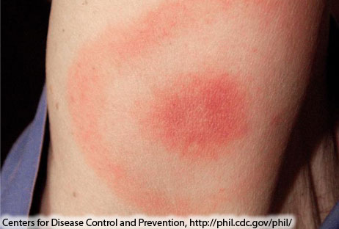
Lyme Disease & Symptoms
Bacterial infection
Fever, headache, fatigue, “Bullseye Rash”
Can lead to chronic symptoms, autoimmune response (link unclear)
Low risk if treated within 72 hours after tick removal

Slide 25
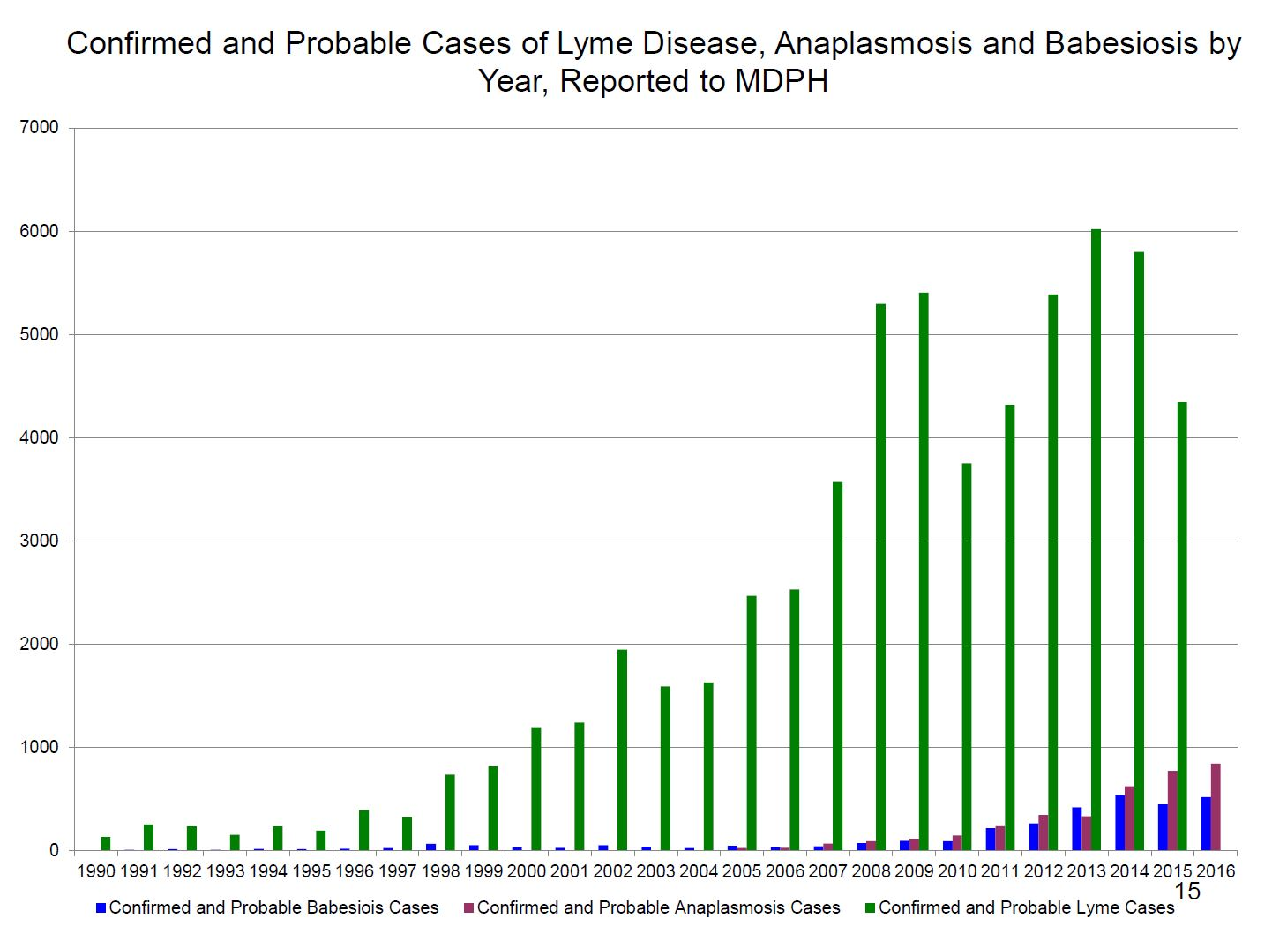
Lyme Disease is Getting More Prevalent

Slide 26
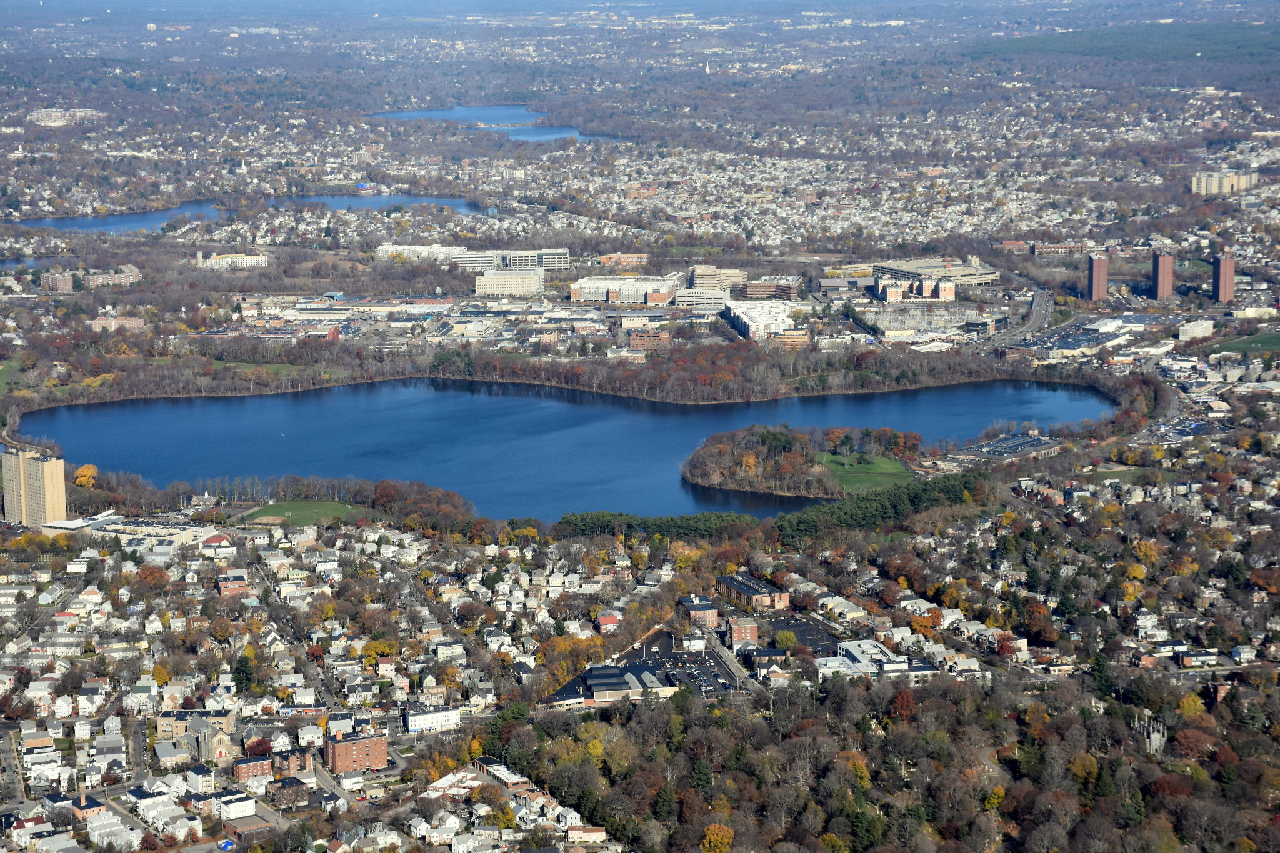
Lyme Disease is Getting More Prevalent
There are 3 main reasons why:
Deforestation and/or Intermediate reforestation
Spread of Deer
A warmer climate has contributed making a larger area suitable for ticks to live & breed in and an extended active period

Slide 27
Where do Ticks Live?
Low Risk High Risk
Notes:
Deer Ticks
Shady, moist areas at ground level
Cling to tall grass, shrubs, “brushy” areas/wooded grasslands
Where deer go, ticks follow- even in cities
Dog Ticks
Similar to deer ticks, common on overgrown trails or scrubland
Found in less tree-covered areas

Slide 28
[Placeholder]
For the following activity, use pictures from high and low risk tick environments in [YOUR CITY/TOWN
Slide 29-34 are an examples from the City of Cambridge, MA.

Slide 29
Let’s play a game!
Is it lower risk, or higher risk?

Slide 30
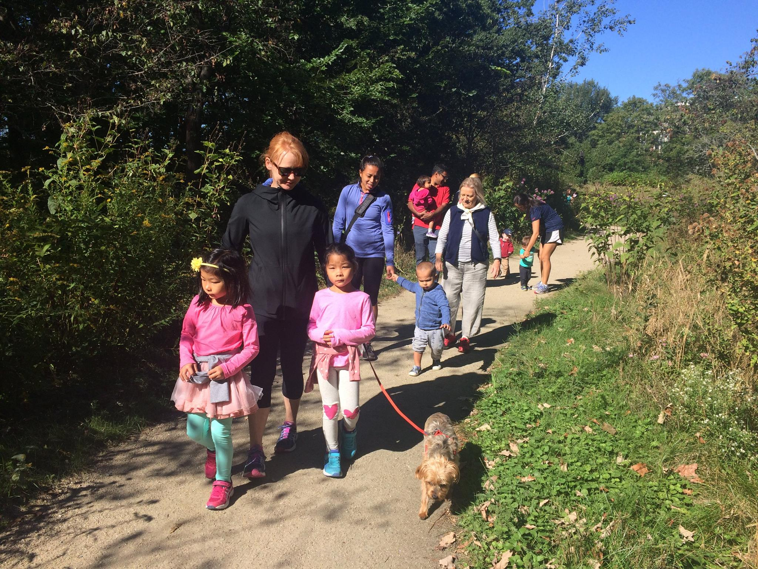

Slide 31
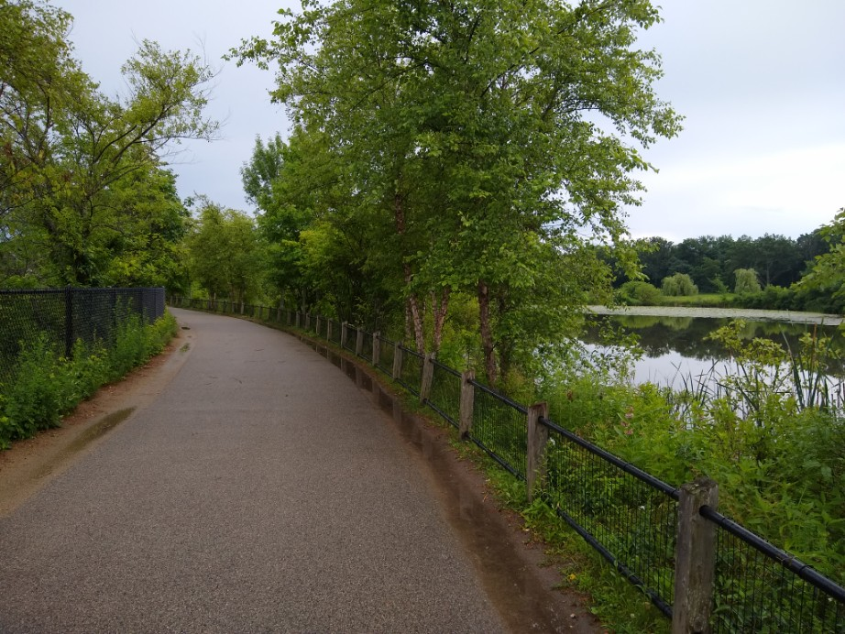

Slide 33
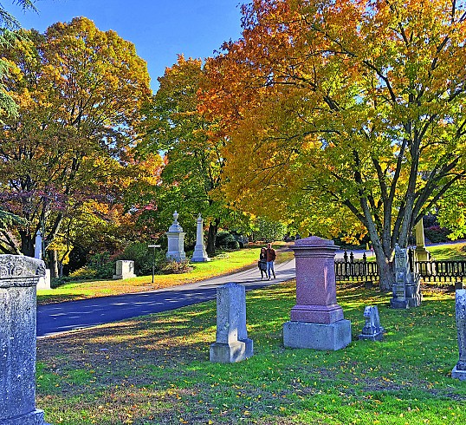

Slide 34
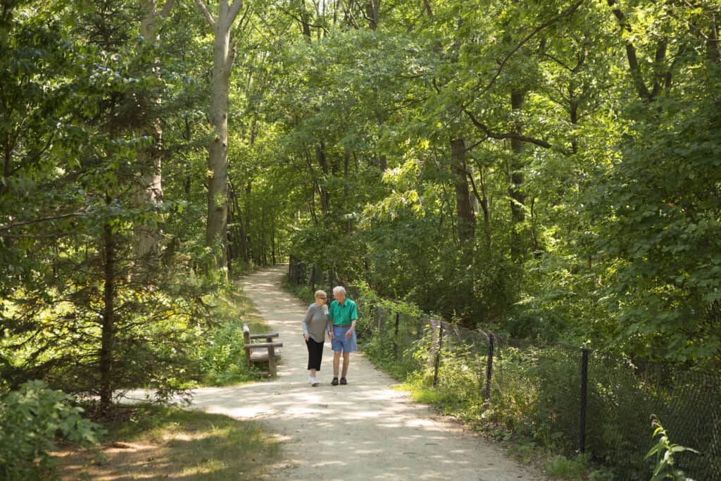

Slide 35
Personal Tick Protection (e.g., how to fight back!)
Personal protection is all about minimizing your contact with ticks. There are 2 main steps:
Avoid high-risk areas.
When you visit a high-risk area, cover skin, apply insect repellent, and stay on trails.

Slide 36
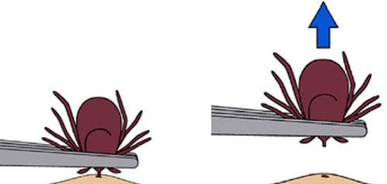
I visited high-risk area, now what?
Once home, take a shower. Any ticks that are unlatched will wash off
Put clothes in dryer on high heat for 10 minutes to kill hidden ticks
Check your body- start around feet and ankles, travel up. Use mirror or phone
If you find a tick, use tweezers as close to the skin as possible

Slide 37
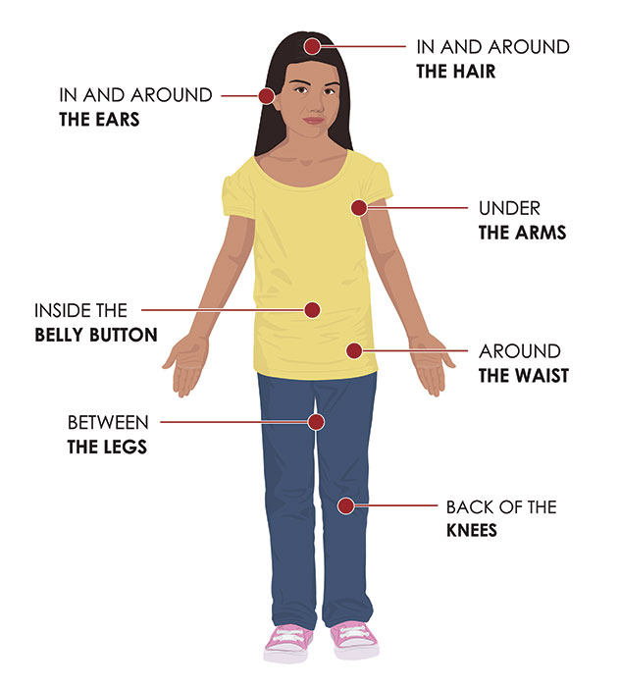
How to do a tick check
Check your body- start around feet and ankles, travel up. Use mirror or phone
Common areas for ticks

Slide 38
Thank you
Please take a minute to tell us how today went & fill out an evaluation form!
Notes:
Next Steps:
Heat round table June 21st, we’ll be presented with scenarios you might encounter as a C3 member and walk through what we would do in them.
Cambridge emergency prep folks did something similar last year.

