Slide 1
Wildfires
A C3 CLIMATE READINESS TRAINING MODULE​

Slide 2
Icebreaker!
Name
[Icebreaker question]

Slide 3
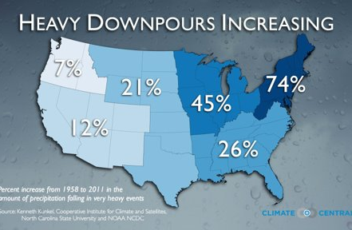
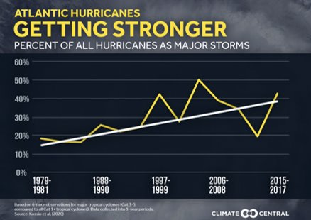
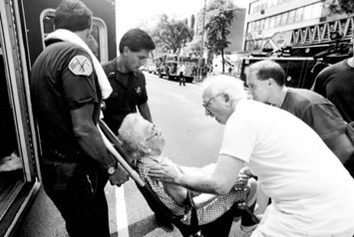
Climate Change: WARMER, WETTER, and WEIRDER
Source: Caleb Balderson
Source: Angela Weiss/Agence France-Presse — Getty Images
Notes:
Compared to historic trends, metro boston is and will continue to experience:
warmer summers and winters and more risky heat days,
Frequent and severe rain and snow event. More frequent/severe Flooding caused by these events and sea level rise
More flash floods, strong storms, cold snaps, just weird weather

Slide 4
Weirder: Wildfire Smoke
The Daily: There’s No Escaping Wildfire Smoke
June 9th, 2023
Start at 6:40; End at 11:20
Source: Angela Weiss/Agence France-Presse — Getty Images

Slide 5
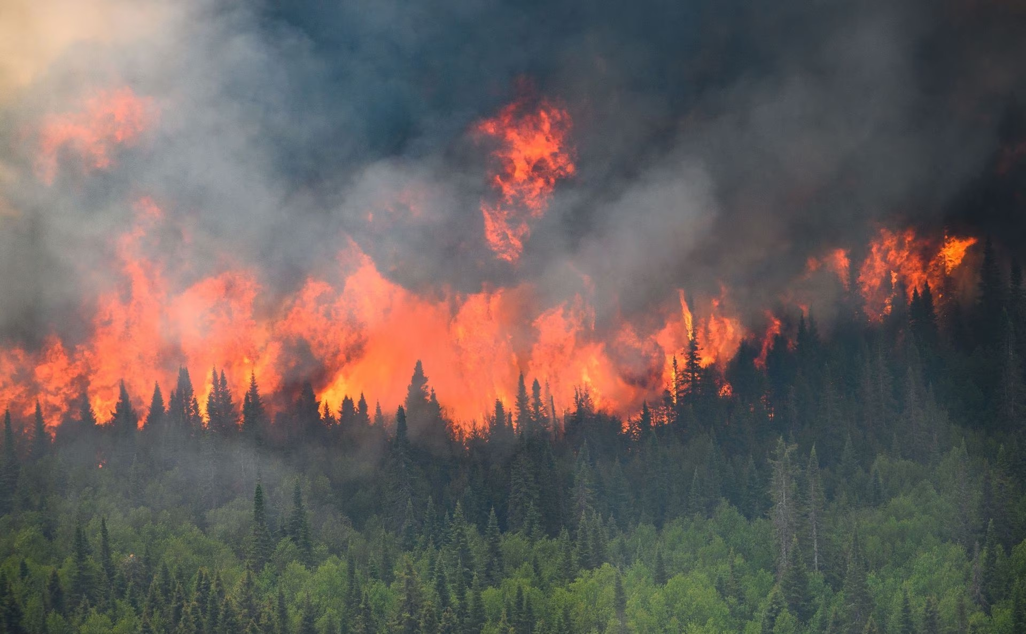
What are wildfires?
Wildfires are unplanned fires in natural areas (e.g., forests, grasslands, etc.)
Most wildfires are started by humans (e.g., discarded cigarettes, downed powerlines, arson)
Lightning and extreme heat can also start wildfires
Wildfire smoke is one of the main climate impacts on air quality (EPA)
Source:FEMA, CGTN, California Air Resources Board, National Parks Service

Slide 6
Air Quality Index is a way to determine whether the air quality is healthy or not
Air Quality Index (AQI) is an indicator of air quality
An AQI below 100 is generally considered healthy air to breath.
You can get the AQI from the weather apps or sign up for alerts from the U.S. EPA’s AirNow program (airnow.gov)
Source:FEMA, CGTN, California Air Resources Board, National Parks Service

Slide 7
Some people are more vulnerable to wildfire smoke
People with pre-existing conditions/
medications
People who work outdoors
Children + Infants
Pregnant people
Why do you think these groups might be more sensitive or less able to cope?
Elderly
People who are unhoused
Communities near highways/with little tree cover

Slide 8
Are there parts of [your community] that might be more vulnerable to the harms of wildfire smoke?

Slide 9
[Placeholder]
Transition to federal or state guidance on wildfires
Cambridge transitioned to the CDC Wildfire materials
If you have an outreach group, consider 1-2 slides on messaging about wildfires for the public and local one-pagers

Slide 10
Protect yourself! Strategies from other states & countries
Wildfires (and air pollution, in general) are global issues
More common in other parts of the world, and now… here.
Source: California Air Resources Board

Slide 11
[Placeholder]
On 1-3 slides, describe the actions your community is taking to combat wildfires and/or their impact
If you have an outreach group, consider 1-2 slides on messaging about wildfires for the public and local one-pagers

