Slide 1
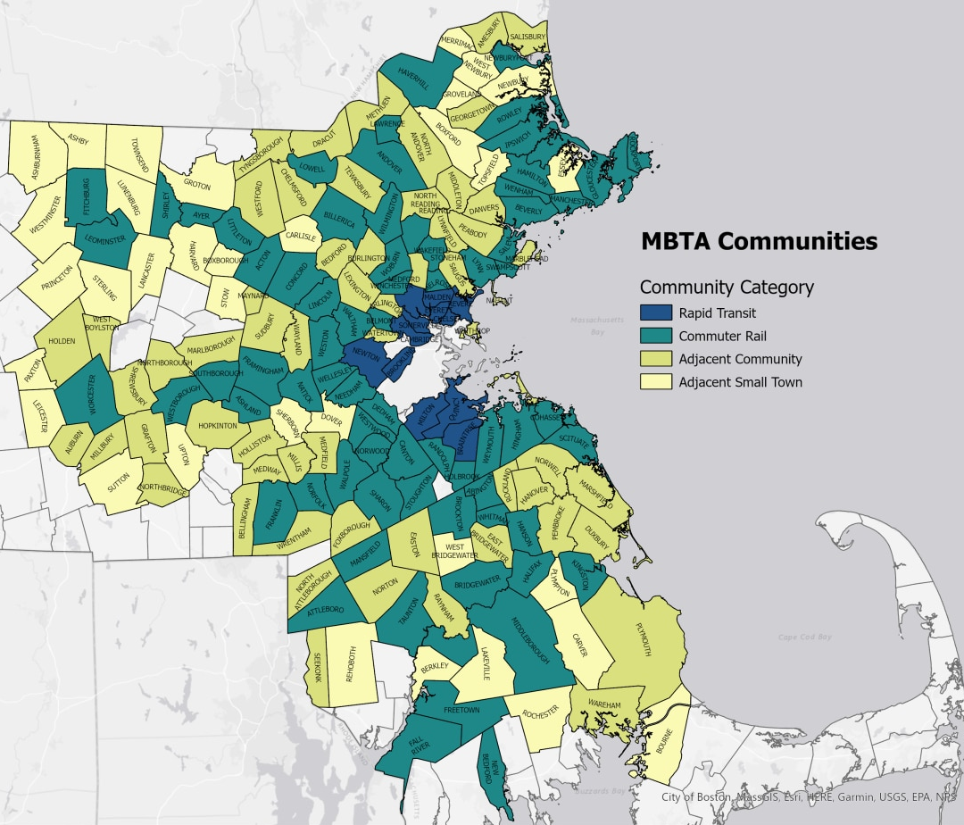
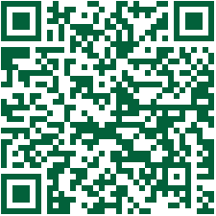
MBTA Communities Law 101
The MBTA Communities Law (adopted in 2021 and codified in MGL Chapter 40A, Section 3A) established a multifamily zoning requirement for the 177 Massachusetts communities in the MBTA service district. While the type of transit may vary in these municipalities, all are in close enough proximity that they benefit from nearby transit amenities.
Section 3A requires that municipalities adopt zoning regulations that allow multifamily developments close to transit or in other walkable “smart growth” locations by right (not requiring a discretionary approval process). The law allows flexibility for local regulations that will best fit their local context. Housing that may be built under the new zoning can vary in size from duplexes to townhomes to larger apartment buildings, as long as the average gross density pencils out to at least 15 units per acre.
Rapid Transit Communities had until 12/31/23 to comply with Section 3A, Commuter Rail and Adjacent Communities have until 12/31/24, and Adjacent Small Towns have until 12/31/25.
Guidelines Requirements
According to guidelines promulgated by the Executive Office of Housing & Livable Communities (EOHLC), Section 3A-compliant zoning districts must:
Include a portion located within a half-mile of the municipality’s transit station (if applicable)
Have a minimum land area of 50 acres, or 1.5% of the municipality’s developable land, whichever is less (required for Rapid Transit, Commuter Rail, and Adjacent Communities; no requirement for Adjacent Small Towns)
Be comprised of contiguous lots for 50% of the zoning district land
Be feasible for development (land that is not suitable, such as wetlands or conservation land, is excluded from minimum land area​)
Meet a minimum unit capacity set by EOHLC (measures the total number of units that theoretically could be built under zoning)
Be suitable for families with children (no bedroom limits)
Not contain age restrictions​
Note: Zoning districts can allow for site plan review, design standards, and inclusionary zoning requirements
Scan QR code to visit www.mapc.org/mbta-communities-show-your-support-toolkit
Your Logo

Slide 2
Benefits of Multifamily Housing Near Housing
There are many benefits that transit-oriented development can bring to communities, including:
Creating more housing options for a variety of households at a range of incomes, including young professionals, families with children, and seniors
Reducing housing costs by increasing housing supply and decreasing the costs associated with discretionary permitting processes
Allowing Massachusetts to retain its competitive economic advantage so future job growth doesn’t leave the state because of high costs of living
Improving walkability by allowing for housing closer to the places we regularly visit, such as local shops, jobs, schools, and parks
Providing better access to work, services, and other destinations by increasing mobility and public transit utilization
Reducing reliance on single-occupancy vehicles, resulting in improved traffic levels and decreased greenhouse gas emissions
Consequences of Noncompliance
Not complying with Section 3A is against the law. Municipalities that don’t comply with the MBTA Communities Law can face the following consequences:
Ineligibility for grants from the MassWorks and HousingWorks infrastructure programs, the Housing Choice Initiative, and the Local Capital Projects Fund
Civil enforcement action by the Attorney General’s Office or legal groups and liability under federal and state fair housing laws
Reduced consideration for the following 13 discretionary grant programs (and potentially others):
EOHLC’s Community Planning Grants​
Executive Office of Economic Development’s Massachusetts Downtown Initiative, Urban Agenda, and Rural and Small-Town Development Fund​
MassDevelopment’s Brownfields Redevelopment Fund, Site Readiness Program, Underutilized Properties Program, Collaborative Workspace Program, Real Estate Services Technical Assistance, and Commonwealth Places Program​
Executive Office of Energy and Environmental Affairs’ Land Use Planning Grants, Local Acquisitions for Natural Diversity Grants, and Municipal Vulnerability Preparedness Planning and Project Grants
Visit MAPC’s website for the Show Your Support Toolkit for assistance with messaging about the MBTA Communities Law based on your municipality’s priorities and access tips and best practices for successful community outreach and guidance on navigating the local adoption process.
Contact:
Name Email
Title Phone
Your Logo

