Slide 1
MBTA Communities Show Your Support Training
Tools for a Successful Adoption
Presentation Date
mapc.org/mbta-communities-show-your-support-toolkit
Your Logo

Slide 2
How to Use the Show Your Support Toolkit
Access messaging resources to inform community members and municipal stakeholders about the housing crisis and why it's critical to update zoning to allow for increased housing production
Find tips and best practices for successful community outreach and guidance on navigating the local adoption process
Download editable materials to utilize in local adoption outreach
mapc.org/mbta-communities-show-your-support-toolkit

Slide 3
How to Use the Show Your Support Training
Municipal staff, housing advocacy group leaders, consultants leading Section 3A-related projects, and others can adapt these slides and share them at a community or committee meeting to prepare for Town Meeting
Audience: 3A advisory committees, local housing advocates
Purpose: Collectively agree on an engagement strategy to educate and mobilize voters in support of proposed 3A zoning

Slide 4
Before the Training
In your invitation to the Show Your Support Training, share the link to the Toolkit and encourage invitees to review ahead of time
If meeting in person, print out copies of the informational flyers and gather materials you may need (nametags, easel, sticky easel pad for notetaking, markers, etc.)
If meeting remotely, provide links to the informational flyers and decide best method for notetaking (Google Jamboard, Mural, ConceptBoard, etc.)

Slide 5
Steps in this Training
Step 1: Understand roles as advisory committee members and pro-housing advocates to promote 3A zoning
Step 2: Determine what messaging resources are most useful for discussing 3A in your community
Step 3: Learn effective community outreach methods and conduct activities that will help you decide your approach

Slide 6
Steps in this Training
Step 4: Review tips for navigating the Town Meeting process and strategize about what will be most effective in your community
Step 5: Determine what gaps remain in your engagement strategy and find external resources that can help you plug the gaps
Step 6: Decide how you want to coordinate efforts moving forward and assign tasks to implement local adoption strategy

Slide 7
Step 1:
Understand roles as advisory committee members and pro-housing advocates to promote 3A zoning

Slide 8
Your Role as an Advisory Committee Member
You have worked hard to craft a Section 3A-compliant zoning proposal that represents community consensus and balances state requirements with local goals and preferences
Now it is up to you to help educate the public about the proposal and prepare them to vote!
If you were appointed as a liaison from another board/committee, you already have a network you can report back to where you can connect the group’s priorities with the zoning proposal

Slide 9
Your Role as a Pro-Housing Advocate
You are passionate about housing and understand the benefits that more housing can bring to your community
Spread that passion to your friends and neighbors by connecting their personal priorities with the zoning proposal
Serve as a force to counter the negative (and often loudest) voices in your municipality

Slide 10
Step 2:
Determine what messaging resources are most useful for discussing 3A in your community

Slide 11
Using and Adapting Messaging Resources
Understanding the law: Review “MBTA Communities Law 101” flyer and determine what information residents need to know about the law to make an informed vote
Connecting to past planning efforts: Discuss what plans exist in your community that have recommendations which overlap with the goals of Section 3A
Myth-busting: Review “Myth-Busting the MBTA Communities Law” flyer, identify misconceptions you have heard locally, and discuss how you can best dispel those myths

Slide 12
Using and Adapting Messaging Resources
Visualizing density: Review “Visualizing a Density of 15 Units Per Acre” flyer and decide what graphics/photos may resonate most (are there recent developments in your town that people like?)
Explaining the housing crisis: Review “Explaining the Housing Crisis” flyer and identify ways the housing crisis manifests in your community (are there personal stories you can share?)
Discussing 3A through different lenses: Identify local priorities in your community (climate change, economic development, etc.) and brainstorm how they connect with Section 3A

Slide 13
Step 3:
Learn effective community outreach methods and conduct activities that will help you decide your approach

Slide 14
Engagement Approaches
Tabling: Set up a physical presence at a community event or public space to engage locals in pro-housing conversations
Flyering: Post flyers and fact sheets in public places and consider mailing out materials if budget allows
Social media: Use different platforms (Facebook, Instagram, WhatsApp, TikTok, etc.)to inform community members about events or issues in real time

Slide 15
Engagement Approaches
Group texting: Utilize a mass texting service to easily send a group text at little or no cost
Phone calls: Engage groups that may be less tech-savvy (can be automated message or done manually)
Letters to the editor: Write letters to promote zoning and show broad support for more housing
Pins/stickers/lawn signs: Establish a physical presence around your community

Slide 16
Reaching Underrepresented Groups
What resources might you need to reach groups left out of past decision-making processes but who may support the zoning?
Translating materials/providing interpretation services at community forums and meetings to accommodate speakers of other languages
Holding hybrid meetings to accommodate parents without childcare
Providing print materials to accommodate people who are not tech-savvy and making them available at community gathering spaces such as local businesses, transit stops, etc.
Meeting the community where they are by holding meetings in locations where resident gatherings already occur (with invitation by hosting organization if applicable)

Slide 17
Identifying and Messaging to Stakeholders
Stakeholder mapping: Make a list of internal and external stakeholders and ask the following for each stakeholder:
How could they be impacted by the zoning proposal?
What is their level of support for the zoning proposal?
How could they impact the outcome of the zoning proposal?
What is their level of influence?
Messaging to stakeholders: For the stakeholders you have identified, consider the following:
How can you appeal to their self-interest and tailor your message?
What are the best engagement approaches for reaching stakeholders?

Slide 18
Step 4:
Review tips for navigating the Town Meeting process and strategize about what will be most effective in your community

Slide 19
Tips for Adoption: Before Town Meeting
Hold meetings early and often to discuss Section 3A and the proposed zoning (formal hearings, informal office hours, etc.)
Make sure groups understand the stakes and why it is important to show up for Town Meeting and speak in favor of the zoning (especially for Open Town Meeting)
Conduct direct outreach to Town Meeting Members and explain why they should speak and vote in favor of the zoning (if you have Representative Town Meeting)

Slide 20
Tips for Adoption: Before Town Meeting
Create pins/t-shirts that supporters can wear, especially if they don’t feel comfortable speaking during Town Meeting
Provide scripts and other materials that can empower advocates to speak in support of the zoning
Have one-on-one conversations with people who have a good standing in the community
Have one-on-one conversations with people who might be in opposition to assuage their concerns before Town Meeting

Slide 21
Tips for Adoption: Before Town Meeting
Test presentation in advance and practice how you might respond to opponents’ comments
Connect with the committees who write the recommendations for warrant articles
Create short videos that voters can watch in advance
Try to predict floor amendments so you can test scenarios in the compliance model to see if those amendments would render the zoning non-compliant

Slide 22
Tips for Adoption: During Town Meeting
If possible, encourage supporters to speak first to set the tone
Connect the proposed zoning with past planning efforts to emphasize how it relates to already-established community goals
Tell stories about housing challenges to provide a personal touch
Ensure voters are speaking to voters (but have planning staff available to answer technical questions)

Slide 23
Tips for Adoption: During Town Meeting
Based on past experience, decide if it would be helpful to have consultants present
Post maps and other visuals in the hallway or lobby that voters can look at as they enter
Provide fact sheets that are graphic and succinct
Invite the municipality’s State Representative and/or Senator
Keep the discussion at a high level to avoid confusion

Slide 24
Strategizing for Town Meeting
Where have Town Meeting votes been successful in the past? What factors made the process successful?
Where have Town meeting votes crashed and burned? What factors made the process unsuccessful?
Of the adoption tips identified on the last slide, what might be effective in your community?
How can you encourage more attendance, especially historically underrepresented groups? (See Step 3)

Slide 25
Step 5:
Determine what gaps remain in your engagement strategy and find external resources that can help you plug the gaps

Slide 26
Identifying Gaps in Engagement Strategy
Based on today’s training and previous discussions, create a list of outstanding tasks that remain for implementing your engagement strategy. Examples include:
Holding meetings to discuss zoning proposal and answer questions
Developing community-specific fact sheets that describe proposal and respond to common misconceptions
Printing lawn signs to signal support
Having one-on-one conversations with your neighbors
Creating maps and other boards hang at Town Meeting location
What else?

Slide 27
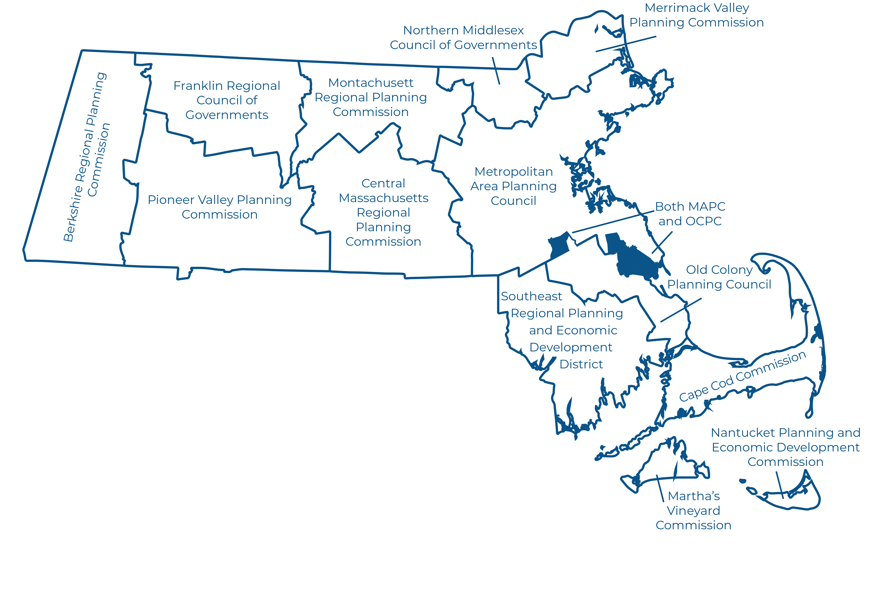
External Resources
Depending on the tasks, there are external resources that can help with local adoption support, including:
*
www.abundanthousingma.org
*Note: AHMA can connect you to local housing advocacy groups from other communities
Your Regional Planning Agency
www.chapa.org

Slide 28
Step 6:
Decide how you want to coordinate efforts moving forward and assign tasks to implement local adoption strategy

Slide 29
Implementation of Strategy
Now that you have a plan in place, it’s time to start talking to your neighbors and other stakeholders in your community!
As a group, decide how you want to check-in on progress and coordinate efforts, such as:
Holding biweekly Zoom meetings to strategize and adapt methods
Creating a Google contact list and spreadsheet of activities to track communications and status updates
While you are all together, start assigning initial tasks to get started on

Slide 30
Thank you!
Primary Contact Person and Information
mapc.org/mbta-communities-show-your-support-toolkit
Your Logo

