Slide 1

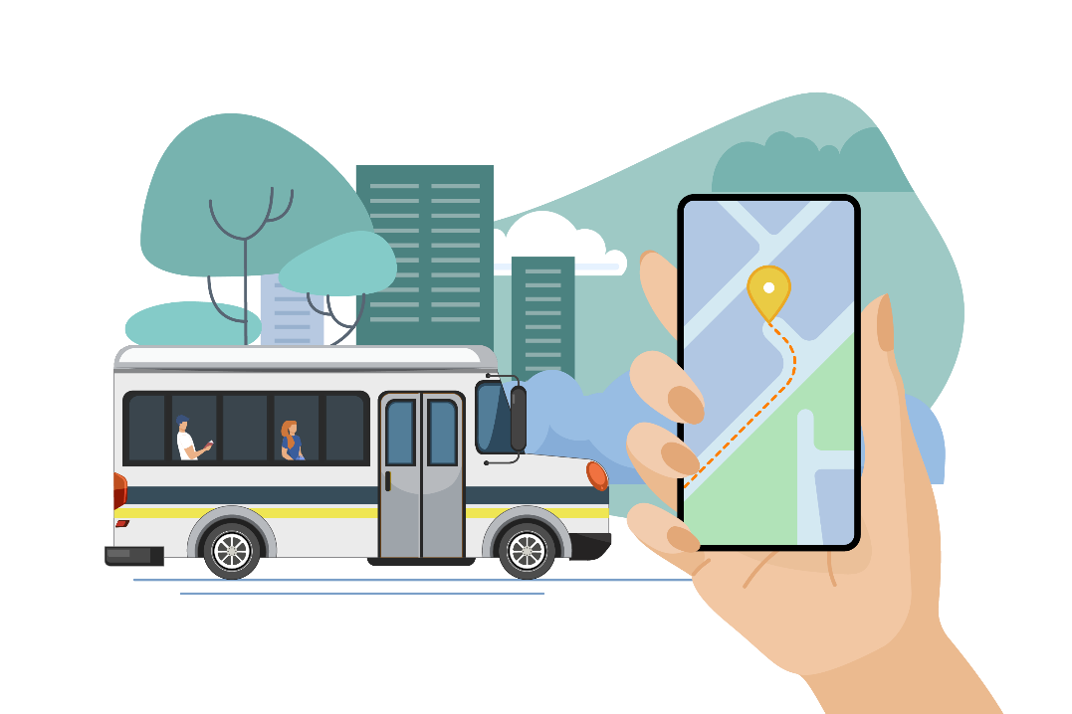
2025 MARPA and DLS Conference
Berkshire Microtransit
October 7, 2025

Slide 2
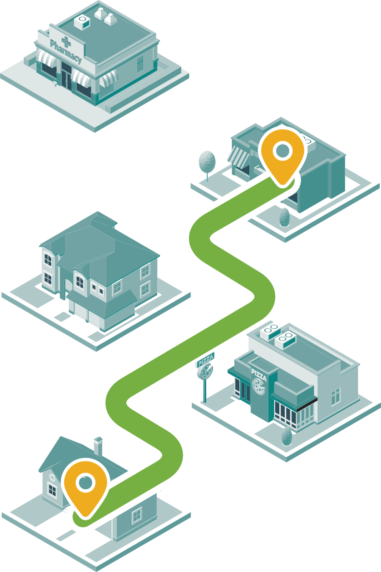
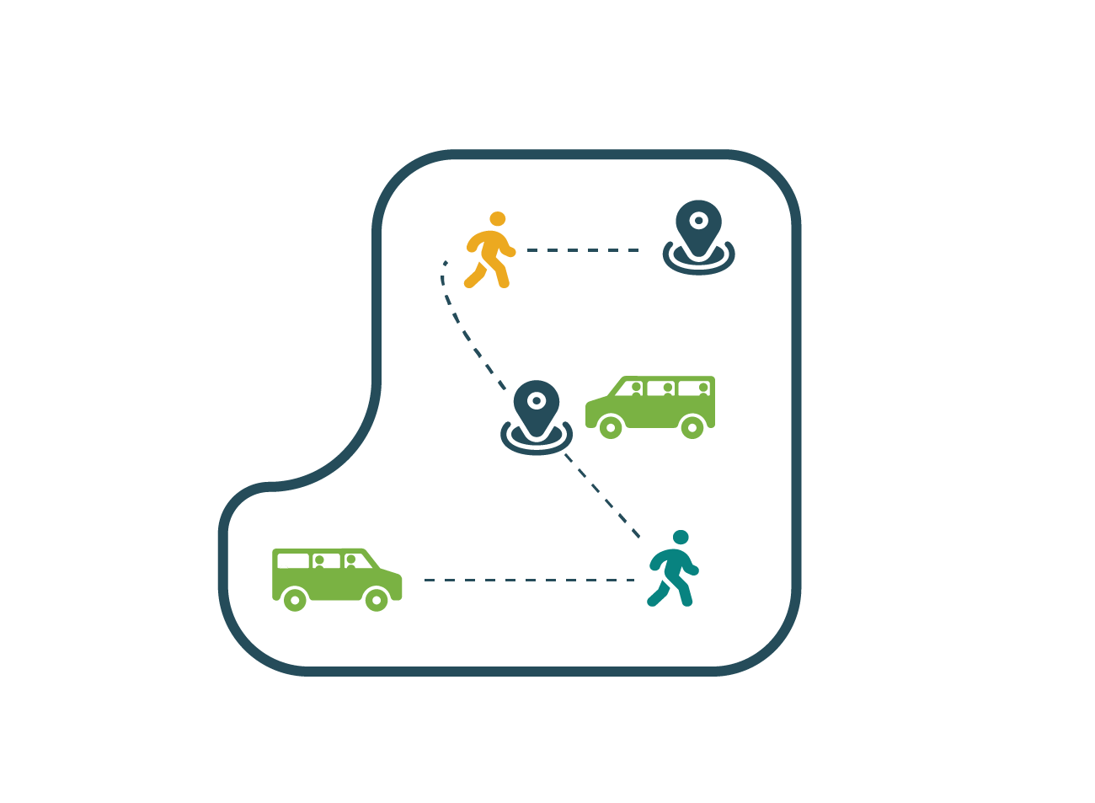
What is Microtransit?
Technology-driven demand-response service with predictable fares
More coverage than fixed-route service; more responsive than traditional dial-a-ride services
Effective approach for low-density and/or auto-oriented environments
Similar interface for those who have used Uber/Lyft app

Slide 3
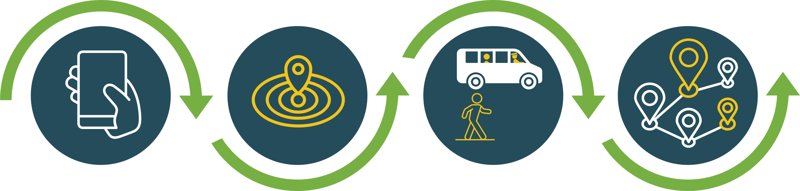
How It Works
Request a trip
Pickup in a designated zone
Pick up and drop off others (sometimes!)
Drop off in a designated zone
Select a pickup time, a pickup point, and a dropoff point within the same zone. You can book using an app, a phone call, or a website.
The microtransit vehicle drops you off, and other riders might be dropped off first if their destinations are closer.
A microtransit vehicle picks you up, and you might share it with other riders.
Zones are conveniently
located for easy access to nearby destinations or transit connections.

Slide 4





Why It’s Useful
Accessibility
Expands transit coverage, allowing you to reach places that are harder to get to.
The South County Connector currently provides microtransit in Great Barrington and the surrounding towns, but we want to explore how it could be expanded to other parts of the county.
Flexibility
Offers more convenient travel times compared to bus schedules.
Connectivity
Connects to bus routes so you can use both together.
Fiscal Responsibility
Allows us to provide transit to more people in places where traditional bus is less efficient.

Slide 5
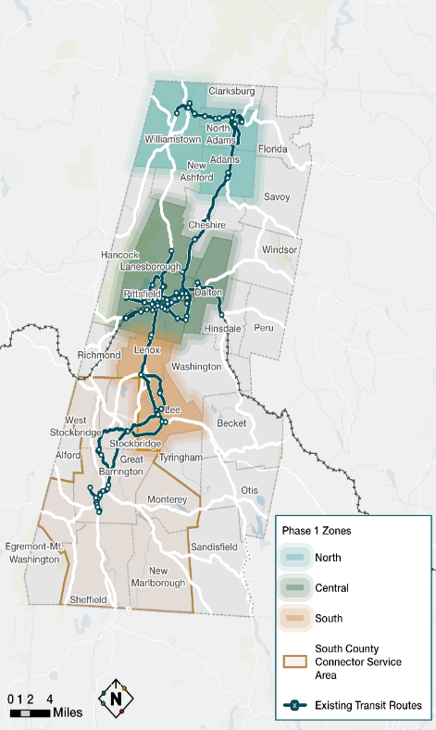
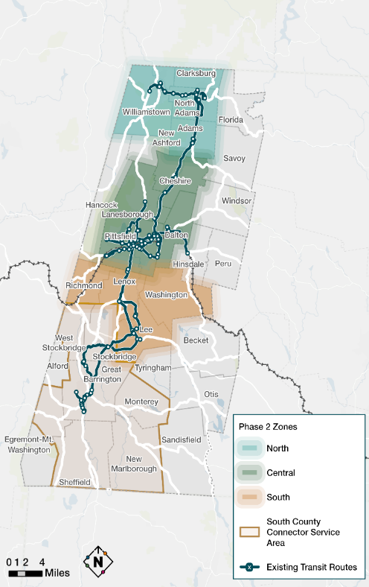
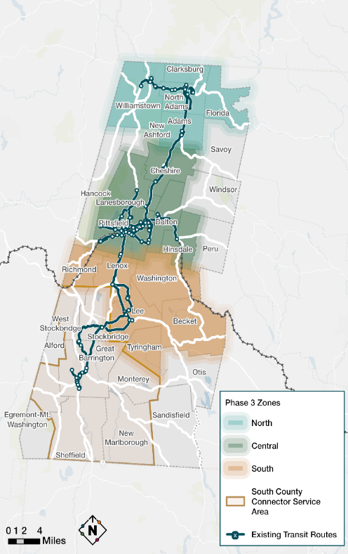
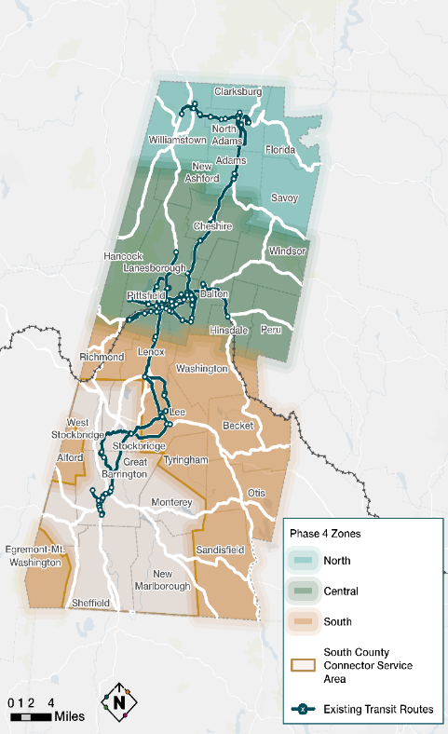
Berkshire Microtransit
Phase One
Phase Two
Phase Three
Phase Four

Slide 6
FFY 2026 MassDOT Transit Grants
Microtransit and Last Mile (due November 7, 2025)
https://www.mass.gov/how-to/microtransit-and-last-mile-transit-grant
Community Transit Grant Program (CTGP) Operating & Mobility Management (due November 7, 2025)
https://www.mass.gov/community-transit-grant-program
CTGP Vehicle Cycle (due November 21, 2025)
https://www.mass.gov/how-to/apply-for-an-accessible-vehicle-through-the-community-transit-grant-program
BRPC Contact:
Anuja Koirala, AICP
Principal Transportation Planner
akoirala@berkshireplanning.org
www.berkshireplanning.org

