Slide 1



ERIN PERRY, DEPUTY DIRECTOR, CAPE COD COMMISSION
2025 MARPA/DLS MUNICIPAL PARTNERSHIPS CONFERENCE | OCTOBER 7, 2025

Slide 2







Key Findings
Development of the Regional Housing Strategy resulted in a number of key findings regarding regional housing challenges.
of residential properties County-wide are single family
homes
Sales prices have increased at a rate that far exceeds income 2019 - 2022
It takes just
YEAR
2
NEARLY
60%
7.5%
MONTHS
80%
median single-family home sales price increase
median household
income increase
for average short-term rents to exceed average year-round rents
ONLY
2%
a household
must earn
$210,000 ANNUALLY
Estimated housing demand is projected to outpace supply by 11,000 to nearly 22,000 housing units by 2035
to be able to affordably purchase a median-priced single-family home
of the region is zoned to allow housing developments with more than two units to be built by-right

Slide 3
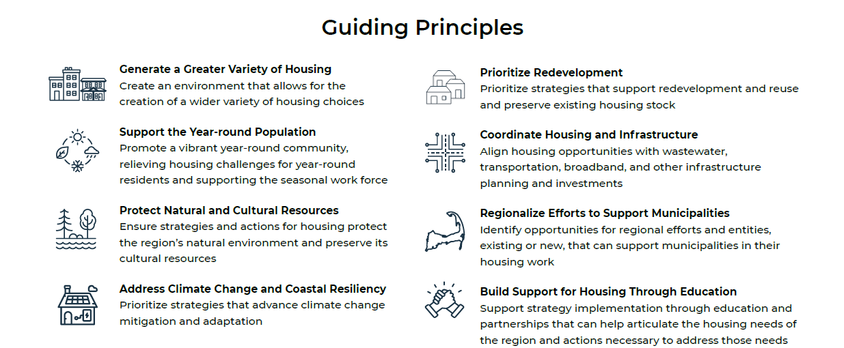
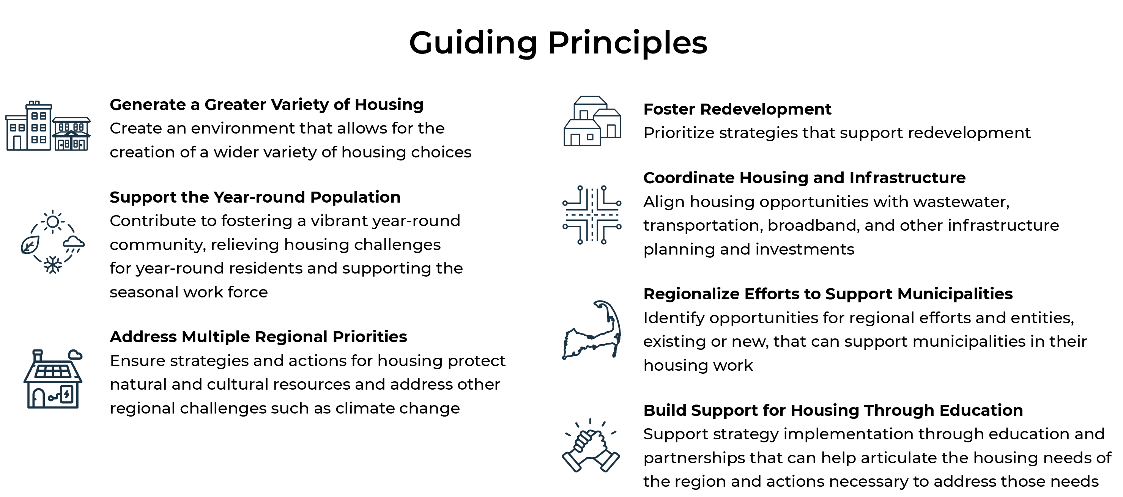
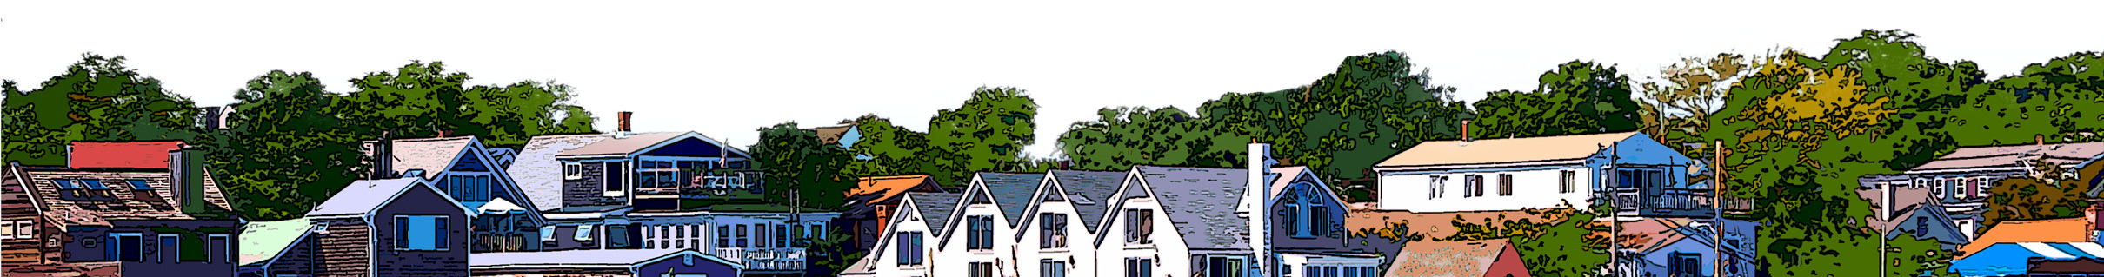
Purpose of the Regional Housing Strategy
Identify policies, strategies, and appropriate areas for housing development and redevelopment to address housing supply, affordability, and availability challenges while protecting sensitive resources.

Slide 4














Recommendations
Change Zoning
Streamline Permitting
Develop a Community Land Trust and Regional Housing Land Bank
Develop a Regional Redevelopment Authority
Provide Financial Incentives to Convert and Preserve Year-round Housing
Finance Housing Affordable to 80%-120%+ AMI
Provide Low- or No-cost Loans for ADUs
Dedicate Municipal Tax Receipts Towards Housing and Infrastructure
Develop a Regional Local Government Investment Pool
Establish a Permanent Regional Housing Services Office
Develop a Regional Capital
Plan
Develop a Regional Homesharing Program
Explore Housing Potential on Joint Base Cape Cod

Slide 5


RECOMMENDATIONS
Develop a Community Land Trust and
Regional Housing Land Bank
A community land trust and regional housing land bank should be developed and work in concert to more swiftly take advantage of opportunities to acquire properties for affordable or attainable housing.
Community Land Trust
Housing Land Bank
An organization that holds land in perpetuity for a values-driven purpose (often affordable housing or land conservation).
An organization that buys and sells land over a short time span for a values-driven purpose (often economic development or land conservation).

Slide 6







RECOMMENDATIONS
PROGRAMS
COMMUNITY LAND TRUST
RECOMMENDATIONS & NEXT STEPS
VALUES
Mission to acquire and hold land in Barnstable County for the creation and maintenance of community-controlled, permanently affordable and attainable housing opportunities for the Cape Cod community.
COMMUNITY POWER
AFFORDABILITY
SUSTAINABILITY
EQUITY
TRANSPARENCY
ACTION

Slide 7



RECOMMENDATIONS
PROGRAMS
COMMUNITY LAND TRUST
RECOMMENDATIONS
PROGRAM AREAS OF FOCUS
PRESERVE EXISTING HOUSING
DEVELOP
INFILL OPPORTUNITIES
AFFORDABLE AND ATTAINABLE

Slide 8





HOUSING LAND BANK
RECOMMENDATIONS & NEXT STEPS
VALUES
Mission to acquire, hold, manage, redevelop, and dispose of property to aid in the development or redevelopment of affordable housing. It works to support the Community Land Trust in its mission to acquire land in perpetuity to create and maintain permanently affordable housing opportunities for Cape Cod residents.
REGIONAL COLLABORATION
EQUITY & INCLUSION
COMMUNITY ENGAGEMENT
TRANSPARENCY & ACCOUNTABILITY
INNOVATION & SUSTAINABILITY

Slide 9



HOUSING LAND BANK
RECOMMENDATIONS
AREAS OF FOCUS & CONSIDERATIONS
ACQUIRE & DISPOSE OF PROPERTIES
PROTECT SENSITIVE ENVIRONMENTAL LANDS
PROJECT SCALE
& PARTNERS

Slide 10

RECOMMENDATIONS
Provide Financial Incentives to Convert
and Preserve Year-round Housing
The gap between income generated from year-round housing and short-term rentals must be closed to bolster the year-round housing supply, particularly year-round rental housing, and increase attainable housing opportunities.
Provide deed restrictions for year-round occupancy of units to preserve year-round housing
Provide grants to current short-term rental owners to rent their properties year-round to help convert short-term rentals to year-round rentals
Next Step
Gather data on short-term rentals and conduct an analysis to identify the financial incentives necessary to encourage participation in the programs and work with landlords and property owners to gauge interest in the programs

Slide 11




INCENTIVIZING YEAR-ROUND HOUSING
PROJECT GOALS
UNDERSTAND
THE YEAR-ROUND HOUSING PROGRAM LANDSCAPE
UNDERSTAND THE SCALE OF SUBSIDY NEEDED
UNDERSTAND NON-FINANCIAL BARRIERS AND SOLUTIONS TO ADOPTION
PROVIDE PROGRAM DESIGN GUIDANCE FOR IMPLEMENTATION

Slide 12
INCENTIVIZING YEAR-ROUND HOUSING
YEAR-ROUND HOUSING PROGRAM TYPES
Deed Restrictions
Annual Incentives
New Build: Zoning & Permitting Negotiations
Existing Homes: Purchases
Cash Transfers
Tax Incentives
$

Slide 13
INCENTIVIZING YEAR-ROUND HOUSING
YEAR-ROUND HOUSING PROGRAM LOCALES
PLACE | TYPICAL HOME VALUE*
Valley County, ID | $660,000
Placer County, CA | $680,000
Barnstable County, MA | $740,000
Summit County, CO | $970,000
Eagle County, CO | $1,270,000
Dukes County, MA | $1,480,000
San Miguel County, CO | $1,510,000
Teton County, WY | $2,160,000
Nantucket County, MA | $2,900,000
TYPICAL HOME PRICES IN PROGRAM LOCATIONS ARE SIMILAR TO OR GREATER THAN THOSE ON CAPE COD
* Zillow Home Value Index

Slide 14
INCENTIVIZING YEAR-ROUND HOUSING
 | Deed Restrictions | Annual Incentives
Timeline | Permanent with ~annual monitoring | 1-year with possible extensions
Target participants | First-time/new local buyers, seniors wanting to age in place, employers, mid-market developers | Non-luxury short-term rental owners, second homeowners who use the property less than they’d like
Cost per unit | Typically 10%–25% of property value (>$100,000 per unit), costs can be piloted | Typically $5k–$20k per unit per year
Income limits | Where they apply, typically 150–250% AMI | Where they apply, typically 100–150%
Administration | More often local | More often third party
Typical Funding | General fund, rooms tax | General fund, rooms tax

Slide 15

Thank you!
www.capecodcommission.org/housing

