Slide 1
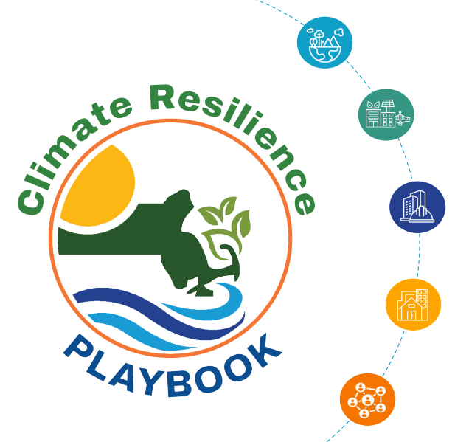
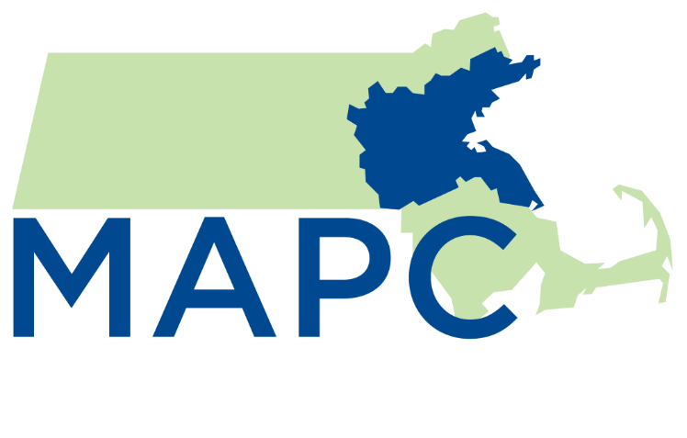
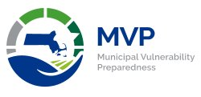

Helping Massachusetts Communities Get Ready for Climate Change
MARPA Annual Conference
October 7, 2025

Slide 2





What is the Playbook?
An online tool
(with downloadable options!) ​
Framework for actions and step-by-step guidance to advance climate resilience planning and implementation
Housing
Ecosystems
and Natural Environments
Infrastructure
Economy
Communities
and Government
Notes:
So what actually is the Playbook? First of all, the Playbook is primarily an online tool and provides guidance to municipalities pursuing actions to advance climate resilience. The Playbook was developed through the lens of equity and aims to complement other state efforts. For example, throughout the development process, the project team considered how to align this tool with existing guidance for MVP 2.0 communities. Through the MVP 2.0 program, municipalities receive funding to identify specific resilience projects. The Playbook tool can be used by these communities to identify potential projects.
The Playbook is centered around five themes that acknowledge how intersectional and cross-cutting resilience work is: Housing, Ecosystems and Natural Environments, Communities and Government, Economy, and Infrastructure.
Importantly, while the Playbook seeks to fill in the gaps and challenges identified earlier, it doesn't cover everything and is intended as a starting point for resilience planning and projects.

Slide 3

Why the Playbook?
Specific case studies and best practices to support local efforts:
Planning Implementation
Community-driven planning and
power sharing
Adapting state guidance to local contexts
Notes:
Van
Speaker Notes: The project team developed the Playbook to address a range of challenges. Massachusetts communities are experiencing intensifying climate change threats, such as extreme heat and flooding. In many communities, the residents most impacted by these threats are low-income residents, residents of color, and other residents with chronic health conditions or mobility constraints. Climate threats are compounding existing inequities. To address these concerns, many different partners are involved. One of the key partners, and the audience Regional Planning Agencies like MAPC directly interact with, are municipalities, which influence local infrastructure, land use, social systems, and much more.
Municipalities play an important role in preparing communities, infrastructure, and social systems for the impacts of climate change and elevating voices, concerns, and ideas of community members most impacted.

Slide 4
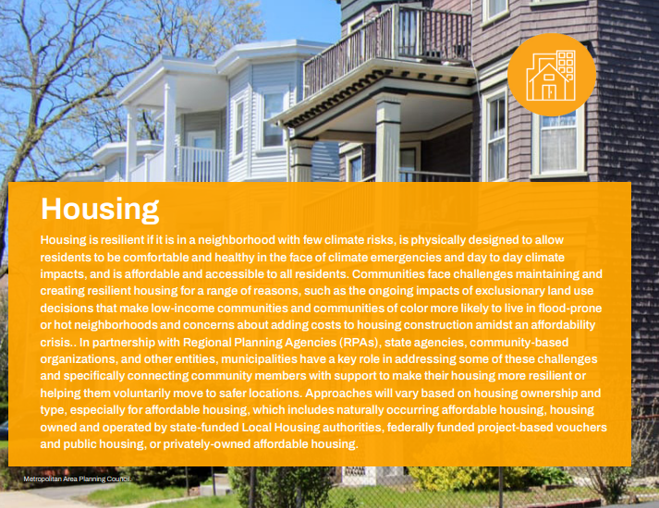
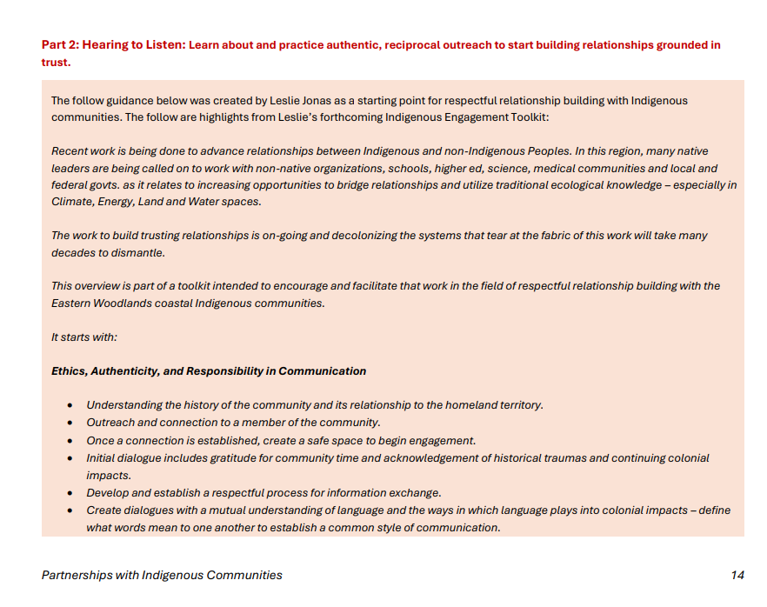
Key Features of the Playbook
Planning Resources
How to Use the Playbook to Guide Local Climate Resilience Planning
Climate Vulnerability and Building Resilience
Community Engagement and Climate Resilience Planning
Partnerships with Indigenous Communities
Adaptive Management for Cost-Effective Climate Adaptation Planning
Playbook Development Process
Glossary
Notes:
Van
The Playbook also has a range of guidance resources. For example, we developed a brief climate vulernability and building resilience primer which link to existing, more detailed resources elsewhere. We also summarized the lessons learned through previous work and for this project into guidance on community engagement in climate resilience planning. MAPC also worked with Leslie Jonas, a member of the Mashpee Wampanoag Tribe and an Indigenous Land and Water Conservationist to outline a living guidance document about partnerships with Indigenous communities on resilience projects.
Throughout these three elements of the Playbook, we aimed to lead with equitable approaches and practices that center the priorities of Environmental Justice communities and other Priority Populations. Throughout the engagement process, we reached out to not only towns and cities, but also many different social service providers, community partners, and others who work directly with community members most vulnerable to climate impacts. In the final product, we offer general guidance for equitable engagement processes as well as specific steps within implementation blueprints about opportunities to center equity within a given project, such as extreme heat mapping.
Add definition of EJ and Priority Populations

Slide 5
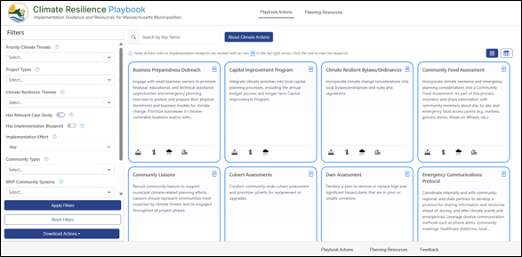
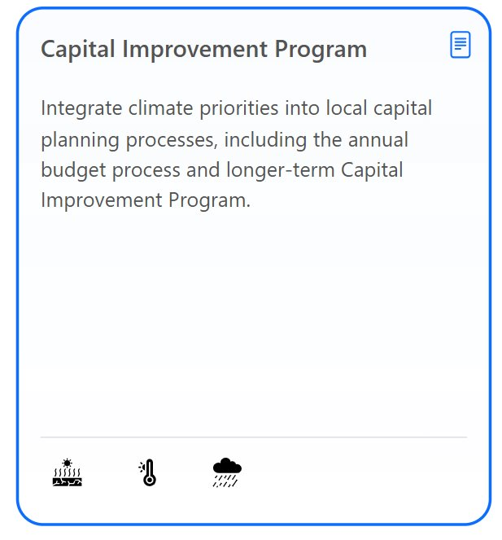
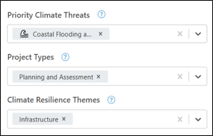
Key Features of the Playbook
Actions Tool
Searchable list of 120 municipal project ideas
Filterable by climate threat, project type, theme, and more
Notes:
Van
The Playbook includes three main elements. First, the website includes an Actions Tool that lists potential actions municipalities may take to address climate threats locally. Second, for a portion of these actions, the Playbook includes more detailed guidance on how a community could go about implementing an action. Third, the Playbook features a number of planning resources, which are documents with more general guidance on aspects of resilience planning and implementation.
The Playbook Actions Tool, which you will get a chance to see in action in our demo, includes a list of 120+ municipal project ideas. We developed this list through many rounds of engagement and analysis. Users can search for relevant actions by factors like climate threat, project type, theme, and more.

Slide 6
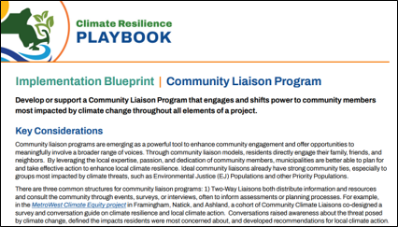
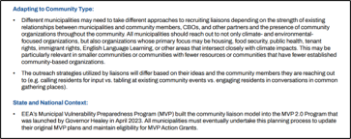
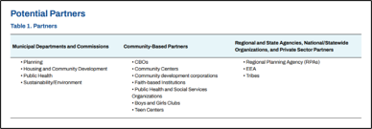
Key Features of the Playbook
20+ detailed implementation blueprints
(and growing!)
Notes:
Van
The Playbook currently has about 20 implementation blueprints. These blueprints bring together lots of crowdsourced advice from community partners, state agencies, and municipalities that have already pursued similar projects. For example, the blueprint on the screen describes implementation steps for developing a local community liaison program. The implementation blueprints include information such as how to adapt an action to a different community, initial implementation steps, case studies, and potential funding resources.

Slide 7
Who is the Playbook for? How would someone use it?
A community-based organization (CBO) is working on a project related to green infrastructure and looking for examples of how other CBOs have worked with municipal partners in the past on similar projects.​
A community has limited staff and is looking for a project related to emergency preparedness that could be pursued regionally in collaboration with other municipalities.​
A town has recently started to assess local food security and needs and is brainstorming priority actions.
A town is updating its zoning bylaw and looking for examples of how other communities have incorporated resilience.​
A town wants to expand cooling options for residents and finds an implementation blueprint outlining key steps to consider.​
A town that hasn’t completed climate resilience projects to date is looking for ideas to pitch for an MVP grant application.​
A city is working with local university students on a semester project to prepare residents for extreme heat. The city searches the database to find potential project ideas.​
An MVP 2.0 community is brainstorming ideas for a seed project related to the top identified community priority of reducing stormwater flooding in an Environmental Justice neighborhood.​
Notes:
Van
So who can benefit from checking out the Playbook? The Playbook identifies actions that municipalities have some influence over, so the primary audience is staff and volunteers in cities and towns across the state. However, the Playbook emphasizes the importance of collaboration with community partners to equitably and successfully implement projects. We have a few example users on this slide. I'll share a few of these that we will return to during the demo.
I'm now going to turn it over to PVPC to share a brief summary of the engagement process that went into developing the Playbook.

Slide 8
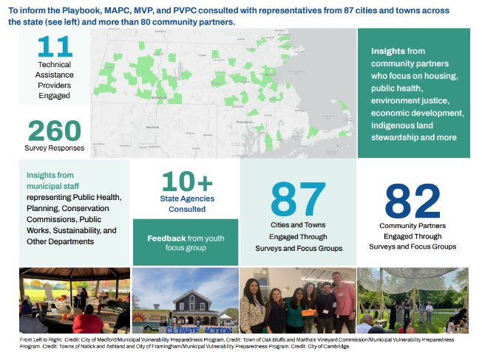
Notes:
The map on this slide highlights those communities we connected with.
Through focus groups and surveys, we heard from 87 cities and towns across the Commonwealth.
We also talked with more than 80 community partners, ranging from Community Development Corporations to social service providers to environmental nonprofits to housing organizations to youth climate groups.
We talked with more than 10 state agencies and with 11 technical assistance providers.
260 surveys were completed
Many 1:1 followup occurred to ensure our blueprints were relevant and addresses the multitude of community need we heard.

Slide 9
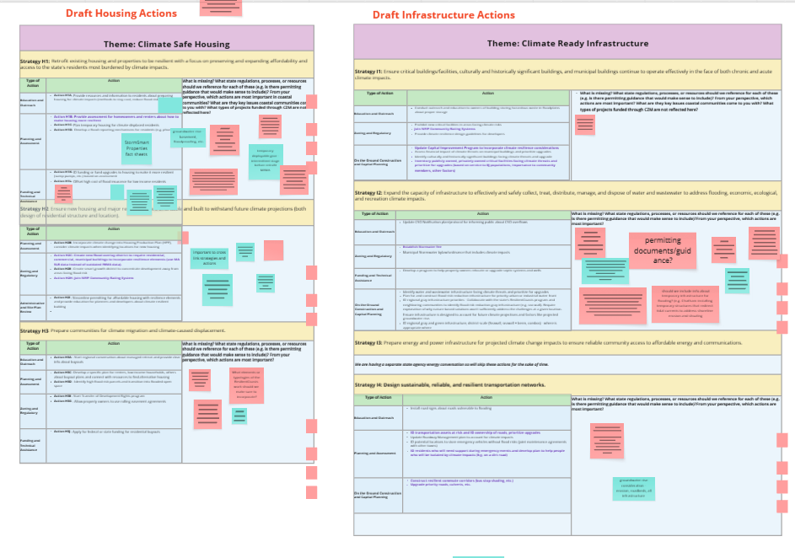
Survey and Focus Groups
Based on input and findings from the survey and focus groups, the project team drafted a list of 200+ project ideas/actions:
Multiple rounds of feedback
Consolidation of project ideas/actions
Incorporation of recommendations from other state efforts (E.g. Resilient Mass Farmland Plan, ResilientCoasts)
Notes:
Ken or Angela
Through the survey and focus group, we asked participants to share where they think the current gaps in support for resilience projects are and to help us put together a list of project types and actions that should be in the Playbook.
We shared draft actions in the focus groups and asked what was missing, went through multiple rounds of consolidation, and referenced state plans, such as ResilientCoasts, to ensure alignment on recommendations.

Slide 10
What We Heard: Needs and Opportunities
Needs | Opportunities
Staffing capacity & capability Necessary technical expertise on climate issues amidst evolving job requirements Building community partnerships Figuring out where to start -selection, prioritization, and justification Funding and timing | Integrate resilience components into required and ongoing projects and processes (e.g. local planning efforts like Open Space and Recreation Plans local processes like capital planning) Lean into partnerships with community organizations and/or colleges and universities. Training for staff and volunteers Pursue regional opportunities Peer learning and education Circuit rider Watershed-scale planning Technical assistance from RPAs
Notes:
Ken and Angela
We also asked cities and towns to share specific challenges and opportunities.
Challenges include limited staffing and capacity and volunteers/staffs having to wear many hats, lack of climate-specific technical expertise, challenges with partnerships, figuring out where to start, and finding and timing. Participants also shared opportunities to build capacity in addition to needing more funding and staff. For example, people recommended integrating resilience components into projects and processes. For example, if a community is already doing a hazard mitigation plan or open space plan, there are opportunities to incorporate resilience components or climate threats into plans. Other opportunities include partnering with universities and pursuing regional projects.

Slide 11
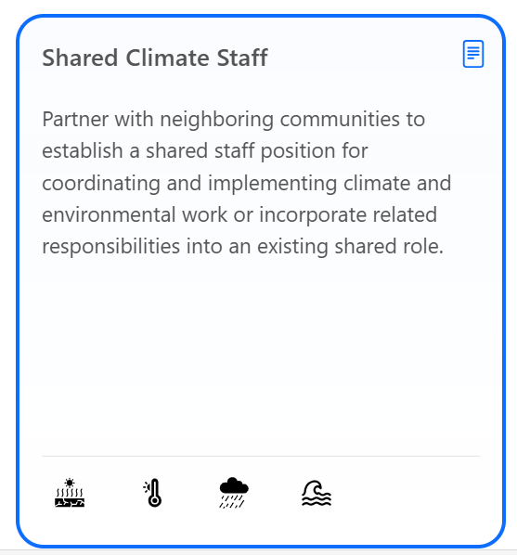
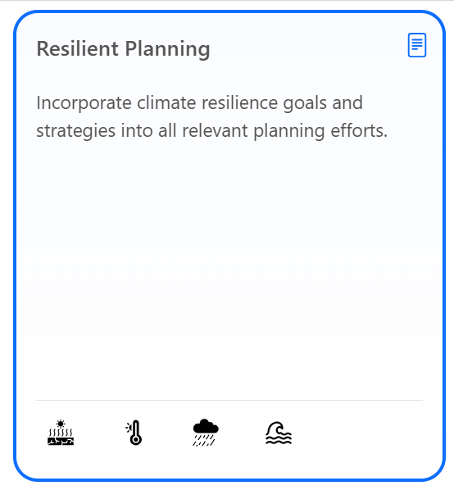
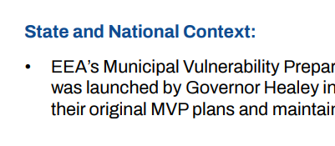

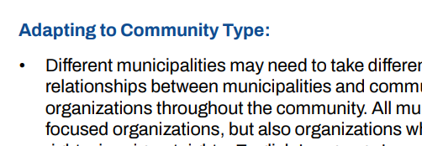
Examples of How This Input Shaped the Playbook
Pursue regional opportunities + volunteers and staff having to wear many hats
Integrate resilience components into required and ongoing projects and processes (e.g., HMP)
Search function allows user to filter by actions that could be pursued in collaboration with one or more other municipalities
Implementation blueprints detail related state, local, and national planning processes
Implementation blueprints detail how implementation may vary by community type and size
Implementation Blueprint about establishing shared climate staff role
Implementation Blueprint about how to integrate resilience into common processes
Notes:
So how did we incorporate all this feedback?
o address concerns about capacity we have provided several blueprints that can be administered regionally - promoting regional partnerships
For example, we developed an implementation blueprint outlining how to created a shared climate staff role across muliple municipalities that could be adapted to any many other services including BOH agents, conservation agents, veterans agents...
A neat feature of the tool is in the search function there is option for users to only see actions that could be pursued regionally.
Also within each blueprint, we also have a section about how to tailor a specific action to community type.
Now I will hand it over to Emma from MAPC to provide a brief demo of the tool.
For the reasons already summarized and acknowledging the fact that climate change impacts do not stop at municipal boundaries, it can also be more cost-effective and streamlined to share resources and implement certain projects at a regional scale. This section briefly outlines how and when it might make sense to work with other municipalities and Regional Planning Agencies.

Slide 12
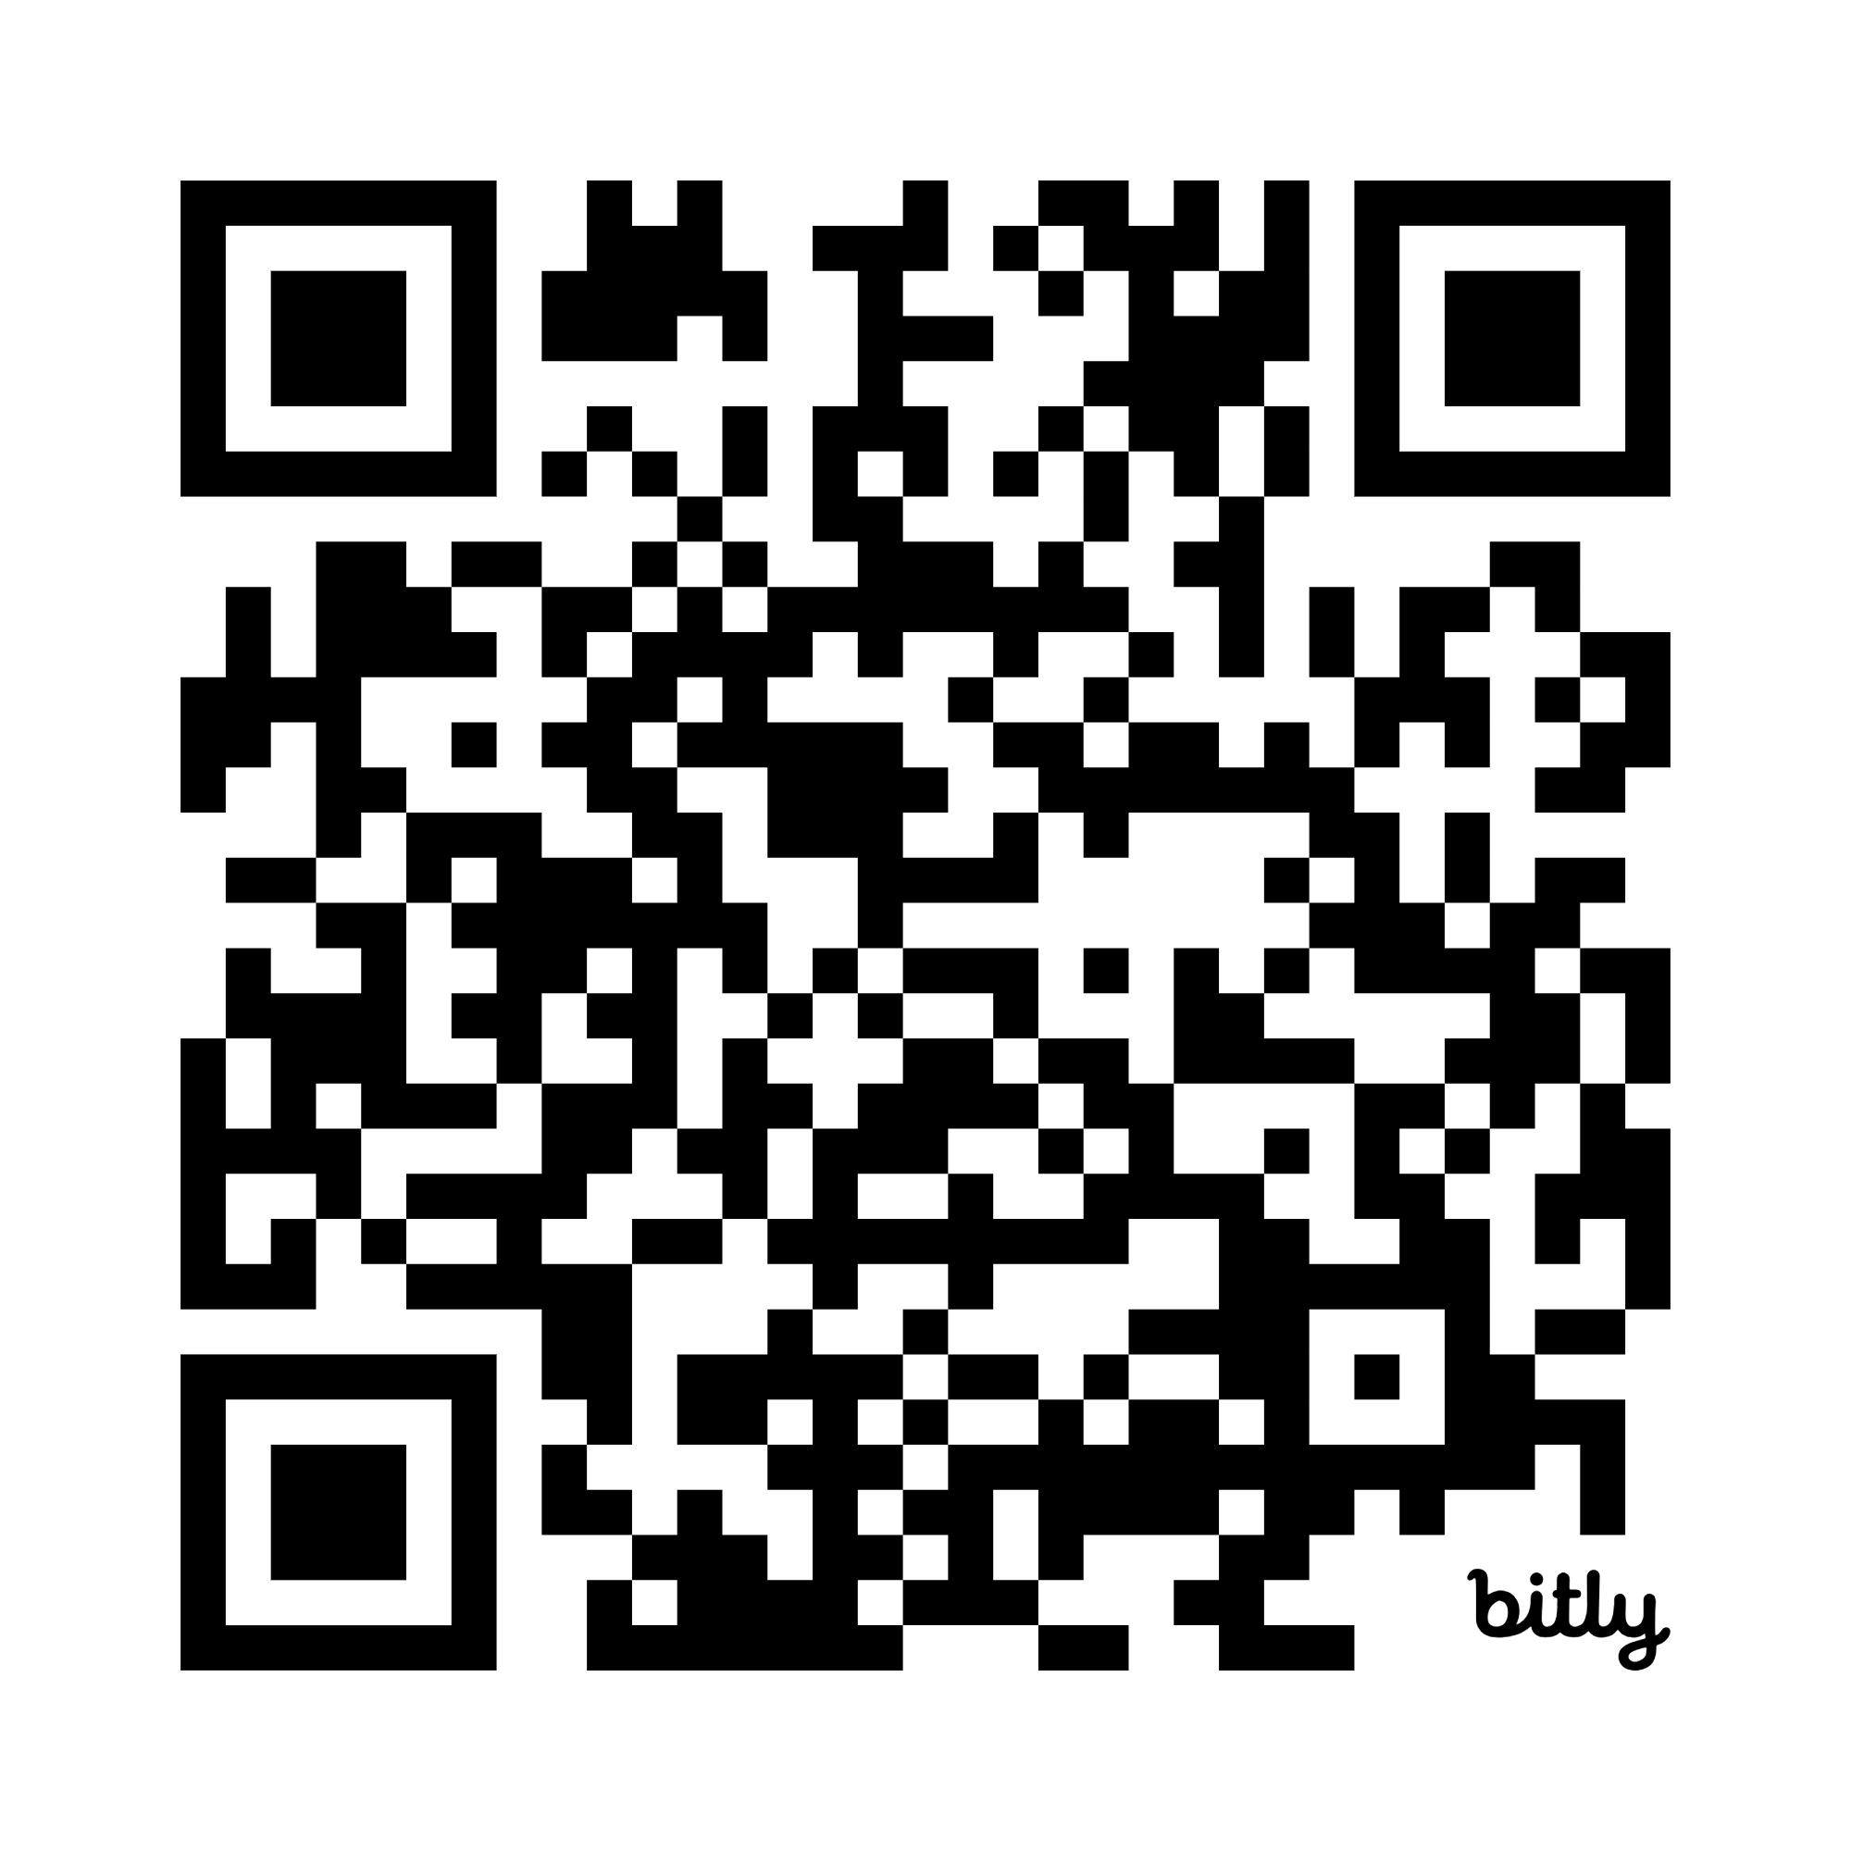
Thank You!
Van H. Du (vdu@mapc.org)

