Slide 1
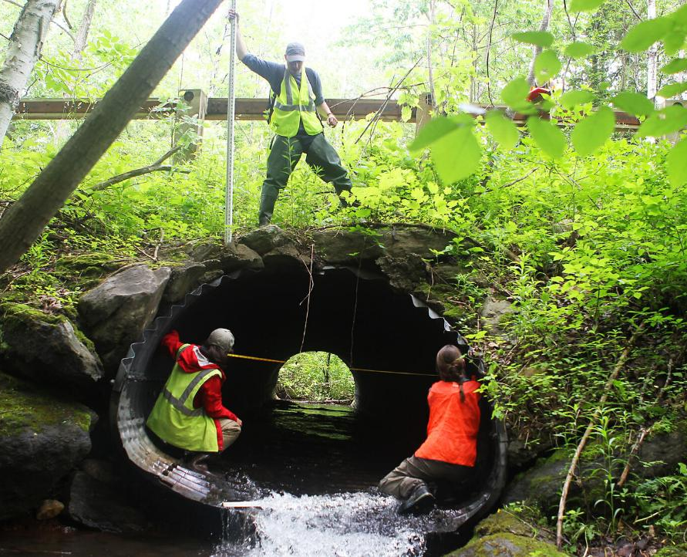

Empowering Resilient Communities
Empowering Municipal Resilience
Katherine Antos, Undersecretary
Executive Office of Energy and Environmental Affairs
October 7, 2025
North Adams, MA

Slide 2
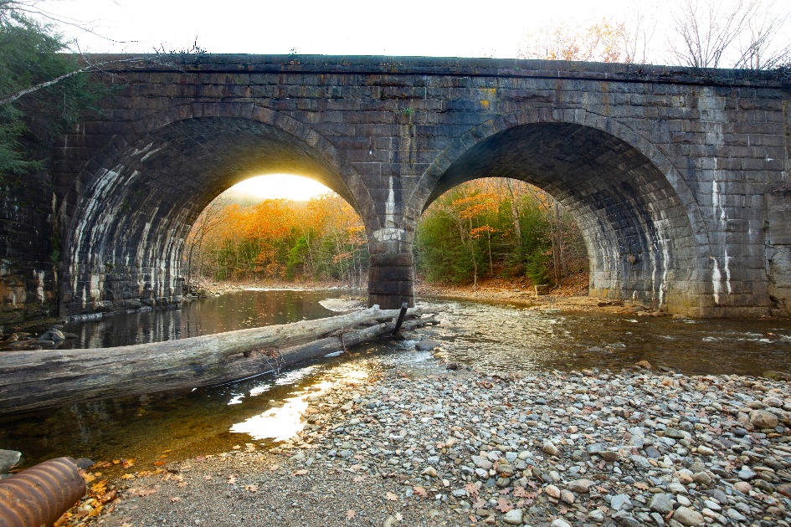
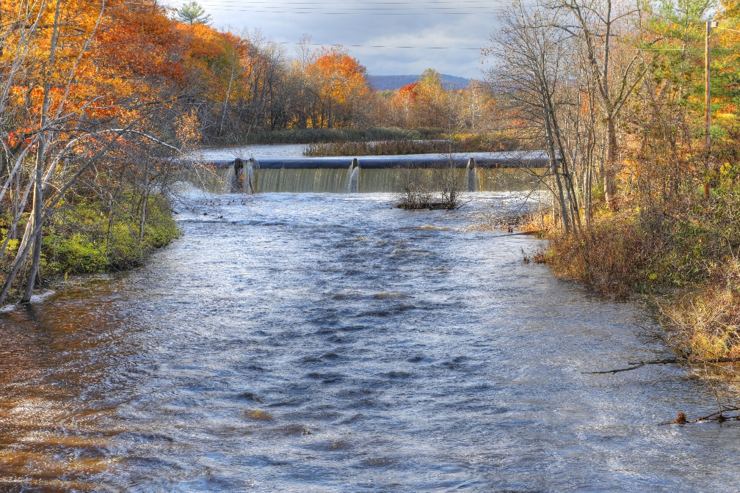
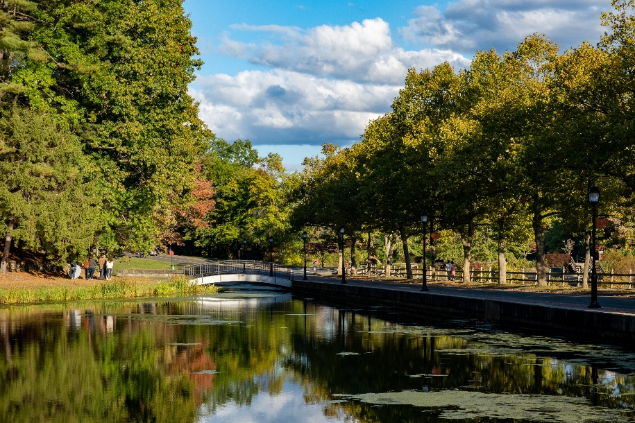
Value of Resilience
Study of federally funded projects found that $1 invested in natural hazard mitigation resulted in $6 in avoided damages over 20 years.
A typical suburban culvert replacement yields $2.50-3.50 for every $1 in cost
Average cost of dam removal was 60% less than repair and maintenance over 30 years
Value of investing in resilience outweigh costs 13 to 1 when considering economic multipliers and co-benefits
Salt marsh restoration results in carbon sequestration and thriving fisheries worth 4 to 7 times more than the cost

Slide 3
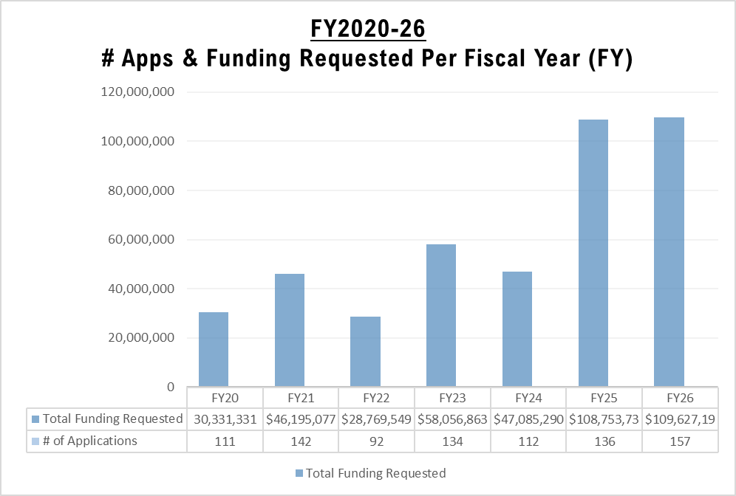
Demand for Resilience: Municipal Vulnerability Preparedness Program
FY 26 Awards:
$28.7 Million

Slide 4
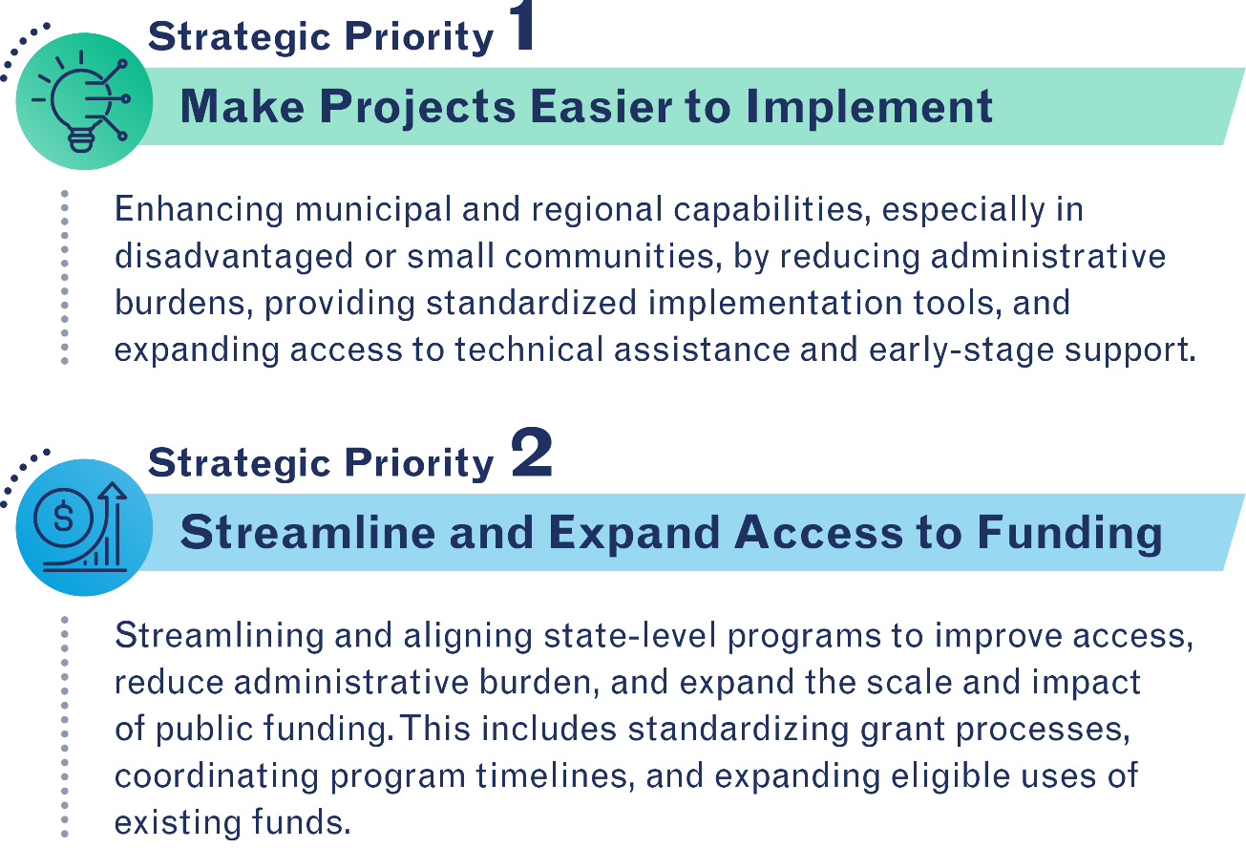
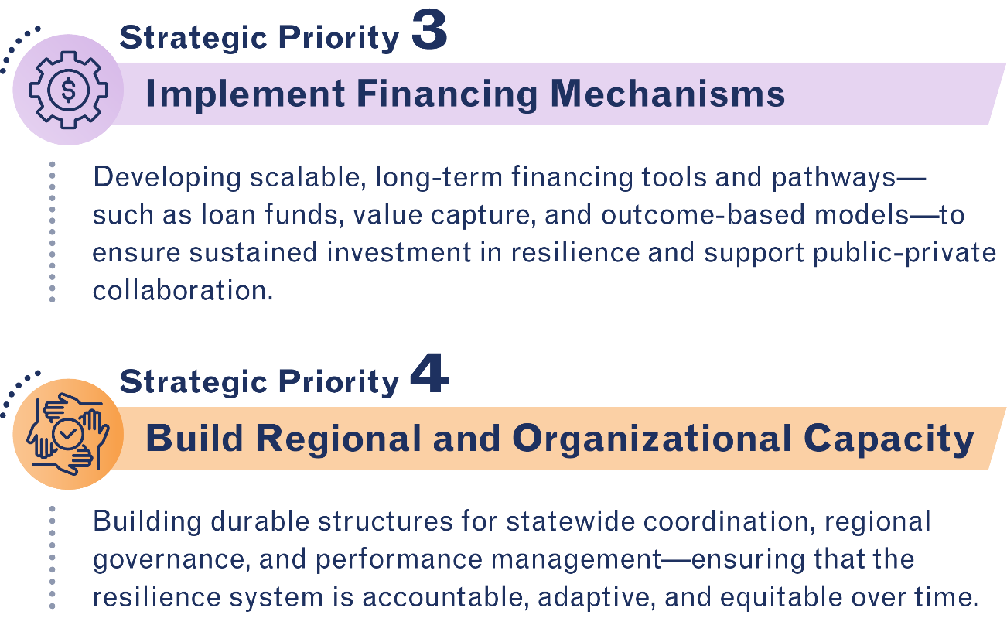
Resilience Finance Roadmap: Building Capacity for Municipal and Regional Action

Slide 5
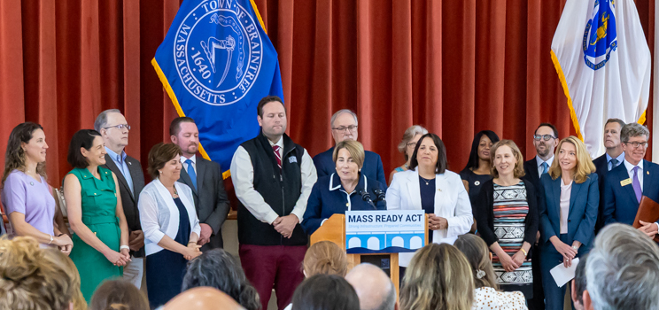
Mass Ready: An Act to Build Resilience for Massachusetts Communities
Invest in Local Economies

Slide 6
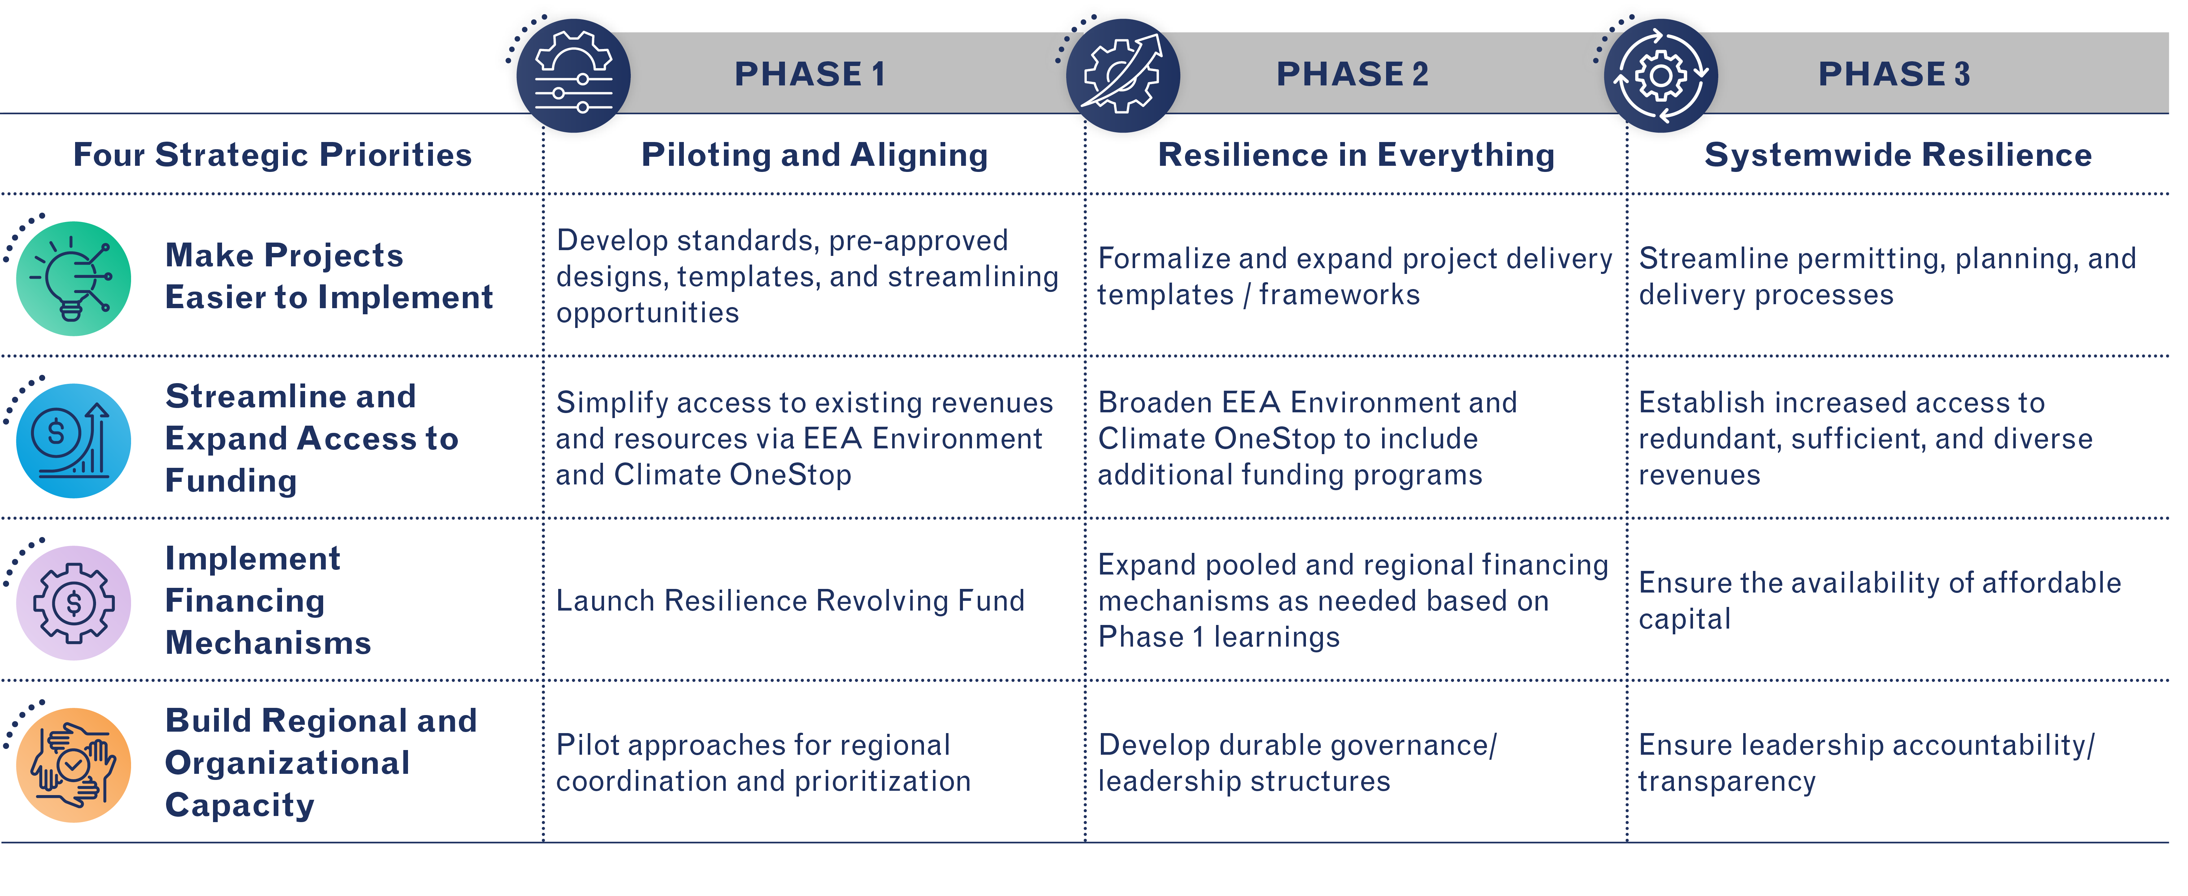

Strategic Priority 1: Making Projects Easier to Implement
Phase 1 Actions
Climate Resilience Playbook: https://resilienceplaybook.mapc.org/
Incorporate Resilience into Design
Streamline Permitting for Nature-Based Solutions and Municipal Culvert Projects that Advance Resilience

Slide 7
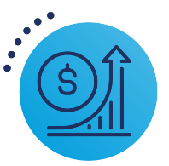

Strategic Priority 2: Streamline and Expand Access to Funding
Phase 1 Actions
Environment and Climate One Stop: https://www.mass.gov/environment-climate-one-stop
A streamlined application process for multiple state-funded climate and environment resilience projects in Massachusetts
Applicants submit one application for multiple grants
Programs work together to match priorities to available resources
Expression of Interest open through October 28 at 11:59 pm; allows early feedback from program staff
Anticipate formal application period will start in early 2026

Slide 8
ECO One Stop includes 7 programs
MVP Action
Offers financial resources to communities that are seeking to advance priority climate adaptation actions to address climate change impacts in alignment with the MVP Core Principles.
CZM Coastal Resilience
Provides financial and technical support for local and regional efforts to address coastal flooding, erosion, and sea level rise.
CZM Coastal Habitat and Water Quality
Provide financial resources for projects that assess and treat stormwater pollution and support comprehensive habitat restoration.
EEA Cooling Corridors
Offers financial resources for conducting tree planting and related activities to assist with mitigating extreme heat and to enhance the tree canopy within neighborhoods and public spaces.
EEA Planning Assistance
Supports sustainable land use practices, including zoning for diverse housing, climate change mitigation, and land conservation, in alignment with the state's Sustainable Development Principles.
EEA Dams and Seawalls
Offers financial resources to support projects for the repair and removal of dams, levees, seawalls, and other forms of flood control.
DER Culvert Replacement Municipal Assistance and Training
Supports replacing or removing an undersized, perched, and/or degraded culverts or small bridges located in an area of high ecological value.

Slide 9
Mass Ready Act: $3B historic investment in environment and infrastructure
The Mass Ready Act, a comprehensive package of spending, policy, and programmatic actions, is the largest environmental investment in MA history and prioritizes resiliency, food security, clean environment and public health for MA families, children and communities.
Strengthen Our Infrastructure
Invest in Local Economies
Protect Water & Nature
Climate Readiness & Environmental Justice
Preparing to withstand, rapidly recover from, and adapt to natural hazard events; net-zero by 2050; equitable access
Parks & Parkways Infrastructure Ensuring all residents have access to safe facilities and infrastructure to access to the outdoors
Land Conservation & Biodiversity Stewardship
Meeting land conservation goals of 40% by 2050, tree planting, and implementing biodiversity goals
Community and agency land conservation
Tree planting, incl Greening the Gateways and Cooling Corridors
Implementing forthcoming biodiversity goals
Water Infrastructure, including State Revolving Fund and PFAS mitigation
Superfund match and emergency response
Nitrogen reduction
Air and water quality monitoring
Municipal Vulnerability Preparedness
ResilientMass Plan
Outdoor Recreation accessibility grants
EJ infrastructure
Clean Air, Water, & Land Ensuring all residents have access to clean air, water, and land
Parkways
Rinks and Pools
Parks
Beaches
Vehicles & vessels
Trails
Boat Ramps
Facilities
Maintenance
Fish Hatchery
Secure Farmers & Food Systems Updating infrastructure to build strong agricultural economy and a secure food system
Food Security Infrastructure Grants (FSIG) Implementing Farmland Action Plan
Grants for climate resilience enhancements
Inland & Coastal Flooding
Preparing communities and our agencies for sea level rise and extreme flooding events
ResilientCoasts implementation, incl district projects
Dam Safety for communities and at our agencies
Culverts
Agency-owned coastal and flood control structures

Slide 10


Strategic Priority 3: Implement Financing Mechanisms
Phase 1 Actions
State Capitalizes Revolving Fund
Resilience Revolving Fund Supports Local Implementation with Low-Cost Loans
Loans Paid Back and Reinvested in New Loans
^{Resilience Revolving Fund}
Fund critical resilience projects with low-interest, flexible loans
Unlock investments for under-resourced communities
Accelerate delivery of climate-smart infrastructure
Build scale through revolving capital system
Resilience Revolving Fund Pools and Leverages Capital
Loan Payments Reinvested into Communities

Slide 11
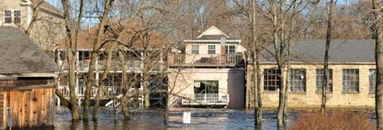
Strategic Priority 4: Build Regional and Organizational Capacity
Phase 1 Actions
Advancing Regional Resilience
Expand MVP eligibility
Expand support to municipalities and Tribal
Notes:
Support communities, including in working together.
Mass Ready: Expands MVP eligibility
Increased auth would also allow regional resilience program

Slide 12
Thank you
Springfield, MA
Source: Adobe Stock

