Slide 1
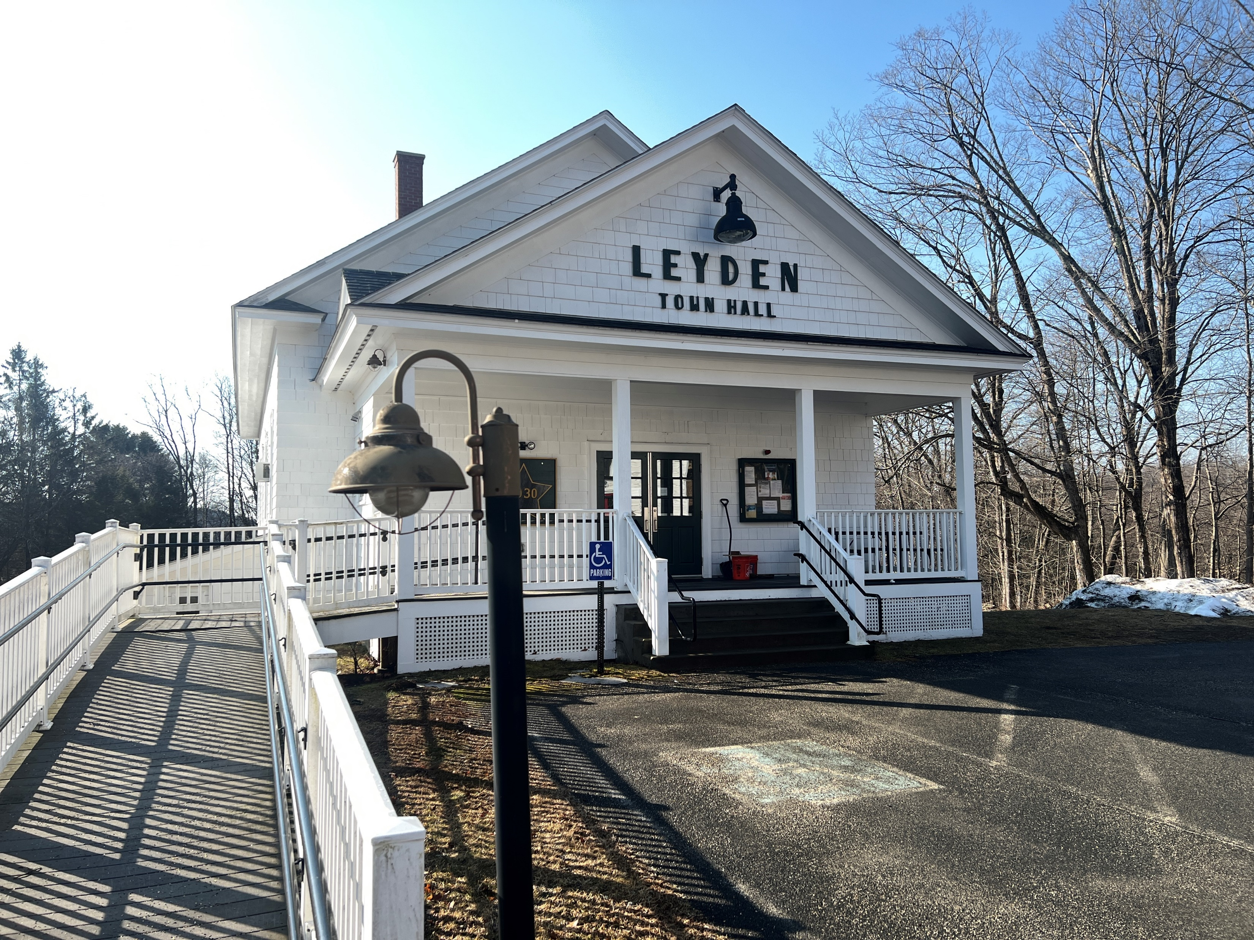
Expanding Municipal Capacity: Regional and State Supports
2025 Statewide Municipal Partnership Conference
October 7, 2025

Slide 2



Panelists
Linda Dunlavy
Executive Director
Franklin Regional Council of Governments
Derek Krevat
Manager of Municipal Planning and Support
MassDOT Office of Transportation Planning
Quentin Palfrey
Director
Federal Funds and Infrastructure Office
Executive Office for Administration and Finance
Commonwealth of Massachusetts

Slide 3
Workshop Goal
Clarify where municipalities go to get assistance on project scoping, planning, design and engineering, grant research and application writing and grant administration.
There are options! But the answer of where to go may not always be clear…

Slide 4
Housing production and environmental planning/design work
Demonstration activities
Tax Assistance (e.g. filing forms with the IRS for Direct Pay)
Master Planning
Land use, zoning, subdivision regulation review or bylaw updates
RPA TA
FFIO MTTA
Grant-Writing
Project Scoping and Financial Analysis
Planning and Feasibility Studies
Traffic counts/turning movement counts
Safe Streets Network Strategy
Traffic Analysis
Benefit/cost analyses
DEFINITIONS
RPA TA = Regional Planning Agency Technical Assistance
MassDOT LEAP = Local Early & Actionable Planning Program
FFIO MTTA = Federal Funds & Infrastructure Office Municipal & Tribal Technical Assistance
Complete Streets and small-scale project design and engineering plans
Engineering/technical analyses needed for project development (e.g. survey, geotechnical analysis, hydraulic analysis, crash diagrams, etc.)
Note: The activities listed here are not exhaustive or exclusive to the organization noted in all cases. This diagram is meant to be used for definitional and illustrative purposes.
MassDOT LEAP

Slide 5
Start with your Regional Planning Agency
We were created to help you
We know your municipality and the region
We understand regional goals and priorities
If we can help, we are saving money for other statewide projects and needs

Slide 6
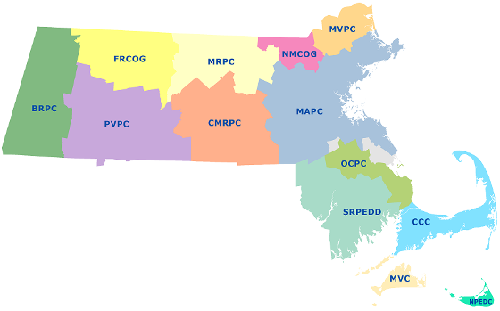

The Work of Regional Planning Agencies
Regional Planning Agencies (RPAs) were created by Massachusetts General Law in 1974.
Purpose: comprehensively study, plan, and recommend how a region can protect and enhance its environment, economy and quality of life through the study of land use, natural resources, climate resilience, economic development, transportation.
Notes:
Organizational Structure: The Massachusetts Association of Regional Planning Agencies is a formal organization with established bylaws. The association consists of the state’s 13 regional development organizations, known as regional planning agencies in the state. Two of the member organizations receive modest funding to provide staff support for the association. The Pioneer Valley Planning Commission provides administrative support and the Metropolitan Area Planning Council, located in the state capital, provides legislative research and advocacy support. Committees are formed on an as-needed basis.
Governing Structure: The executive directors and the chair of each regional organization form the state association board. Each member of the board has one vote. The president, vice president and secretary/treasurer form an executive committee.

Slide 7
Key Functions of MA RPAs
Regional Planning
Develop comprehensive plans for land use, housing, transportation and economic development that consider issues across multiple communities.
Advocacy
Advocate for regional needs and interests to state and federal officials and other partners.
Coordination and Collaboration
Facilitate communication and coordination between local, state, and federal governments, as well as private organizations, on regional matters.
Data and Research
Conduct research, analyze trends, and provide data, such as GIS mapping services and comprehensive data sets, to support decision-making.
Resource Management
Manage natural resources and coordinate services related to solid waste, water systems, and other critical infrastructure.
Service Delivery
Improve the efficiency of regional services: public safety, emergency preparedness, health care, and transportation; can also perform non-planning functions for their members.
Technical Assistance
Offer professional planning expertise and support to help member municipalities design and implement development programs and planning initiatives.

Slide 8
Technical Assistance Typically Available
Project development
Traffic counts, intersection analyses, air quality modelling, turning movement counts, Complete Streets assessments, speed studies
Zoning analysis and development
Housing production plans and housing siting
Natural resources, river and watershed resiliency, stormwater management
Green Communities and other green energy assistance
Industrial park planning, infrastructure planning, economic development assistance, brownfields assessment and clean up loans
Open space and recreation plans (OSRPs)
Grant research and writing; fiduciary and grant administration

Slide 9
Specialized Assistance Possibly Available
Drone imagery – regional flyovers, planimetrics and lidar
Pedestrian counters for trails and sidewalks
GPS of trails and other assets
Culvert assessments
Post-storm infrastructure assessment
ADA assessments
Historic preservation inventories
Arts and culture planning
Clean energy plans, policy and programs
Small business support and loans
Community health assessment and improvement plans
Emergency preparedness and shelter plans, trainings, exercises and After Action Reports
Even siting of porta potties at recreational facilities

Slide 10
If an RPA Can’t Help, Where Do You Go Next?
Are you a rural municipality or a Gateway City and is it a transportation project?
Go to LEAP

Slide 11
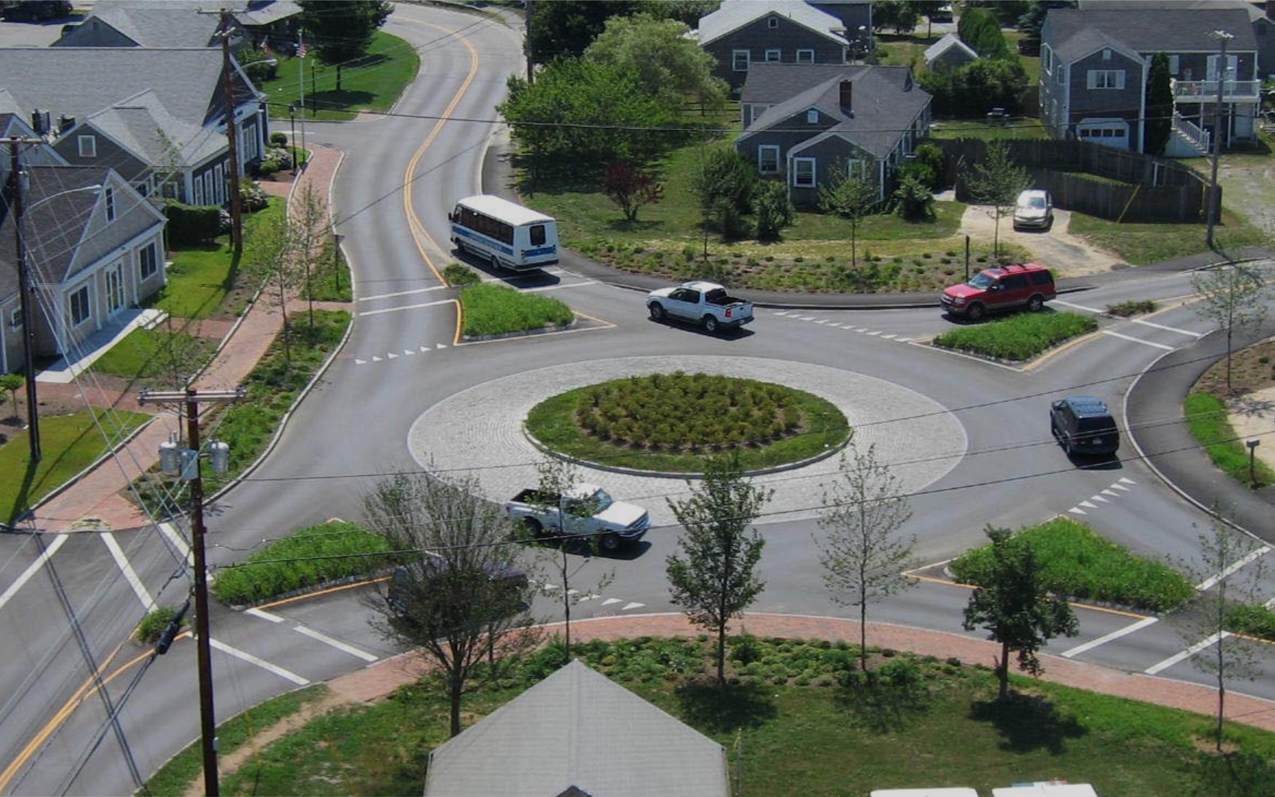

Municipal Planning & Support (MP&S) Team
Introduction and Available Services

Slide 12
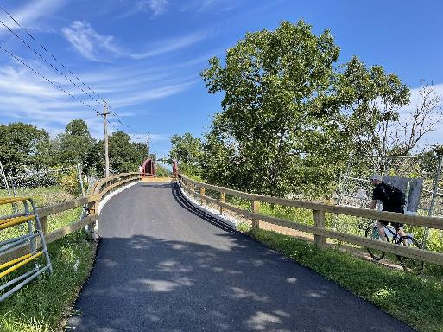
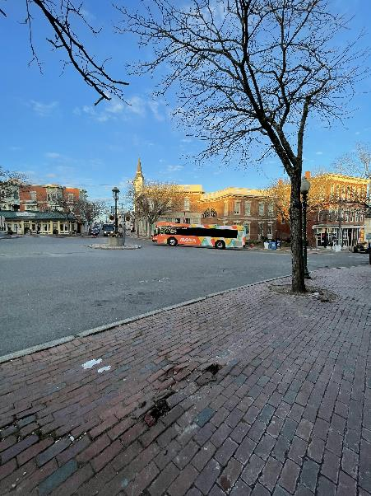
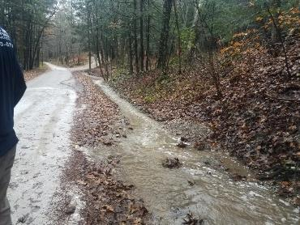
Background
MassDOT’s Municipal Planning & Support Group’s mission is to connect municipalities with federal funding opportunities to advance local and regional transportation needs.
The group will also provide technical assistance to Massachusetts communities, with a focus on rural areas and Gateway Cities, to prepare projects for the receipt of federal funding, develop discretionary grant applications, and assist with coordination efforts across MassDOT, municipalities, and our partner agencies.

Slide 13
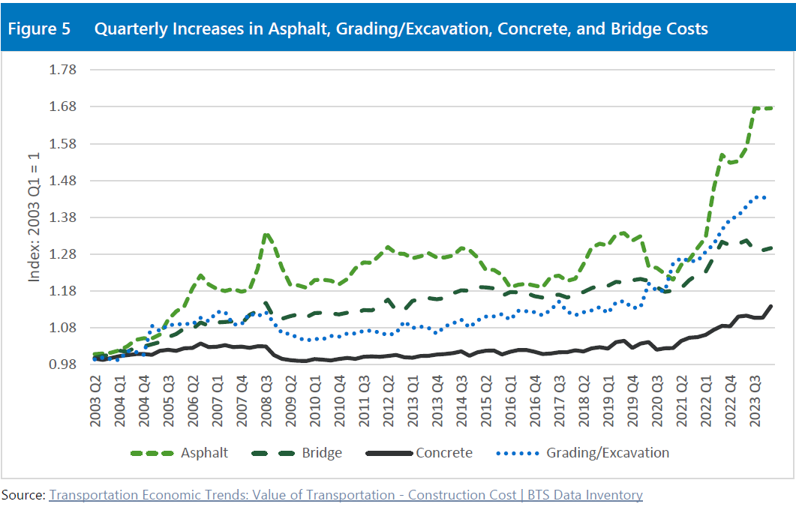
Big Picture Local Funding Challenges
While the Chapter 90 Program has remained level-funded since 2012, construction and labor costs have experienced significant inflationary pressure during this period.
Asphalt costs have increased by 167 percent compared to 2003 costs, with the highest increases occurring in 2008 and between Q1 and Q3 of 2023.
Grading and Excavation costs have experienced the second highest increases during this period, rising by 143 percent.
Bridge costs saw the third highest spike, increasing by 129 percent.
Concrete costs saw the fourth highest increase, rising by 114 percent.

Slide 14
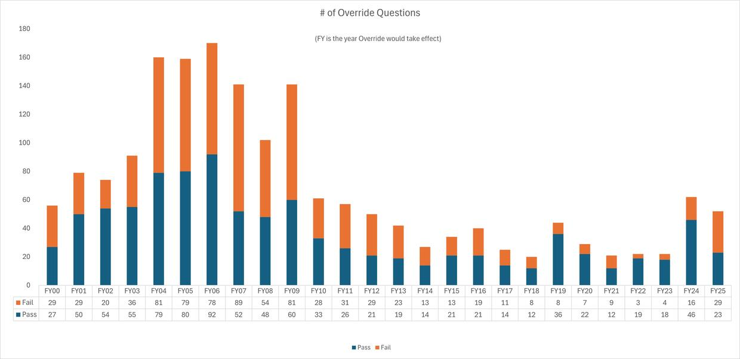
Big Picture Local Funding Challenges (cont.)
Municipal budgets are strained, prompting more proposition 2.5 override in Massachusetts votes in FY24 and FY25 at any point since the Great Recession in 2009.
Source: https://www.mass.gov/info-details/reporting-prop-2-12-election-results-and-related-fy2025-analysis

Slide 15
LEAP Program Overview
MassDOT’s Municipal Planning & Support (MP&S) Group is procuring consultant support to provide early-stage planning and project development activities (see next slide for details) for underserved municipalities in Massachusetts.
Two consultant teams will be procured in the summer of 2025 with an expected notice to proceed in October 2025.
MassDOT anticipates that individual tasks funded as part of this program and performed by these consultant teams on behalf of municipalities will be roughly between $25,000 - $100,000 per project.
Requests from municipalities are currently being accepted on a rolling basis. Municipalities can make requests using the form linked here: https://mbta.qualtrics.com/jfe/form/SV_d5YEu8i81ktYxlY

Slide 16
LEAP Program Process Flow
Municipality Submits Request
MassDOT and Committee* Review Request
Request Approved for LEAP Support
Assigned to LEAP Consultant Team
Project is Scoped**
Consultant Team Produces Requested Deliverables
MassDOT Provides Suggestions for Other Opportunities for Project Advancement
Request Not Approved for LEAP Support
*The Review Committee will be made up of MassDOT HQ and District Staff as well as RPAs
** Scoping process will define consultant staffing hours, finalize project budget, and outline specific tasks

Slide 17
Eligible Activities
Concept Development
☐ Develop conceptual designs or sketch plans
☐ Provide high-level alternatives for short-term improvements
☐ Provide high-level alternatives for long-term improvements
Complete Streets Engineering & Design
Safe Streets Network Strategy
☐ Identification of priority streets for improvement and development of strategies to support the creation of a safe network for all users, with an emphasis on walking, biking, and taking transit.
☐ For an example, please see the Lynn Safe Streets for People Playbook
Grant Application Development
☐ Draft technical components of federal or state grant application
Safety Analysis
☐ Create crash diagrams
☐ Conduct hot spot/crash pattern analysis
Traffic Analysis
☐ Conduct a traffic study
☐ Conduct a traffic impact assessment

Slide 18
Eligible Activities (cont.)
Site Investigation and Data Collection
☐ Perform field reconnaissance of the project area / Field measurements
☐ Collect traffic volume data
☐ Conduct speed studies
☐ Automatic Traffic Recorder (ATR) counts
Design Documentation Support
☐ Assist with completing a Design Justification Workbook (DJW)
☐ Provide guidance on required documentation for project development
Cost Estimation
☐ Develop preliminary cost estimates for proposed improvements
Visual and Mapping Support
☐ Create maps to support project understanding or communication
☐ Provide graphic design for outreach materials or plan illustrations
Technical Analysis
☐ Conduct geotechnical analysis (e.g., soil and subsurface conditions)
☐ Conduct hydraulic analysis (e.g., drainage or flood impacts)

Slide 19
Review Process and Criteria
MassDOT will work in partnership with Regional Planning Agencies (RPAs) and MassDOT District offices to review and score each request on a recurring (likely quarterly) basis.
A review team specific to each region will evaluate submissions based on the following criteria:
Scoring Criteria:
Community Designation (30%)
Prioritizes Rural and Gateway Cities; also considers similar high-need communities.
Community Needs (30%)
Assesses municipal capacity based on request form responses.
Project Momentum (20%)
Favors projects with a clear, realistic path to implementation following LEAP Program assistance.
Availability of Alternative Funding (20%)
Considers local funding constraints and how program support fills gaps.

Slide 20
Contact Us
Northern Middlesex
Merrimack Valley
Franklin
Montachusett
Pioneer Valley
Central Mass
Boston
Berkshire
OCPC
Program Staff by Region
SE Mass
Lily Wallace: lily.n.wallace@dot.state.ma.us ​
Noah Harper: noah.a.harper@dot.state.ma.us ​
Derek Krevat: Derek.Krevat@dot.state.ma.us
Leah Pickett: leah.i.pickett@dot.state.ma.us
Cape Cod
Martha’s Vineyard
Nantucket

Slide 21
Questions?

Slide 22
I’m not rural or a Gateway City, it’s not a transportation project, my RPA can’t help…
Contact FFIO

Slide 23
Federal Funds and Infrastructure Office – Municipal Technical Assistance Programs

Slide 24
About the Federal Funds and Infrastructure Office (FFIO)
Officially created by Executive Order No. 624, and tasked with implementing a whole-of-government to compete for federal funding by:
Leading bi-weekly meetings of the interagency Advisory Council on Federal Funds and Infrastructure
Identifying and tracking key federal funding opportunities and Massachusetts applications through the State Clearinghouse
Implementing the Federal Match legislation (Chapter 214 of the Acts of 2024)
Leading the Massachusetts Federal Funds Partnership and other meetings to support local governments in their applications for federal funding

Slide 25
Background:
  FFIO/A&F deployment of technical assistance is enabled by Chapter 214 of the Acts of 2024 (“An Act to Provide for Competitiveness and Infrastructure Investment in Massachusetts” or “the Act”) to support projects for cities and towns across the state.
  The Act enables new resources for local government technical assistance to pursue federal funding opportunities.
  FFIO/A&F has established a Municipal and Tribal Technical Assistance (MTTA) Grant Program, and a Technical Assistance Grant Program for Regional Planning Agencies (TARPA.)

Slide 26
Municipal and Tribal Technical Assistance Program
  Grant type: Competitive, direct funding for selected municipalities
  Funding Cap: None; decisions made on a rolling, first-come-first-serve basis (up until a fixed amount per year)
  Covered Services (related to pursuing federal opportunities): Including but not limited to:
      Tax assistance (e.g. for Direct Pay) and legal assistance
      Grant-writing, project scoping and financial analysis
      Planning and feasibility studies,
      Demonstration activities
      Post-award grant management support.
  Administration: In coordination with ANF, FFIO will establish and oversee a process to receive requests for technical assistance services and select successful applicants
  Funding amount: approximately $2,500,000 over 2 years

Slide 27
Technical Assistance Grants for Regional Planning Agencies
  Grant type: Formula-based, direct funding for all 13 RPAs with grant conditions.
  Eligibility: All Massachusetts RPAs.
  Covered Scope of Work (related to pursuing federal opportunities): Including but not limited to: hiring in-house capacity to provide technical assistance, grant application support, project development and implementation support such as project scoping and financial analysis, planning and feasibility studies, cost-benefit analysis.
  Administration: In coordination with ANF and DLS, FFIO will establish and oversee a process to allocate grant funding to RPAs on an opt-in basis. Funding would be tied to specific conditions and reporting requirements:
    Projects pursuing federal funds;
    Regular updates to FFIO, and coordination with FFIO as needed;
    Annual spending reports
  Funding amount: $2,000,000 over 2 years

Slide 28
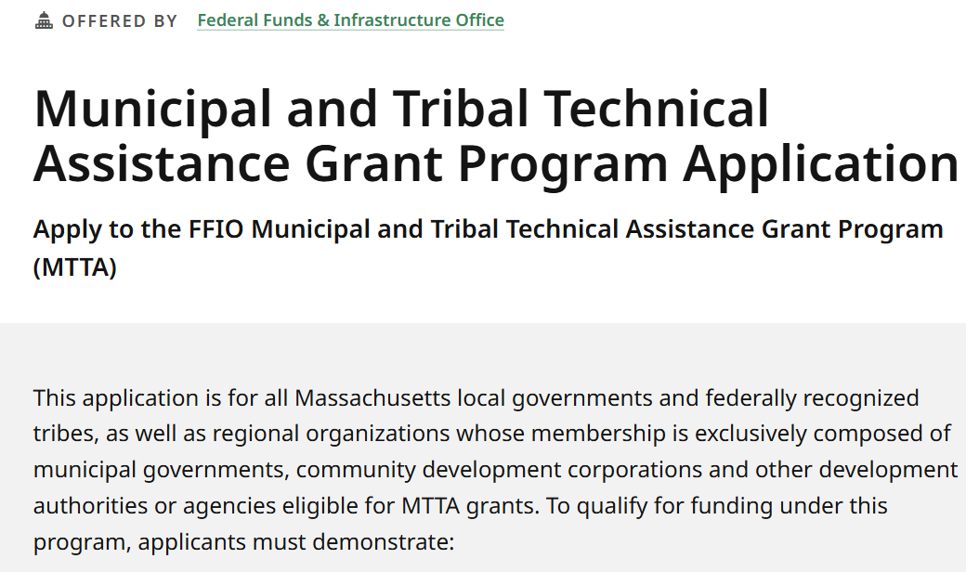
Learn about the technical assistance programs here:
mass.gov/MTTA
mass.gov/TARPA
mass.gov/FFIO-TA

