Slide 1
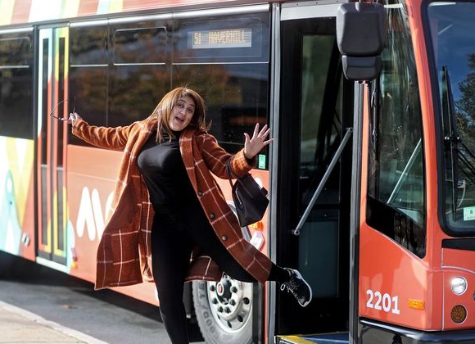
Transportation Innovations: MeVa Transit
2025 MARPA & DLS Conference
October 7, 2025| Worcester, MA
Noah S. Berger,
Administrator/CEO
MeVa Transit
nberger@mevatransit.com

Slide 2
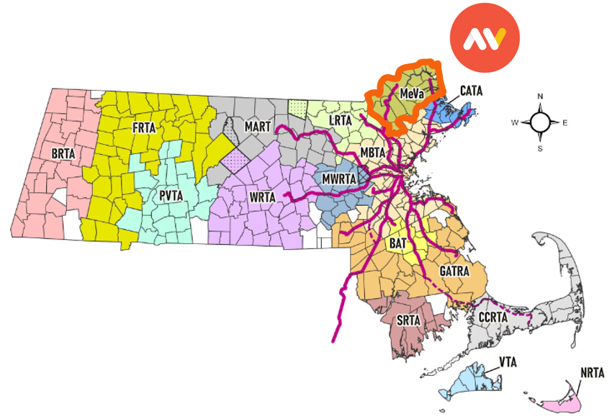
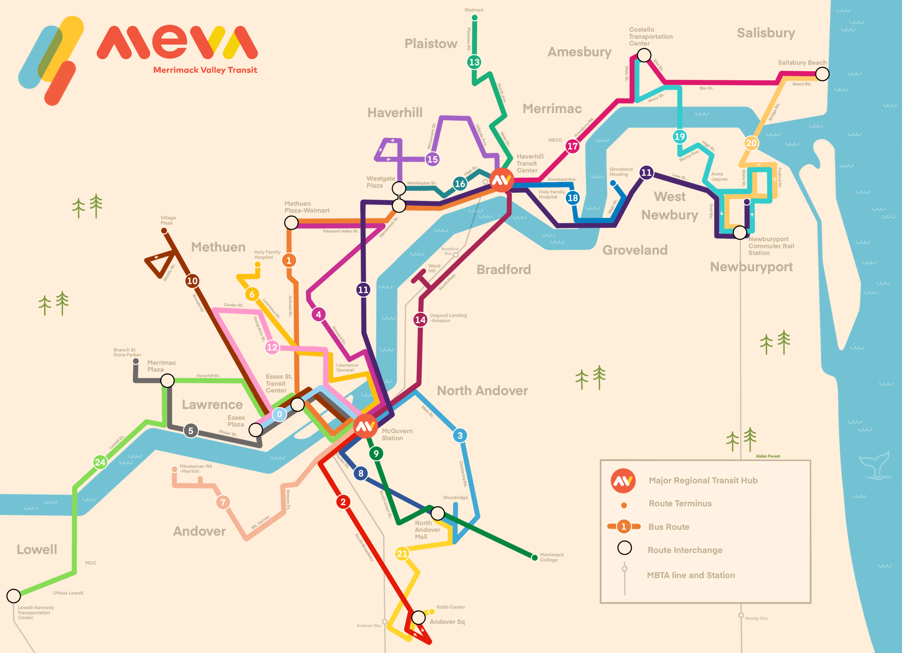
MeVa is 1 of 15 RTAs in Massachusetts
Serves 16 cities & towns in the northeast corner of the state
Anchored by the Gateway Cities of Lawrence, Haverhill & Methuen
Lawrence is 83% Latino

Slide 3
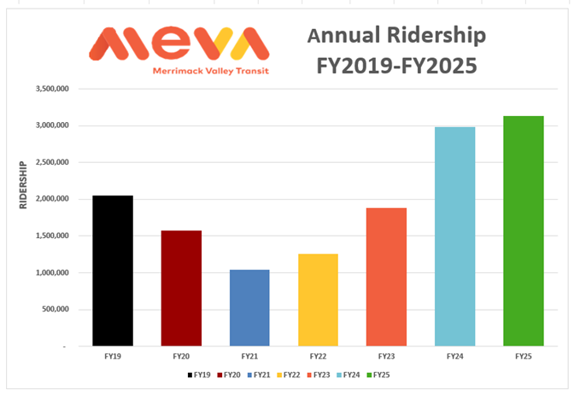
3.5 million riders/year
60% above pre-pandemic ridership
Fare-Free since March 2022
Ridership more than tripled since going fare free
Complaints down by over 30%
Workforce increased over 40% 2021

Slide 4
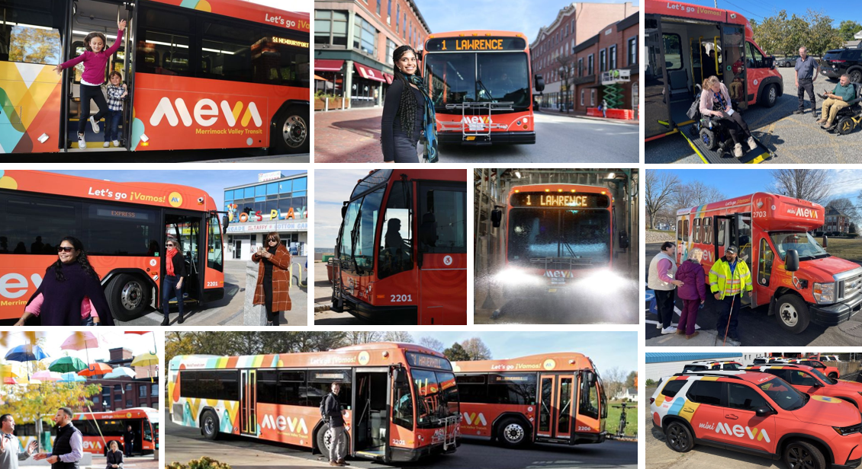

Slide 5
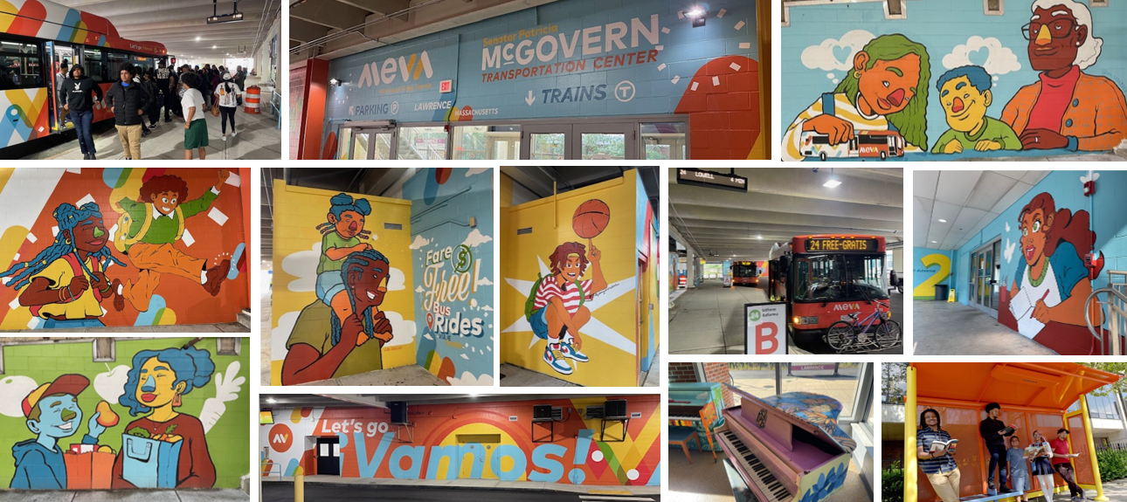

Slide 6

Frequencies increased to as much as every 20 minutes
Service Hours Extended to 10pm
Sunday Service Added
Routes Optimized
Added Crosstown Routes
Added Workforce Targeted Routes
Simplified Paratransit (miniMeVa)
New mediMeVa to VA in Bedford
MeVa is a great place to work!
Recognized by Latinos In Transit as the 2025 Transit Agency of the Year!!!

Slide 7
