Slide 1
Siting and Permitting Reforms for Energy Infrastructure Overview of Draft Regulations and Guidance MARPA Annual Meeting October 7, 2025

Slide 2
Commission on Energy Infrastructure Siting and Permitting
Commission was established by Executive Order 620
Required to advise the Governor on:
accelerating the responsible deployment of clean energy infrastructure through siting and permitting reform in a manner consistent with applicable legal requirements and the Clean Energy and Climate Plan;
facilitating community input into the siting and permitting of clean energy infrastructure; and
ensuring that the benefits of the clean energy transition are shared equitably among all residents of the Commonwealth.
Two public listening sessions held and over 1,500 public comments received.
Recommendations sent to Governor Healey on March 29, 2024.
The Commission’s recommendations were largely passed into law through An Act promoting a clean energy grid, advancing equity, and protecting ratepayers (2024 Climate Act), signed by Governor Healey in November 2024.

Slide 3
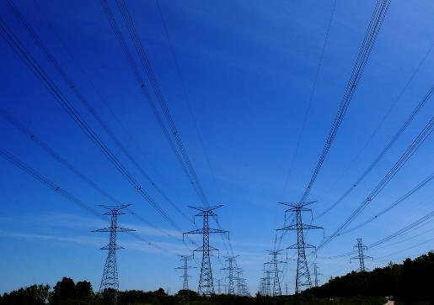
Consolidated State Permitting
All state, regional, and local permits for Large Clean Energy Infrastructure Facilities combined into one consolidated permit issued by the EFSB.
All state and local agencies that would otherwise have a permitting role are able to automatically intervene and participate by issuing statements of recommended permit conditions.
All projects must submit cumulative impact analysis as part of application to Energy Facilities Siting Board (EFSB).
Permit decision must be issued in less then 15 months from determination of application completeness.
EFSB decisions can be appealed directly to the Supreme Judicial Court.
Applies to generation facilities >25 MW, storage facilities >100 MWh, offshore wind related infrastructure, and large new transmission projects

Slide 4

Consolidated Local Permitting
Local governments (municipalities and regional commissions such as the Cape Cod and Martha’s Vineyard Commissions) retain all permitting powers for projects not subject to review by the EFSB.
Local governments may continue to run separate approval processes concurrently (e.g., wetlands, zoning, etc.), but are required to issue a single permit that includes individual approvals for clean energy infrastructure.
Permit decision must be issued in within 12 months.
Local governments can refer permitting review directly to the EFSB if they do not have sufficient resources.
Permit applications can also be reviewed by EFSB following a local government’s final decision if a review is requested by parties that can demonstrate they are substantially and specifically impacted by the decision, then further appealed directly to the Supreme Judicial Court.
Department of Energy Resources (DOER) is responsible for creating a standard municipal permit application and a uniform set of baseline health, safety, and environmental standards to be used by local decision makers when permitting clean energy infrastructure.
Applies to generation facilities <25 MW, storage facilities <100 MWh, and non-EFSB jurisdictional transmission and distribution projects

Slide 5
More Meaningful & Just Community Engagement
Formal establishment of the Office of Environmental Justice and Equity in statute, with a specific mandate to develop guidance regarding community benefits agreement and cumulative impact analyses.
First-ever mandatory community engagement requirements, including documentation of efforts to involve community organizations and demonstration of efforts to develop community benefit agreements.
New Division of Public Participation at DPU to assist communities and project applicants with engagement and process questions in DPU and EFSB proceedings.
New Division of Siting and Permitting at DOER to assist communities and project applicants with engagement and process questions in local permitting.
Intervenor financial support is available to under-resourced organizations that wish to participate in an EFSB proceeding and are granted intervenor status. Municipalities with a population of 7,500 or less are automatically eligible for financial support.

Slide 6
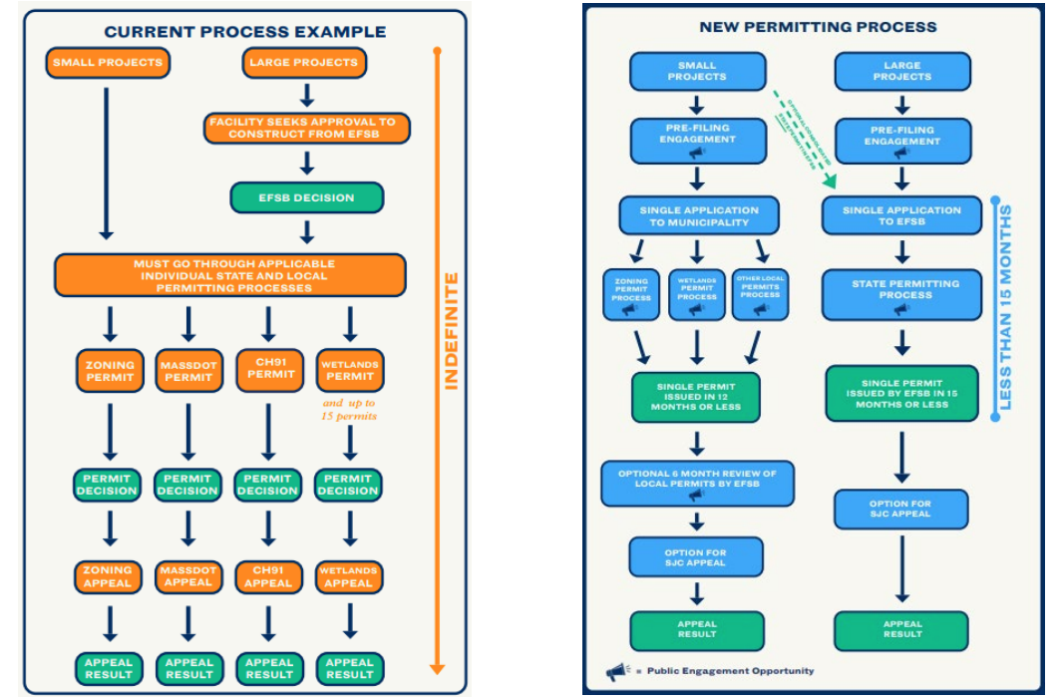
Process Reforms

Slide 7
Roles and Responsibilities
There are five workstreams that stem from the bill that are being administered by three different agencies: EEA, DPU, and DOER.
All three agencies are in close communication with each other, and other state agencies that have significant energy permitting roles have also been consulted as proposals are being developed.
Regulations are required to be promulgated by March 1, 2026.
In Spring 2025, the agencies held stakeholder sessions to provide information to the public on implementation, receive comments, and take questions on numerous straw proposals. More information is available on the 2024 Climate Act Stakeholder Sessions webpage.
Workstreams
Site Suitability Guidance
EEA
Cumulative Impacts and Community Benefits Guidance
EEA
Siting and Permitting Rules for Municipalities
DOER
EFSB Siting and Permitting Rules
EFSB
DPU Intervenor Funding Support Rules
DPU

Slide 8
Energy Facilities Siting Board and Department of Public Utilities Regulations

Slide 9
Proposed Regulations
Draft Regulation | Topic | Summary
980 CMR 1.00 – EFSB revised | Adjudicatory Proceedings | Adds new requirements from the Act and codifies certain existing practices
980 CMR 2.00 – EFSB revised | Board Procedures | Adds new requirements from Act, including: Revises the Board’s mandate and scope of review Exempts EFSB-jurisdictional facilities from Massachusetts Environmental Policy Act (MEPA) review Revises Board membership Requires an online dashboard of progress reviewing and deciding on cases
980 CMR 16.00 – EFSB new | Pre-filing Consultation and Engagement | Sets requirements for pre-filing engagement, including: Pre-filing consultations with permitting agencies and the MEPA Office Public meetings and other forms of outreach with community Documentation that these requirements have been met

Slide 10
Proposed Regulations
Draft Regulation | Topic | Summary
980 CMR 13.00 – EFSB new | Consolidated Permit Applications | Establishes consolidated permit requirements and procedures, including: Standard conditions for all consolidated permits, and supplemental conditions that could be applied Application requirements Completeness determination processes Permit enforcement procedures for the permit agency that would have otherwise issued the permit
980 CMR 14.00 – EFSB new | De Novo Adjudication | Establishes process for de novo adjudications: De novo adjudication occurs when (1) there is a request for the Director to take a fresh look at a decision by a local government on a consolidated local permit; or (2) when a local government lacks resources to review an application for a consolidated local permit within 12 months EFSB Director to make decisions on de novo adjudications based on consistency with 225 CMR 29.00 and G.L. c. 164, § 69H.

Slide 11
Proposed Regulations
Draft Regulation | Topic | Summary
980 CMR 17.00 – EFSB new | Constructive Approval | Establishes procedures for issuing constructive approvals when the Board fails to issue a final decision within its review timeframe, including processes and permit conditions
220 CMR 34.00 – DPU new | Intervenor Support Grant Program | Establishes processes for a program that would provide financial assistance to eligible organizations, community groups, and governments who are unable to participate in proceedings before the DPU and EFSB because of financial hardship or lack of procedural knowledge.

Slide 12
Regulations Governing Consolidated Local Permitting

Slide 13

Regulations Governing Local Permitting
The 2024 Climate Act created a new Division of Clean Energy Siting & Permitting at DOER to develop regulations streamlining the permitting of small clean energy infrastructure projects and provide technical support and assistance to municipalities, project proponents, and other stakeholders.
DOER filed issued proposed regulations (225 CMR 29.00) on September 12, 2025 that establish pre-filing requirements, a universal application, site suitability scoring and mitigation expectations, and new permitting processes.

Slide 14
Regulations Governing Local Permitting
Pre-Filing Outreach
Includes requirements for pre-filing outreach to municipality and local stakeholders
Common Application
Includes a common application that will be used in every municipality for consolidated local permits.
DOER/EFSB will build a new online permitting portal for large and small projects.
Environmental, Health, Safety Standards
Will establish universal baseline standards around how projects should be designed to protect public health, safety, and local environment. Will touch on setbacks, electrical, stormwater management, lighting, emergency
Munis will be able to go above and beyond if they can show a need to protect the public health, safety, and environment.

Slide 15
Regulations Governing Local Permitting
Permitting
Requires applicants to respond to questions, provide new plans within certain timeframes
DOER to create a Circuit Rider program to assist applicants and municipalities with understanding new regulations and resolve disputes between parties to prevent delays and appeals
Siting and Mitigation
Includes provisions for using site suitability assessments in permitting
Ties mitigation to Site Suitability scoring. Requires applicant to avoid, minimize, or mitigate negative impacts and propose projects to offset weak criteria scores.
DOER is creating new model bylaws for solar, battery storage, canopy that will encourage municipalities to consult Site Suitability models to create new "by-right" zoning.
Common Conditions
Establishes a set of common conditions for cases where an application receives constructive approval. Will be aligned with EFSB common conditions.

Slide 16
EEA Guidance

Slide 17

Site Suitability Assessments
As required by the Act, EEA released guidance including a methodology for determining the suitability of sites for applicable energy infrastructure and recommendations for using the methodology in the review of applications for consolidated permits by the EFSB and local governments.
Clean Energy Infrastructure Facilities applying to the EFSB or municipalities for consolidated permits will be required to complete the Site Suitability Assessment, with certain exceptions.
Applicants should use the scoring framework to estimate their project’s scores before submitting their permit application. This allows the methodology to work as a pre-filing screening tool that discourages developers from submitting applications for sites with poor scores.
These scores will be taken into consideration by permitting authorities, and impact the types and level of minimization or environmental mitigation measures needed to be issued a permit.

Slide 18
Criteria-Specific Suitability Scores
Criteria | Scoring Method Summary | Possible Points
Climate Resilience | Highest exposure ratings for (1) riverine flooding and (2) coastal flooding hazards | 0 to 5
Carbon Storage and Sequestration | Total ecosystem carbon storage, plus 50-year sequestration potential. | 0 to 5
Biodiversity | Overlap with specific Biomap elements and NHESP Priority Habitat, as well as ecological integrity value | 0 to 5
Agricultural Resources | Overlap with areas designated as: (i) Prime Farmland; (ii) Farmland of Statewide Importance; and (iii) Farmland of Unique Importance, with greater weight given to areas under active agricultural use. | 0 to 5
Social and Environmental Burdens | Overlap with MassEnviroScreen Score | 0 to 5
All | Total: | 0 to 25
Lower suitability scores (0-2) = more suitable, lower impact/exposure locations; expect few, modest minimization/mitigation measures
Higher suitability scores (4-5) = less suitable, higher impact/exposure locations; expect more, substantial minimization/mitigation measures

Slide 19
Score Modifiers
Site Suitability Criteria | Data Source | Scoring Method
Development potential | Pre-determination letters obtained from DOER (for Solar Canopies, Brownfields, Eligible Landfills, and Previously Developed Lands only) | Automatic Total Site Suitability Score of 25: Located in Protected Open Space 1-point subtraction: Located in a Capital Investment Project (CIP) investment area 0-points for all Criteria-Specific Site Suitability scores (except Climate Change Resilience): Solar Canopies or Applicable Facilities located on a Brownfield, Eligible Landfill, or Previously Developed Lands
Social and environmental benefits | Signed agreements between host municipality and Applicable Facility | Projects can subtract one (1) point from their score for providing certain social and environmental benefits up to a total of five (5) points, if agreed to by the host municipality.

Slide 20
Recommendations for Use by EFSB
Projects that are located in a Burdened Area and thus required to complete a Cumulative Impact Analysis will not be required to complete a Site Suitability Assessment.
The EFSB should incorporate the elements of the site suitability criteria (e.g., carbon sequestration, habitat, etc.) in its CIA and Route and Site Scoring analyses as feasible.
The EFSB is recommended to consider the Total Site Suitability Score in its decisions alongside other aspects of the project.
The Total Site Suitability Score should be considered in the context of the project’s design plan and planned mitigation measures.
The EFSB should use the criteria-specific suitability scores as a resource to determine if minimization or environmental mitigation measures should be required for a project to receive a consolidated permit.

Slide 21
Recommendations for Use by Local Governments
Municipalities are recommended to consider a project’s Total Site Suitability Score and Criteria-Specific Suitability Scores when determining permit conditions.
Sites with a Total Site Suitability Score below a certain level should be assumed to be highly suitable and require minimal to no mitigation, regardless of Criteria-Specific Suitability Scores.
Municipalities should use the criteria-specific suitability scores as a resource to determine if minimization or environmental mitigation measures should be required for a project to receive a Consolidated Local Permit.
The level and type of mitigation measures required should be based on the Criteria-Specific Site Suitability score. Requirements should be relevant to the category in which the score was assessed.
Criteria Score Range | Suitability (for specific criteria) | Interpretation (for specific criteria)
1 or less | Highly suitable, minimal impact | No minimization or mitigation measures required
1 to 2 | Suitable, low impact | Modest minimization and/or mitigation measures may be required
2 to 3 | Moderately suitable, moderate impacts | Minimization and/or mitigation measures likely required
3 to 4 | Not very suitable, moderate to high impact | Significant minimization and/or mitigation measures likely required
4 to 5 | Unsuitable, high impact | If permitted, will generally require extensive minimization and/or mitigation

Slide 22
Standards and Guidelines for Community Benefits Plans and Agreements
The Office of Environmental Justice and Equity (OEJE) has developed standards and guidelines governing the potential use and applicability of Community Benefit Plans (CBPs) and Community Benefit Agreements (CBAs).
The draft guidelines outline best practices to ensure CBPs and CBAs provide meaningful, measurable benefits to communities hosting energy infrastructure, including:
A step-by-step process for effective engagement with a community
How to design commitments that are specific, measurable, and accountable
Examples of meaningful commitments
Recommended template for CBPs
Clear accountability mechanisms

Slide 23
Siting and Permitting Public Engagement Calendar

Slide 24
Thank You
Information on the regulations, process and public engagement opportunities can be found at: www.mass.gov/energypermitting
Questions can be directed to energypermitting@mass.gov

