Slide 1
Gathering, Information and Service
Understanding the First Days of Mass Casualty Response
Tara S Hughes, LCSW-R

Slide 2
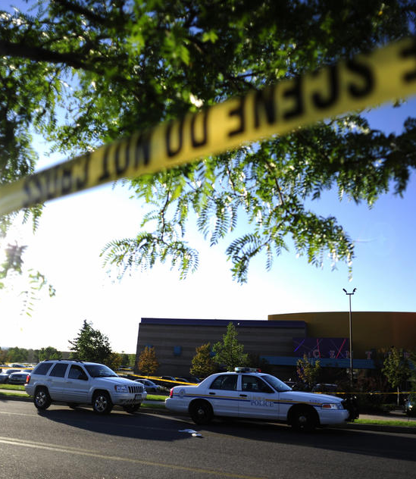
-Planning
-Immediate (Acute)
During the incident
Immediate aftermath
-Intermediate (Transitional)
Family Assistance Center
Up to the first remembrance date
-Long Term (Recovery)
18 months +
Appeals, parole hearings, Memorial dedications, remembrances
-Planning

Slide 3
















16 Best Practices in Planning for CMV/DT
Incident Command | 2. Committee Identification & Engagement | 3. Up-To-Date Contact List | 4. Notification and Information Center
5. Victim Identification & Notification Protocol | 6. Public Information & Crisis Communications Protocol | 7. Volunteer Management Protocol | 8. Family and Survivor Assistance Center (FAC) Plan
9. Financial Donation Management Protocol | 10. Memorial & Special Event Management Protocols | 11. Community Behavioral Health Response | 12. First Responder Support
13. Planning & Preparedness Grants and Emergency Funding Assistance | 14. Community Resilience Planning | 15. Criminal Justice System – Victim Support | 16. Training and Exercise
Notes:
Project Foundation: 16 Best Practices in Planning; combining emergency management and victim services principles.

Slide 4
Planning
Incident Command System
Planning team
Call downs
Notes:
NSA

Slide 5
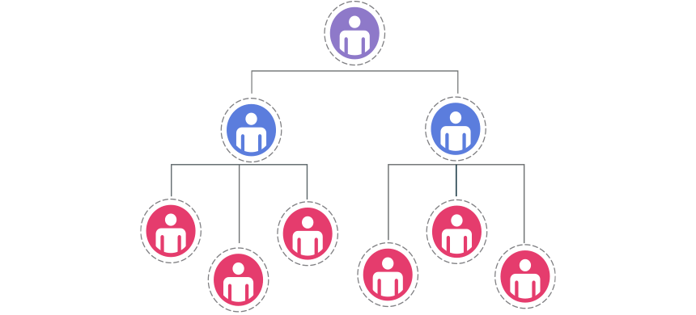
Incident Command System
Law enforcement and emergency management are unfamiliar with Victim Services.
Victim Services do not understand or know how to integrate within ICS.
Notes:
IACP
Mass violence incident responses are organized within the ICS system. Law enforcement and emergency management are unfamiliar with Victim Services. Victim Services do not understand or know how to integrate within ICS.
Sandy Hook - Victim services did not know how to get into the system, so LE officers filled in the gaps and suffered personally as a result. CT State Troopers assigned an officer to each family. They stayed with the family at the family’s home and got them all that they requested to meet their needs (went shopping, dealt with the media and crowds on the lawn, assisted with transporting people to and from the airport, etc). The officers were not trained in how to do this or to maintain appropriate boundaries and therefore got too connected to the families. Most spent all of the Christmas holidays with the families (shooting was on Dec 14th), including the day of Christmas and New Year’s Eve and day. the officers were not told when to end this service with the families other than “…when the family seemed ready to be on their own.” The officers therefore stayed with the families for months. Many of the officers who were connected to the families of the deceased children divorced within 2 years, had an increase in stress related illness and almost ½ had left the force within 5 years. The officer who oversaw the Peer Support Team for the CT Troopers (as well as those who were assigning people to tasks after the shooting) had NO IDEA that victim advocates existed and are trained to do this work.

Slide 6
Incident Command / Unified Command
PIO
Logistics
Operations
Admin/Finance
Planning
Response
Recovery
Safety Officer
Victim Services Liaison

Slide 7
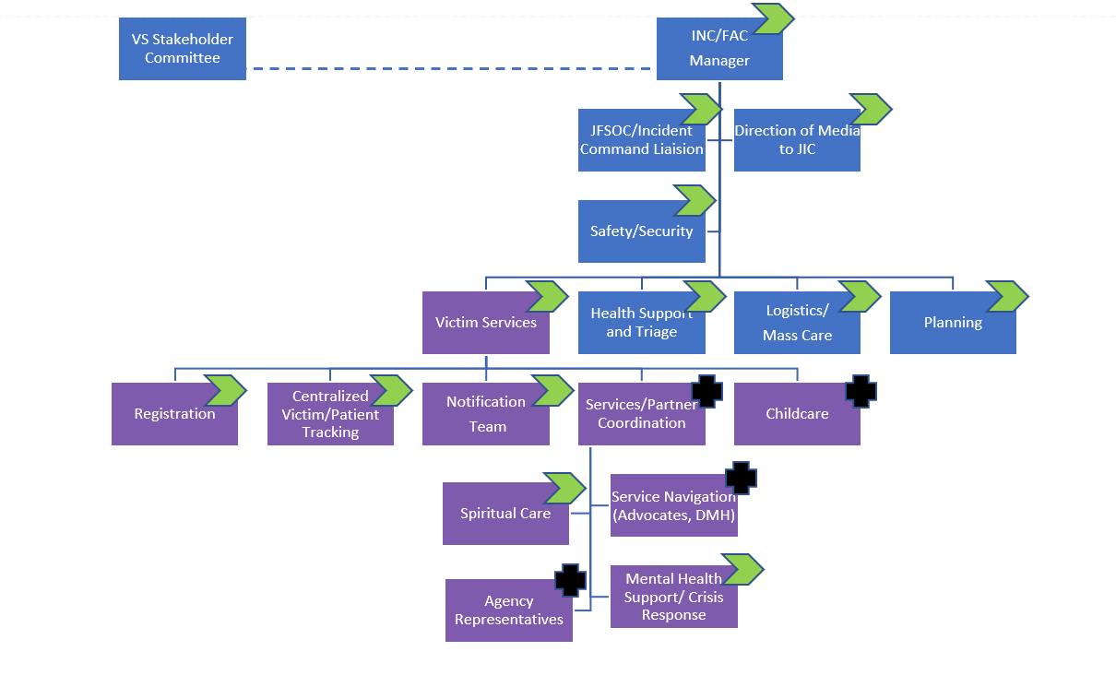
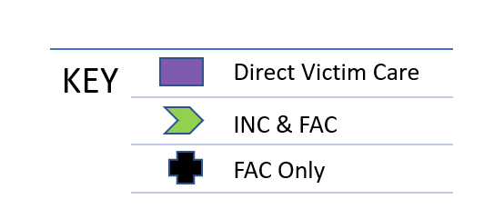
Specific Branch under Response

Slide 8
Immediate “Acute” Phase
During incident
Immediate aftermath
Information and Notification Center
Family Assistance Center
Notes:
NSA

Slide 9
Immediate needs of victims and families…
SAFETY
MEDICAL CARE
INFORMATION
REUNION WITH FAMILY AND FRIENDS
Notes:
NSA

Slide 10
Immediate needs of community…
SAFETY
INFORMATION
Notes:
NSA

Slide 11
Immediate Phase
Tactical Response
Victims Services
Communications
Neutralize threat
Triage victims
Secure suspect vehicle
Search suspect apartment
Set up Information and Notification Center
Set up media only email
Set up additional phone lines
Develop social media communications
Press conferences
Press releases
Trauma notifications
Notes:
Steve – Tactical
Krista – VS (emphasize getting away from “reunification center”_)
Cassidee – Comms

Slide 12
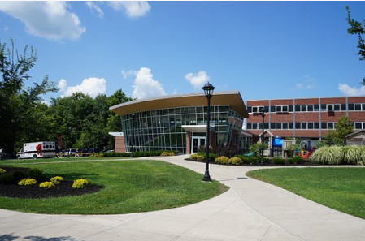
Information and Notification Center (INC)
Families, survivors convene to get information
Location of loved ones
Status of investigation, rescue and recovery
Trauma notifications
May be at several locations
Hospitals, hotels, churches, schools
Incident Commander will determine location of official center
Open 24-48 hours
Notes:
IACP

Slide 13
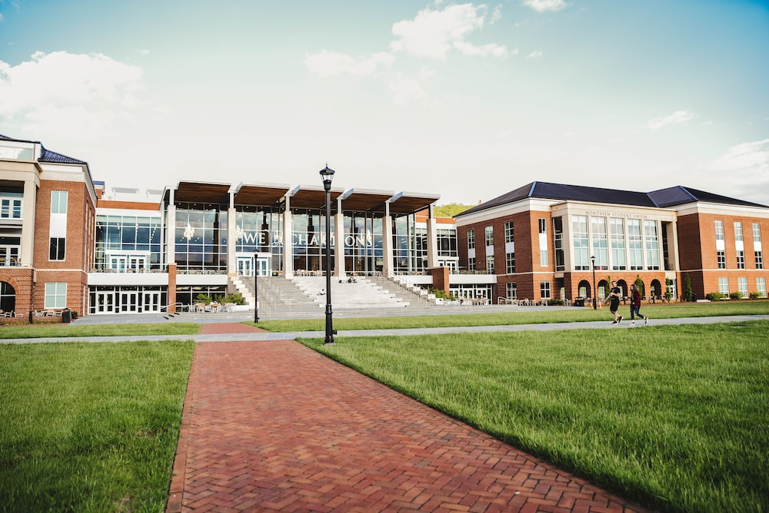

Location
Availability
Proximity to incident location
Occupancy limits
Parking availability
Proximity to public transit
Accessibility
Communication capabilities
1:1 meeting space
Hospitals, hotels, churches, schools
Incident Commander decision
Notes:
Availability
Proximity to incident - Out of the line of sight, sounds, and smells of the incident
Occupancy limits - Size dependent on scope and scale of the incident
Parking availability / access to public transit
Accessibility
Consider impacted demographics
Communication capabilities, such as high-speed internet and phone lines
Space for 1:1 meetings
Ability to record information about those who come.

Slide 14
INC Activities / Functions
Registration
Crisis Support
Spiritual Care
First Aid
Food/
Beverage
Information
Briefings
Reunification
Trauma Notification
Notes:
Crisis support
Reunification
Death notification
Spiritual Care
Information Briefings
Location of loved ones
Status of investigation, rescue, and recovery
Victim/witness interviews

Slide 15

Lesson 2: Victim Identification & Notification
Centralized Tracking System
Who is privy to what information?
How is information gathered?
Who can deliver information from this system?
?
Notes:
NOVA/NCF
HIPPA law interpretations vary and can result in:
Families being left without important information
Distraught individuals driving from hospital to hospital to locate loved one
Delays in receipt of donations
NOVA
Dayton - Clarify the ability to communicate essential information about victims, victim status, victim locations. Can hospital release name and information to officials at the family reception site? Incident leaders should have a plan to communicate and routinely update casualty/fatality lists with victim information. (NOVA)
9/11 – People visiting 20+ hospitals in New York and New Jersey
NCF
Buffalo – Validation required

Slide 16
Centralized Tracking System
Challenges
Unusual transport
Treatment without names or identification
Urgent Care locations
HIPAA
Expanded access (NTSB, Red Cross)
Victim Advocates

Slide 17
Trauma Notifications
Involved
Injured
Deceased
Missing
What parameters are in place for notifications?
Who will do them?
How many can each person/team do?
Where will they happen?
What support services will be available?

Slide 18
Communications

Slide 19
Public Information
Concern
I or someone I know was there.
Was my loved one injured?
Where are they now?
How do I find and get reconnected to them?
What resources are available?
Curiosity
What happened?
Who did this?
Why?
How are authorities responding?
Is there anything I can do to help?
Notes:
NSA
NOTE: This slide has animations
Use this slide to explain the type of information that was sought. Falls into two interconnected categories. Typically: concern = victims and loved ones, curiosity = general public.
Victims and loved ones have a heightened curiosity and investment in finding out what happened and why due to involvement/impact. General public wants to know about the identity and experiences of victims and families.

Slide 20
Communication - First Few Hours
Lead victim advocate in all briefings
Immediately set up a media only email (this is a good tool for everyday use. It allows for other users and easier to maintain a distribution list).
Set up additional phones IMMEDIATELY. This includes for media and people looking for family and friends.
Utilize social media.
Google Voice
Notes:
Social Media
Informal notifications (still need to do official notification)
Information overload
Incorrect information
Speculation…so much speculation
Cassidee
Lead victim advocate in all briefings
Immediately set up a media only email (this is a good tool for everyday use. It allows for other users and easier to maintain a distribution list).
Set up an automatic reply telling media where you want them to go for information.
Set up additional phones IMMEDIATELY. This includes for media and people looking for family and friends.
Can’t possibly answer all calls. Our phones were virtually useless because of calls.
Voicemail should advise callers of where information will be most up to date
Utilize social media.
Victim identification
Trauma notifications
You have to control the message and that will be done by social media.
Facebook and Twitter pages.
Think about setting your own hashtag.
Google Voice
Select DO NOT DISTURB on Google Voice so everything rolls to voicemail during critical times.
Set up an automatic voicemail with pertinent information for callers.

Slide 21
Social Media
Informal notifications (still need to do official notification)
Information overload
Incorrect information
Speculation…so much speculation

Slide 22

Lesson 3: Public Information
Key Messages
Build trust and accountability
Express empathy for victims and their families
Focus on how your agency is responding right now
Focus on what you are preparing to do
Redirect questions to the appropriate authority
Everything you say will have an impact.
Notes:
NSA
DC Sniper Case - During the DC Sniper case in 2002, an international deluge of press and media descended on the jurisdiction where most of serial murders occurred. This pressure for information was unrelenting and police media officials were immediately overwhelmed. An information update process was developed which included several key principles. 1-all jurisdictions were united and informed by daily briefings so that when a press briefing was held all were represented and messaging was consistent across all jurisdictions. 2-Press briefings were held despite the lack of information that was available at times. This created a press appreciation of transparency and reliability for their purposes. 3- political representatives were also kept informed on a daily basis so that they were committed to the Sniper Task Force and less likely to act unilaterally in interacting with the press.

Slide 23
Intermediate Phase
Several days after the incident up to the first remembrance date
Family Assistance Center
Spontaneous memorials

Slide 24
Intermediate needs of victims and families…
CONTINUED REUNION WITH FAMILY AND FRIENDS
INDIVIDUALIZED, CIRCUMSTANTIAL SUPPORT
BEHAVIORAL HEALTH
SOCIAL SERVICES
FINANCIAL
AND MANY MORE…
ANSWERS
Notes:
NOVA facilitates discussion

Slide 25
Intermediate needs of community…
SAFETY
INFORMATION ABOUT INCIDENT
INFORMATION ABOUT PREDICTABLE REACTIONS OVER TIME
SUGGESTIONS FOR “GIVING BACK”
Notes:
NSA

Slide 26
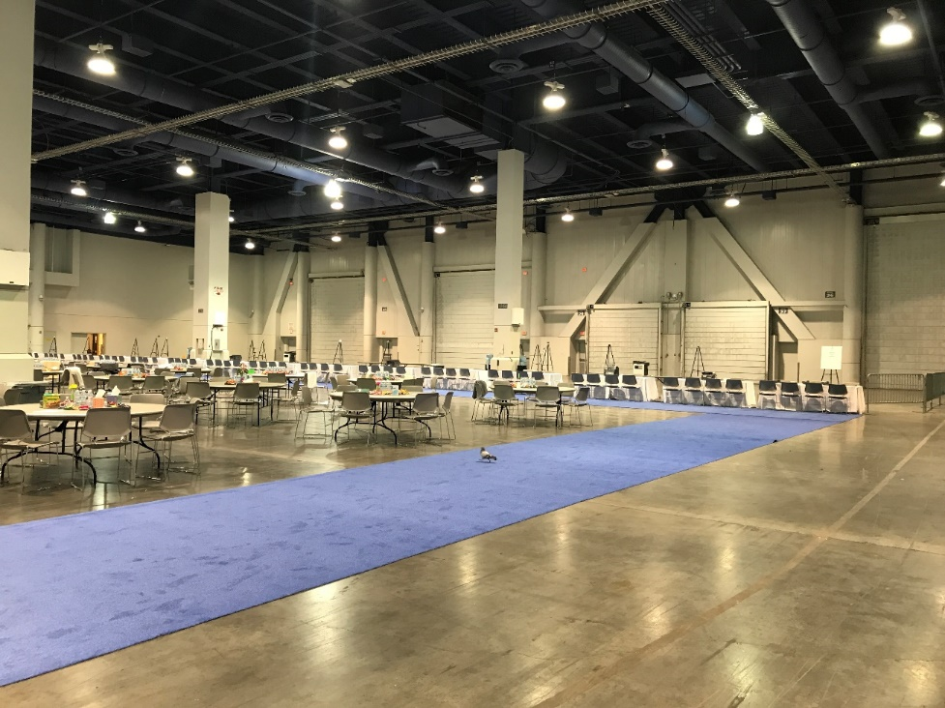

Family/Friends Assistance Center
A Family Assistance Center is the co-location of multiple social and other service agencies that are brought together to meet the immediate and short-term needs of victims and their families following a Mass Casualty Incident.
A FAC generally stays
open 8-9 days.
Notes:
Tara
Information access
Access to immediately needed services
Ability to be in a location with people who are experiencing similar things
Personal effects

Slide 27
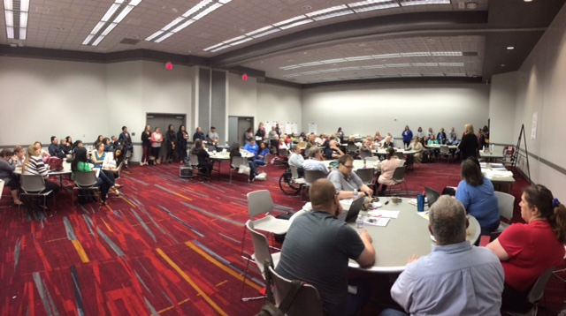
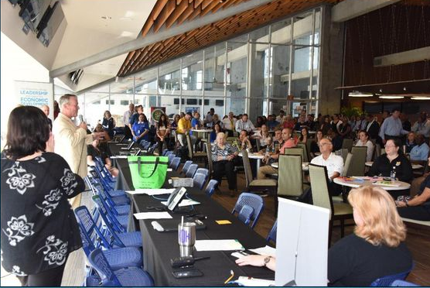
FACs -- Safe, Secure, Sacred
Agencies and Partners to Serve Victims and Families
Depends on Size and Scope of the Incident
Staffing – Employees Playing Non-Traditional Roles
Communications
(Daily) Briefings
Media Staging Area
- offsite
JIC and/or JFSOC
Dignitary Visits
Notes:
Kathy

Slide 28

Who is eligible to come to the FAC?
Who are the victims? (i.e. who will have access to FAC?)
Open vs Closed population
Impacted populations
Vulnerabilities
Image of those who are impacted
International connections
Undocumented people
Are people still in the area?
Notes:
NCF
May need to use creative tactics to make distinctions.
Las Vegas – Anyone who was at the concert at the time of the shooting was classified as a victim. 850 documented “patients” (injured and deceased), but more than 18,000 present by not injured. Used property return to help as an identifier. Anyone who could identify where they were on the grounds of the festival and which of the three staged Jason Aldene was on at the time of the shooting was allowed into the FAC. Large numbers also meant varying levels of impact. People who were more strongly impacted (injured, lost a loved one) taken into private rooms and had the services come to them to minimize chaos.

Slide 29
What are the IMMEDIATE needs?
What Victim Assistance funds might be available (Crime)…FBI Victim funds, State VOCA funds, Victim Compensation fund
Are there private companies that will be involved in the response?
Air or Rail Carriers
Bus companies
School Districts / Universities
Notes:
NCF

Slide 30



FAC Activities / Functions
Registration
Crisis Support
Spiritual Care
First Aid
Food/
Beverage
Information
Briefings
VIP Profiles
Trauma Notification
Victim Advocacy
Notes:
Crisis support
Reunification
Death notification
Spiritual Care
Information Briefings
Location of loved ones
Status of investigation, rescue, and recovery
Victim/witness interviews

Slide 31
Who Needs to be at a FAC?
FAC Lead Community Partner Coordinator | Feeding / Comfort Care Community -- VOAD Transportation Carrier or business Red Cross
Disaster Mental Health Local / State Teams Red Cross | Health Services EMS Red Cross
Disaster Spiritual Care Red Cross Local Partners (VOAD Guidelines) | ME / Coroner (possibly)
Victim Advocates Crime Victim’s Compensation FBI Victim Services Division | Law Enforcement (low key to meet with victims who need to be interviewed)

Slide 32
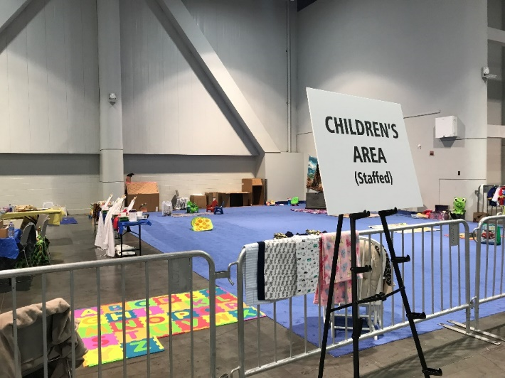
Who can be at a FAC?
Legal Guidance Custody issues Protection against “Ambulance Chasers” Immigration issues | Department of Social Services Child Custody Disability Insurance Benefits
Travel Assistance Hotels / AirBNB Airlines Taxicabs / Ride Share | Department of Motor Vehicles IDs Vehicle ownership
Disaster Child Care Services

Slide 33
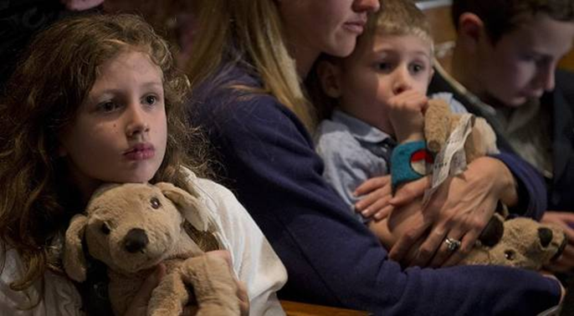
FAC Logistics
FAC Protocols
Companion Instructions
Resource Guide
What is available?
Who is providing it?
Who qualifies?
How does someone access the benefit?
How long will it be available?
Notes:
NCF
May need to use creative tactics to make distinctions.
Las Vegas – Anyone who was at the concert at the time of the shooting was classified as a victim. 850 documented “patients” (injured and deceased), but more than 18,000 present by not injured. Used property return to help as an identifier. Anyone who could identify where they were on the grounds of the festival and which of the three staged Jason Aldene was on at the time of the shooting was allowed into the FAC. Large numbers also meant varying levels of impact. People who were more strongly impacted (injured, lost a loved one) taken into private rooms and had the services come to them to minimize chaos.

Slide 34

Behavioral Health
Need a robust system that you can prioritize victims into for long term care. You may need to augment existing system in order to make that happen.
Notes:
NOVA
Gilroy Garlic Festival – Had a really challenging time because Gilroy is small. Professionals work in Mountain View or San Fran (bedroom town). Extreme number of people who needed assistance. No system locally that people could be referred to. Finding and hiring appropriate therapists was a struggle. Group out of a Santa Clara (45 min away) that has been starting to send counselors to Gilroy work with people in the area. The vast majority of people directly impacted were 1st gen from Mexico, lots of cultural dancing, drum circles, every meeting has a talking stick, gatherings start with temperature taking activities (say how you are and what is going on for you today). Struggled to find Spanish speaking therapist.
Mutual aid
Going out a bit further
Making sure alternative interventions are interventions.

Slide 35

Lesson 5: Volunteer Management
Volunteers
People will self-deploy. Need a systematic way to determine:
Who you can use now
Who you can use later
How to turn away inappropriate or unneeded volunteers
Notes:
NSA
Las Vegas – Large influx of volunteers – more than they had use for. Intake form with name, contact information, availability, and skills followed by basic interview process. Store for both current and future use.
Once initial wave of volunteers needs to step away, go to stored list to find reinforcements. May not get a great return rate on folks called in later. Schedules or motivation has changed.
Volunteers not able to be used were plugged into other volunteer organizations in the community
Allow for thank you notes once the dust has settled
Example – Former UPS logistics employee ran the receiving area for physical donations.
Pulse – Many services present at the FAC will have documentation that requires notaries. This is an easy, low commitment volunteer opportunity. May be good to have at the FAC or even willing to go to people’s homes (team of paralegals at Pulse).

Slide 36

Donation Management
Relief funds can impact eligibility for public benefits.
Notes:
NCF
Uvalde– Can impact Medicaid, children's health insurance, TANF, SNAP, SSI Disability. Screen for public benefits and have legal assistance lined up ahead of time. Many volunteers lawyers who will create trusts are not familiar with public benefits and will need to be educated to effectively help. The local BAR association should have a Continuing Legal Education (CLE) seminar in the can and ready to go.

Slide 37
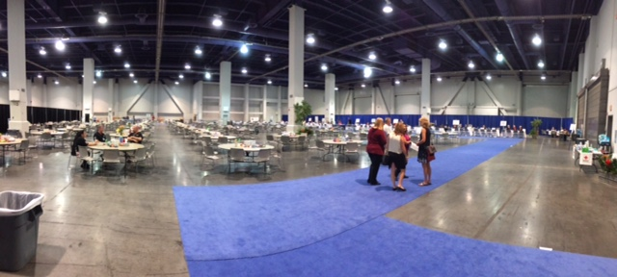
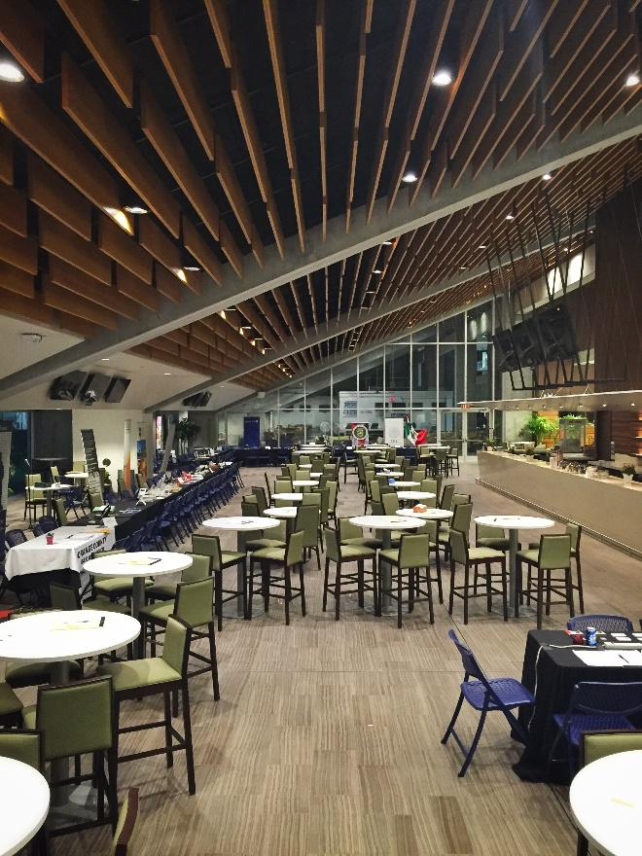
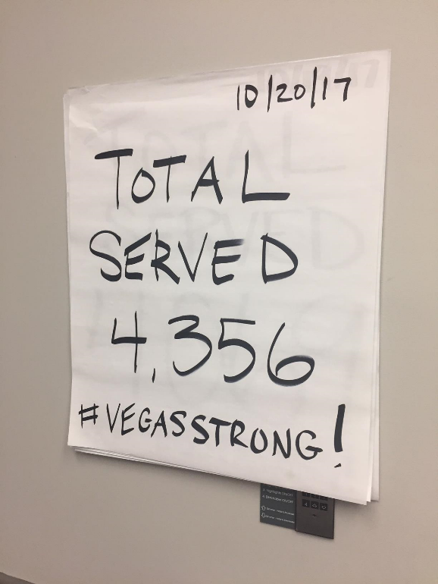
Pulse FAC:
1200 Volunteers served over:
956 Individuals
298 Families
Notes:
NCF
May need to use creative tactics to make distinctions.
Las Vegas – Anyone who was at the concert at the time of the shooting was classified as a victim. 850 documented “patients” (injured and deceased), but more than 18,000 present by not injured. Used property return to help as an identifier. Anyone who could identify where they were on the grounds of the festival and which of the three staged Jason Aldene was on at the time of the shooting was allowed into the FAC. Large numbers also meant varying levels of impact. People who were more strongly impacted (injured, lost a loved one) taken into private rooms and had the services come to them to minimize chaos.

Slide 38
Long-term Phase -- Recovery
18+ months
Criminal justice proceedings
Community Resiliency Center
Memorial dedications and remembrance dates

Slide 39
QUESTIONS
THANK YOU!!!
Tara.Hughes@redcross.org

