Slide 1

Volt typhoon - Foreign Hackers Targeting U.S. Utilities
Littleton Electric light and water departments
OCTOBER 2025

Slide 2
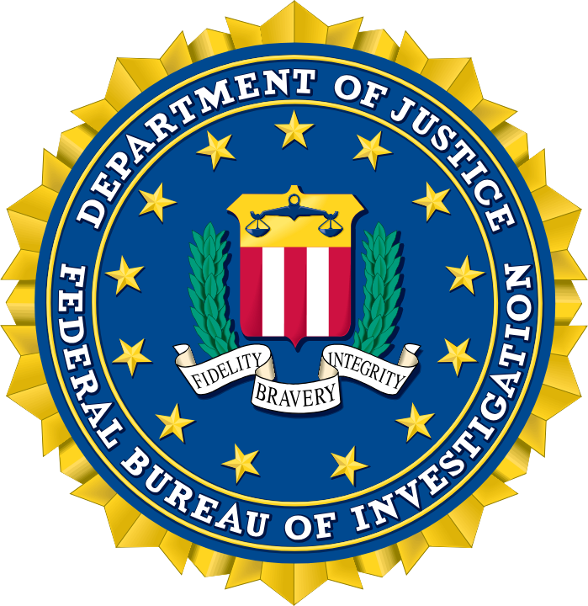
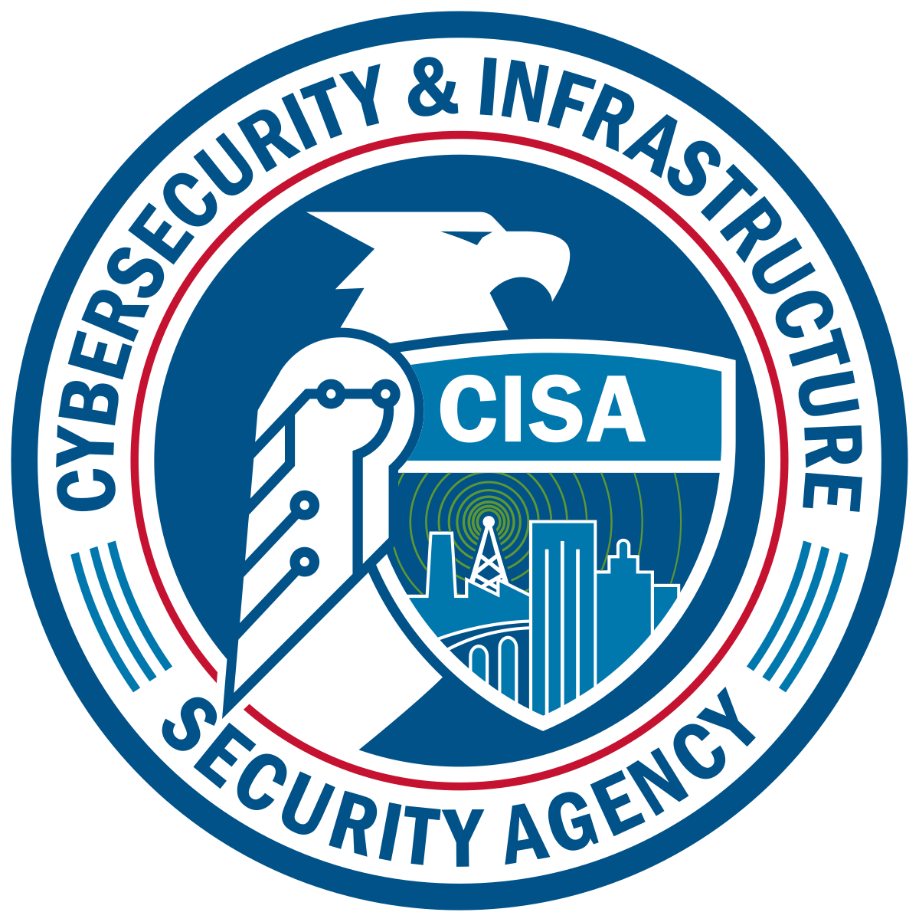



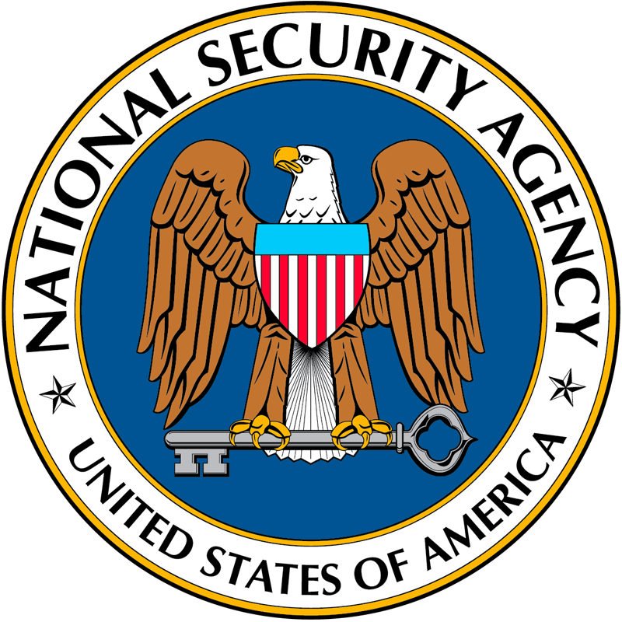

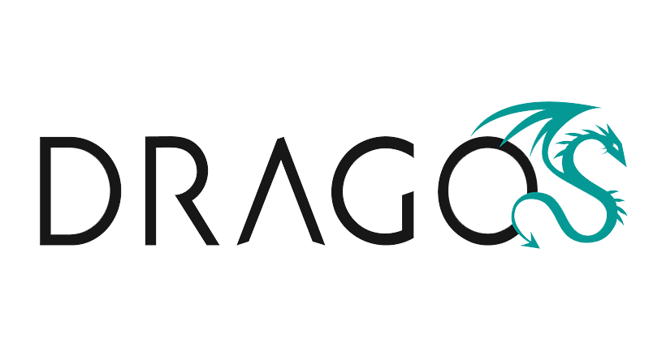
introduction
Notes:
LELWD networks were compromised by a Chinese State Funded attack called Volt-Typhoon.
Above are most of the companies that were involved in some form or fashion in this fight against China.

Slide 3
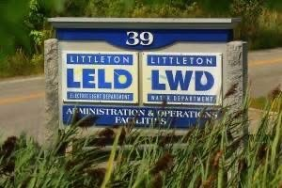
Background
Littleton, Massachusetts is a small farm town an hour outside of Boston with a population of just over 10,000 people.
Littleton Electric Light and Water Departments (LELWD) is a municipally owned utility that has been in operation since 1912.
LELWD provides electric, water and wastewater utilities to Littleton and Boxborough.
LELWD has its own elected board of commissioners.
Approximate Customer count:
Electric – 8,000
Water – 3,500
Wastewater – 100
Notes:
Discuss LELWD operations.

Slide 4
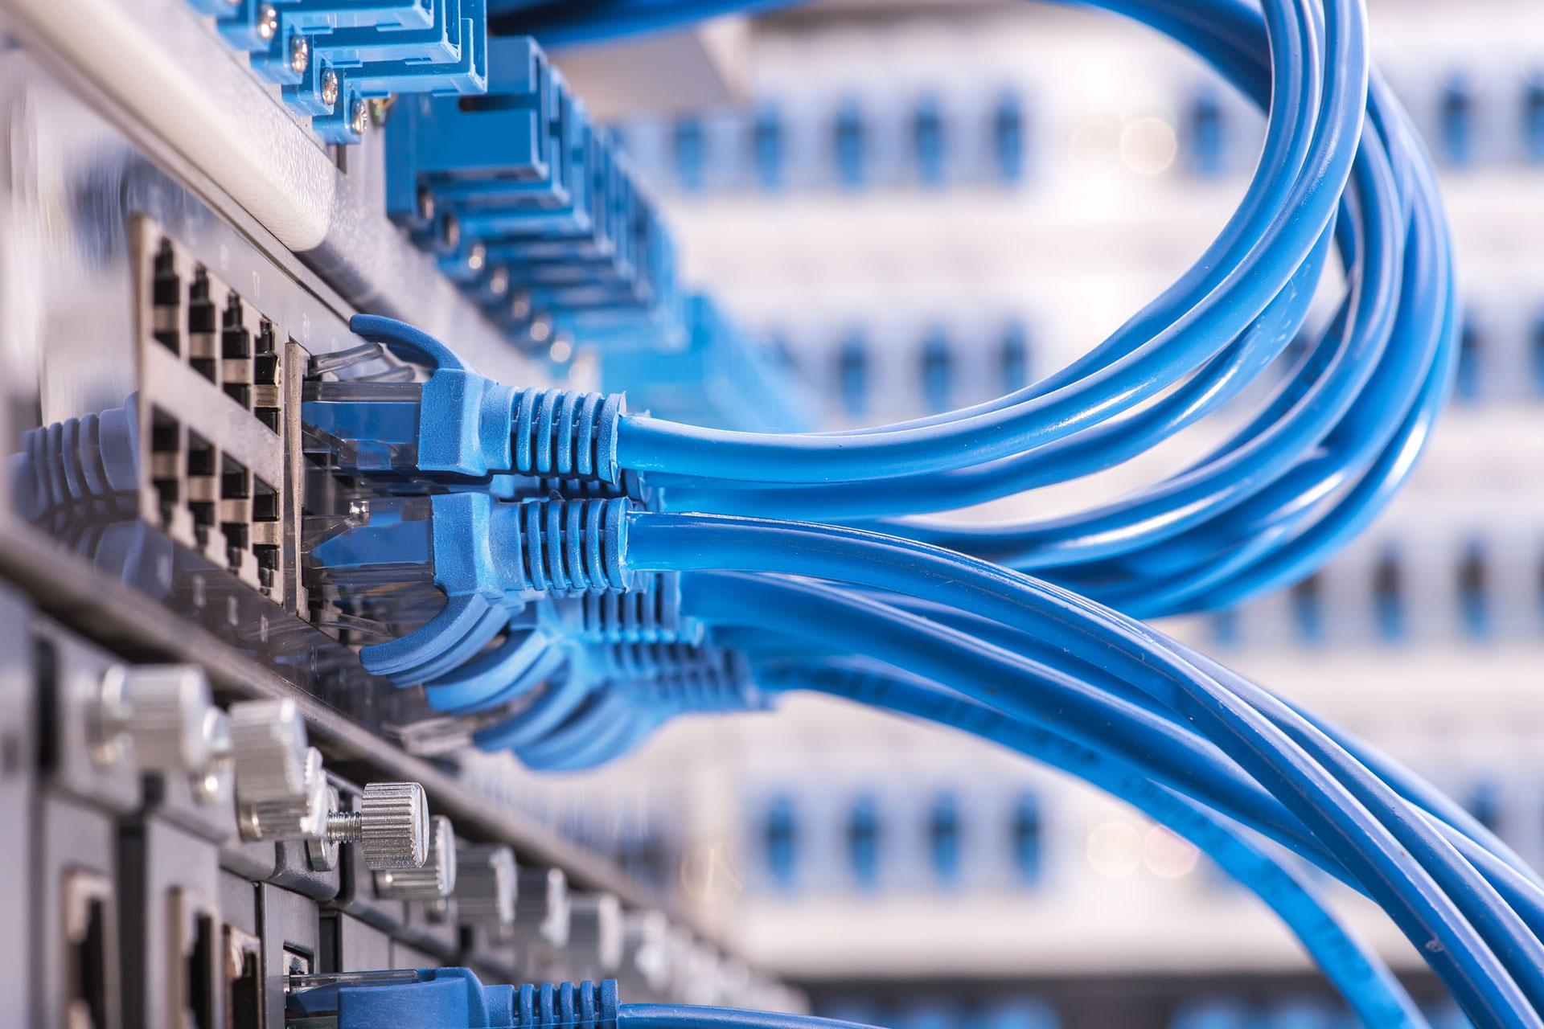
network infrastructure
In the early 2010’s, LELWD’s IT team began the process of installing a municipal fiber loop throughout town.
Goal 1: To bring high speed, secure networks to as many town buildings as possible.
Goal 2: To combine network infrastructure so that the LELWD server room served as the head end for all town buildings to ensure network redundancy and by creating economies of scale.
In 2015, LELWD management made the decision to go away from the all-inclusive townwide strategy and began segmenting its network.
LELWD hired a Managed Service Provider (MSP) in 2015 and moved on from its internal IT personnel.
Notes:
Discuss LELWD network history up to the point of the incident.
Discuss history of Thrive.

Slide 5


cybersecurity posture
We believed that our cybersecurity efforts were in good standing.
Managed Service provider monitoring system and managing firmware upgrades/patches.
MSP managing users and licenses.
FortiGate Firewalls at the front of the network.
VPN installed on Microsoft products.
“Air gapped” Electric and Water SCADA.
Training – LELWD utilized KnowBe4 for employee cybersecurity training and phishing training (provided quarterly).
APPA Cybersecurity Grant sponsored by the Department of Energy
Dragos is selected as project partner and is installed on LELWD’s system beginning in August of 2023.
Notes:
Discuss LELWD network history up to the point of the incident.
Discuss history of Thrive.

Slide 6
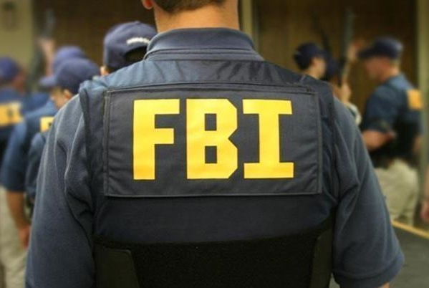
A CALL FROM THE FBI
FBI contacted LELWD regarding traffic related to Volt Typhoon that Microsoft threat hunters had seen in connection with LELWD’s network.
FBI recommended partnering with CISA Threat Hunting team to complete the mitigation. FBI stayed in the loop until completion.
CISA installed network monitors to monitor traffic and determine how to best mitigate.
Volt Typhoon was using “living off the land tactics”.
The Threat Actor was active on LELWD’s network while CISA was actively monitoring everything.
Notes:
The FBI reached out to us on a Friday and then was in our offices on the following Monday letting us know the severity of volt typhoon. They explained to us that Microsoft threat detectors had seen activity on our network IP’s that was in line with Volt Typhoon. The FBI recommended that we partner with the Cybersecurity and Infrastructure Security Agency (CISA), which we agreed to.
CISA began working immediately and had a complete dedicated team working with us. CISA shipped us network monitoring devices that we installed which allowed CISA to see further network activity. CISA had two team members drive from DC to LELWD overnight from Thursday into Friday. Upon arrival CISA conducted a network audit to determine the severity of the issue and to help with planning mitigation.
Once CISA determined that Volt Typhoon could access OT infrastructure, they recommended mitigating immediately. This included changing domain controllers, restructuring network, changing passwords, better securing different points within the network. We also completely replaced our firewalls. This was planned for a while.

Slide 7

incident timeline – December 12th, 2022
Fortinet publicly disclosed critical vulnerability CVE-2022-42475/FG-IR-22-398 which affected the SSL-VPN component in several versions of FortiOS and ForiProxy applications including ones used by LELWD’s perimeter firewall (300D).
LELWD Managed Service Provider (MSP) contacted LELWD that they would be implementing a patch to protect against this vulnerability.
Notes:
December 12th, 2022 – Fortinet publicly disclosed critical vulnerability CVE-2022-42475/FG-IR-22-398 which affected the SSL-VPN component in several versions of FortiOS and ForiProxy applications including ones used by LELWD’s perimeter firewall (300D). Thrive emails LELWD to disclose the vulnerability and to say that firmware upgrades will be made starting that night.
December 13th, 2022 – LELWD reaches out to Thrive to verify if LELWD is impacted by this vulnerability. Thrive confirms that LELWD is affected and replies that a Thrive engineer will reach out to schedule firmware updates.
January 12th, 2023 – Thrive sends email that automatic firewall firmware updates will take place between 10 PM EST and 4 AM EST over the nights of 1/16, 1/17, 1/18 and 1/19. Due to prior automatic upgrades made by Thrive in the past that caused water treatment plants to trip offline due to loss of communication, LELWD asked to be taken off of the automatic upgrades and to have these scheduled with a Thrive engineer ASAP so that LELWD knows when to expect this downtime.

Slide 8
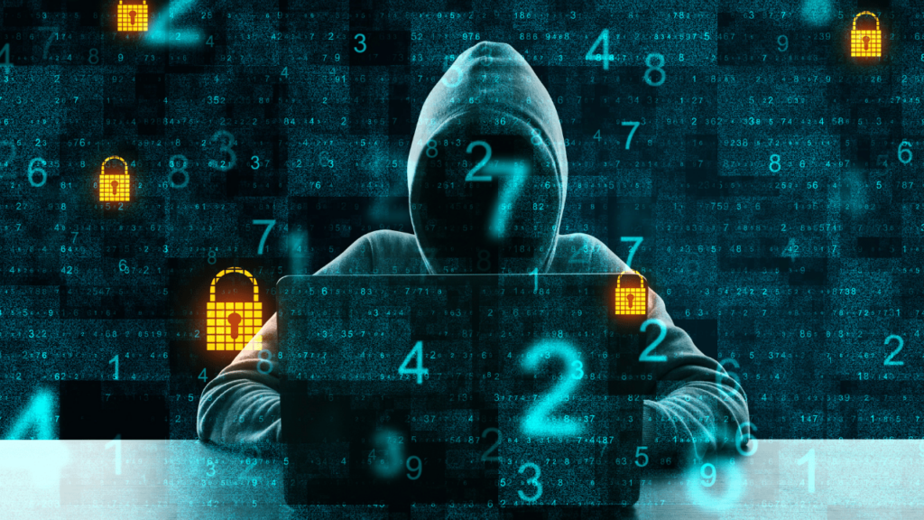
incident timeline – January 10th, 2023
Threat Actor (TA) gained access to LELWD’s network by exploiting a known vulnerability in the perimeter FortiGate firewall. TA leveraged compromised credentials and VPN access to maintain persistence and perform extensive internal reconnaissance of the network.
LELWD MSP had not yet deployed required security patch to customer base.
LELWD/MSP have not detected any advisory on network.
Notes:
January 10th, 2023 – Threat Actor (TA) gained access to LELWD’s network by exploiting a known vulnerability in the perimeter FortiGate firewall. TA leveraged compromised credentials and VPN access to maintain persistence and perform extensive internal reconnaissance of the network. TA had access at all network levels due to Thrive’s lackluster network security posture.

Slide 9
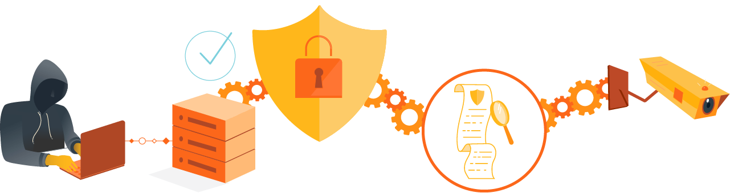
incident timeline – January-November 2023
Threat Actor was “living off the land” on LELWD network. TA would check in every few months to guarantee that they still had access and were undetected.
Unlike traditional malware, LOTL techniques exploit trusted system tools already present in the environment, making detection incredibly difficult.
In June, Microsoft discovers Volt-Typhoon activity on IP addresses link to LELWD network. Microsoft sends an email to account holder (MSP), to alert them of the incident. MSP does not see or respond to this email.

Slide 10
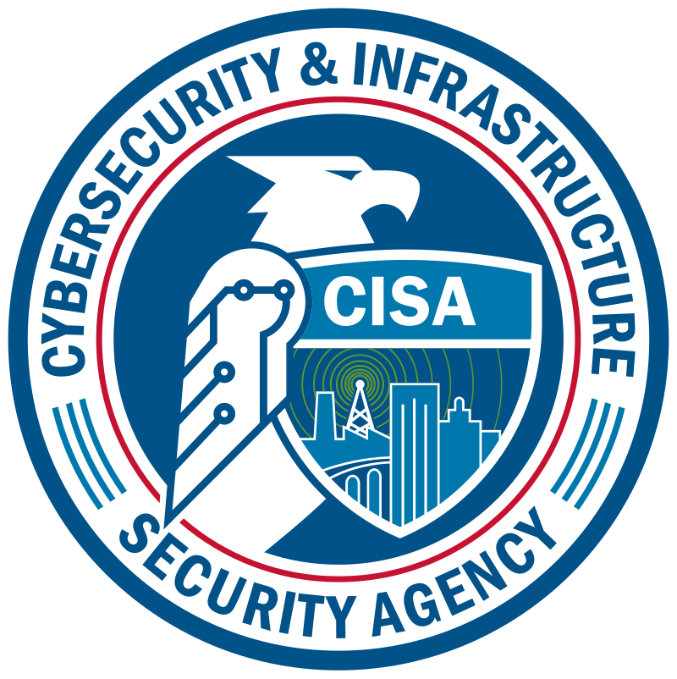
Incident timeline - November 17th, 2023
FBI contacted LELWD regarding traffic related to Volt Typhoon that Microsoft threat hunters had seen in connection with LELWD’s network.
FBI recommended partnering with CISA to complete the mitigation. FBI stayed in the loop until completion.
CISA installed network monitors to monitor traffic and determine how to best mitigate.
Volt Typhoon was using “living off the land tactics”.
The Threat Actor was active on LELWD’s network while CISA was actively monitoring everything.
Notes:
As I stated the FBI reached out to us on a Friday and then was in our offices on the following Monday letting us know the severity of volt typhoon. They explained to us that Microsoft threat detectors had seen activity on our network IP’s that was in line with Volt Typhoon. The FBI recommended that we partner with the Cybersecurity and Infrastructure Security Agency (CISA), which we agreed to.
CISA began working immediately and had a complete dedicated team working with us. CISA shipped us network monitoring devices that we installed which allowed CISA to see further network activity. CISA had two team members drive from DC to LELWD overnight from Thursday into Friday. Upon arrival CISA conducted a network audit to determine the severity of the issue and to help with planning mitigation.
Once CISA determined that Volt Typhoon could access OT infrastructure, they recommended mitigating immediately. This included changing domain controllers, restructuring network, changing passwords, better securing different points within the network. We also completely replaced our firewalls. This was planned for a while.

Slide 11
Incident timeline – December 15th, 2023
LELWD, CISA and LELWD’s managed service providers implement mitigations.
Immediate Remediation:
Step 1 – Disable Internet Access for entire environment
Reset the Kerberos Ticket Granting Ticket account in Microsoft Active Directory
Reset all domain account passwords
Disable all unused domain accounts
Rebuild all other VM servers (file server, print server, etc)
Update firewalls
Enforce MFA for VPN Access
Re-enable internet access
Long Term:
Replace EoL Firewalls
Segment Networks from one flat network to multiple VLANs dependent on use case (workstation VLAN, server VLAN, DMZ VLAN, etc)
Implement MFA for all applicable accounts
Implement password manager
Re-architect physical / virtual network topologies to further isolate SCADA networks from IT environments
Replace SSL VPN solution with IPSEC or other access type.
Employ jump hosts for any remote access to privileged systems and enforce MFA on jump host access
Proxy web servers through a service like Cloudflare
Employ patch management across all servers, workstations, and networking equipment etc.
Notes:
December 15th, 2023 – Thrive, LELWD, Evo-Labs and CISA work through VPN MFA configurations and domain migration completion. This is completed in one day with the correct resources and attention. Thrive lastly needs to create new network diagrams before this project can be closed out. Multiple CISA recommended network changes are implemented as well.

Slide 12

Incident Timeline
Volt Typhoon Infiltration Timeline
December 12th, 2022
January 10th, 2023
January-November 2023
November 17th, 2023
December 15th, 2023
Fortinet Discloses Vulnerability
Threat Actor (TA) gained access to LELWD’s network
Threat Actor active on LELWD network
FBI contacts LELWD
Mitigation
Fortinet publicly disclosed critical vulnerability CVE-2022-42475/FG-IR-22-398 which affected the SSL-VPN component in several versions of FortiOS and ForiProxy applications including ones used by LELWD’s perimeter firewall (300D).
Threat Actor (TA) gained access to LELWD’s network by exploiting a known vulnerability in the perimeter FortiGate firewall. TA leveraged compromised credentials and VPN access to maintain persistence and perform extensive internal reconnaissance of the network.
Threat Actor was “living off the land” on LELWD network. TA would check in every few months to guarantee that they still had access and were undetected.
FBI contacts LELWD to alert us that Volt Typhoon was happening on our network. FBI recommends partnering with CISA to view network activity and resolve network compromise.
LELWD, CISA and LELWD’s managed service providers work through CISA’s recommended mitigations, including password changes, user privilege changes, firewall upgrades, and two-factor authentication on VPN access.
Notes:
December 12th, 2022 – Fortinet publicly disclosed critical vulnerability CVE-2022-42475/FG-IR-22-398 which affected the SSL-VPN component in several versions of FortiOS and ForiProxy applications including ones used by LELWD’s perimeter firewall (300D). Thrive emails LELWD to disclose the vulnerability and to say that firmware upgrades will be made starting that night.
January 10th, 2023 – Threat Actor (TA) gained access to LELWD’s network by exploiting a known vulnerability in the perimeter FortiGate firewall. TA leveraged compromised credentials and VPN access to maintain persistence and perform extensive internal reconnaissance of the network. TA had access at all network levels due to Thrive’s lackluster network security posture.
November 17th, 2023 – FBI contacts LELWD to alert us that Volt Typhoon was happening on our network.
December 15th, 2023 – Thrive, LELWD, Evo-Labs and CISA work through VPN MFA configurations and domain migration completion. This is completed in one day with the correct resources and attention. Thrive lastly needs to create new network diagrams before this project can be closed out. Multiple CISA recommended network changes are implemented as well.

Slide 13
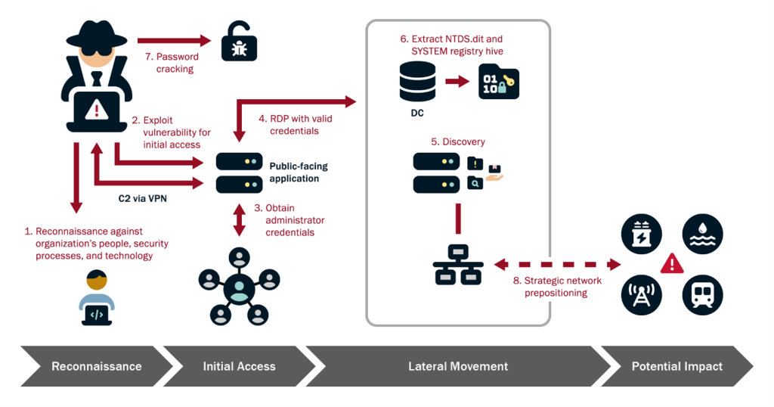
Detection of threat
Notes:
Here is a portrayal of how the threat actor likely compromised LELWD.
Microsoft uncovered targeted malicious activity focused on credential access and network system discovery aimed at critical infrastructure organizations in the United States.
The attack is carried out by Volt Typhoon, a state-sponsored actor based in China that typically focuses on espionage and information gathering.

Slide 14
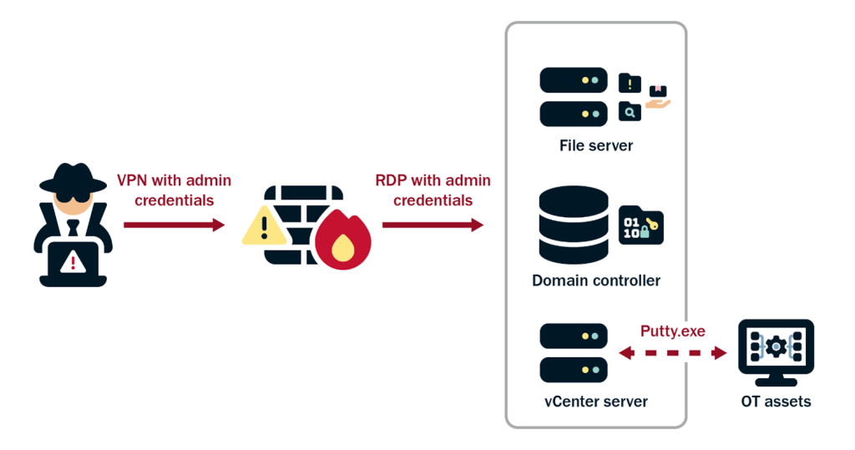
Detection of threat
Notes:
Further depiction, getting to OT assets.

Slide 15

Geopolitical landscape
China’s potential goals with Volt Typhoon:
Intelligence gathering on US resilience.
Pre-positioning for a Taiwan conflict.
Exploiting US private-sector vulnerabilities
Living off the land avoids escalation
Get inside, stay hidden, and gain leverage.

Slide 16
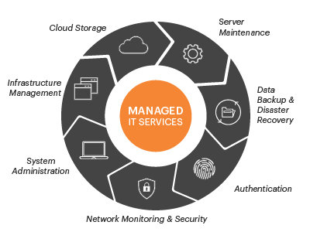
Challenges and solutions
Utilizing Managed Service Providers can be challenging. Make sure that you stay on top of your MSP so that they are being proactive and not reactive.
Working with CISA “offline” to remedy this situation without tipping off the threat actor.
Network architecture was flat – we have since completely revamped our network architecture.
Employee personal passwords were compromised. We have since installed a company wide password manager.
Notes:
Working with Thrive. Being “stuck” with MSP. Many utilities might not have the “IT Staff” that larger utilities might have and need to count on outside vendors for network management.

Slide 17

Lessons learned
After mitigations were complete, CISA recommended that LELWD sign up for a Risk and Vulnerability Assessment which took place in the summer of 2024.
CISA and LELWD met to review pre-assessment questions pertaining to LELWD’s network.
CISA then spent two weeks, one week remote and one week on-site, performing a penetration test. A CISA team actively tried to find vulnerabilities and hack into the LELWD network.
A post-assessment report was review and more network recommendations were made.
LELWD partners with CISA to conduct continuous network and vulnerability scanning of LELWD publicly accessible networks and systems.
LELWD received a cyber grant from MassDEP to make network improvements on water OT assets.
Make sure back-ups are being completed and are in a secure location.
Notes:
Discuss Pentest.
Discuss CyHy reports.
Discuss DEP cyber grant.
Takeaways from previous events – sandworm (changing passwords on OT devices)

Slide 18

conclusion
Q and a

