Slide 1
Who, Where and When
Collaboration in Mass Casualty Crisis
Tara S Hughes, LCSW-R
American Red Cross Northeast Division Disaster Mental Health Advisor
Mass Casualty Response Subject Matter

Slide 2

The Challenge of Integrated Community Response
Why Do We Care?

Slide 3



Mass Casualty Incidents are Different
Size and scale.
Number of agencies potentially involved
Services needed.
Length and duration.
Long-term effects.
Stress on victims, responders and the whole community.
Disaster responders’ families’ concern for their loved ones’ safety, especially in terrorist or active shooter incidents.

Slide 4
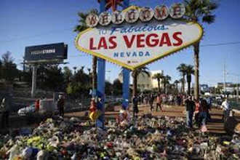
Scale !

Slide 5
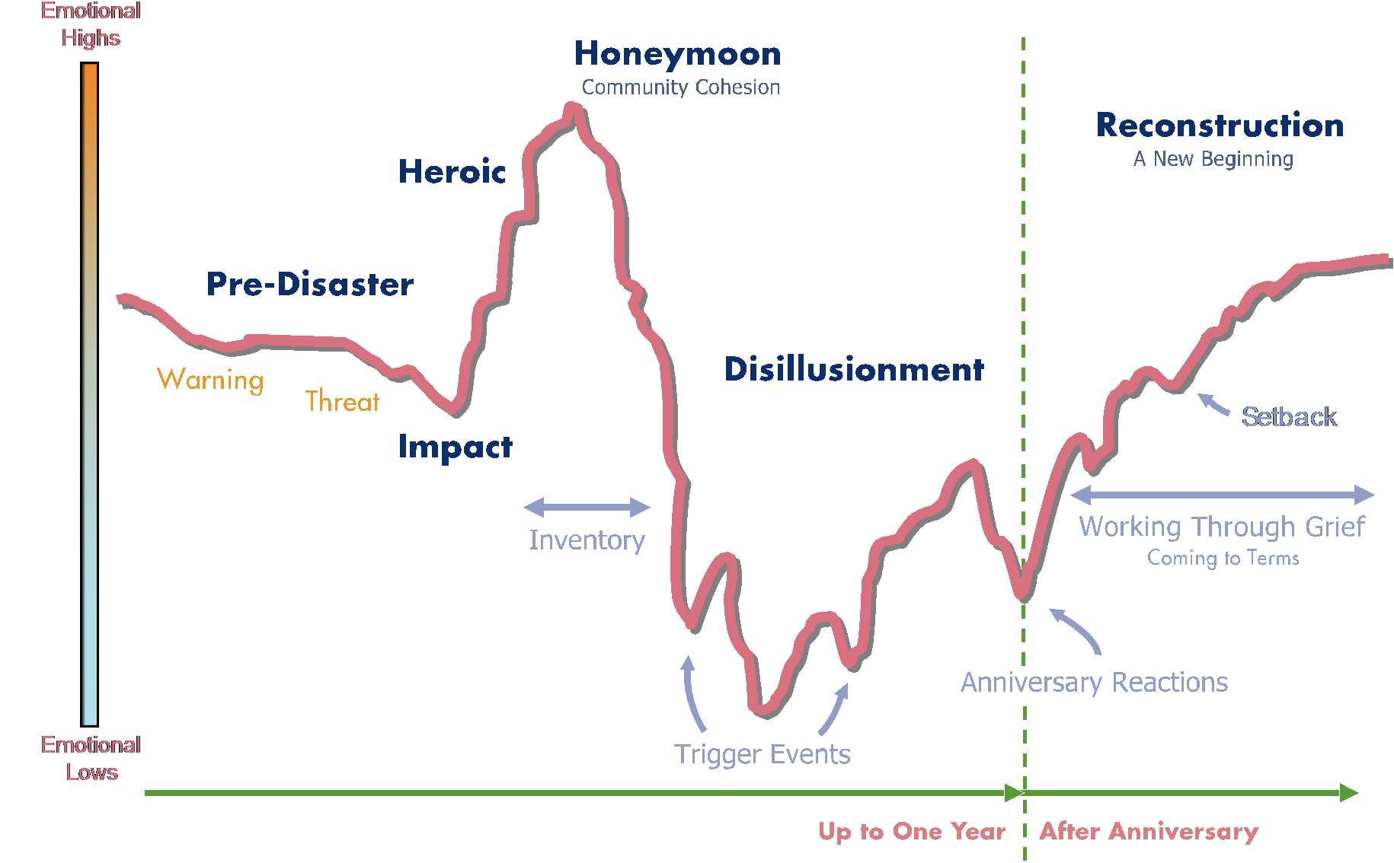
Favorite Graph…
Adapted from Myers & Zunin, 1990; SAMHSA, 2018
Notes:
Gerard -
This timeline of the emotional impact of crises on communities helps too highlight some of the predictable stages of reaction following a traumatic event. As you can see on the left hand side of the screen events that are higher on the scale are generally positive emotional events for individuals and communities, whereas those on the lower end of the scale are more challenging emotionally. When there is some sort of warning or threat prior to the event itself you can begin to see a slight negative trend within the community. But the impact of the event itself will be the first low of the emotional challenges. following the event itself there is often a heroic phase where individuals are focused on the efforts that are being made to save lives and secure the community from any further damage. You'll also see individuals in the community reaching out seeking opportunities to contribute in a positive way, think blood drives, etc.) and we'll talk about opportunities to provide communities with direction during that time later in our discussion. The heroic phase peaks with a honeymoon period where the community feels a connection with one another and there is a common goal that is shared and understood by individuals in the community.
What follows is what we discuss as the disillusionment stage. As information comes to light, as external resources begin to step back, and as individuals try to reorient their lives following a mass violence event there is a reckoning with the true impact of what has transpired. You'll also note that near the bottom of this disillusionment stage is the potential for other events to trigger individuals in the community because those events happen in close geographic proximity or share some sort of similarity with a traumatic event their community experienced.
The disillusionment phase gives way to the reconstruction. Which can be thought of as the longer term recovery process. There is nothing magic about the one year day of remembrance. Reconstruction and recovery can go on for months or years longer. Individuals and the community worked through their grief and come to terms with what is referred to as “the new normal”

Slide 6

Key Concepts
No one who experiences a disaster is untouched by it.
Mass casualty events involving trauma and loss affect both the individual and the community.
Most survivors respond to active, genuine interest and concern.
Confusing and distressing
  Law enforcement procedures,
  Criminal and Legal proceedings
  Medical Examiner’s protocols,
  Disaster Relief requirements

Slide 7
Vulnerability Factors
Age
Culture
Physical/Mental Vulnerabilities
Language
Socioeconomic Status
Country of Origin
Why is there so much variability in response?
Notes:
Identify populations that have been impacted, - particularly vulnerable populations. Vulnerable populations are those subsets of the population that may suffer greater harm or lengthened recovery.
Older and Younger populations
Cultural connections that were targeted or of which the perpetrator was a member
Individuals with pre-existing physical, mental, or emotional conditions are at increased risk
Individuals who do not speak English need to receive specific outreach, as initial information may not reach them effectively. Burial requirements can also vary widely based upon religious or cultural traditions.
Individuals of more modest SES may not have access to mental health services, or the ability to take time off work to tend to trauma related needs.
Family members who are not US Citizens may not have the resources to come to the location of the event. Again, language assistance may be necessary.

Slide 8


Personnel and Command Challenges
How you go from being
“in charge”
to being a cog in the wheel….
Then, back again?

Slide 9
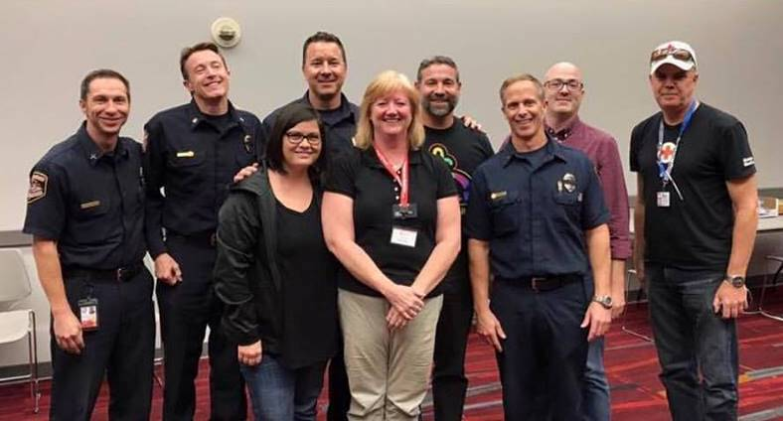
Multi-Agency Collaboration and Cooperation
Communication among agencies
Adherence to a strict chain of command
Crime scenes or investigation sites which will restrict movement by response personnel
Knowledge of relevant MOUs and legislation

Slide 10

Response Overview

Slide 11
Incident Timeline
First Hours
24-48 Hours
Information and Notification Center
8-9 days
-- Family Assistance Center (FAC)
-- Spontaneous memorial sites
-- Interfaith memorial events
-- Disaster site visit
-- Non-locals
Language matters…
Gathering area
Long-Term
-- Resiliency Center
-- Dates to Remember
-- Milestones of Note

Slide 12
IMMEDIATE RESPONSE
Direct Victims
Families
Wider Campus
Safety of their member
Outreach to Impacted communities and people
Medical Care
Reunification with support systems
Surrounding Community
Mobilize Partners and Supports
Manage Community participation
Connection to family member/friend
Health, emotional, and spiritual needs
Acknowledgement of event, with information about security measures and services offered
Guidance about Media Attention
Consistent, Uniform Information
Notes:
Gerard - Using the example scenarios, explain how each of the groups might respond. What questions/concerns do they have? What do they need?
Directly impacted survivors - Physically injured, not physically injured, temporarily displaced or dislocated from a support system awaiting shelter or transportation
Family members/loved ones - Of those directly impacted, of individuals in broader campus community
Wider campus community - Students, employees, vendors, contractors, visitors
Surrounding Community –As the event scales up, alerting community partners as early as possible about needs will facilitate integrating those resources appropriately. Managing community participation can be both a good thing, or present some challenges. this is where we are likely to see individuals self deploying, and coming to contribute resources or services. It is helpful to also consider the needs for Donation Management, as cards, flowers, teddy bears, and even cash will begin to appear.

Slide 13
SHORT TERM
Direct Victims
Families
Wider Campus
Behavioral Health Services
Social Services and Benefit Support
Surrounding Community
Memorials
Legal Support
Spiritual Care
Behavioral Health Services
Burial costs
Spiritual Care
Behavioral Health Services
Spiritual Care
Victim Compensation
Medical Expenses
Memorials
Behavioral Health Services
Prepare for Disillusionment
Prepare for Disillusionment
Consistent, Uniform Information
Notes:
Using the example scenarios, explain how each of the groups might respond. What questions/concerns do they have? What do they need?

Slide 14
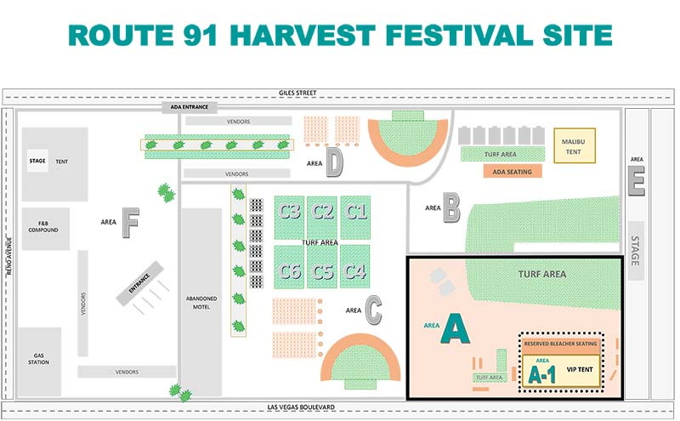
Impacted People & Communities
WHO is impacted?
  Victims Eligibility
FAC access
Hospital Locations
Special Considerations
  Non-documented victims
  Children
  Elderly
  Newly injured
  Etc

Slide 15

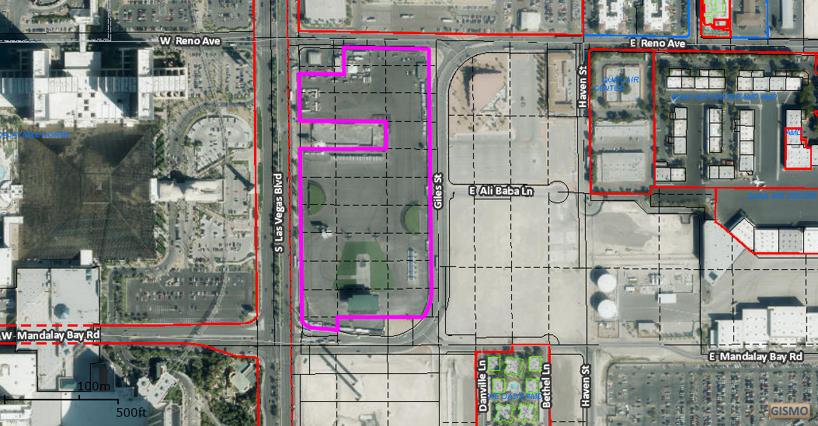
Who is eligible to come to the FAC?
Notes:
NCF
May need to use creative tactics to make distinctions.
Las Vegas – Anyone who was at the concert at the time of the shooting was classified as a victim. 850 documented “patients” (injured and deceased), but more than 18,000 present by not injured. Used property return to help as an identifier. Anyone who could identify where they were on the grounds of the festival and which of the three staged Jason Aldene was on at the time of the shooting was allowed into the FAC. Large numbers also meant varying levels of impact. People who were more strongly impacted (injured, lost a loved one) taken into private rooms and had the services come to them to minimize chaos.

Slide 16


Responder service delivery sites:
  Respite center for first responders
    Transitions in and out
  Morgue and other body recovery sites

Slide 17



Slide 18
LONG TERM
Direct Victims
Families
Wider Campus
Support Around Day of Remembrance
Day of Remembrance
BOLO for Triggering Events Around the Country
Attention to Evolving Needs
Notable events
Surrounding Community
After-action Review
Support Around Day of Remembrance
Attention to Evolving Needs
Reclaiming Identity
On-going support and development of partnerships
Consistent, Uniform Information
Notes:
Using the example scenarios, explain how each of the groups might respond. What questions/concerns do they have? What do they need?
Directly impacted survivors - Physically injured, not physically injured, temporarily displaced or dislocated from a support system awaiting shelter or transportation
Family members/loved ones - Of those directly impacted, of individuals in broader campus community
Wider campus community - Students, employees, vendors, contractors, visitors

Slide 19
Unified Command
…handling Elected Officials
Who can make the decision?
Who has the authority to act?
Will they do it?
(Can we stop them?)
Notes:
Administrative structure is often distributed and very confusing.
Someone needs permission
Once that permission is granted, can we find the right person to provide the service
Will they be willing, because that is not how we usually do this?
Highlight the need for buy-in from the very TOP of the decision making structure.

Slide 20

What plan exists already?
Does it anticipate integration with broader community resources?
Does it consider victim services or simply the response to the event?
Does it lend itself to coordination with outside groups?
Notes:
Mass Violence/Mass Casualty plan to be implemented when response to an incident exceeds the day-to-day operational capacity of the HEI.
The plan needs to be designed to be situational, scalable, and needs-focused, providing guidelines and operational tools for determining the appropriate response;
Plan needs to be based on HEI capabilities as well as jurisdictional capabilities and regulatory requirements,
Focus on unmet needs,
Provides immediate and short-term assistance and transition planning to long term recovery,

Slide 21
Mass Fatality vs Mass Casualty

Slide 22
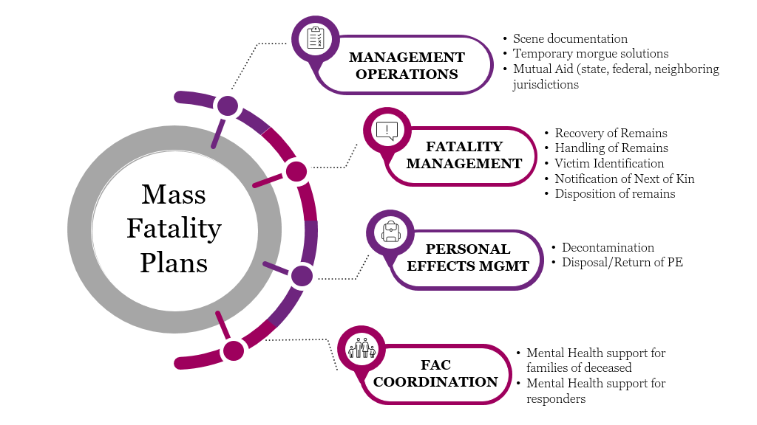

Slide 23
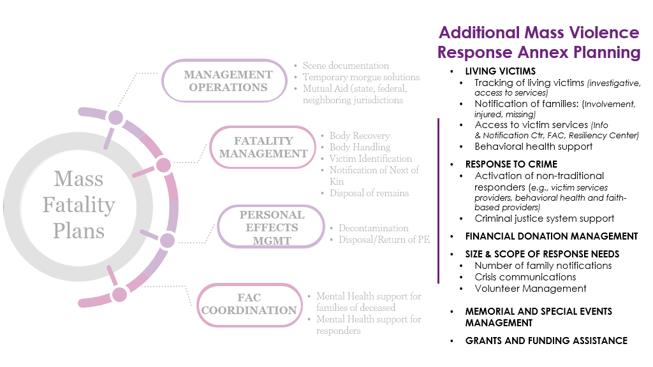

Slide 24



Types of Readiness
Jurisdiction & Region
  Do you have a plan?
  Relationships with community partners
    Who should be at the table?
    VOADs, Red Cross
    State/local agencies (MOVA)
    Federal Partners (FBI, NTSB, DOJ)
  Workforce readiness
Coordination with national partners
Relevant trainings, exercises, and drills

Slide 25

TRAINING Considerations
Consistency in training and responding practices
Possibly Train non-traditional personnel/teams in ICS/NIMS (especially leadership)
Train Leadership in mass violence response
  Leadership
  Communication
  Steps for recovery
Train/Drill with Victim Advocates (local, federal)
Train Behavioral Health in mass violence response (immediate and longer term)
Get EAP staff trained in mass violence response
Notes:
Tara
What does planning look like?
How does this fit with the larger plan/response?

Slide 26
Protecting The Workforce
This isn’t for everyone!
Take Care of Yourself!
Responsibility of the individual worker, the supervisor, and the organization
The wellbeing of the workforce is a primary consideration during all phases of the response

Slide 27
THANK YOU!
Tara.Hughes@redcross.org

