Slide 1
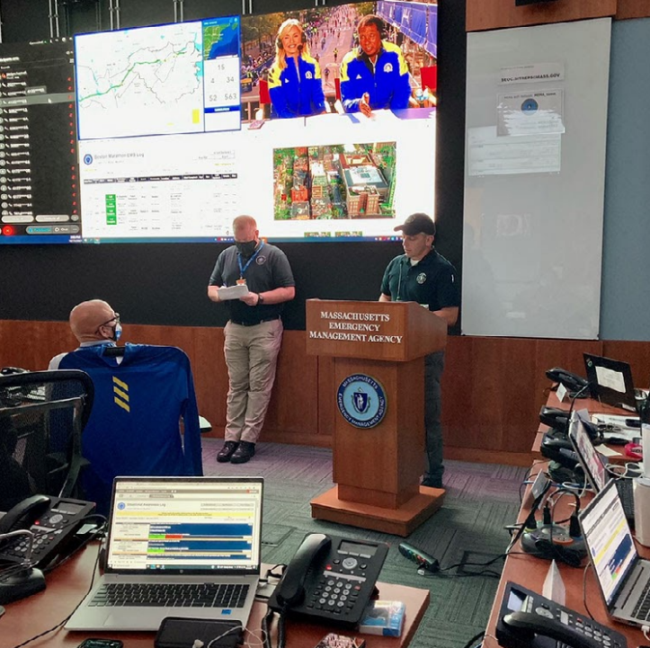
Massachusetts Emergency Management Agency
Simon van Leeuwen
Assistant Director for Mitigation and Recovery
Matthew Kolhonen
Local Coordinator
Max Hughes
Recovery Coordinator
North Shore Emergency Preparedness and Sustainability Conference – April 7, 2026
Notes:
Show of Hands –
Municipality – EMD, Mayor/town manager/DPW/Fiscal
Private Sector
Other Public
Emergency Management Context
MEMA Structure and Engaging State Support
Damage Assessment and Cost Recovery
Update on the February 22-23 Snow process

Slide 2

Massachusetts Emergency Management Agency
The Massachusetts Emergency Management Agency (MEMA) is charged with ensuring the state is prepared to withstand, respond to, and recover from all types of emergencies and disasters, including natural hazards, attacks, and technological and infrastructure failures.
MEMA is “HERE TO HELP”
To learn more about MEMA visit https://www.mass.gov/mema

Slide 3

All Disasters Begin & End Locally
Requests for Assistance
Local Response
State Response
Federal Response
Local Resources
Intrastate Mutual Aid
Local Volunteers
State Agencies
Private Organizations
Non-Impacted Local Resources
Interstate Mutual Aid (EMAC)
Emergency Contracts
Federal Agencies
Private Organizations
Disaster Impacts a Local Jurisdiction
➲ STATE  FEDERAL
Notes:
As we walk through response and recovery, it's important to keep in mind is that disasters begin and end locally. Locals are responsible for their communities, they are the first responders, and they are the ones still recovering long after the feds leave, and the media is no longer paying attention. Primary responsibility for disaster response and recovery lives with the municipalities. But, from the beginning to the end of the disaster, which can take years, MEMA is side-by-side with localities providing assistance, support, resources, and guidance to help them meet their own missions of protecting their communities and recovering from disasters.
That said, I want to add that the state does have a responsibility as well. Disaster response starts locally, then moves to the state, and only after both state and local capabilities are or will be exhausted, do we turn to the federal government. This includes all phases of EM including both response and recovery.

Slide 4
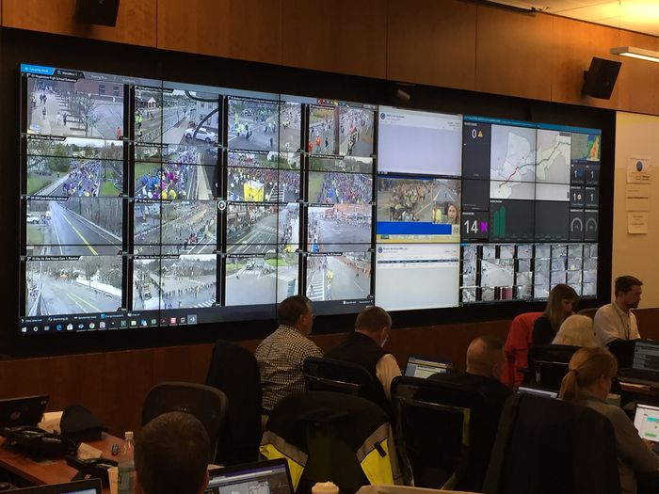
State Emergency Operations Center
The State Emergency Operations Center (SEOC)
is a central location from which local, state and
federal partners provide interagency coordination
and decision-making in support of incidents and
planned events in the Commonwealth.
MEMA has Regional Emergency Operations
Centers (REOC) located in Agawam, Franklin and
Tewksbury that activate for regional and statewide
incidents.
To learn more about the SEOC visit https://www.mass.gov/service-details/state-emergency-operations-center

Slide 5

State Response Coordination
Make recommendations to and advise Governor and other key officials on response actions, priorities and objectives
Operate the State Emergency Operations Center (SEOC) and Regional EOCs
Provide situational awareness
Issue alerts and warnings
Establish operational priorities & objectives
Coordinate state response
Coordinate with federal agencies, particularly FEMA
Coordinate with private sector
Deploy field personnel
Establish critical communications
Process / fulfill resource requests
Facilitate mutual aid (intra & interstate)
Coordinate public information
Assess impacts
Coordinate state disaster assistance
Seek and coordinate federal disaster assistance
Initiate recovery actions
Notes:
During an event that is significant in scope and scale, the state may need to coordinate its own response and may need to provide assistance to cities and towns. Coordination of this state response is led by MEMA, guided by strategy and policy decisions made by the Governor, and supported by over 70 partner agencies and organizations. State response coordination includes all the operational tasks listed here and more. MEMA plans and prepares for, trains and exercises all these capabilities throughout the year with our response partners to ensure we are ready to respond when needed as your bad day experts.

Slide 6
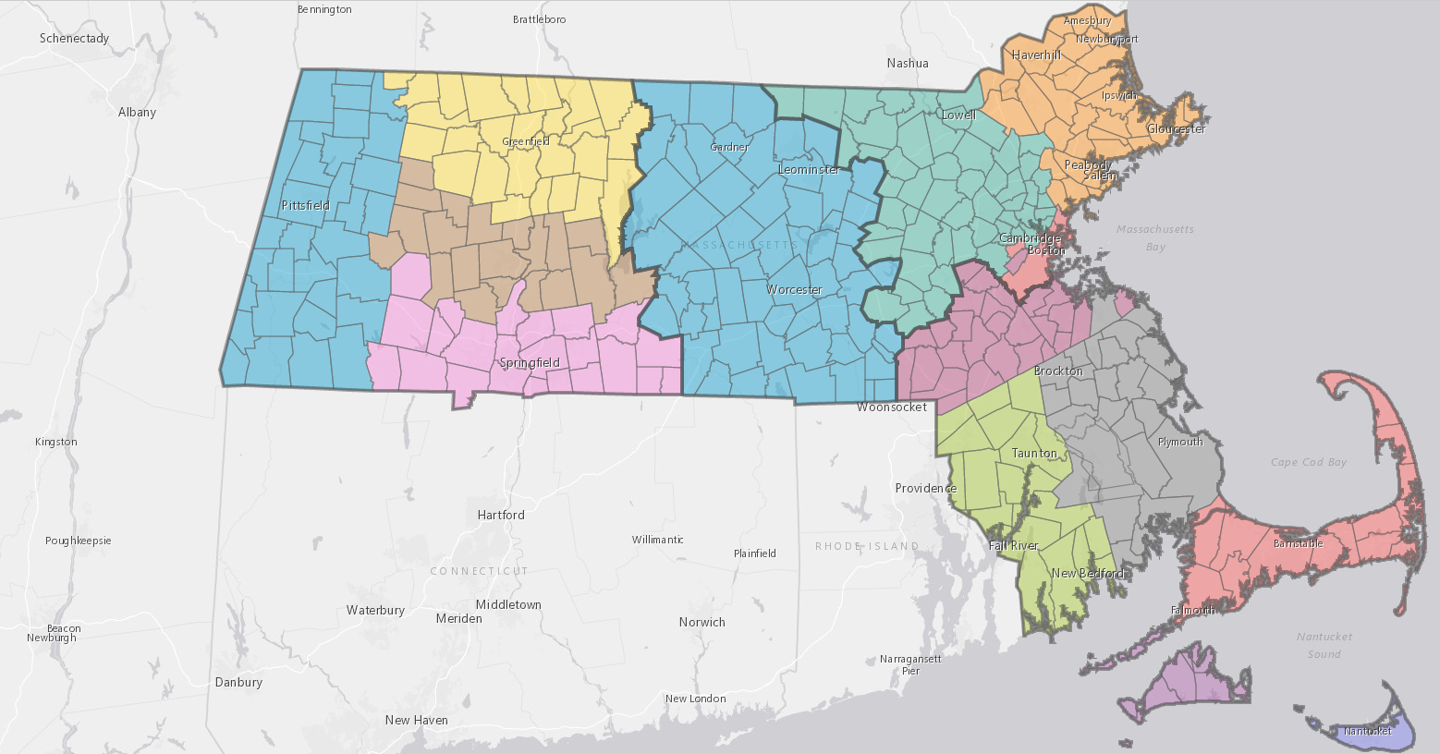
MEMA Regions
Headquarters Office in Framingham
MEMA East Offices in Franklin & Tewksbury Essex County Middlesex County Suffolk County Barnstable County Bristol County Dukes County Nantucket County Norfolk County Plymouth County
MEMA West Office in Agawam Berkshire County Franklin County Hampden County Hampshire County Worcester County

Slide 7
MEMA Local Coordinators
Every community is assigned a MEMA Local Coordinator (LC) that assists the community’s Emergency Management Director with their EM Program. The LC can connect an EMD to any resource that MEMA offers.
LCs regularly conduct trainings, workshops and provide technical assistance related to:
“Real World” Incident Support/Situational Awarness
WebEOC/Resource Request
Commodity Point of Distribution Plan (CPOD)
Comprehensive Emergency Management Plan (CEMP)
Continuity of Operations Plan (COOP)
Special events and EAPs

Slide 8
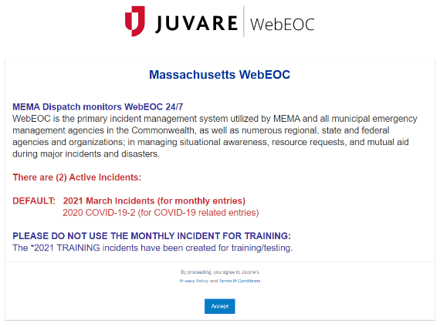
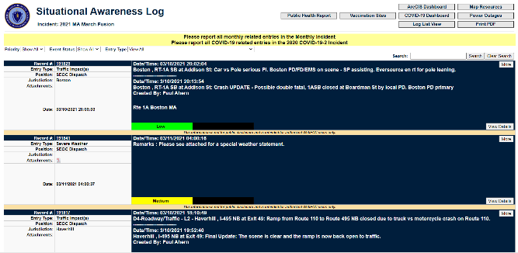
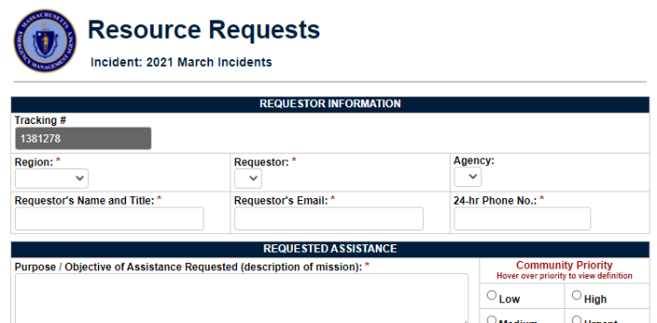
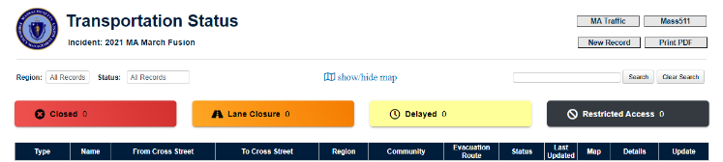
WebEOC
WebEOC is the primary incident management system utilized by MEMA to…
Assist and manage situational awareness.
Request resources and mutual aid.
Your MEMA Regional Office can create a WebEOC account for you and can provide training to your staff on how to use it.
To learn more about WebEOC visit https://mema.webeocasp.com/mema

Slide 9
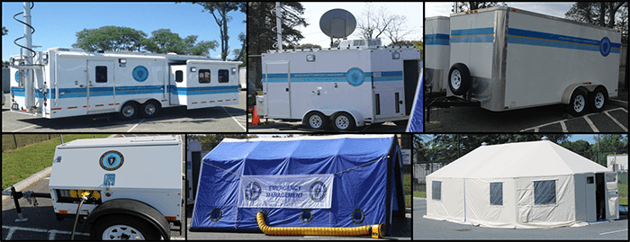
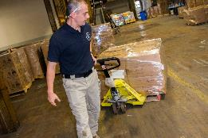

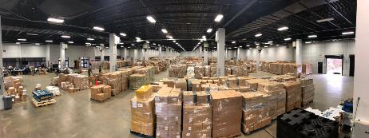

MEMA Resources – Logistics
Mobile Emergency Operation Centers 1 & 2
Mobile Generator Trailer and 6 portable generators
Mobile Field Tents (inc. Heat, AC, Lights, Tables etc.)
Shelter Equipment Trailers (human and animal)
Sleep kits (sleeping bags, pillows)
22’ Box Truck w/Liftgate
Electric Forklift
250 Bed Field Hospital w/Electrical Distribution System
25 additional medical beds
2 Portable Barrel Fan and 1 large Evaporative Cooler
Commodity Point of Distribution (CPOD) Supplies
Light Towers (2), Message Boards (4)
Deployable Logisticians
Notes:
Reach out to LC

Slide 10


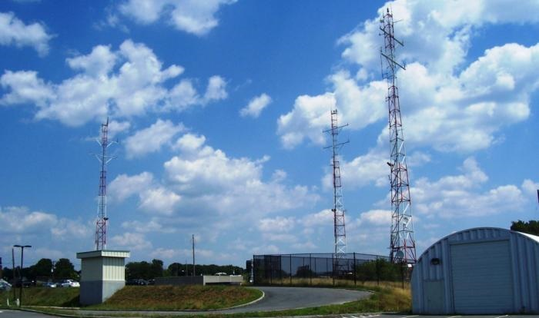

MEMA Resources – Communications
Mobile Communications Trailer
Mobile Satellite Trailer
Portable Radio Cache
Radio Base Stations
Tactical Radio Channels
COML & COMT Support
To learn more about the Massachusetts Statewide Interoperability Plan visit https://www.mass.gov/doc/massachusetts-statewide-communication-interoperability-plan-scip-2020/download

Slide 11
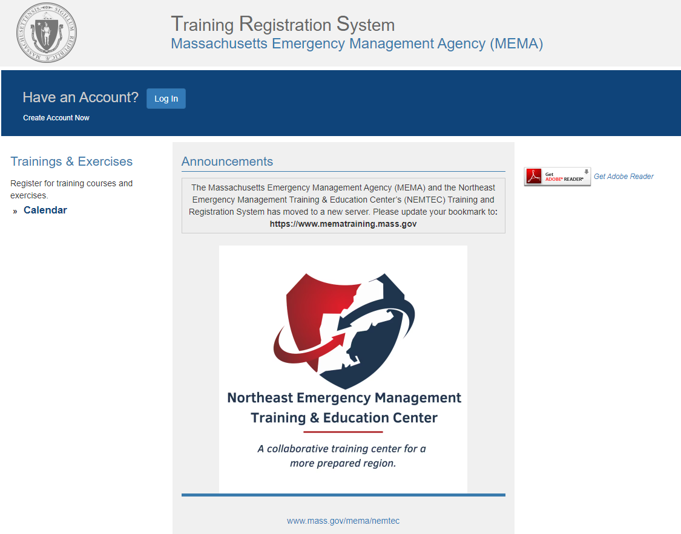
MEMA Resources – Training and Exercise
MEMA has an online training portal that allows students to register online for state and federal classes.
Users can view upcoming sessions and any required prerequisites for the training.
The training portal allows the student to keep track of their completed courses and print certificates.
To register for a MEMA Training visit https://www.mematraining.mass.gov/TRS/

Slide 12
MEMA Administers FEMA Grants
Emergency Management Performance Grant (EMPG)
Public Assistance (PA)
Individual Assistance (IA)
Hazard Mitigation Grant Program (HMGP)
Flood Mitigation Assistance (FMA)
Building Resilient Infrastructure and Communities (BRIC)
Additional Grant Support and Coordination

Slide 13
Recovery Riembursment Grants

Slide 14



Recovery: Returning to a (new) normal
Stafford Act Declarations
FEMA Programs
SBA Disaster Declarations
USDA Emergency Designations and Declarations
Direct Federal Assistance
FHWA Emergency Relief (ER)
HUD CDBG-DR
Local Recovery
Local impacts
Local State of Emergency
Rapid, Individual, and Preliminary Damage Assessments
Long Term Recovery Groups (LTRG)
Assistance to citizens
State Recovery
State impacts
Rapid, Individual, and Preliminary Damage Assessments
State of Emergency
Declaration Requests
LTRG Support
Gap disasters
Federal Recovery
Joint Preliminary Damage Assessments
Public/Individual Assistance
SBA Loans
Federal Coordinating Officer (FCO)
Joint Field Office (JFO)
➲ STATE  FEDERAL
Notes:
Recovery from a disaster begins before the incident is even over and continues as we transition back to normal or to a new normal. As with response, cities and towns have the primary responsibility for recovery including repairs, supporting and assisting individuals and businesses, and coordination of the recovery effort.
The state may have it’s own recovery repairs and work to do but also MEMA works closely with municipalities and FEMA after large events to facilitate the declaration process and implement or support any FEMA or SBA programs made available through declarations. Again, like response, recovery starts locally, is state supported, and when both the local and state capabilities are exhausted, we turn to the federal government. As we have seen throughout this summer, there are events that are significant enough to outstrip local capabilities and funding, but do not meet the criteria for a federal dec. In that gap between locals and feds is where our state responsibility lies.

Slide 15
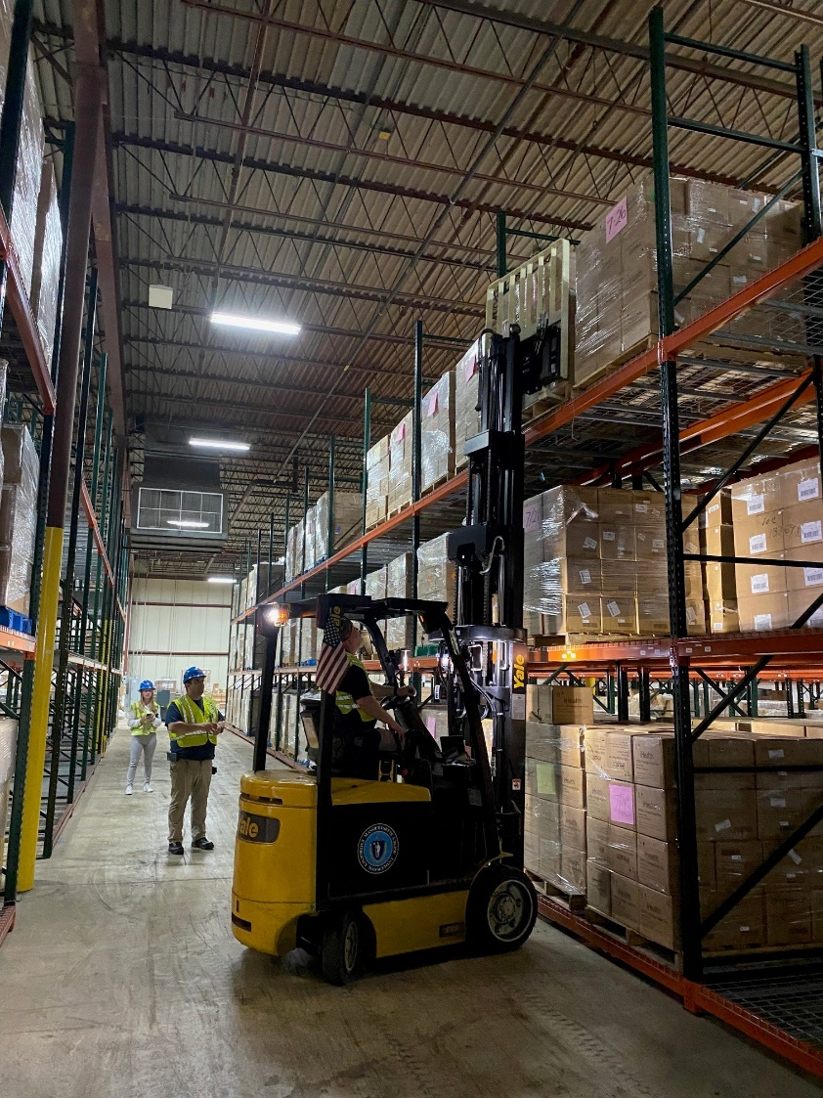
Stafford Act Disasters
Governed By Statute
Robert T. Stafford Disaster Relief and Emergency Assistance Act
Declaration Process is codified at 44 C.F.R. Part §206, Subpart B
Emergency Declaration (EM)
Provides Direct Federal Assistance to support the State’s response to an event
Limited reimbursement for emergency protective measures
Can be requested prior to an event
Limited to $5 million in federal support
Major Disaster Declaration (DR)
Requires a Joint Preliminary Disaster Assessment (PDA)
Must meet “thresholds” and demonstrate the event is beyond the capabilities of local and state response
Provides access to Federal Grant Programs:
Individual Assistance (IA)
Public Assistance (PA)
Hazard Mitigation Grant Program (HMGP)
Notes:
Presidential declarations are governed by the Stafford Act which includes 2 types of decs: an emergency declaration, which we did for Hurr Lee (Fall 2023), and the one everyone is much more familiar with – the major disaster declaration.
** This is the state’s declaration request and the declaration is for the state, not a specific locality – for example: a tornado that goes through a county may have the heaviest damage in one town but the declaration is made for the state as the event affected more than one municipality.
EMERGENCY DECLARATION: The President can declare an emergency for any occasion or instance when the President determines federal assistance is needed. Emergency declarations supplement State and local or Indian tribal government efforts in providing emergency services, such as the protection of lives, property, public health, and safety, or to lessen or avert the threat of a catastrophe in any part of the United States. The total amount of assistance provided for in a single emergency may not exceed $5 million. The President shall report to Congress if this amount is exceeded.
REQUIREMENTS³
The Governor of the affected State or Tribal Chief Executive of the affected Tribe must submit a request to the President, through the appropriate Regional Administrator, within 30 days of the occurrence of the incident. The request must be based upon a finding that the situation is beyond the capability of the State and affected local governments or Indian tribal government and that supplemental federal emergency assistance is necessary to save lives and protect property, public health and safety, or to lessen or avert the threat of a disaster.
In addition, the request must include:
Confirmation that the Governor or Tribal Chief Executive has taken appropriate action under State or Tribal law and directed the execution of the State or Tribal emergency plan;
A description of the State and local or Indian tribal government efforts and resources utilized to alleviate the emergency;
A description of other federal agency efforts and resources utilized in response to the emergency; and
A description of the type and extent of additional federal assistance required.
ASSISTANCE AVAILABLE UNDER EMERGENCY DECLARATIONS
Public Assistance (PA) – Only Categories A (debris removal) and B (emergency protective measures) may be authorized under an emergency declaration. Categories C-G (permanent work) are not available under an emergency declaration. Emergency declarations often include only Category B and will typically be limited to DFA, absent damage assessments showing significant need for financial assistance. This assistance is generally provided on a 75% federal, 25% non-federal cost sharing basis.
Individual Assistance (IA) – The Individuals and Households Program (IHP) is the only form of IA that may be authorized under an emergency declaration. Authorization of IHP under an emergency is rare. Housing Assistance under IHP is provided at a 100% federal share, while Other Needs Assistance under IHP requires a 25% non-federal cost share.
Direct Federal Assistance (DFA)
We could potentially access a number of other agencies - USDA, SBA, USACE, USDOT, DOD, etc
Pre-Disaster Emergency Declarations
A Governor or Tribal Chief Executive may request an emergency declaration in advance or anticipation of the imminent impact of an incident that threatens such destruction as could result in a major disaster. Such requests must meet all of the statutory and regulatory requirements for an emergency declaration request. Requests must demonstrate the existence of critical emergency protective measure needs prior to impact are beyond the capability of the State and affected local governments or Indian tribal government and identify specific unmet emergency needs that can be met through DFA.
A major disaster declaration occurs after – or sometimes during – a natural catastrophe or any fire, flood, or explosion when the event causes damage of sufficient severity and magnitude to warrant major disaster assistance to SUPPLEMENT, the efforts and available resources of States, local governments, and disaster relief organizations.

Slide 16

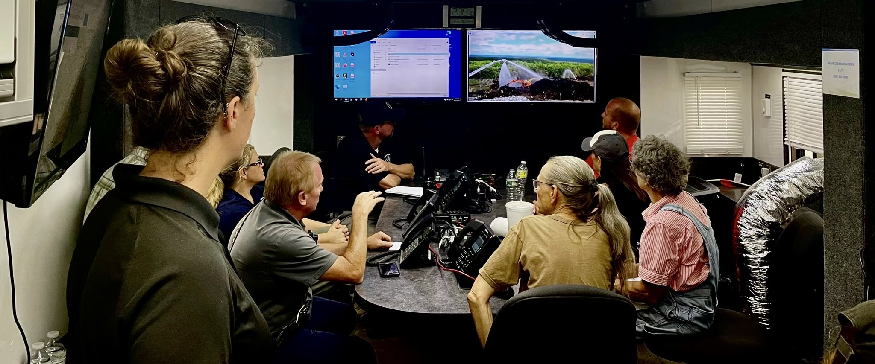
Major Disaster Declaration Criteria
For a Major Disaster Declaration, FEMA will consider factors such as:
The amount and type of damages;
Estimated cost of assistance (utilizing the established cost thresholds);
Localized impacts;
The available resources of the State and local governments and other disaster relief organizations;
Insurance coverage in force (consideration of amount of insurance coverage that is in force or should have been in force as required by law and regulation);
Imminent threats to public health and safety;
Recent multiple disasters in the State(disaster history within the last 12-month period as well as declarations by the Governor and the extent to which the State has spent its own funds);
Hazard mitigation (extent to which State and local government measures contributed to the reduction of disaster damages, especially implementation of measures required as a result of previous major disaster declarations);
Assistance available from other Federal program and other sources; and
Other factors pertinent to a given incident.
Notes:
FEMA will evaluate a long list of criteria to determine if the event was, in fact, of sufficient severity and magnitude to exceed the capabilities and available resources of the State and local governments. When we hear from elected officials, **CLICK** we typically only hear them talk about these two bullets – the threshold – although the threshold is the baseline bar we have to get across, there is more to making the case for a federal declaration.

Slide 17
Federal Recovery Programs
Public Assistance (PA)
Individual Assistance (IA)
Supplement State, Tribal, and Local Expense through reimbursement
Emergency Work
Emergency protective measures, debris removal, snow assistance
Permanent Work
Repair/restore damages infrastructure, utilities, and equipment to pre-disaster conditions
Benefits to survivors that are uninsured or underinsured
Individuals and Households Program (IHP)
Rental Assistance
Short-term Lodging Expenses
Home Repair Assistance
Replacement of destroyed Property
May also include:
Legal services, Crisis Counseling, Case Management and Mass Care
Notes:
But why do we want a declaration? It could make available FEMA’s public assistance and/or individual assistance programs.
PA reimburses state, tribal, local, and some PNPs for eligible costs. This is a reimbursement Program and does not trigger any grants or immediate funding. The ‘threshold’ everyone focuses on after an event applies ONLY to this program, not Individual Assistance. We walk through the eligibility and thresholds for both of these today, but please keep in mind as we go, that the county and state thresholds are only for the PA program.
The IA program provides benefits to impacted households and individuals. It Does not include economic loss for businesses, nor does it include business loss or impact – These May be covered under SBA’s disaster programs through low interest loans.

Slide 18
FEMA Public Assistance Threshold for State/Counties (2026)
Public Assistance (PA) Damage Thresholds
Statewide: $13,638,039
Barnstable: $1,112,921​
Berkshire: $627,066
Bristol: $2,814,912
Duke: $100,116
Essex: $3,935,769
Franklin: $345,201
Hampden: $2,263,910
Hampshire: $788,817​
Middlesex: $7,931,530​
Nantucket: $69,279​
Norfolk: $3,528,268
Plymouth: $2,579,780
Suffolk: $3,877,969
Worcester: $4,189,859​
Notes:
This was effective 10/01/25 – for FFY2026 it is based on a $1.94 statewide per capita multiplier and a $4.86 per capita county
The current administration has proposed increasing the threshold – even to 4X the current one

Slide 19
FEMA Public Assistance Grant Program
FEMA’s Public Assistance (PA) Grant Program reimburses state, local, and tribal governments and private non-profits for 75% of eligible costs related to a declared disaster.
Emergency Work
Category A: Debris Removal
Category B: Emergency Protective Measures
Permanent Work
Category C: Roads and Bridges
Category D: Water Control Facilities
Category F: Utilities
Category G: Parks and Recreation
Administrative Work
Category Z: Management Costs
IS-632: Introduction to Debris Operations
IS 559: Local Damage Assessment
Notes:
The program aims to support eligible entities in responding to and recovering from the disaster by helping to repair, replace, or restore damaged public infrastructure and facilities.
Eligible Applicants
Categories of Assistance
Emergency Work
Debris Removal - Category A
Emergency Protective Measures – Category B
Permanent Work – Categories C – F
Must meet damage threshold to be awarded Public Assistance
Volunteer hours can be used as a match here for the 25%
PA reimburses state, tribal, local, and some Private non-profits for eligible costs. This is a reimbursement Program and does not trigger any grants or immediate funding. The ‘threshold’ everyone focuses on after an event applies ONLY to this program, not Individual Assistance. We walk through the eligibility and thresholds for both of these today, but please keep in mind as we go, that the county and state thresholds are only for the PA program.

Slide 20
State Disaster Declaration Process
IDA
PDA
DEC
After the disaster occurs, state EMA staff conduct an Initial Damage Assessment (IDA) by requesting damage and cost data from communities.
The President may subsequently issue a disaster declaration under the Stafford Act.
If PDA meets state/county thresholds, the Governor requests a disaster declaration from the President of the United States.
If IDA data indicates state/county thresholds may be met, FEMA, state, and Local EMD conduct joint Preliminary Damage Assessments (PDA) to view and document damage.
To learn more about the Stafford Act visit https://www.fema.gov/disasters/stafford-act

Slide 21
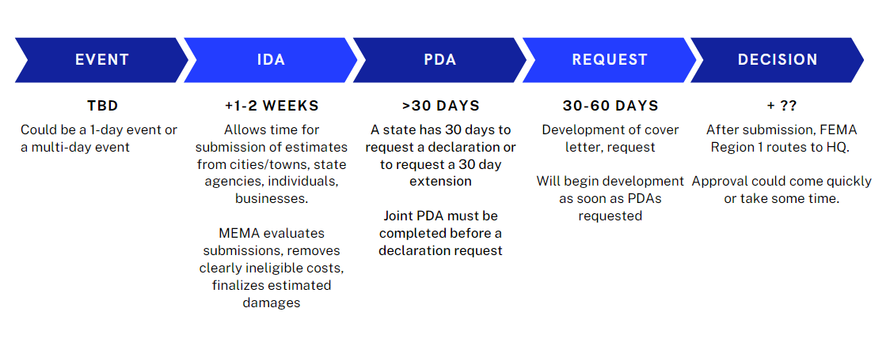
Disaster Timeline
Notes:
This is a general timeline of a disaster from impact to the President’s decision on a request for a major disaster declaration. From the day of the triggering event to decision on a dec can be longer than 2 months.
**PDAs will take longer if requesting IA program

Slide 22
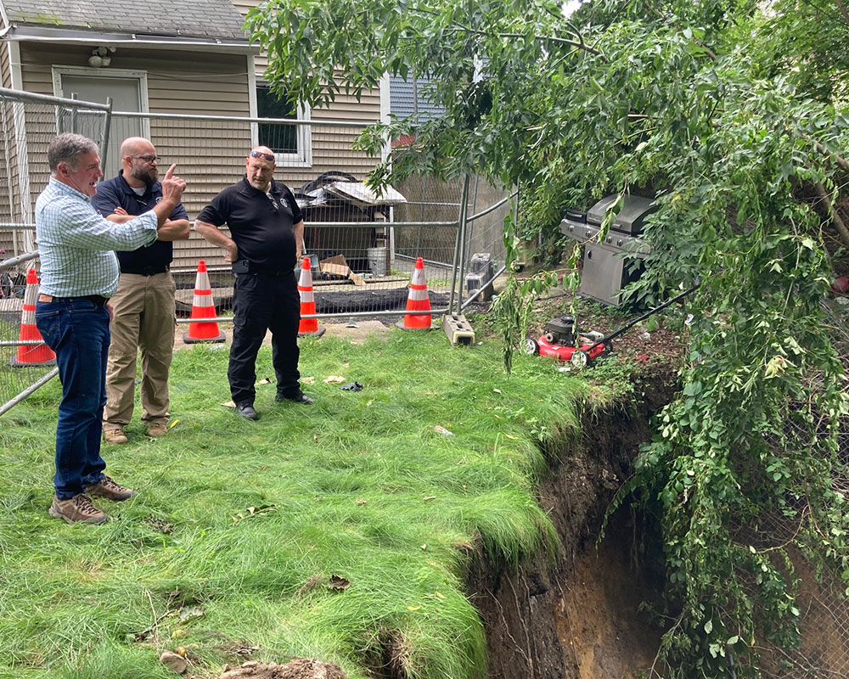
Initial Damage Assessment (IDA)
Conducted by cities/towns and state agencies with technical assistance from MEMA, including:
Templates and forms
Just-in-time training
Onsite subject matter experts
Assessment verification
Gather preliminary estimates of event related costs and damages to:
Public infrastructure, emergency response costs, debris removal (Public Assistance)
Impacts to residential structures and businesses (Individual Assistance and Small Business Administration)
Community Should Include: EMD, Fiscal, DPW, etc
Notes:
Initial damage assessments are conducted as soon as response ends for events that have even a remote potential for a federal declaration. IDAs are conducted by the cities, towns, and state agencies – because they have the information, we don’t – and supported by our local coordinators and recovery team. MEMA provides JIT training for IDAs, provides the templates and forms, and will again deploy out to the field to provide on site SMEs. MEMA aggregates all the information and reviews it, removing clearly ineligible costs as we are required to do, to determine if the thresholds for either PA or IA are met.

Slide 23
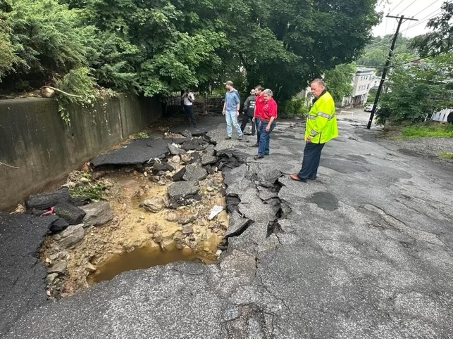
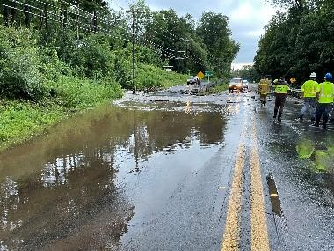
Initial Damage Assessment (Cont.)
May include inaccurate or overestimates
May include expenses that are ultimately ineligible:
Covered by insurance
Pre-existing damage or deferred maintenance
Duplication of benefits with another program (e.g., federal roads, mitigation projects)
Notes:
It is important to know that ---
Many times the numbers reported out publicly are far higher than those that are actually considered for determining whether we meet county and state public and individual assistance thresholds. Reporting out numbers that are not accurate, including damage unrelated to receiving a federal declaration such as business damage and mitigation projects, will cause confusion and angst for public officials, businesses, and residents when promises are made that later cannot be met.

Slide 24
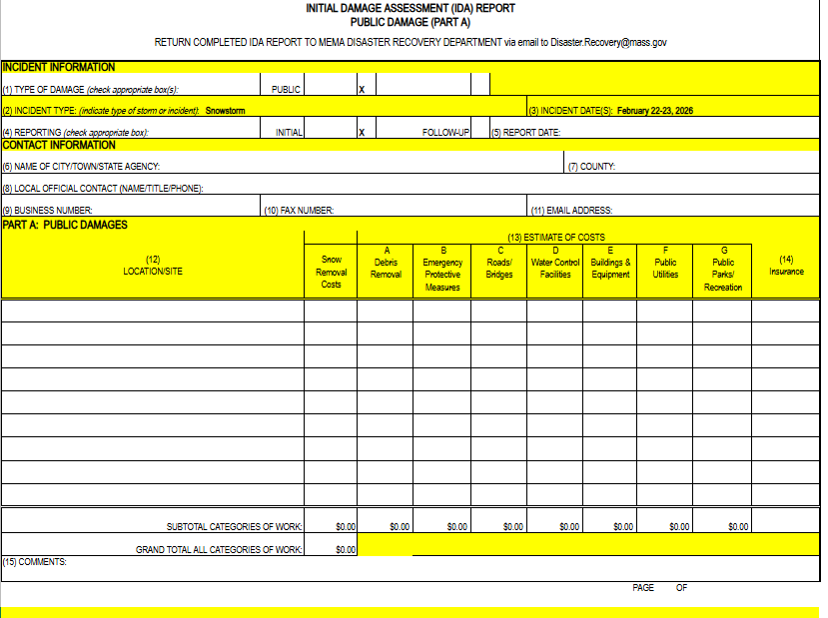
MEMA Public Assistance IDA Form

Slide 25
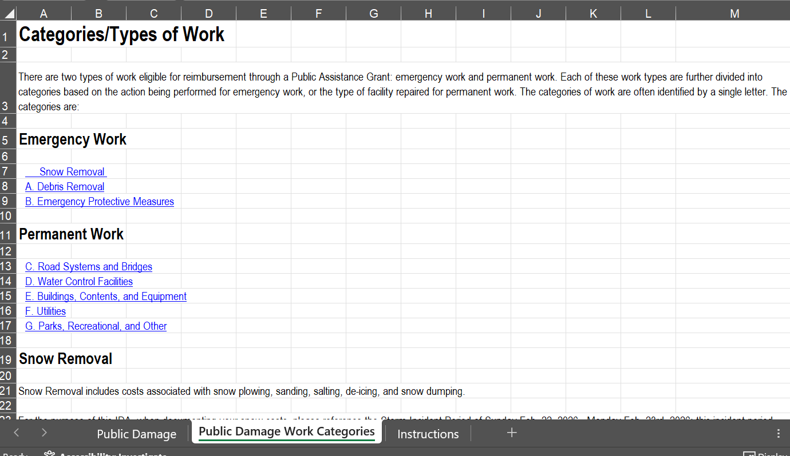

Slide 26
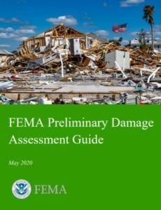
Preliminary Damage Assessment (PDA)
State makes a request to FEMA to conduct
Jointly conducted with FEMA, MEMA, and impacted communities
Onsite – for Damages
Virtual or Meeting – Costs Review
Community EMD, Fiscal, DPW, Others
Includes professional FEMA cost estimators (Sometimes)
In Massachusetts, PDA has historically resulted in an estimated damage reduction of about 50% from the Initial Damage Assessment
Notes:
****provide handout of pocket guide****
https://www.fema.gov/disaster/how-declared/preliminary-damage-assessments
PDAs are a huge lift for FEMA, State, and local communities and the state has a legal obligation to ensure we are submitting accurate information to FEMA. So we review IDA submissions, and after doing what we can to remove only clearly ineligible costs, if we are close to the thresholds, even arguably close, we will request PDAs.
These are conducted jointly, with federal, state and local partners. SBA will join FEMA when PDAs are requested for IA.
FEMA brings in cost estimators to validate the costs and this is where we see a reduction by an average of 50.67% due to FEMA finding things like ineligible costs, an applicant being unable to document costs or provide estimates, or duplication of benefits or covered by insurance.

Slide 27
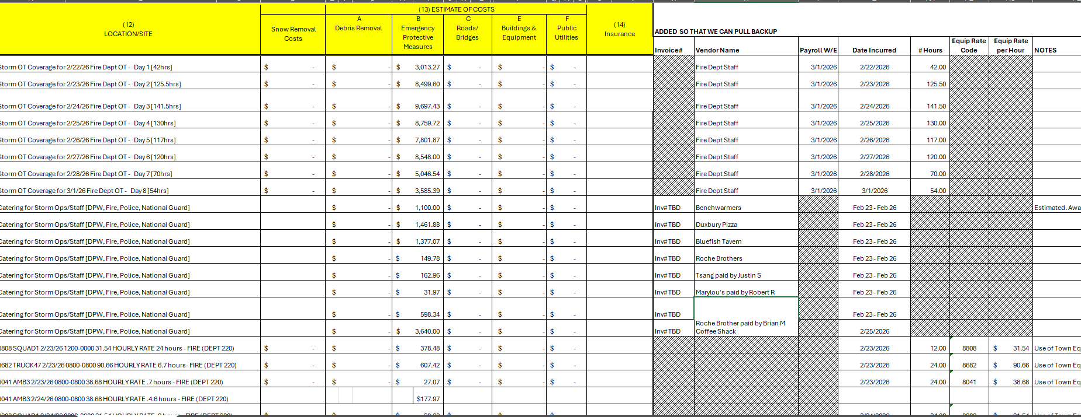
Example of PDA follow-up to IDA

Slide 28

And then what?
Notes:
Once we get the PDA results, the Recovery Unit makes a recommendation on requesting a declaration or not to the MEMA director and then to the Governor. When it is decided to move forward for a request MEMA’s recovery unit will work on the declaration request letter and supporting documentation. This request will be a collaboration with the Governor who does the final review and submission. The request first goes to our FEMA Region 1 office who will review the request and make their own recommendation that will be sent to the President. The President will review the Governor’s request and FEMA Region 1’s recommendation and make a determination.
The President can accept or decline the all or parts of the request. If denied, the state has an opportunity to appeal this decision.
If our request is approved for IA, PA or both…our work is not done and there is still a lot of complex work that occurs over the next months to years.
This is FEMA’s workflow graphic for PA. Note that funding is not made available to applicants to the PA program until Phase 5.
The process takes time and expertise to navigate but there is a process we must follow. MEMA has navigated this process for decades and employs subject matter experts in this area. From day 1 of an event, we begin working closely with FEMA and local EMDs to determine if we should initiate this process and then continue to work with them to ensure smooth sailing when we do.

Slide 29
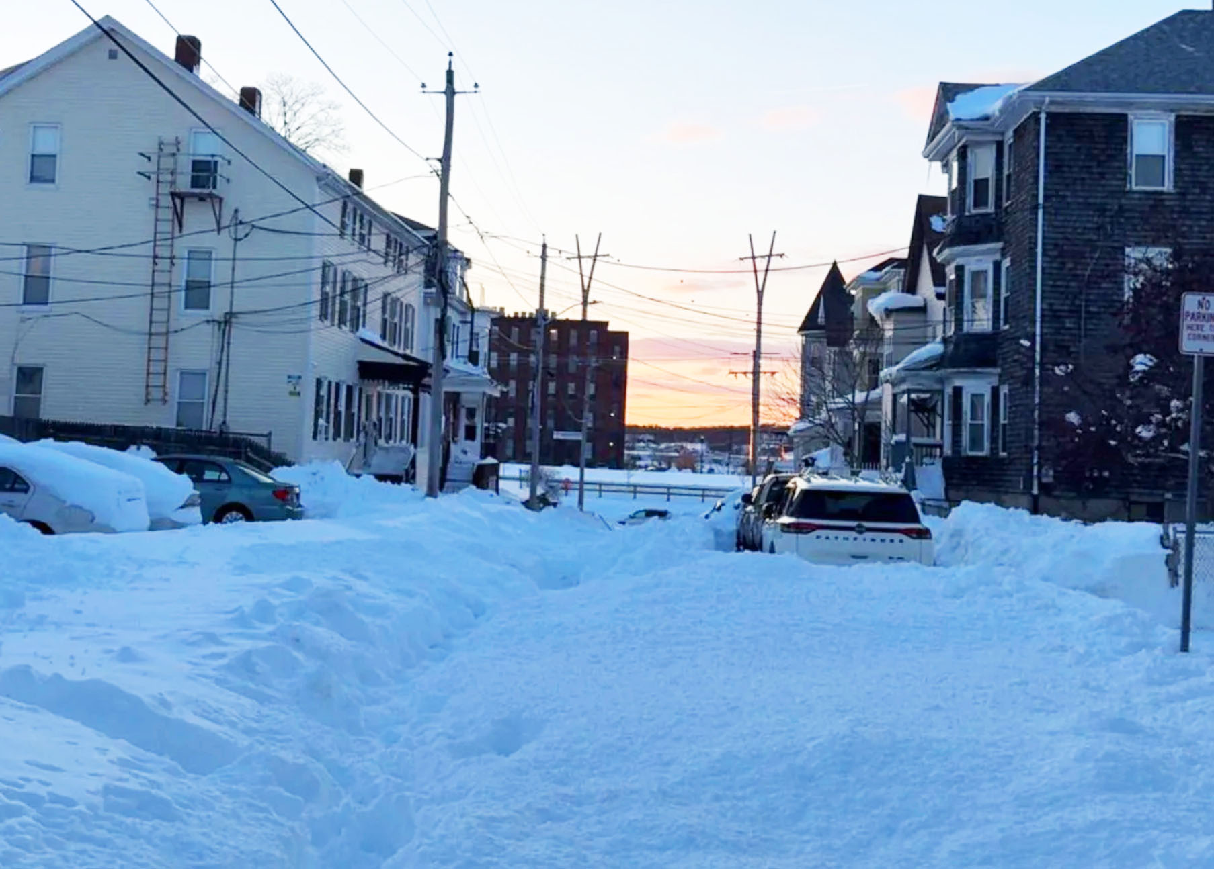
State Resources for Recovery
Leveraging Support of State Agencies
Supplemental Budgets
Initiated by Governor’s Office
Coordinated by Administration and Finance
The Disaster Relief and Resilience Fund (DRRF)
State Legislation in 2024
Administered by Administration and Finance
Still In Development

Slide 30
Pre-Positioning for Recovery Funds

Slide 31
Cost Recovery
Starts concurrently with response operations
Culvert washout/fill, roadway passage, debris management
Typically ends within weeks of a disaster but could take years
Expenses can accumulate before the disaster in some cases
Debris clean-up, evacuations, sheltering, responder overtime
Jurisdictions should track everything before and during a disaster
No detail is too small – Every penny counts toward your PA threshold

Slide 32
Cost Recovery
Proper organization and documentation from the start helps prevent denials, appeals and delays of funding
A jurisdiction that uses processes and a database or accounting tools to log and track disaster response and recovery costs can rapidly provide the necessary documentation to obtain reimbursement.
Jurisdictions without a centralized repository for expenses will waste valuable time trying to assemble documentation. Accuracy in documentation is also critical to avoid errors and audit findings.

Slide 33
Costs versus Damages
Costs
Overtime, Equipment Usage, Vendor Support Contracts, Resources
Relatively Easy to Document
FEMA Equipment Usage Forms (includes fuel, wear and tear, etc)
Timesheets and Overtime/Standby Policies
Deployment, Equipment, Staff Logs
Contracts, Purchase Orders, Invoices, etc
Damages
Repair Estimate Documentation Can be a Bit More Complicated (or not available until later)
Before and After Photos (if you have them)
Comparative Invoices for similar work
Quotes and Vendor Estimates

Slide 34
Standard of Documentation
Initial Damage Assessment (IDA)
Community best guess (“Back of the envelope”)
Use FEMA Schedule of Equipment Rates
Build a timeline and a narrative
Include EMD, Fiscal, DPD, and other agencies
Joint Preliminary Damage Assessment (PDA)
FEMA will take your IDA reporting and ask “How did you come up with these Estimates?”
Impact Statement/Narrative
Authority to accrue costs/Overtime Policy
Photos, GIS/GPS location
Contracts, Purchase Orders, Invoices
Current or Historic Estimates

Slide 35
Some Additional Words of Advice
Have a Narrative
Explain how YOUR process works
MEMA is your advocate
Feel free to ask if you are not sure
We are happy to hold preparatory meetings
This is still an estimate, it is not an application for reimbursement
“Let us get back to you” – To questions you are not sure of the answers/or the implications

Slide 36
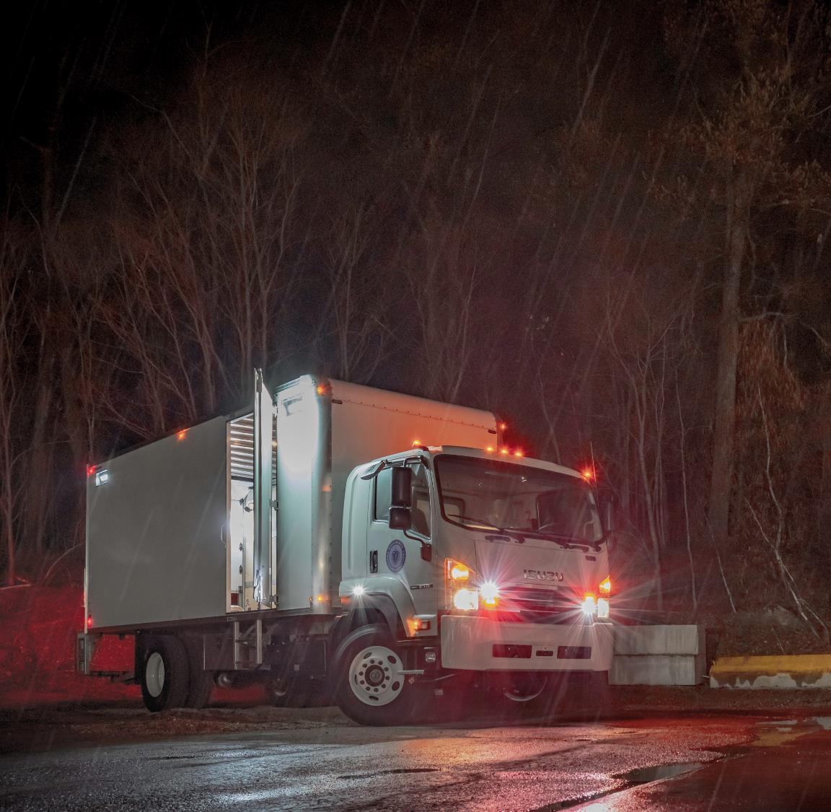
Thank you/Questions
Simon van Leeuwen
Assistant Director for Mitigation and Recovery
Massachusetts Emergency Management Agency
400 Worcester Road, Framingham, MA 01702
Cell: 508 380-2462
E-Mail: simon.vanleeuwen@mass.gov

